Slide 1
Week 3
Traffic Flow & Congestion
Automated Traffic Management
Submission-ready weekly summary deck
Week 3 added traffic-flow analysis, congestion classification, near-term prediction, and route advice using logged junction data.

Slide 2
Objective and implemented work
Week 3
• Objective: analyse traffic flow at different times and identify congestion-prone areas. • Implemented time-window congestion analysis and saved congestion records per junction. • Implemented flow, hourly, prediction, and alternative-route endpoints for visualisation and route advice. • Django sends congestion alerts to drivers when results reach HIGH or SEVERE.
10 APIs
traffic analysis flow
2
sequence diagrams
4
congestion levels

Slide 3
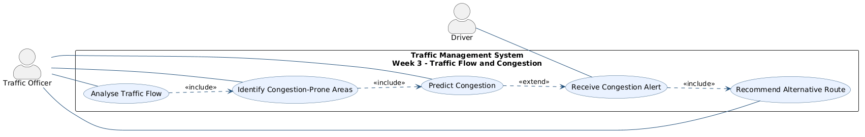
UML and main files
Week 3
Main files
• MicroserviceLayer/TrafficController.cpp • MicroserviceLayer/TrafficRules.cpp • DataAccessLayer/CongestionRepository.* • DataAccessLayer/RoadSegmentRepository.* • gateway/templates/traffic/*.html
Repository anchors
• docs/week3/: use case + two sequence diagrams • docs/api-testing.md and docs/verify_route_algorithm.py
Use case diagram from docs/week3

Slide 4
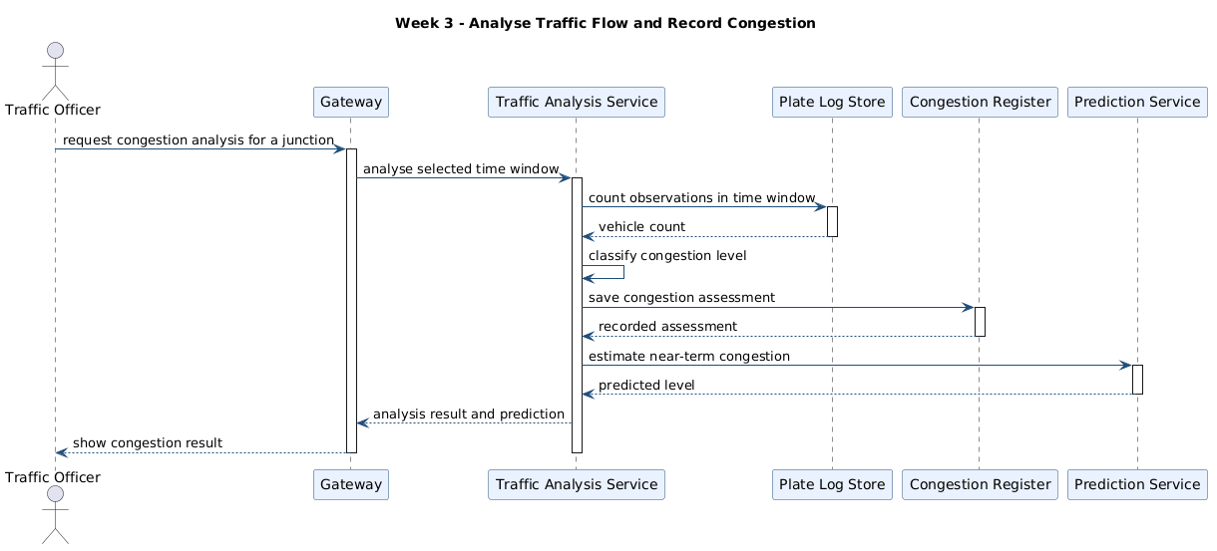
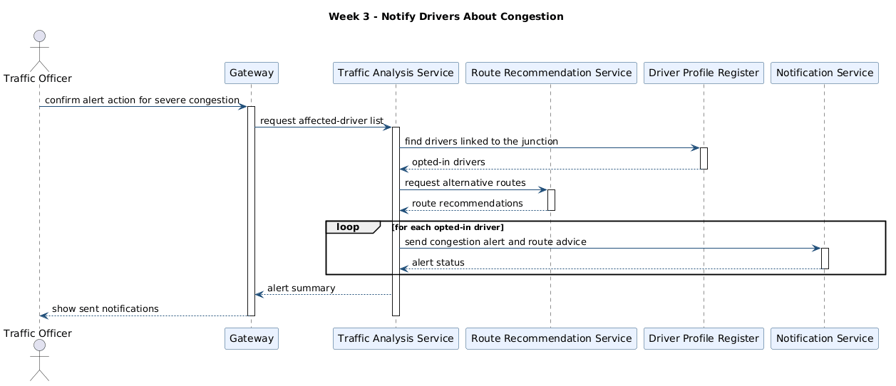
Run and test evidence
Week 3
Verification points
• Run path: docker compose up --build, then call the gateway traffic endpoints. • docs/api-testing.md covers POST /api/traffic/analyze plus flow, hourly, prone, and prediction reads. • backend/tests/RulesTests.cpp verifies the LOW, MODERATE, HIGH, and SEVERE thresholds. • gateway/gateway_app/web_views.py calls send_congestion_alert and renders the traffic pages.
Analyse traffic flow and record congestion
Notify drivers about congestion
Run: docker compose up --build | Traffic flow: docs/api-testing.md | Rule checks: backend/tests/RulesTests.cpp

