Slide 1
Week 4
Emergency Vehicle Prioritisation
Automated Traffic Management
Submission-ready weekly summary deck
Week 4 added emergency-vehicle registration, route clearing, signal prioritisation, and affected-driver notification within the project scope.

Slide 2
Objective and implemented work
Week 4
• Objective: detect emergency vehicles, clear a route, and notify regular drivers to give way. • Implemented emergency vehicle registration, event creation, shortest-route computation, and green-priority signal plans. • Implemented affected-driver lookup using route overlap and email-based give-way alerts. • The submission scope uses stored signal states and email alerts rather than live roadside hardware.
Route
Dijkstra-based clearance
Alerts
affected drivers
Signals
green priority states

Slide 3
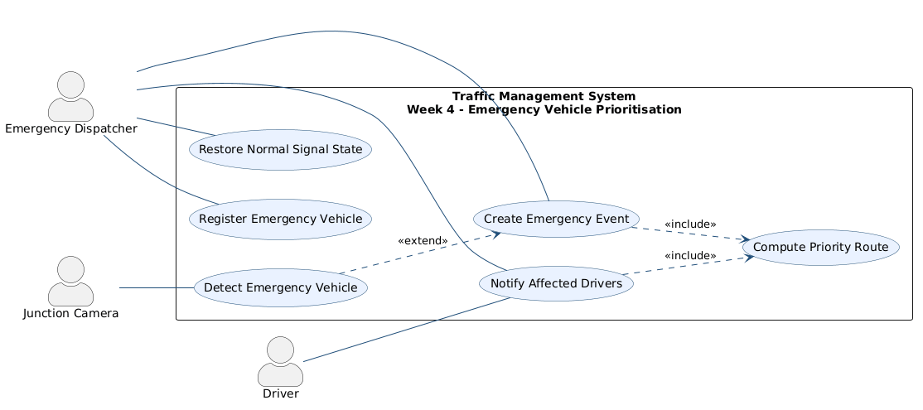
UML and main files
Week 4
Main files
• MicroserviceLayer/EmergencyController.cpp • DataAccessLayer/EmergencyVehicleRepository.* • DataAccessLayer/EmergencyEventRepository.* • DataAccessLayer/SignalRepository.* • DataAccessLayer/DriverProfileRepository.*
Repository anchors
• docs/week4/: use case, class diagram, two sequences • gateway/gateway_app/email_service.py
Use case diagram from docs/week4

Slide 4
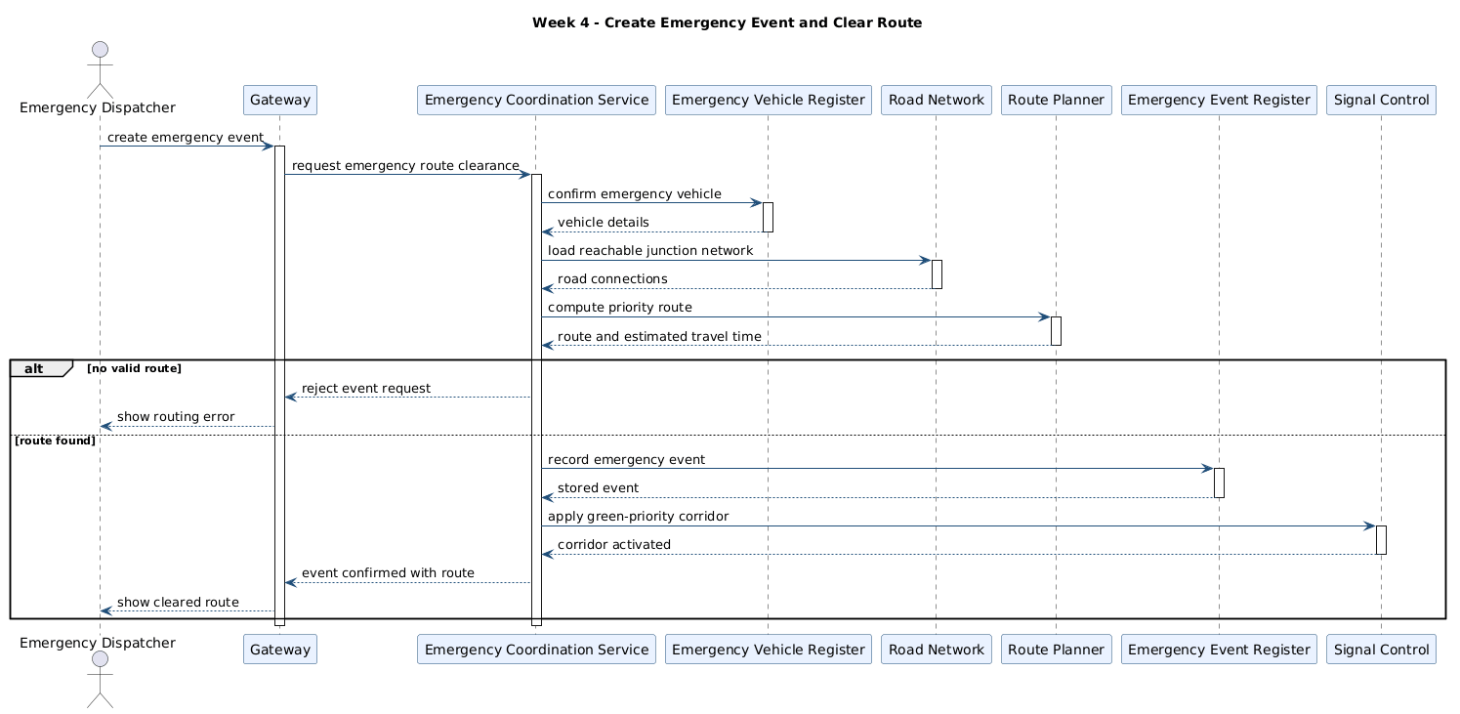
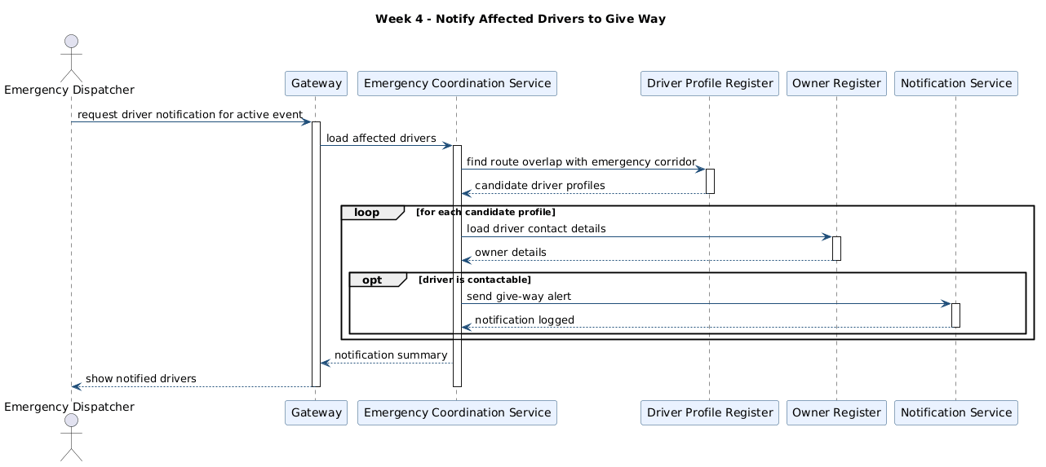
Run and test evidence
Week 4
Verification points
• Run path: docker compose up --build, then create an event through the Django gateway. • docs/api-testing.md covers POST /api/emergency/events and GET /api/emergency/events/:id/affected-drivers. • gateway/gateway_app/tests.py covers the emergency page and event creation flow. • EmergencyController applies setPriorityForRoute and releases the corridor on resolve.
Create emergency event and clear route
Notify affected drivers to give way
Run: docker compose up --build | Emergency flow: docs/api-testing.md | Web checks: gateway/gateway_app/tests.py

