Slide 1
Sales Trend Analysis
Why a growing retailer stopped growing — and what the data says to do about it
BED 106 — Business Analytics · Mini Capstone Project
Talibon Polytechnic College · A.Y. 2026–2027, 1st Semester
Alber · Julebeth · Mardy
Final Defense
Notes:
Good day. We are presenting our BED 106 mini capstone on sales trend analysis. Introduce the three of you by name, then go straight into the problem.

Slide 2
AGENDA · 20–25 MINUTES
What we will cover
1
Introduction & business context
2–3 min
Two checkpoints of analysis
1,194 transaction lines
March 2020 – March 2025
8 tables · 8 SQL queries
57 months modelled
2
Data & SQL overview
3–4 min
3
Statistical insights
3–4 min
4
Live dashboard demo
5–6 min
5
Predictive analytics & recommendations
4–5 min
6
Ethics & governance
1–2 min
7
Open defense / Q&A
5 min
Notes:
Keep this short — name the seven segments, flag that segment four is a live demo, and move on.

Slide 3
1 · BUSINESS CONTEXT
The company grew, then stopped
A multi-category retailer — electronics, furniture, office supplies — trading across six US states.
On a like-for-like monthly basis revenue rose to a 2022 peak, then fell two years running.
So why does a falling sales figure need a database?
Because of what didn't move.
Margin held between 23.97% and 26.93% for five years. Average order value stayed between 5,008 and 5,444.
Had margin collapsed, the answer would be "we discounted too hard". It didn't. The company is writing fewer orders, not worse ones.
+30.9%
−17.6%
2020 → 2022 peak
2022 peak → 2024
Source: sales_trend database, Query 3. Synthetic dataset — see Checkpoint 1.
Notes:
This is the slide that frames everything. Stress the margin point: it is what turns 'sales fell' into a question worth a database.

Slide 4
1 · BUSINESS CONTEXT
Three questions, and every deliverable maps to one
How have revenue and profit trended, and is the company still growing?
1
Answered by Query 3 · CP2 regression
Which categories and sub-categories drive the trend?
2
Answered by Queries 5 and 7
When does demand concentrate, and is it the same for every category?
3
Answered by Queries 4 and 8
What hangs on them: what to stock, when to stock it, where to put the sales effort.
Notes:
Read the three questions, then the one-line consequence. Do not linger.

Slide 5
2
Data & SQL
What the raw file was, what was wrong with it, and what the database found
Notes:
Hand over to whoever takes the data segment.

Slide 6
2 · DATA & SQL
Five things were wrong with the raw file
1
Order ID is not a primary key
1,194 rows, 547 distinct IDs — repeats span different dates and customers
We fixed none of it.
2
Customer name is not an identifier
Repairing Order ID means deciding which of two conflicting rows is real, with no evidence for the decision.
That is data fabrication, which the brief says is grounds for a failing mark.
So we documented every defect and worked around it. The method is unaffected.
807 customers from 802 names; five names appear in two cities
3
Year-Month is redundant
Derivable from the date — rebuilt in a dates table
4
Both ends of the file are partial
Starts 22 March 2020, stops 15 March 2025
5
The dataset is synthetic
Five machine-checked signals — we say so rather than bury it
Notes:
The synthetic-data point must be said out loud here, before anyone asks. Five signals: no loss-making line in five years; 22 names with credential suffixes; US cities with Indian payment rails; near-uniform payment mix; a flat amount histogram.

Slide 7
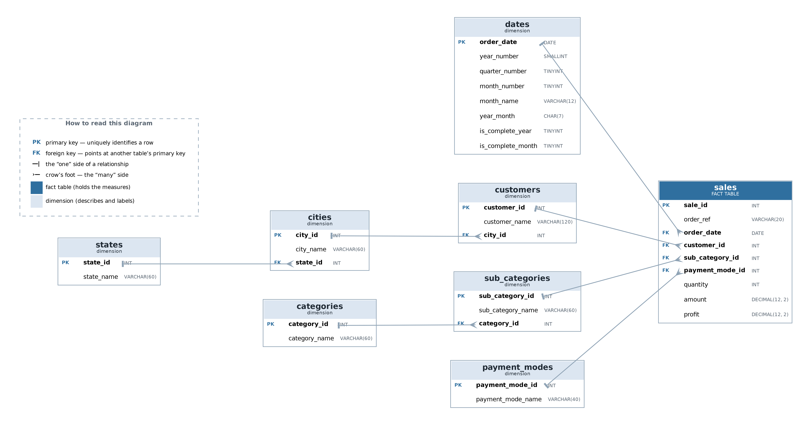
2 · DATA & SQL
A star schema, eight tables
8 tables
1 fact, 7 dimensions
8 primary keys
7 foreign keys
6 unique constraints
4 check constraints
Tested to reject bad rows, not assumed to.
Figure: Entity-Relationship Diagram of the sales_trend database.
Notes:
Three reasons for the star: consistency, the brief asks for it, and the queries need category and date on the same row as the amount. Mention the reserved-word trap: year_month broke CREATE TABLE in MySQL until backticked.

Slide 8
2 · DATA & SQL · FINDING 1
Growth stopped in 2022 — and in a specific way
Measured per month
2020 holds nine months. Comparing its part-year total against a full 2021 was the one real error we made, and corrected.
Margin never left 24–27%. Average order value never left 5,008–5,444.
Fewer orders — not cheaper ones. That points at demand generation, not pricing.
Source: Query 3, revenue per month by year. 2020 = 9 complete months.
Notes:
The correction belongs here: we reported 69.9% growth in Checkpoint 1 and the like-for-like figure is 30.9%. Volunteer it.

Slide 9
2 · DATA & SQL · FINDING 2
One sub-category explains most of the gap
−71%
Printers, 2023 → 2024
136,865 lost on one line item — over half the entire peak-to-2024 gap.
Every Electronics sub-category fell. Every Office Supplies sub-category grew.
This is not a slowdown. Two opposite trends are running at once, and the company-wide figure is their average — which describes neither.
Source: Query 7, sub-category revenue change 2023 against 2024.
Notes:
This is the most useful thing Checkpoint 1 produced. Let the chart do the work — the red block at the top and the green at the bottom.

Slide 10
2 · DATA & SQL · FINDING 3
Seasonality is category-specific
The blended curve is wrong for all three
Electronics peaks in Q2 at 30.79% of its own annual revenue.
Furniture and Office Supplies peak in Q4.
A single company-wide planning curve over-stocks Electronics in Q4 and under-stocks it in Q2.
Source: Query 8, each quarter's share of its own category's annual revenue.
Notes:
If asked why it matters: inventory and staffing are planned on the blended curve, so they are mistimed for a third of the business.

Slide 11
3
Statistical Insights
How strong is the evidence, and what can be predicted
Notes:
Checkpoint 2 takes the same dataset into Excel.

Slide 12
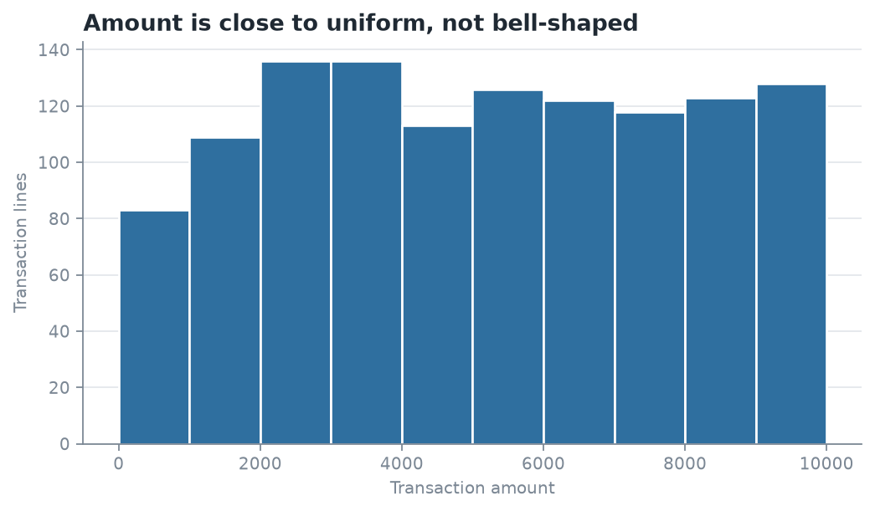
3 · STATISTICS
The histogram is itself a finding
54.2%
Amount — coefficient of variation
82.9%
Profit — far less predictable, skew +0.94
A revenue target does not manage profit. And a flat distribution is what a random number generator produces — our own descriptive statistics confirm the data is synthetic.
Source: Checkpoint 2, Task 2.2. n = 1,194 transaction lines, ten bins of 1,000.
Notes:
Two points only: profit is less predictable than revenue, and the flat shape is evidence the data is generated.

Slide 13
3 · STATISTICS
One driver, and one strategy the data kills
r = 0.923
r = 0.045
Monthly orders → monthly revenue
Units sold → order value · p = 0.123
Order count explains about 85% of the variation in monthly revenue.
Checkpoint 1 inferred this. Checkpoint 2 measures it.
No relationship, and not statistically significant.
A negative result we are keeping: a "sell more units" target would not move revenue in this business.
Correlation is not causation — the association is strong and consistent over 57 months, which is not the same as one causing the other.
Source: Checkpoint 2, Task 2.3. n = 57 months and 1,194 lines respectively.
Notes:
Say the caveat out loud. The negative result on the right is the one worth pausing on.

Slide 14
3 · STATISTICS
Order count drives revenue — measured, not inferred
Monthly Revenue = −1,353.65 + 5,224.25 × Orders
R² = 0.8514
t = 17.75
p = 1.98 × 10⁻²⁴
5,178.09
85% of month-to-month variation
55 degrees of freedom
The slope is not zero
The actual mean order value
The check that makes this convincing: the slope lands within 0.9% of the plain mean order value. The regression rediscovered it without being told.
Four orders a month below the 2022 level ≈ 250,000 a year. Checkpoint 1 reached 257,297 by summing category shortfalls — two independent methods within 3%.
Source: Checkpoint 2, Task 2.4. n = 57 complete months, April 2020 – December 2024.
Notes:
The 250,000 corroboration is the strongest single piece of evidence in the project. Say that sentence deliberately.

Slide 15
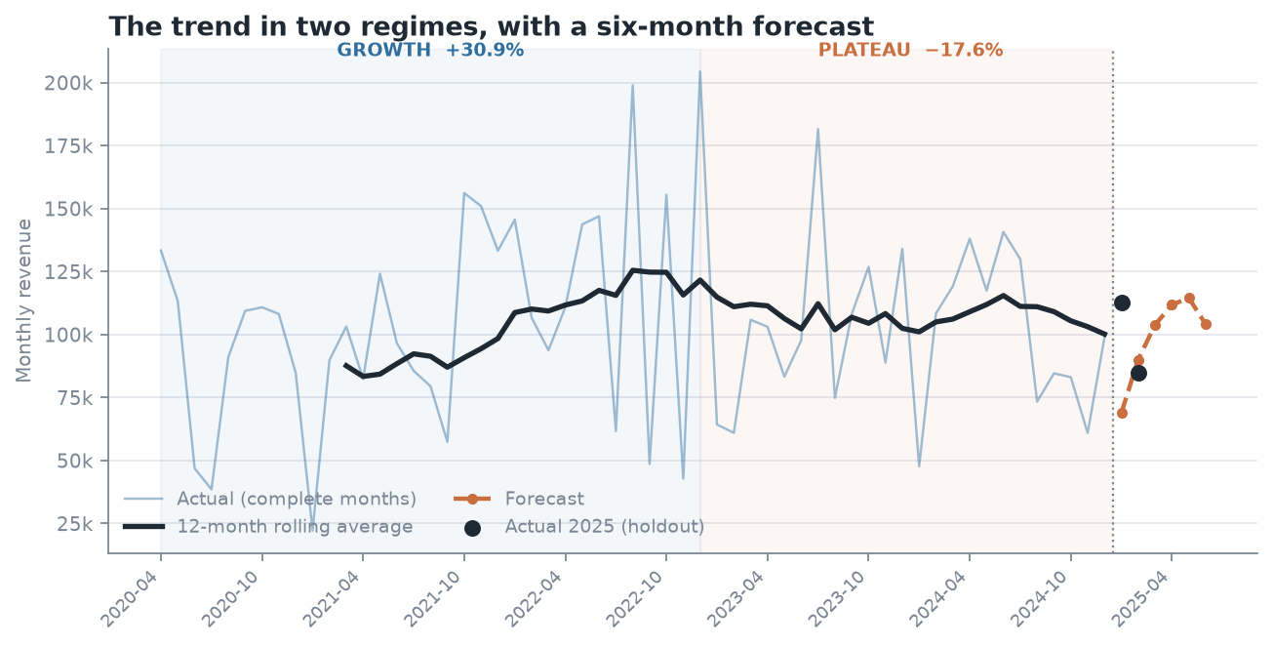
3 · STATISTICS
Two regimes — and a forecast that lost
Why no growth rate?
A straight line across all 57 months explains under 1% — R² = 0.0078, p = 0.515.
That is not "no trend". It is that no single line fits both regimes — the up-slope and the flat cancel out.
So the forecast uses level and seasonality, not a growth rate we cannot demonstrate.
Tested honestly: our seasonal forecast lost to a flat average. 22.7% mean absolute error against 14.9%. We report it and keep the method, because choosing on two observations is overfitting the holdout.
Source: Checkpoint 2, Task 2.5. Holdout: January and February 2025.
Notes:
January 2025 came in at 112,906 against a prediction of 68,853. January's index says it is the weakest month; this one was not.

Slide 16
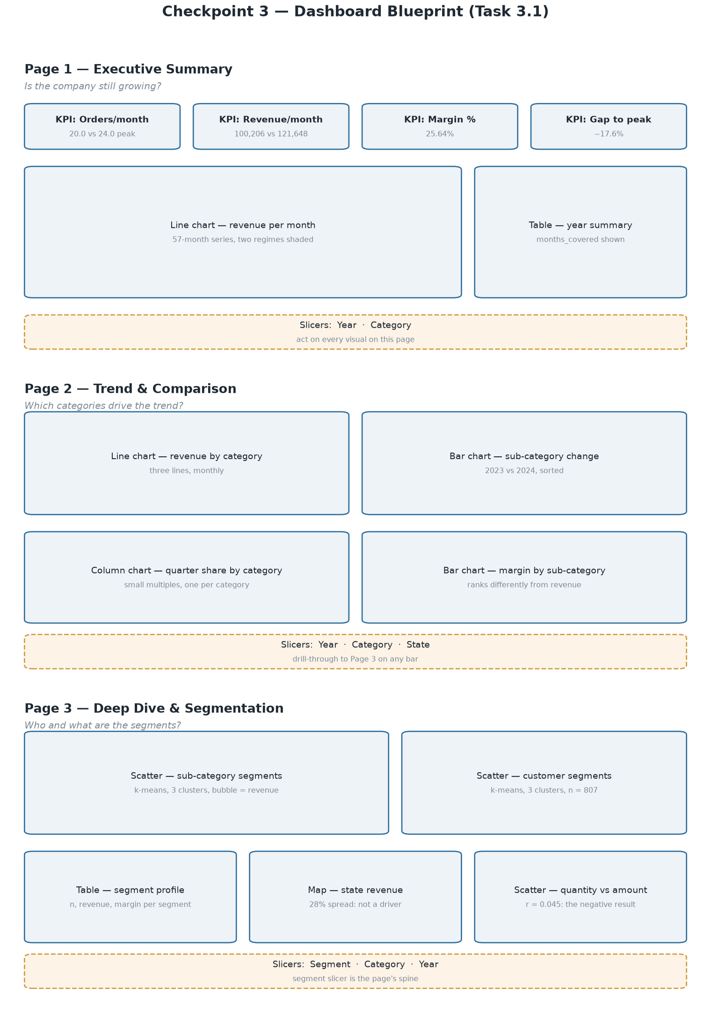
4
Live Dashboard Demo
Three pages, built in Power BI on the same database
Page 1 — Executive Summary: four KPI cards, the 57-month trend
Page 2 — Trend & Comparison: category lines, sub-category change
Page 3 — Deep Dive: the customer and product segments
Demonstrate live: the segment slicer on Page 3
Notes:
Switch to Power BI here. Select Thin-Margin Buyers on the Page 3 slicer and show the profit share collapse — that is the most persuasive single interaction on the dashboard. Replace the wireframe on this slide with a screenshot of the finished dashboard before the defense.

Slide 17
4 · DASHBOARD · SEGMENTATION
The largest customer group returns the least profit
k-means, k = 3
807 customers clustered on value, margin and recency. k chosen by silhouette.
Thin-Margin Buyers: 43% of customers, a third of revenue — and 19% of the profit.
High-Margin Buyers turn less revenue into 43% of it. A sales push aimed at revenue would chase the wrong group.
Source: Checkpoint 3, Task 3.3. Recency separated nothing; frequency spans 1–4 lines only.
Notes:
If asked why three clusters and not five: k=5 scores 0.295 against 0.277, but two of its five came out with the same profile, and the brief asks for two or three.

Slide 18
5
Predictive Analytics
Extending the regression — and what happened when we tested it
Notes:
Checkpoint 4, Task 4.1.

Slide 19
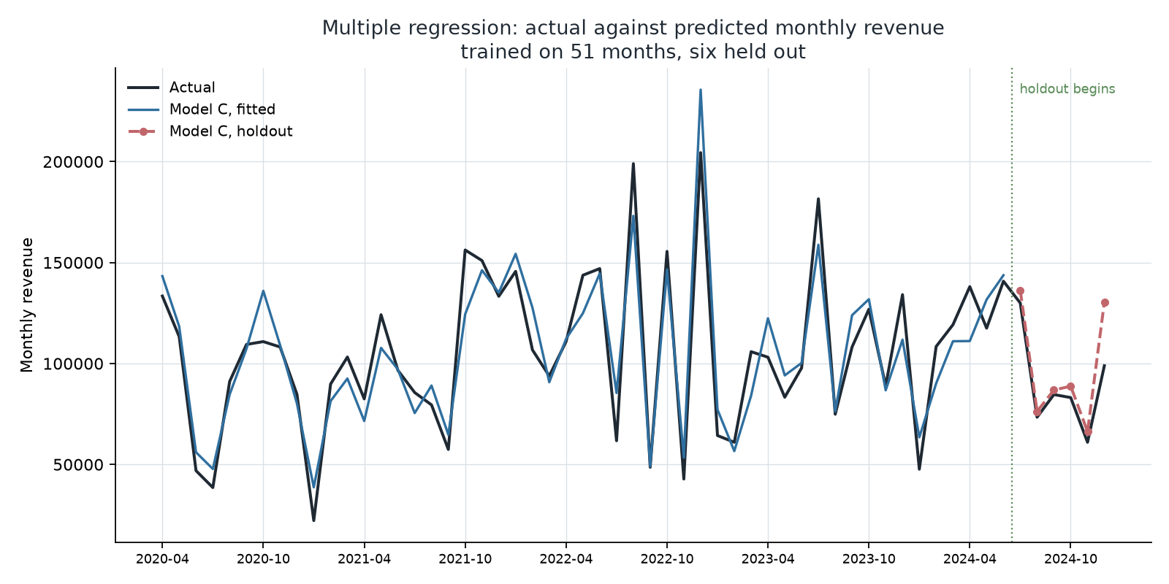
5 · PREDICTIVE ANALYTICS
We extended the model. The simple one still wins.
Holdout — six unseen months
9.3%
Orders only — the CP2 baseline
9.8%
Multiple regression, five predictors
So why present it? Because the value is diagnostic. Units sold (p = 0.79), customer count (p = 0.27), product mix (p = 0.48) and elapsed time (p = 0.55) were each given a fair chance alongside order count. None explained anything — which is the evidence behind building the dashboard on order count.
Source: Checkpoint 4, Task 4.1. Trained on 51 months, six held out. R² = 0.8647, adjusted R² = 0.8514.
Notes:
Two problems handled rather than ignored: severe multicollinearity — orders, units and customers are 0.81 to 0.92 correlated, VIF 13.67 — and Breusch-Pagan rejecting constant variance at p = 0.0023, so robust standard errors are reported.

Slide 20
5 · RECOMMENDATIONS
Five recommendations, each tied to a measurement
1
Track order count, not revenue
r = 0.923 · the only predictor that survives
What we would stand behind
2
Investigate Printers first
A dataset whose defects are documented rather than hidden.
A normalised schema with constraints that are enforced and tested.
Queries verified on two database engines.
Statistics tested for significance rather than eyeballed — with the negative results reported alongside the positive.
136,865 lost — over half the entire gap
3
Plan seasonality by category
Electronics peaks Q2; the others Q4
4
Segment on margin, not revenue
43% of customers return 19% of profit
5
Drop volume and acquisition targets
Units and customer count predict nothing
Notes:
These are the answer to 'so what'. Each one names the measurement behind it.

Slide 21
6 · ETHICS & GOVERNANCE
Ethics, privacy and governance
Privacy
Ethics
The names are synthetic, so there is no data subject and R.A. 10173 is not engaged. Not because the file is public — public availability is not consent.
Our own segmentation is the risk. Labelling 350 customers "Thin-Margin" is accurate, and on real data it is a mechanism by which poorer customers get served worse.
Governance
Regulation
A named owner for the customer dimension, analysts on pseudonymised views, a retention rule, and reproducible lineage.
R.A. 10173 on proportionality, purpose and the right to object. GDPR Article 22 on automated decisions — a line our clustering is closer to than it looks.
Full reflection: Checkpoint 4, Task 4.2 — 1,153 words against a 500-word minimum.
Notes:
Ninety seconds. The one point to land is that public availability is not consent, and that the ethical risk comes from our own segmentation rather than from the data.

Slide 22
LIMITATIONS
What we would not claim
The data is synthetic
These figures illustrate a method; they do not describe a real company. We proved it with five signals and did not invent corrections.
The forecast is weak
22.7% mean absolute error against a flat average's 14.9%. We measured our own error rather than dropping the test.
Correlation is not causation
Order count and revenue move together over 57 months. That is not proof one causes the other.
A project that only reports what worked is a sales deck. These three are why this one is analysis.
Notes:
Say all three before Q&A. Volunteering them is worth more than defending them under questioning.

Slide 23
Questions
Any member can answer on any part of the project.
Your dataset is fake — what is the project worth?
The figures illustrate a method. Every query, statistic and model would run identically on a real export.
Your multiple regression performed worse. Why present it?
Its value is diagnostic: it rules out units, customers, mix and time as drivers.
Why three clusters and not five?
k=5 scores higher, but two of its five had the same profile — and the brief asks for two or three.
What would you do differently?
Check the completeness of both ends of the date range first. That caused our one real error.
Thank you.
Notes:
Do not read this slide out. It is a prompt for whoever is fielding the question.

