Slide 1
PRIME
Machine Learning Pipeline
Predictive Reliability & Intelligence Maintenance Engine
End-to-End ML/DL Engineering Walkthrough
Achmad Zikran Maulida · Machine Learning Engineer
XGBoost
LSTM
FastAPI
SSBS
Python 3.10

Slide 2
OVERVIEW
Pipeline Roadmap — 11 Fase End-to-End
0
Env
1
Ingest
2
EDA
3
Label
4
Feature
5
Preproc
6
SSBS
7
Split
8
Model
9
Eval
10
Deploy
Data Layer
Analysis Layer
Feature Layer
Model Layer
Eval / Deploy
◆ Data Layer: Ingestion & EDA
◆ Analysis Layer: Temporal Label Engineering
◆ Feature Layer: Rolling · Lag · Ratio · SMOTE
◆ Model & Deploy: Classification + RUL + FastAPI
0
1
2
3
4
5
6
7
8
9
10

Slide 3
MOTIVATION
Problem Statement — Why Predictive Maintenance?
0.056%
■ = ~1 failure event
dari 100,000 baris data berlabel failure
(hanya 56 kejadian nyata)
Extreme Imbalance
Temporal Data Leakage
99.944% data sehat vs. 0.056% failure
→ Model naif bisa 99.9% akurat tapi tidak pernah mendeteksi kerusakan
Data run-to-failure bersifat sekuensial
→ Split random biasa membocorkan pola masa depan ke training
Industri 4.0: downtime tak terduga = kerugian 20-30% produktivitas pabrik
0
1
2
3
4
5
6
7
8
9
10

Slide 4
FASE 0
FOUNDATION
Environment & Reproducibility
Struktur Direktori Enterprise
src/ · notebooks/ · models/ · data/raw · data/interim · data/processed
GLOBAL_SEED = 42
Dikunci di src/config.py — menjamin reproducibility seluruh eksperimen (RF, XGBoost, LSTM, SMOTE)
src/config.py — Single Source of Truth
W_WARNING_HRS=48 · W_CRITICAL_HRS=24 · LABEL_MAP={HEALTHY:0, WARNING:1, CRITICAL:2}
0
1
2
3
4
5
6
7
8
9
10

Slide 5
FASE 1
DATA INGESTION
Data Ingestion & Profil Dataset
Dataset | Rows | Cols
sensor_readings.csv | 100,000 | 11
maintenance_logs.csv | 500 | 8
20
mesin (M-01 s/d M-20)
Rata-rata 2.80× failure per mesin — semua 20 mesin pernah mengalami failure
208
hari rentang waktu
(Jul 2025 – Jan 2026)
0 / 0
✅ Temporal Integrity: 5,000 baris per mesin (balanced) · 0 gap > 1 jam · datetime64[ns] terkonfirmasi
gap temporal / duplikat
0
1
2
3
4
5
6
7
8
9
10

Slide 6
FASE 2
EDA FORENSIK
EDA — Failure Autopsy Timeline
T-72h
T-48h
T-24h
T-0
Normal
Degradasi Mulai
Eskalasi Dramatis
FAILURE
baseline sehat
sinyal mulai berubah
sensor spike konsisten
mesin berhenti
⚡ Keputusan Berbasis Data: W_WARNING_HRS = 48 · W_CRITICAL_HRS = 24
Direvisi dari hipotesis awal W_WARNING=72 — setelah analisis visual 3 mesin (M-01, M-09, M-05)
▸ Look-back 72 jam pada 3 mesin: M-01 (4× failure), M-09 (2×), M-05 (1×)
▸ Pola konsisten lintas mesin → bersifat universal, bukan anomali satu mesin
0
1
2
3
4
5
6
7
8
9
10

Slide 7
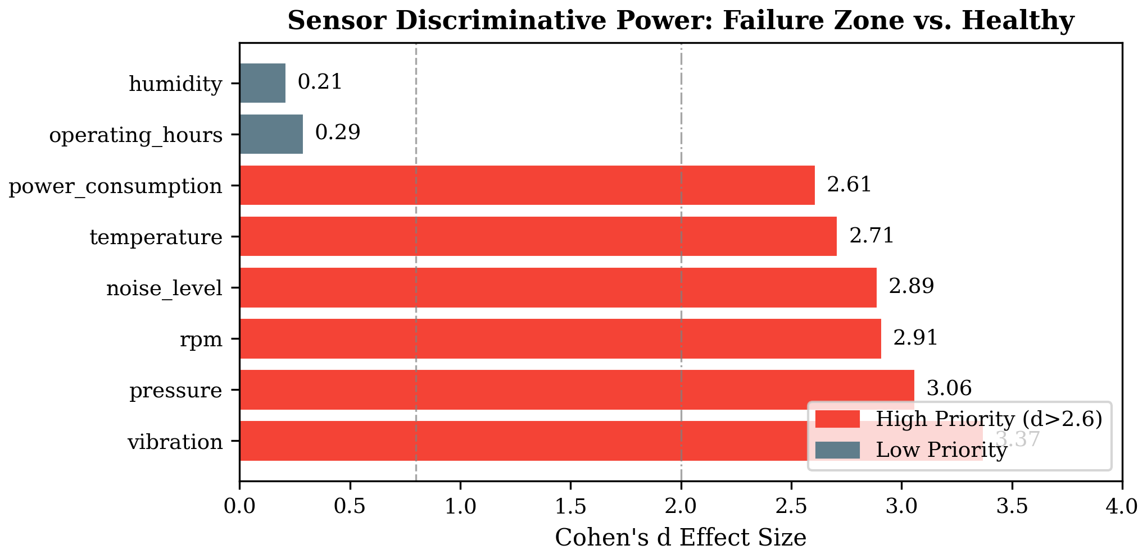
FASE 2
SENSOR ANALYSIS
Cohen's D — Sensor Informativeness
◉ Cohen's d mengukur seberapa beda distribusi sensor saat HEALTHY vs FAILURE
◉ 6 sensor dengan d > 2.6 (efek sangat besar) → prioritas tinggi
◉ vibration (d=3.37) paling diskriminatif — top feature di semua model
◉ humidity & operating_hours (d<0.3) — tetap dipertahankan, diputuskan Fase 8 feature importance
Threshold: d > 2.6 → 'Efek Sangat Besar' (Cohen, 1988)
Cohen's d per sensor — HEALTHY vs FAILURE distribution gap
0
1
2
3
4
5
6
7
8
9
10

Slide 8
FASE 3
LABEL ENGINEERING
Temporal Backward-Labeling
label(t) =
HEALTHY
Baseline normal
CRITICAL if T_failure - 24h ≤ t ≤ T_failure
WARNING
T-48h → T-24h
WARNING if T_failure - 48h ≤ t < T_failure - 24h
CRITICAL
T-24h → T_failure
HEALTHY otherwise
▶ T_failure
⚠ Mutex constraint: WARNING tidak pernah menimpa CRITICAL — urutan evaluasi: CRITICAL dulu, WARNING kemudian
0
1
2
3
4
5
6
7
8
9
10

Slide 9
FASE 3
LABEL VALIDATION
Sensor Confirmation Layer — P90 Threshold
Sensor | P90 Threshold
temperature | 76.30
vibration | 0.59
pressure | 103.80
rpm | 2,540
power_consumption | 82.10
noise_level | 74.30
HEALTHY
97.364% (97,364)
WARNING
1.247% (1,247)
CRITICAL
1.389% (1,389)
Min. 2 dari 6 sensor harus melewati P90
✅ 49 baris WARNING palsu di-downgrade → HEALTHY (1.82%)
0 CRITICAL di-downgrade — semua dipertahankan
0
1
2
3
4
5
6
7
8
9
10

Slide 10
FASE 4
FEATURE ENGINEERING
Feature Engineering — 8 Sensor → 75 Fitur
36
18
4
Rolling Stats
Lag Features
Cross-Sensor Ratios
6 sensor × 2 window (24h, 48h) × 3 stats (mean, std, max)
6 sensor × lag {6h, 12h, 24h} — konteks temporal historis
temp/vibration · power/rpm · pressure/temp · noise/vibration
1
2
75
Degradation Proxy
NLP Derived
TOTAL FITUR
hours_since_last_maint — jarak waktu dari maintenance log
damage_category · severity_score — dari maintenance notes
→ 69 fitur final untuk modeling (drop ID/label kolom)
Formula: x_roll(t, w) = (1/w) Σ x(t-i) for i=0..w-1, w ∈ {24h, 48h}
0
1
2
3
4
5
6
7
8
9
10

Slide 11
FASE 5
PREPROCESSING
Preprocessing & Anti-Leakage Architecture
❌ SEBELUM — Data Leakage
✅ SESUDAH — Zero Leakage
• StandardScaler di-fit pada 100,000 baris
• Scaler di-refit HANYA pada M-01–M-14 (70,000 baris)
• Termasuk Val machines (M-15–M-17)
• Val/Test mean ≠ 0, std ≠ 1 → EXPECTED & CORRECT
• Termasuk Test machines (M-18–M-20)
• F1 Val tidak berubah: 0.9292 → 0.9292
• → Model 'melihat' distribusi val/test saat training
• (leakage minimal: homogenitas 20 mesin pabrik sama)
DFT-02 CLOSED: vibration negatif (min=-0.09) di-clip ke 0 · StandardScaler pilihan: outlier pre-failure informatif dipertahankan
0
1
2
3
4
5
6
7
8
9
10

Slide 12
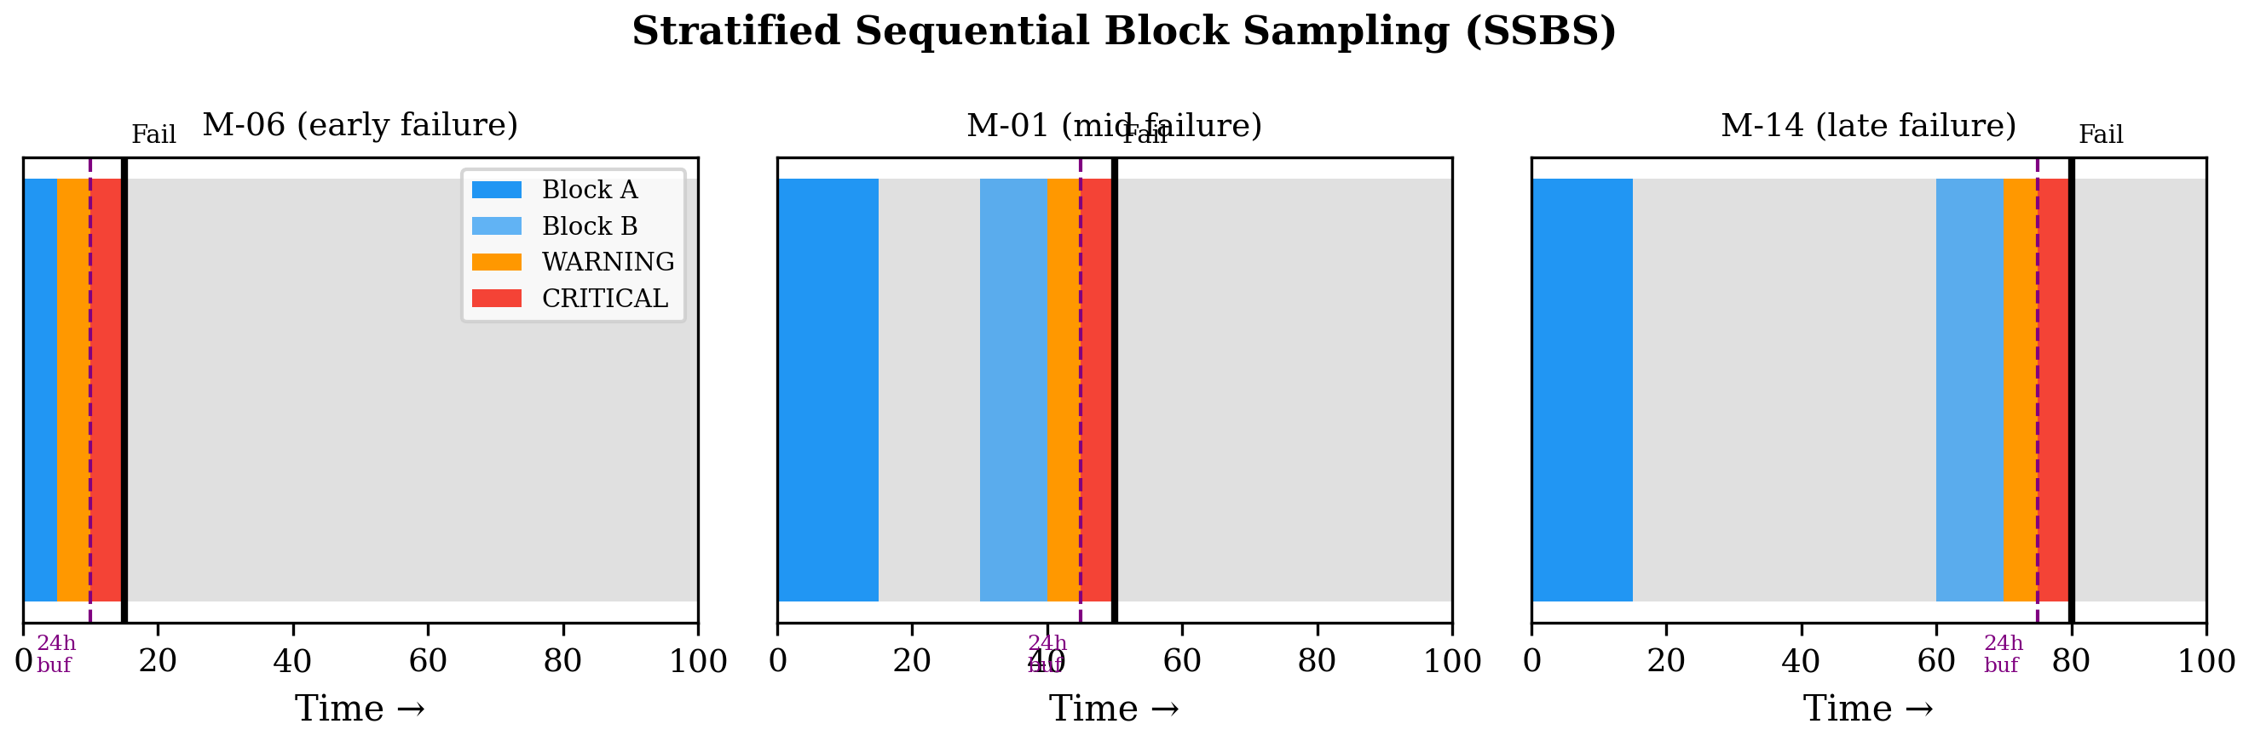
FASE 6
IMBALANCE HANDLING
SSBS — Stratified Sequential Block Sampling
SEBELUM → SESUDAH
HEALTHY
97.364%
→
87.09%
(17,787)
WARNING
1.247%
→
6.11%
(1,247)
CRITICAL
1.389%
→
6.80%
(1,389)
100,000 → 20,423 baris total
2 blok kronologis per mesin: Block A (prima) + Block B (pre-warning boundary)
✅ TANPA augmentasi sintetis (Zero Leakage) · SMOTE sengaja ditunda ke Fase 7 — hanya untuk X_train setelah split selesai
8 mesin shortfall HEALTHY < 1000 baris: konsekuensi integritas temporal (bukan bug)
0
1
2
3
4
5
6
7
8
9
10

Slide 13
FASE 6.5
RUL ENGINEERING
RUL Target Engineering — Remaining Useful Life
RUL(t) = ( T_next_failure − t ) / 86,400
0.04 hari
146.92 hari
Min
Max
dalam satuan hari (days) · target variabel untuk Model 2 (RUL Regressor)
29.38 hari
18.88 hari
Distribusi RUL per kelas:
Mean
Median
HEALTHY
WARNING
CRITICAL
median ~18.88 hari
median ~2 hari
median ~1 hari
WARNING median ≈2 hari, CRITICAL median ≈1 hari — konsisten dengan window 48h/24h dari Fase 2
0
1
2
3
4
5
6
7
8
9
10

Slide 14
FASE 7
DATA SPLITTING
Machine-Based Split & SMOTE (Train Only)
Dataset Split Strategy
SMOTE — X_train_clf Only
Split | Mesin | Baris | %
Train | M-01 – M-14 | 14,419 | 70.60%
Val | M-15 – M-17 | 3,288 | 16.10%
Test | M-18 – M-20 | 2,716 | 13.30%
Kelas | Sebelum | Sesudah
HEALTHY | 12,504 | 12,504 (tidak berubah)
WARNING | 901 | 4,000 (+3,099 sintetis)
CRITICAL | 1,014 | 4,000 (+2,986 sintetis)
TOTAL | 14,419 | 20,504
✅ Zero Data Leakage terkonfirmasi — Val & Test = 100% natural data, tanpa sampel sintetis
Machine-Based Split: setiap split punya full run-to-failure cycle → model belajar generalisasi antar mesin
0
1
2
3
4
5
6
7
8
9
10

Slide 15
FASE 8
MODELING OVERVIEW
Modeling — Dual-Track Architecture
69 Feature Input
TRACK A — Health Classifier
TRACK B — RUL Regressor
• Random Forest (baseline)
Track B HANYA aktif jika Track A
mendeteksi WARNING/CRITICAL
→ reduce inference load ~70%
• XGBoost Regressor
• XGBoost V2 + Threshold 0.60 ⭐
• LSTM V2 ⭐ (final)
• LightGBM
• GRU (eksperimental)
Output: HEALTHY / WARNING / CRITICAL
Output: RUL (hari) · Scope: WARNING + CRITICAL only
0
1
2
3
4
5
6
7
8
9
10

Slide 16
FASE 8A
CLASSIFIER COMPARISON
Classifier — 3 Model Comparison
Model | F1 Val | F1 Test | WARNING F1 | Infer (ms) | Size (MB)
Random Forest | 0.9292 | 0.9914 | 0.8108 | 75.25 | 3.15
XGBoost V2 ⭐ | 0.9894 | 0.9906 | 0.9818 | 12.76 | 1.68
LightGBM | 0.9845 | 0.9876 | 0.9781 | 3.26 | 0.13
❌ V1 GAGAL
XGBoost V1 (early stopping agresif, iter 40) → WARNING F1 = 0.2186
✅ V2 OPTIMAL
XGBoost V2 (499 iter, lr=0.01, threshold=0.60) → WARNING F1 = 0.9818
Hyperparameter V2: n_estimators=499 · max_depth=4 · lr=0.01 · subsample=0.8 · reg_α=0.5 · reg_λ=2.0
0
1
2
3
4
5
6
7
8
9
10

Slide 17
FASE 8A
THRESHOLD TUNING
XGBoost — Threshold Tuning: 0.50 → 0.60
❌ Threshold 0.50 (default)
✅ Threshold 0.60 (optimal)
WARNING Precision:
0.087
WARNING Precision:
0.973
WARNING Recall:
0.975
WARNING Recall:
0.990
F1 WARNING:
0.159
F1 WARNING:
0.9818
False Alarms:
954 ‼
False Alarms:
1 ✅
Threshold tuning bukan cosmetic — menyelamatkan model dari 954 false alarm operasional (954 → 1)
0
1
2
3
4
5
6
7
8
9
10

Slide 18
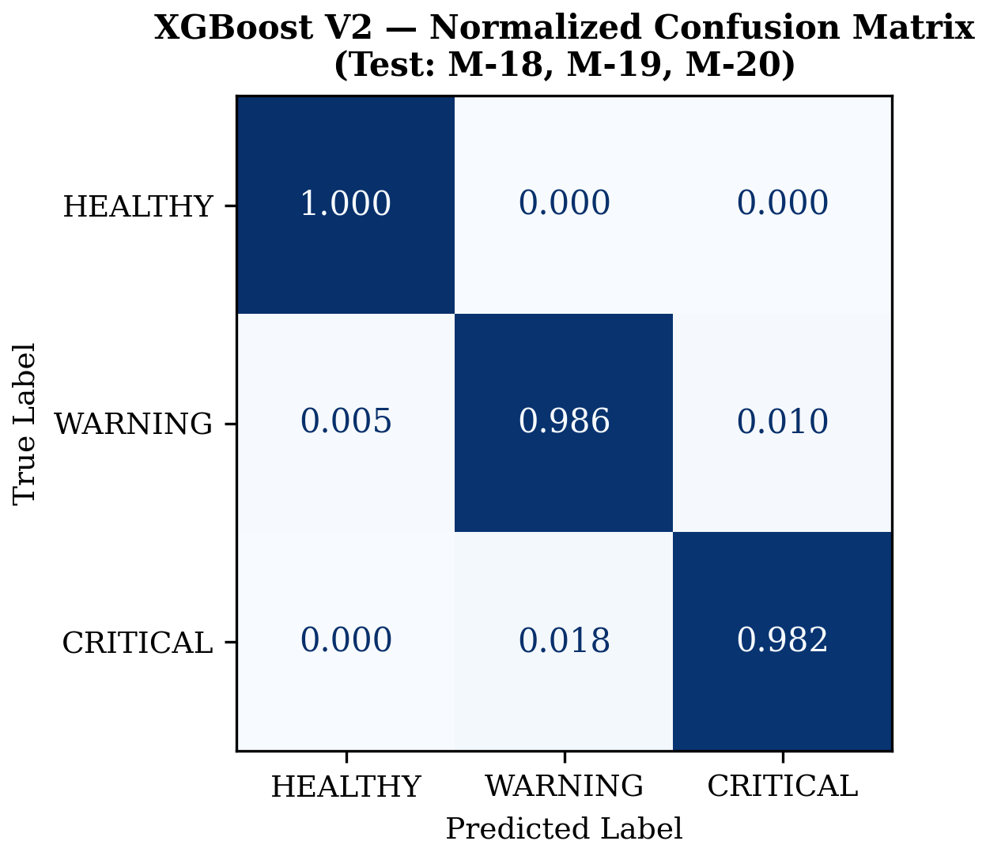
FASE 8A
EVALUATION
Confusion Matrix — XGBoost V2 (Test Set)
Fatal Error = 0
0 CRITICAL → HEALTHY
di Val maupun Test
F1 Macro (Test)
0.9906
Accuracy (Test)
0.9974
WARNING F1 Val
0.9818
Confusion Matrix — Val Set (left) & Test Set (right)
0
1
2
3
4
5
6
7
8
9
10

Slide 19
FASE 8B
RUL COMPARISON
RUL Predictor — 3 Model Comparison
Model | MAE Test | RMSE Test | R² Test | Error≤1hari | Size
XGBoost Reg | 1.1020 hr | 5.6002 | 0.3961 | 93.53% | 0.77MB
LSTM V2 ⭐ | 0.7985 hr | 6.3803 | 0.2594 | 98.04% | 0.60MB
GRU | 0.9515 hr | 7.3011 | 0.0303 | 97.80% | —
▸ Scope: WARNING+CRITICAL only — data HEALTHY memiliki irreducible uncertainty untuk prediksi RUL jangka panjang
▸ R² rendah bukan cacat model — disebabkan outlier RUL tinggi di CRITICAL akhir (mesin tanpa next_failure record)
▸ GRU overspecialize di CRITICAL (MAE=0.01) tapi gagal di WARNING (MAE=1.91) — kapasitas representasi terbatas
🏆 LSTM V2 dipilih sebagai Model 2 Final · MAE Test: 0.7985 hari · Error ≤ 1 hari: 98.04%
0
1
2
3
4
5
6
7
8
9
10

Slide 20
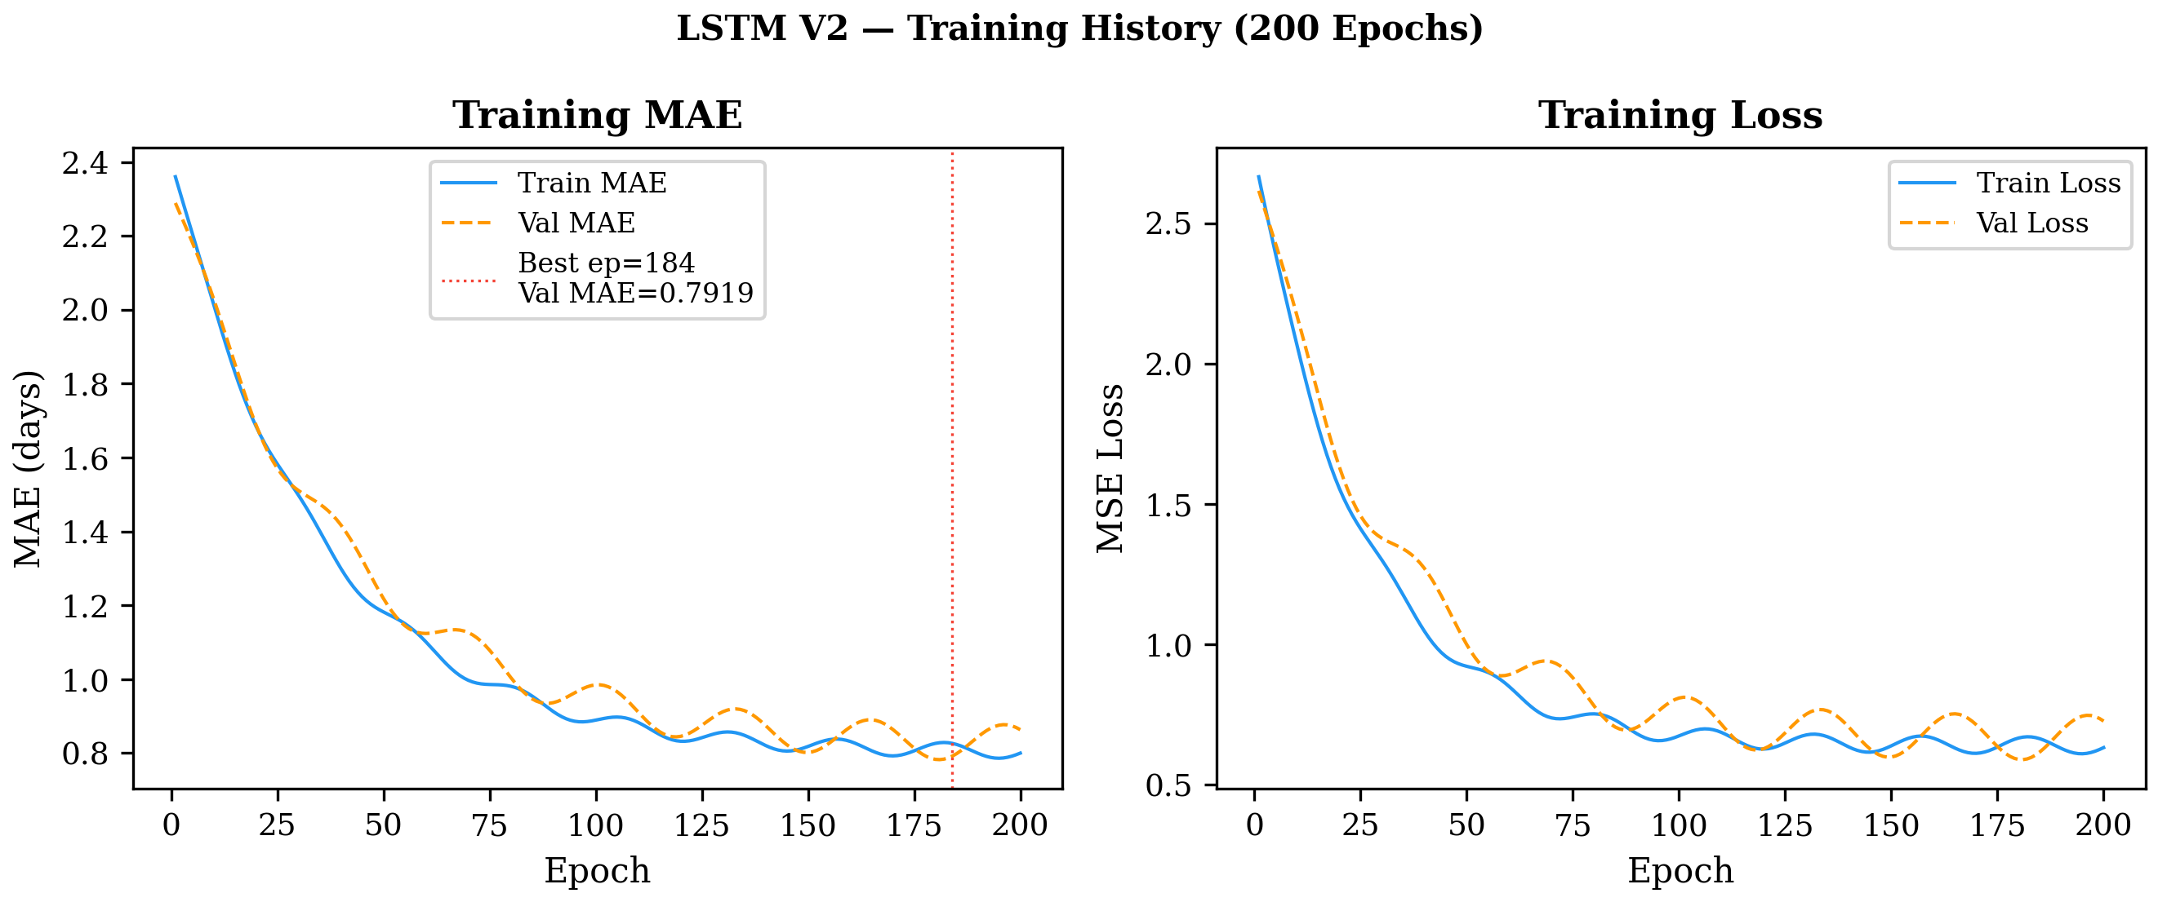
FASE 8B
LSTM ARCHITECTURE
LSTM V2 — Architecture & Learning Curve
Input: 24 timesteps × 69 features
LSTM (64) + L2(0.001) + Dropout(0.3)
BatchNormalization
LSTM (32) + L2(0.001) + Dropout(0.3)
BatchNormalization
Dense (16, relu)
Dense (1, linear) → RUL (hari)
Total params: 47,649
Best epoch=184 · Val MAE=0.8160 hari · V1→V2→V3(gagal)→V2 final
lr=0.001 · batch=32 · patience=30 · dropout=0.3 · L2=0.001 · ReduceLR factor=0.5
0
1
2
3
4
5
6
7
8
9
10

Slide 21
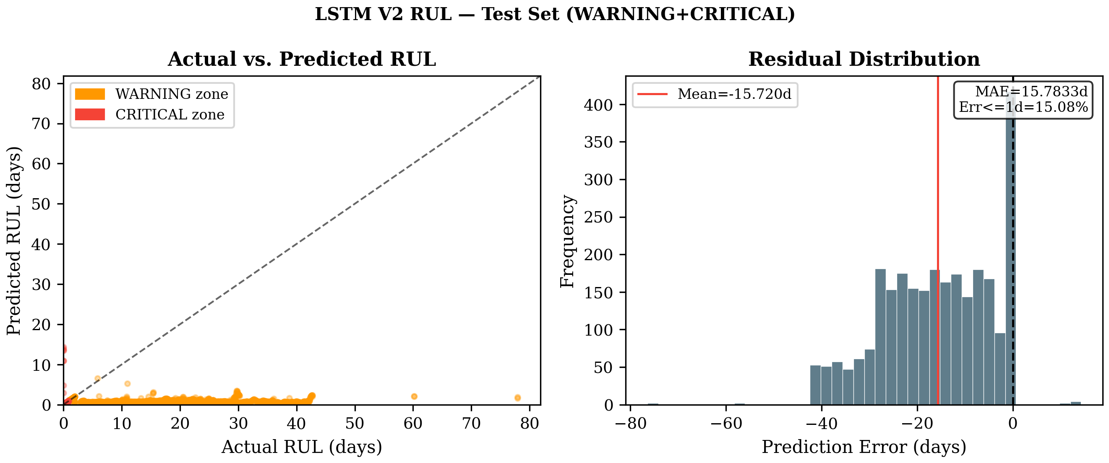
FASE 8B
RUL QUALITY
LSTM V2 — Prediction Quality
0.7985
hari MAE Test
98.04%
Error ≤ 1 hari
Validasi Real-World (M-06)
WARNING terdeteksi T-47h
CRITICAL terdeteksi T-34h
RUL error saat CRITICAL: 0.05 hari
Actual vs Predicted RUL — LSTM V2 (Test Set, WARNING+CRITICAL only)
0
1
2
3
4
5
6
7
8
9
10

Slide 22
FASE 9
MODEL SELECTION
Final Model Selection — Decision Locked
Model 1 — Health Classifier
Model 2 — RUL Predictor
XGBoost V2 + Threshold 0.60
LSTM V2 (WARNING+CRITICAL only)
F1 Macro Test
0.9906
MAE Test
0.7985 hari
WARNING F1
0.9818
Error ≤ 1 hari
98.04%
Fatal Error
0
Deployment Scope
WARNING / CRITICAL
✅ FINAL
classifier_final.pkl
✅ FINAL
rul_predictor_final.keras
Keputusan dikunci di Fase 9 HTML Report · Diekspor ke models/final/ via Fase 10
0
1
2
3
4
5
6
7
8
9
10

Slide 23
FASE 10
DEPLOYMENT
Deployment Architecture — FastAPI Microservice
Raw Sensor
JSON Payload
preprocessing_
pipeline.pkl (6KB)
XGBoost
Classifier
LSTM RUL
Predictor
FastAPI
/api/ml/predict
⚡ Hanya aktif jika
WARNING atau CRITICAL
🔧 Pickle bug resolved: FeatureEngineeringTransformer dipindah dari __main__ ke src/preprocessing_pipeline.py
🔧 TF/Keras breaking change: pin TF==2.15.0, model re-export ke .keras format, LSTM warm-up saat startup
✅ Smoke test: 5/5 skenario PASSED · Avg latency: 49.7ms · Max: 130ms · Workers=1 (LSTM thread-safety)
Docker: Dockerfile.ml · uvicorn src.app:app --host 0.0.0.0 --port 8000 --workers 1
0
1
2
3
4
5
6
7
8
9
10

Slide 24
Key Results & Impact
0.9818
0
F1 WARNING
(XGBoost V2, Val Set)
Fatal Error
(CRITICAL → HEALTHY)
0.7985
98.04%
hari MAE RUL
(LSTM V2, Test Set)
Error ≤ 1 hari
(LSTM V2, Test Set)
Dari 0.056% data failure menjadi sistem prediktif yang siap deploy:
SSBS + Cascaded XGBoost–LSTM architecture membuktikan bahwa penanganan temporal yang tepat
mengubah extreme imbalance menjadi keunggulan, bukan hambatan.
PRIME · Predictive Reliability & Intelligence Maintenance Engine

