Slide 1

CST 336 Internet Programming
Course Overview
Summer 2018
Miguel Lara, PhD

Slide 2
CST 336
Class Objectives
Upon completion of this course, students should be able to:
Read and write HTML and CSS using common tags.
Create interactive forms and dynamic web pages.
Write PHP programs using variables, arrays, functions and control structures.
Retrieve data from existing APIs via AJAX/JSON
Use web-based database administration tools.
Write MySQL queries to select, insert, update, and delete records in PHP.
Apply HTML, CSS, JavaScript, jQuery, PHP, and MySQL to the development of interactive and database-driven website systems.

Slide 3
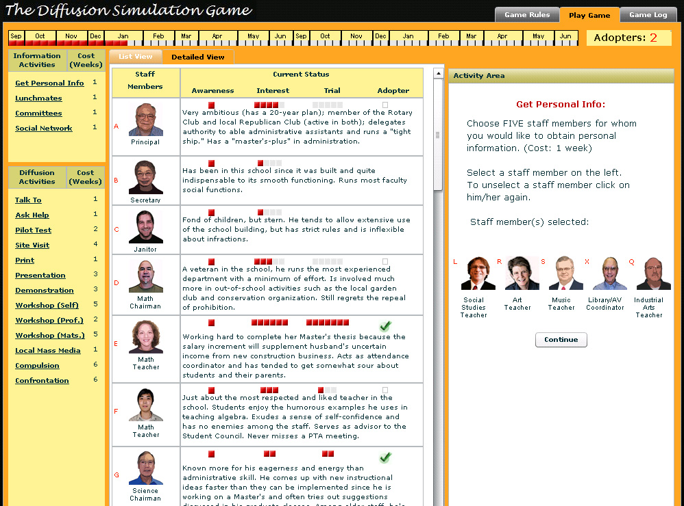
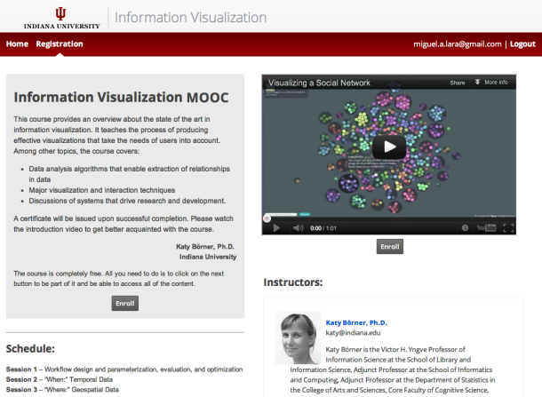


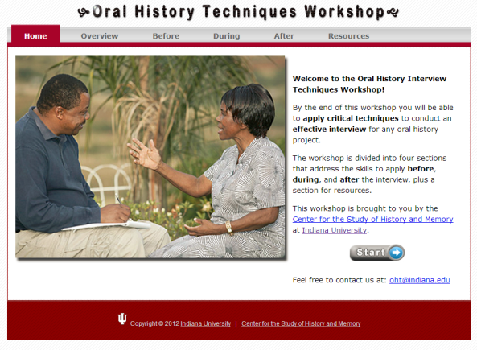

Miguel Lara, PhD: Instructional Designer, Media Developer, Application Developer

Slide 4

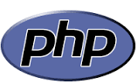

CST 336
Class Schedule
HTML & CSS
PHP (Control Structures and Arrays)
HTML Forms / PHP Sessions
MySQL & PHP
SQL CRUD / Authentication
JavaScript & jQuery
AJAX / Web APIs
Final Project / Exam

Slide 5
CST 336
Class Activities/Grading
Labs - 20%
Assignments - 20%
Midterm - 20%
Final Exam - 20%
Final Project - 20%
Notes:
Grades will be posted regularly in iLearn

Slide 6
CST 336
Tips to succeed in the class:
Don't fall behind
Seek help
Invest at least 10 hours per week
Don't aim low

Slide 7
CST 336
Programs we'll be using:
Github - https://github.com
Cloud 9 - https://c9.io/
Heroku – https://heroku.com
XAMPP (optional)

Slide 8



CST 336
Programs we'll be using:
Development & Testing Environment
Production Environment

Slide 9
CST 336
Pre-Test

