Slide 1

SMART INDIA HACKATHON 2026
FogNet
Problem Statement ID – 26007
Problem Statement Title- Safe and Efficient Operation of Mine Vehicles in Fog and Low-Visibility Conditions in Open Cast Iron Ore Mines.
Theme- Smart Automation
PS Category- Hardware
Team ID-
Team Name -NEXORA

Slide 2
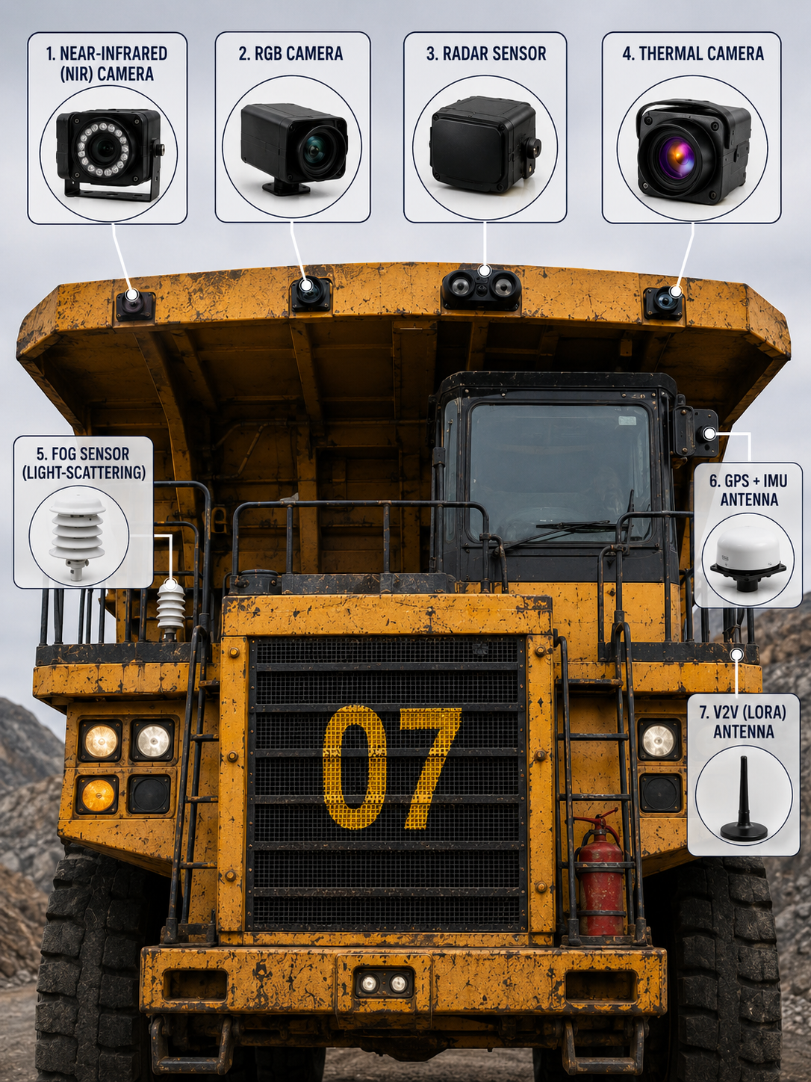
“Develop a real-time AI-based safety system for mine vehicles to detect fog, obstacles, and hazards, and provide advance warnings to prevent accidents in low-visibility conditions.”
NEXORA
Proposed Solution
Radar-First Detection: 77 GHz radar detects and tracks vehicles and obstacles even in dense fog.
Dynamic Safe Speed: Calculates safe speed using stopping distance, braking, road grade, payload, and route conditions.
GNSS/IMU & V2V: Tracks vehicle position and shares movement data for early conflict warnings.
MOR Visibility Monitoring: Roadside nodes continuously monitor visibility and weather conditions.
Driver HMI & Alerts: Provides safe-speed, hazard direction, and real-time audio, visual, and vibration alerts.
Fail-Safe Operation: Maintains local radar-based safety with a conservative degraded mode during sensor or network failures.
Innovate & Uniqueness
📡🚛 🧠📡 🚛 ⇄ 🚛📶 🚛 ⇄ 🚛🔄 🌫️⏱️
Radar Detection AI sensor Fusion V2V awareness Alpha call Predictive Fog Alert

Slide 3
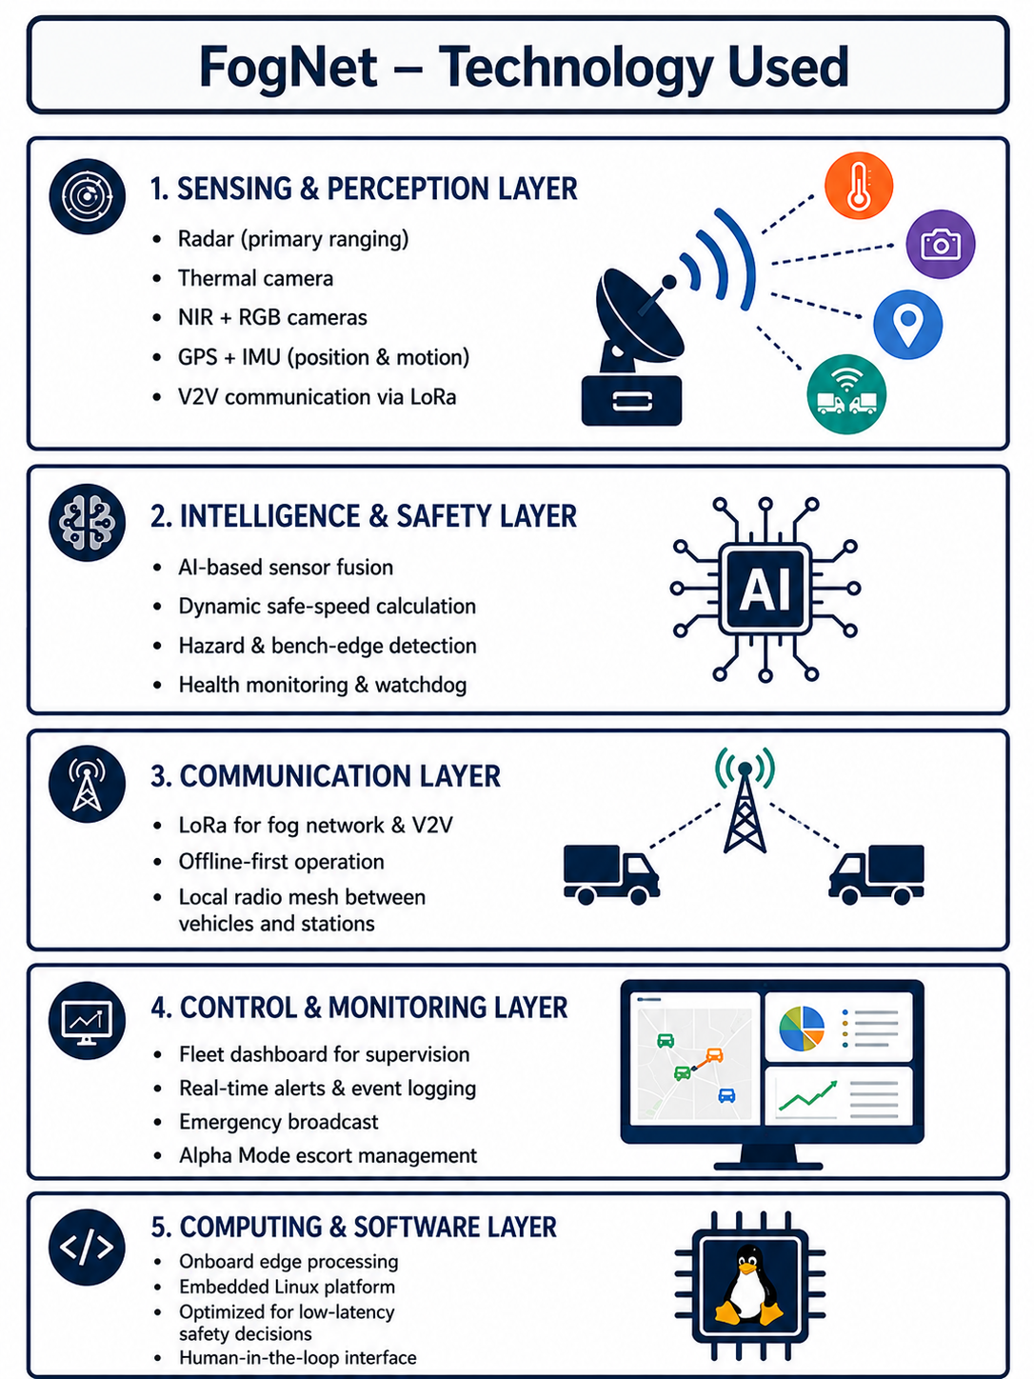
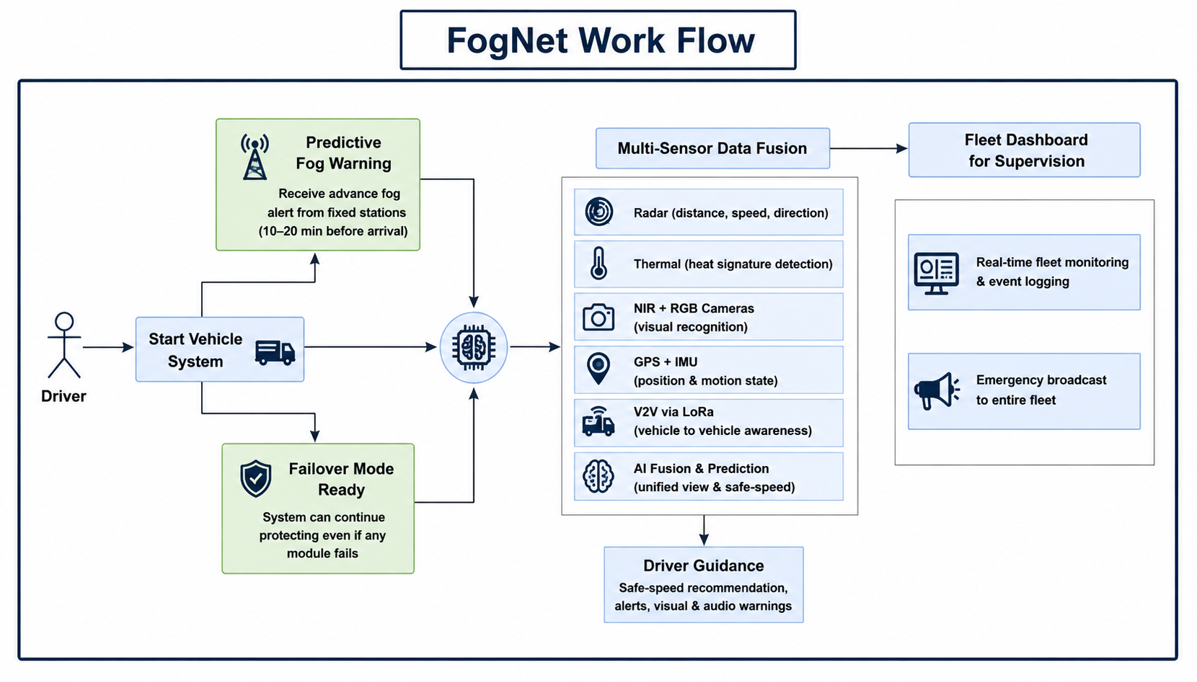
TECHNICAL APPROACH
NEXORA

Slide 4
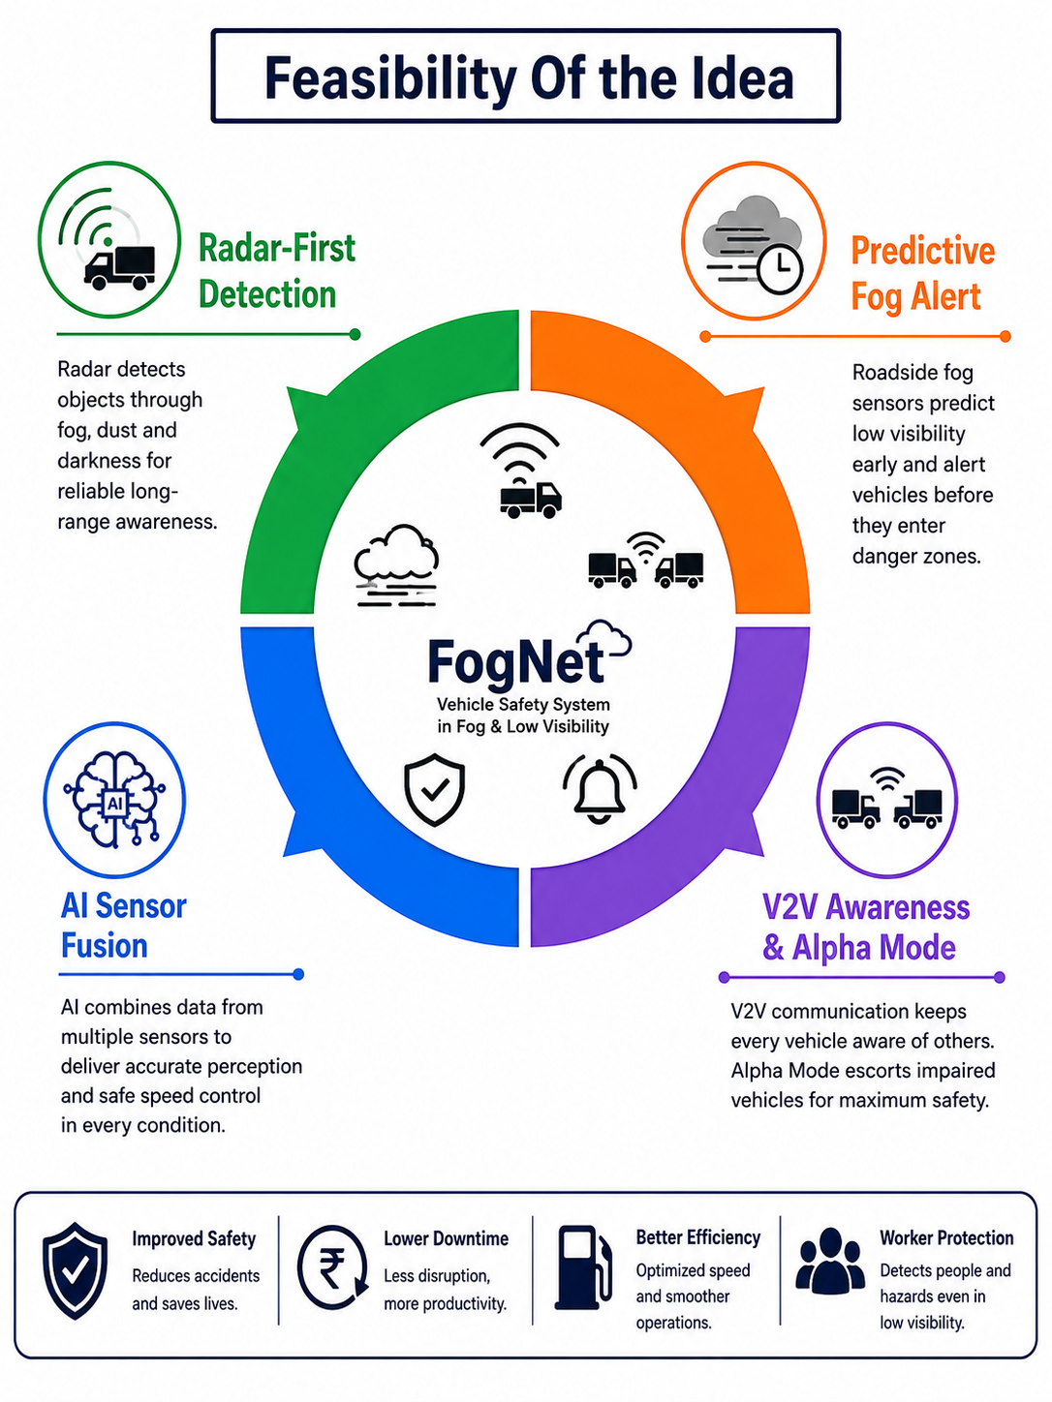
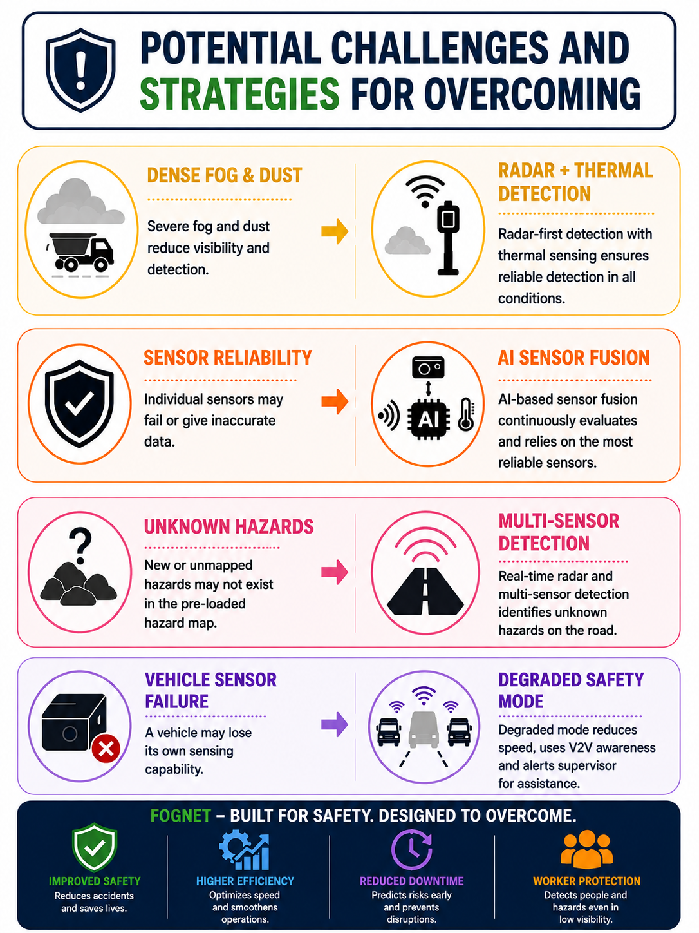
FEASIBILITY AND VIABILITY
NEXORA

Slide 5

IMPACT AND BENEFITS
NEXORA

Slide 6
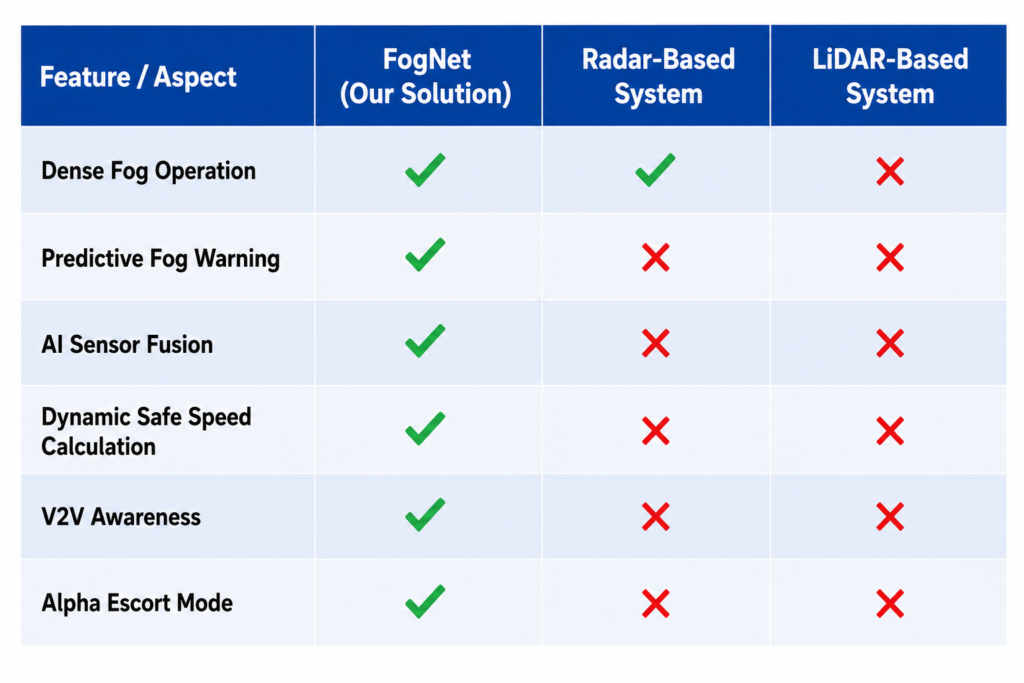

RESEARCH AND REFERENCES
NEXORA
References

