Slide 1
CH3
Lisa Xu

Slide 2
Keyboard
the keyboard has electrical circuitry together with its own microprocessor and a ROM chip. The keys are positioned above a key matrix which consists of a set of rows of wires and another set of columns of wires. Pressing a key causes contact at a specific intersection. The microprocessor continuously tests to see if any electrical circuit involving a row wire and a column wire has become closed. When the microprocessor recognises that a circuit has become closed, it can identify the particular intersection that is causing this. It then uses data stored in the ROM to create the appropriate character code relating to the key associated with that intersection and sends this code to the processor. The same principles apply if two keys are pressed simultaneously.

Slide 3
Speaker and microphone
For input, a microphone is needed. This is a device that has a diaphragm, a flexible material which is caused to vibrate by an incoming sound. If the diaphragm is connected to suitable circuitry the vibration can cause a change in an electrical signal. A condenser microphone uses capacitance change as the mechanism; an alternative is to use a piezoelectric crystal. The electrical signal has to be converted to a digital signal by an analogue-to-digital converter before it can be processed by a sound (audio) card inside the computer. For output, a loudspeaker or speaker is needed. This is involved in what is effectively the reverse process to that for input. The computer sound card produces a digital signal which is converted to analogue by a digital-to-analogue converter. The analogue signal is fed to the speaker. In the traditional technology the current flows through a coil suspended within
the magnetic field provided by a permanent magnet in the speaker. As the direction of the current keeps reversing, the coil moves backwards and forwards. This movement controls the movement of a diaphragm which causes sound to be created.

Slide 4
Mouse
a relative movement to be recorded so that it can influence the screen cursor position.
As the mouse moves the rubber ball rotates causing one or both rollers to rotate. Each roller is attached to a spindle on which there is a disc with holes arranged around the outer edge. A light beam and detector are arranged so that the intermittent transmission of the light through the holes in the disc is recorded as the disc rotates and the circuitry attached to the pair of detectors then sends the appropriate data to the computer to activate movement of the screen cursor.

Slide 5
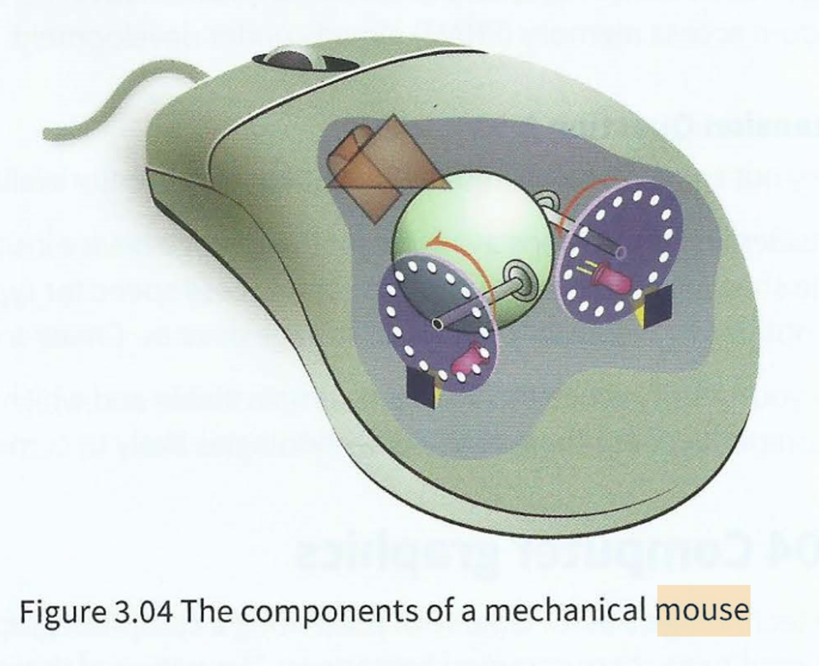

Slide 6
Inkjet printer
The working principle of an inkjet printer is very simply explained: a sheet of paper is fed in; the printhead moves across the sheet depositing ink on to the paper; the paper is moved forward a fraction and the printhead carries out another traversal and so on until the sheet has been fully printed.

Slide 7
Laser printer
1 The drum is given an electric charge.
2 The drum starts to revolve step by step.
3 At each step a laser beam is directed by the mirror and lens assembly to a sequence of positions across the width of the drum.
4 At each position the laser is either switched off to leave the charge on the drum or switched on to discharge the position.
5 This process repeats until a full page electrostatic image has been created.
6 The drum is coated with a charged toner which only sticks to positions where the drum has discharged.
7 The drum rolls over a sheet of paper which is initially given an electric charge.
8 The sheet of paper is discharged and then is passed through heated rollers to fuse the toner particles and seal the image on the paper surface.
9 The drum is discharged before the process starts again for the next page.

Slide 8
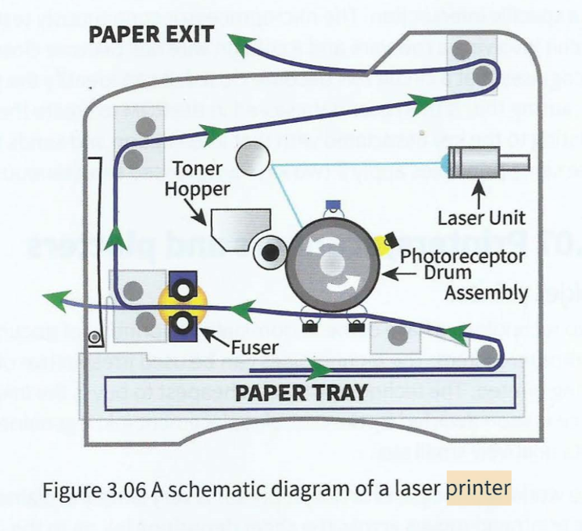

Slide 9
Graphics plotter and 3D printer
This requires the use of a graphics plotter. A plotter uses pens to write, usually, on a large sheet of paper constrained by sprockets along one pair of sides. The sprockets can move the paper forwards or backwards and pens can either be parked or in use at any given time. The controlling circuitry and software can create the drawing directly from the original vector graphic file.
The technology is very versatile and still under development. Figure 3.07 shows a striking example. This bionic ear was constructed with three 'inks'. Silicone was used for the basic structure, a gel containing chondrocyte cells and silicone infused with silver nano particles were the other two 'inks'. The final curing step involved incubation in a culture medium to allow the chondrocyte cells to produce cartilage. The only missing component was skin.

Slide 10
Scanner
The sheet of paper is held in a fixed position and a light source covering the width of the paper moves from one end of the sheet to the other. The reflected light is directed by a system of mirrors and lenses on to a charge-coupled device (CCD). The finer details of how a CCD works are not important but the three aspects to note are:
It consists of an array of photo-sensitive cells.
It produces for each cell an electrical response proportional to the light intensity.
It needs an analogue-to-digital converter to create a digital value to be stored.

Slide 11
Optical discs
The first is that if the disc is spinning at constant revolutions per second the outer part of the disc travels faster than the inner part. Early technology counteracted this by spinning at a constantly changing speed keeping the bit density constant along the spiral path. The second is that the wavelength of the light controls how well the light can be focused; the shorter the wavelength the better the focus. The original infrared diode laser used in a CD-ROM has much longer wavelength than the red laser light used in a DVD. The more recently used blue laser light has an even shorter wavelength. This change in wavelength is one of the reasons for the improvements in the storage capacity of the modern technology.

Slide 12
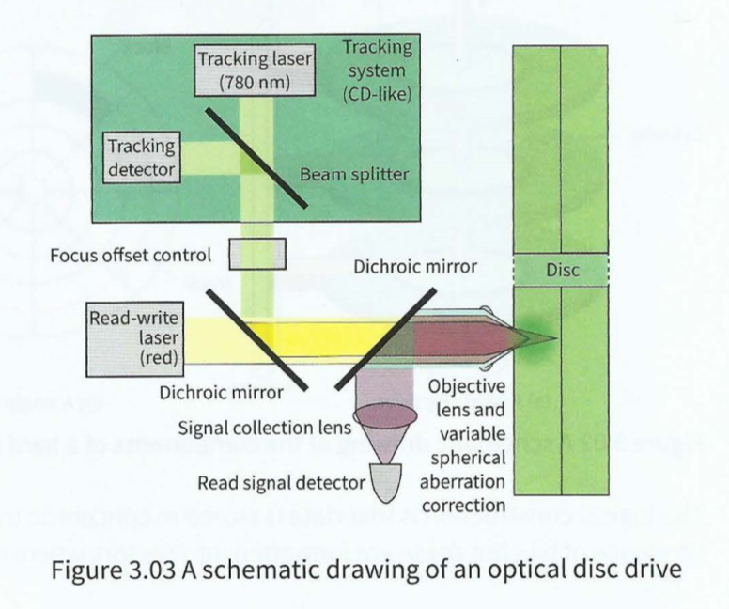

Slide 13
Touch screens
There have been two approaches used. The first is the resistive touch screen. This type has two layers separated by a thin space beneath the screen surface. The screen is not rigid so when a finger presses on to the screen the pressure moves the topmost of these two separated layers so that it makes contact with the lower layer. The point of contact creates a voltage divider in the horizontal and vertical directions. These allow the position of the point of contact to be transmitted to the processor.

Slide 14
The second technology is the capacitive touch screen. This does not require a soft screen but instead makes use of the fact that a finger touching a glass screen can cause a capacitance change in a circuit component immediately below the screen. The most effective technology is projective capacitive touch (PCT) with mutual capacitance. This has a circuit beneath the screen which contains an array of capacitors. This enables multi-touch technology, which allows more functionality than just pointing at one location on a screen.

Slide 15
Resistive touch screen: a flexible surface which causes contact between electrically resistive layers beneath when touched
Capacitive touch screen: a rigid surface above a conductive layer which undergoes a change in electrical state when a finger touches the screen

Slide 16
Solid-state media
The more frequent use is either in a memory card or in a USB flash drive. In the latter case the flash memory is incorporated in a device with the memory chip connected to a standard USB connector. This is currently the technology of choice for removable data storage but how long this will remain so is very uncertain with alternative technologies such as phase-change random access memory (PRAM) already under development.

