Slide 1




2018 NUS School of Computing Summer Workshop
SWS3004: Cloud Computing with Big Data
Member：
Hu Weilin / t0916163
Zhao Zihan / t0916191
Liu Chao / t0916216
Liu Ziru / t0916047

Slide 2
1
2
3
Motivation
Objective
Approach
4
5
6
Implementation
Hightlight of FilmU
Demo

Slide 3
1
2
3
Motivation
Objective
Approach
4
5
6
Implementation
Hightlight of FilmU
Demo

Slide 4
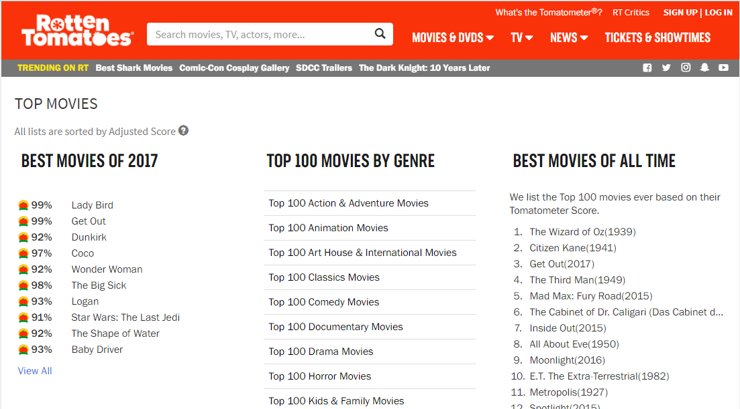
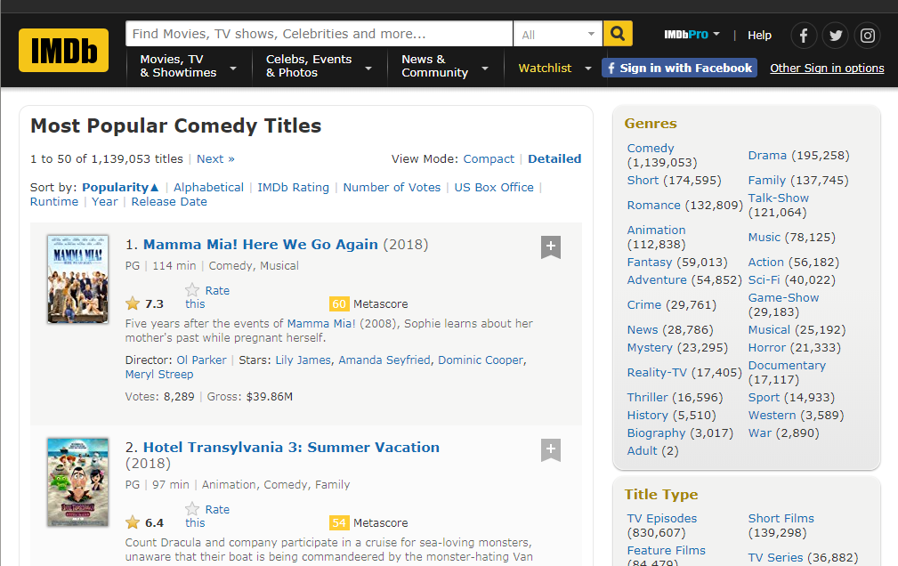
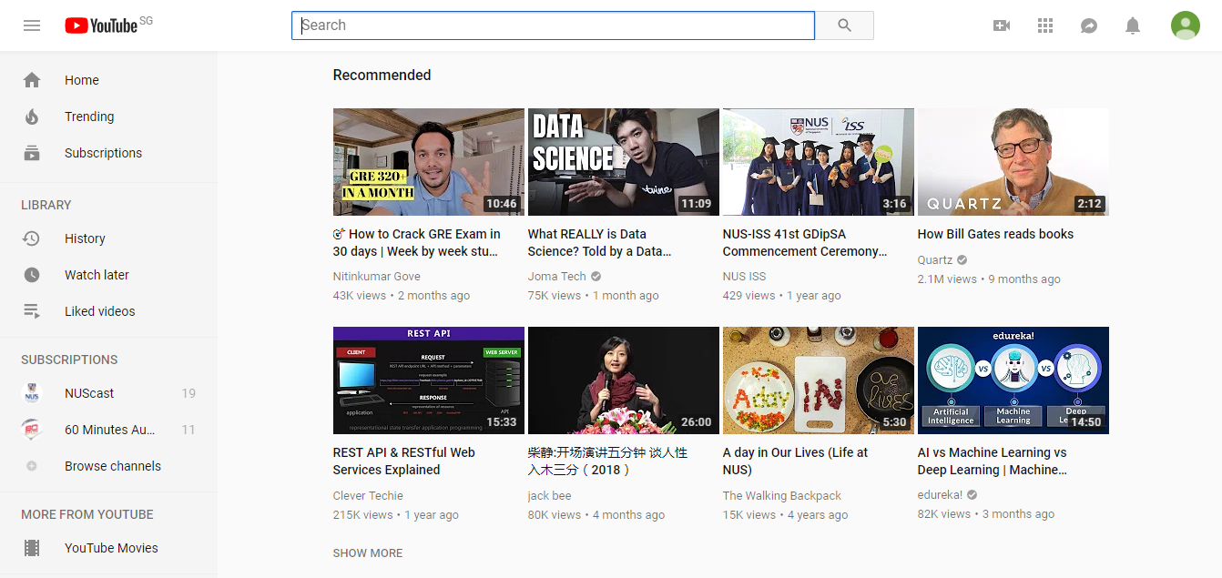
PART 1
Motivation

Slide 5
Giant Movie Website
Cannot Feel U!
NO!

Slide 6
1
2
3
Motivation
Objective
Approach
4
5
6
Implementation
Hightlight of FilmU
Demo

Slide 7
We intend to design a movie recommendation system providing films according to user’s unique personality. Incorporating information provided by twitter and IBDM movie database, our recommendation not only can provide every visitor with movies most suitable for his own taste,but also enable users to know themselves better in terms of personality.
PART 2
Objective

Slide 8
1
2
3
Motivation
Objective
Approach
4
5
6
Implementation
Hightlight of FilmU
Demo

Slide 9



PART 3
Approach
---
Service on Cloud
Log in
Cloud
Application
Pure
Tweets
Request
API
Result
VM
Movies
Info
Table
Movies Data
DB2
Personality
Insights
Big 5 personality
Score
VM
VM
Movies
Data
Tweets
JSON

Slide 10
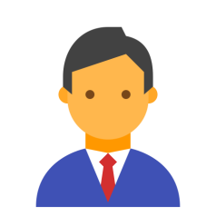





User
Web Application
Cloud Service
Sign in Twitter
PART 3
Approach
---
Interaction between Frontend
&
backend
Tweets
Data
Personality
Data
Personality analysis report
Click
”See some movies”
Query
Database
Movie
Data
Recommendation
Algorithm
User
Web Application
Cloud Service

Slide 11
1
2
3
Motivation
Objective
Approach
4
5
6
Implementation
Hightlight of FilmU
Demo

Slide 12






Part 4 Implementation
---
Technology Used
Your Personality
Twitter User Log In
web application
Movies for You
web server
front end GUI
control script
database
Personality Insight
(layout design)
(program script)
SaaS: IBM Db2
SaaS: IBM Waston
Personality insights
PaaS: IBM Bluemix Node.JS Boilerplate

Slide 13

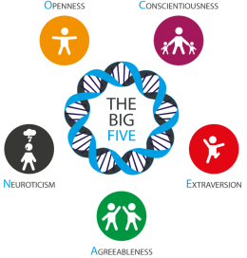



Big Five
personality score
Movie
Genre
Recommendation Algorithm
IMDB Score
Personality Matching Score
Releasing Year
Part 4
Implementation
---
How to score movie
Weighted Formula:
W(i) * F(i)
||
Final Score

Slide 14
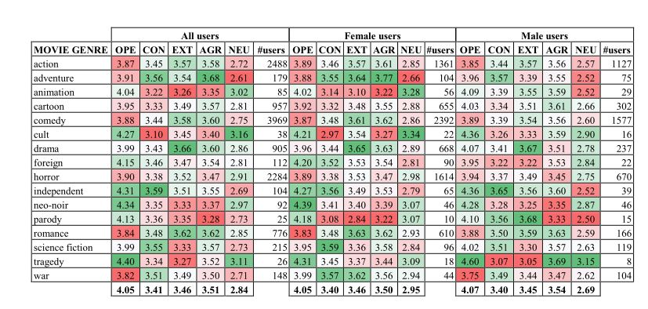
Part 4 Implementation
---
Personality-based Recommendation Algorithm
Cantador I, Fernández-Tobías I, Bellogín A. Relating personality types with user preferences in multiple entertainment domains[C]//CEUR WorkshopProceedings. Shlomo Berkovsky, 2013

Slide 15
1
2
3
Motivation
Objective
Approach
4
5
6
Implementation
Hightlight of Film U
Demo

Slide 16
Part 5 Highlight of FilmU
✔Shed light on your personality and provide you with movies most suitable to your tastes
✔ Latest movie are more likely to be recommended
✔ Show all scores for you to make a personal choice:
Personality matching score
Overall popularity among historical audience
Comprehensive score

Slide 17
1
2
3
Motivation
Objective
Approach
4
5
6
Implementation
Hightlight of FilmU
Demo

Slide 18
2018 NUS School of Computing Summer Workshop
THE END
Thanks
July ,2018

