Slide 1

Exploratory Data Analysis
<Cab Investment>
<2022.12.20>

Slide 2
Agenda
Executive Summary
Problem Statement
Approach
EDA
EDA Summary
Recommendations

Slide 3
Executive Summary
Select the preferable Cab company for investment
Analyze the profit, travel distance along with time, location
Concluded that we should invest Yellow Cab

Slide 4
Problem Statement
There are 2 Cab companies, we need to choose one of them for investment
The given data includes datetime, travel distance, customer age and income, revenue and cost, and location of the transactions.

Slide 5
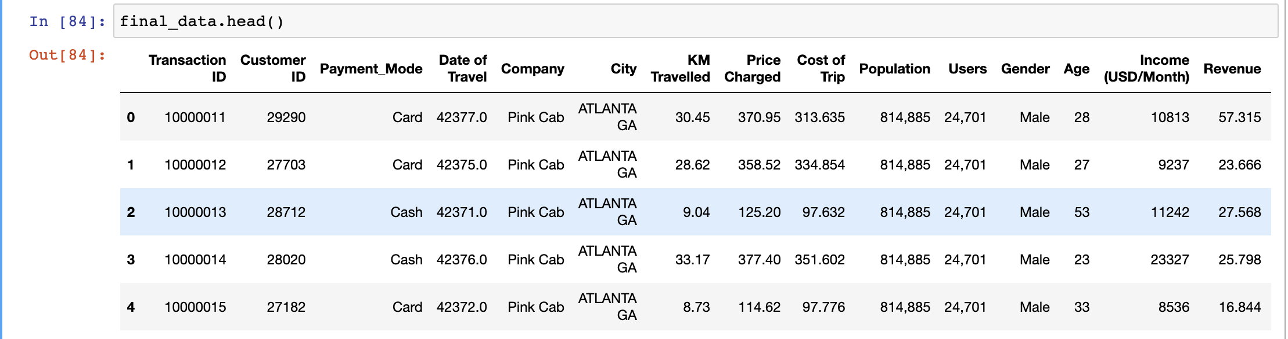
Approach
Data Loaded & Cleaning & Preprocessing

Slide 6
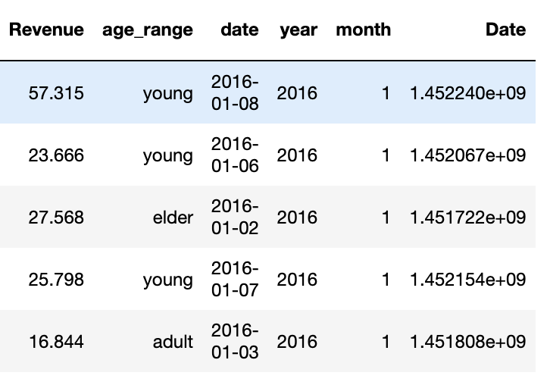
Approach
Data Loaded & Cleaning & Preprocessing

Slide 7
Approach
EDA analysis & Visualization using Tableau
Recommendations based on the results

Slide 8
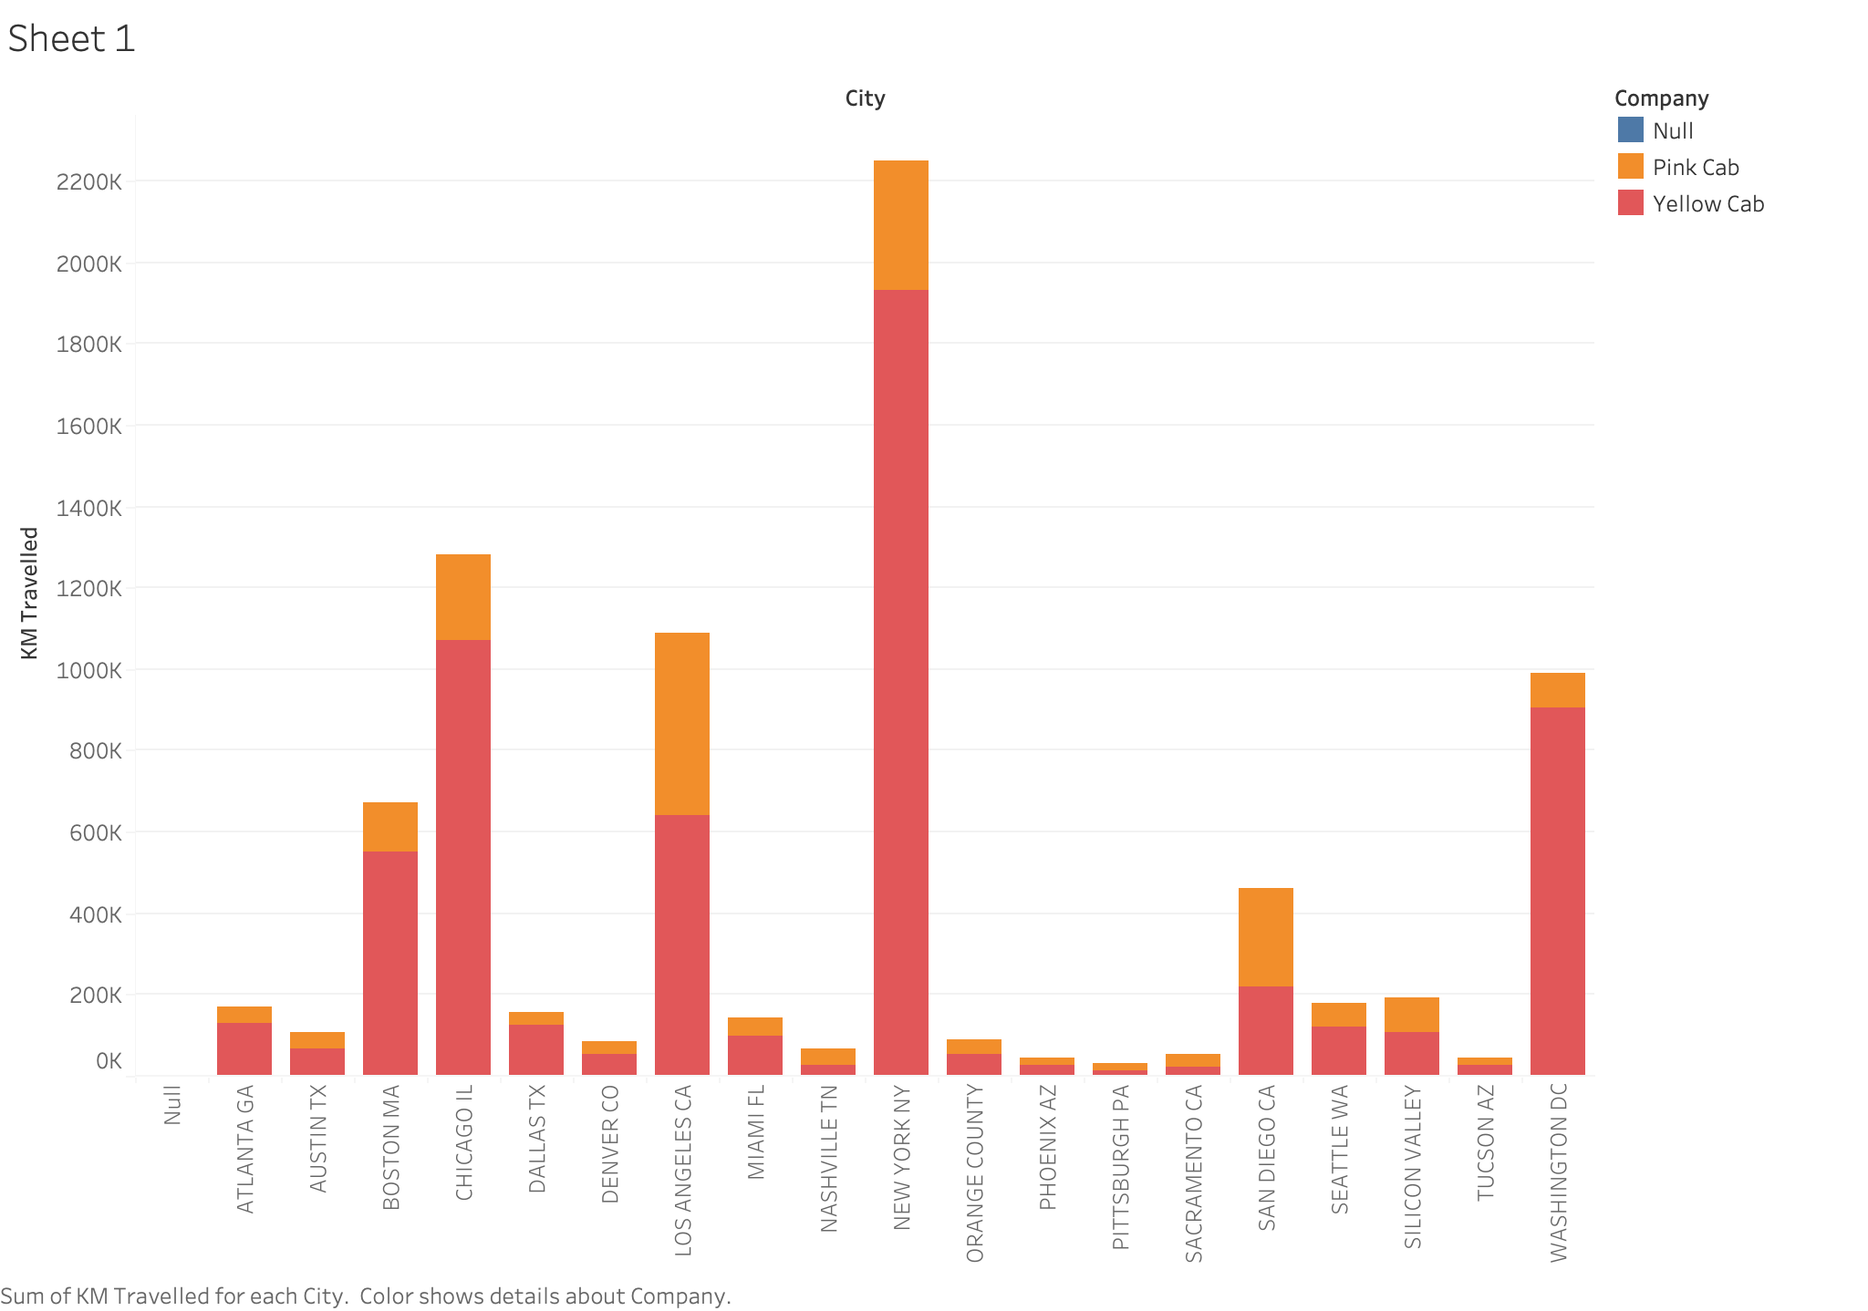
EDA
Sum of KM travelled vs different company & different places
Note: All “Revenues” in the graphs stand for “profit”. Sorry for the confusion!

Slide 9
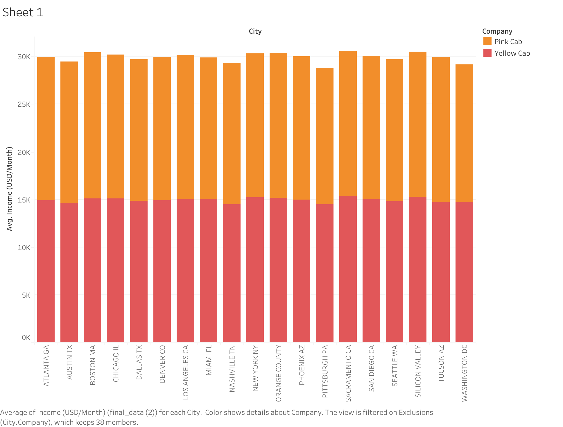
EDA
Average/Sum Income vs different company

Slide 10
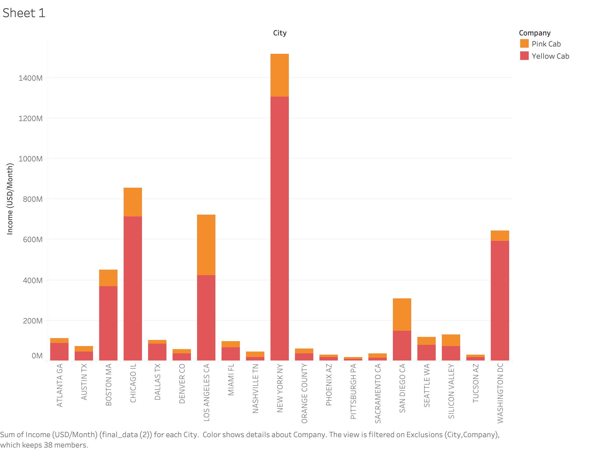
EDA
Average/Sum Income vs different company

Slide 11
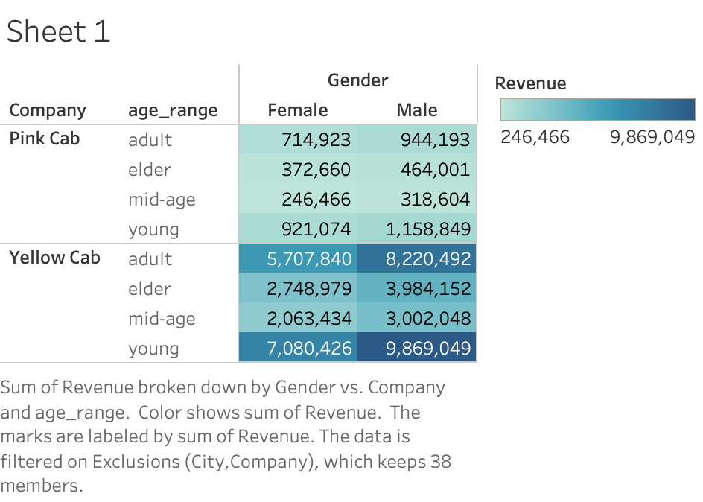
EDA
Profit vs age and gender

Slide 12
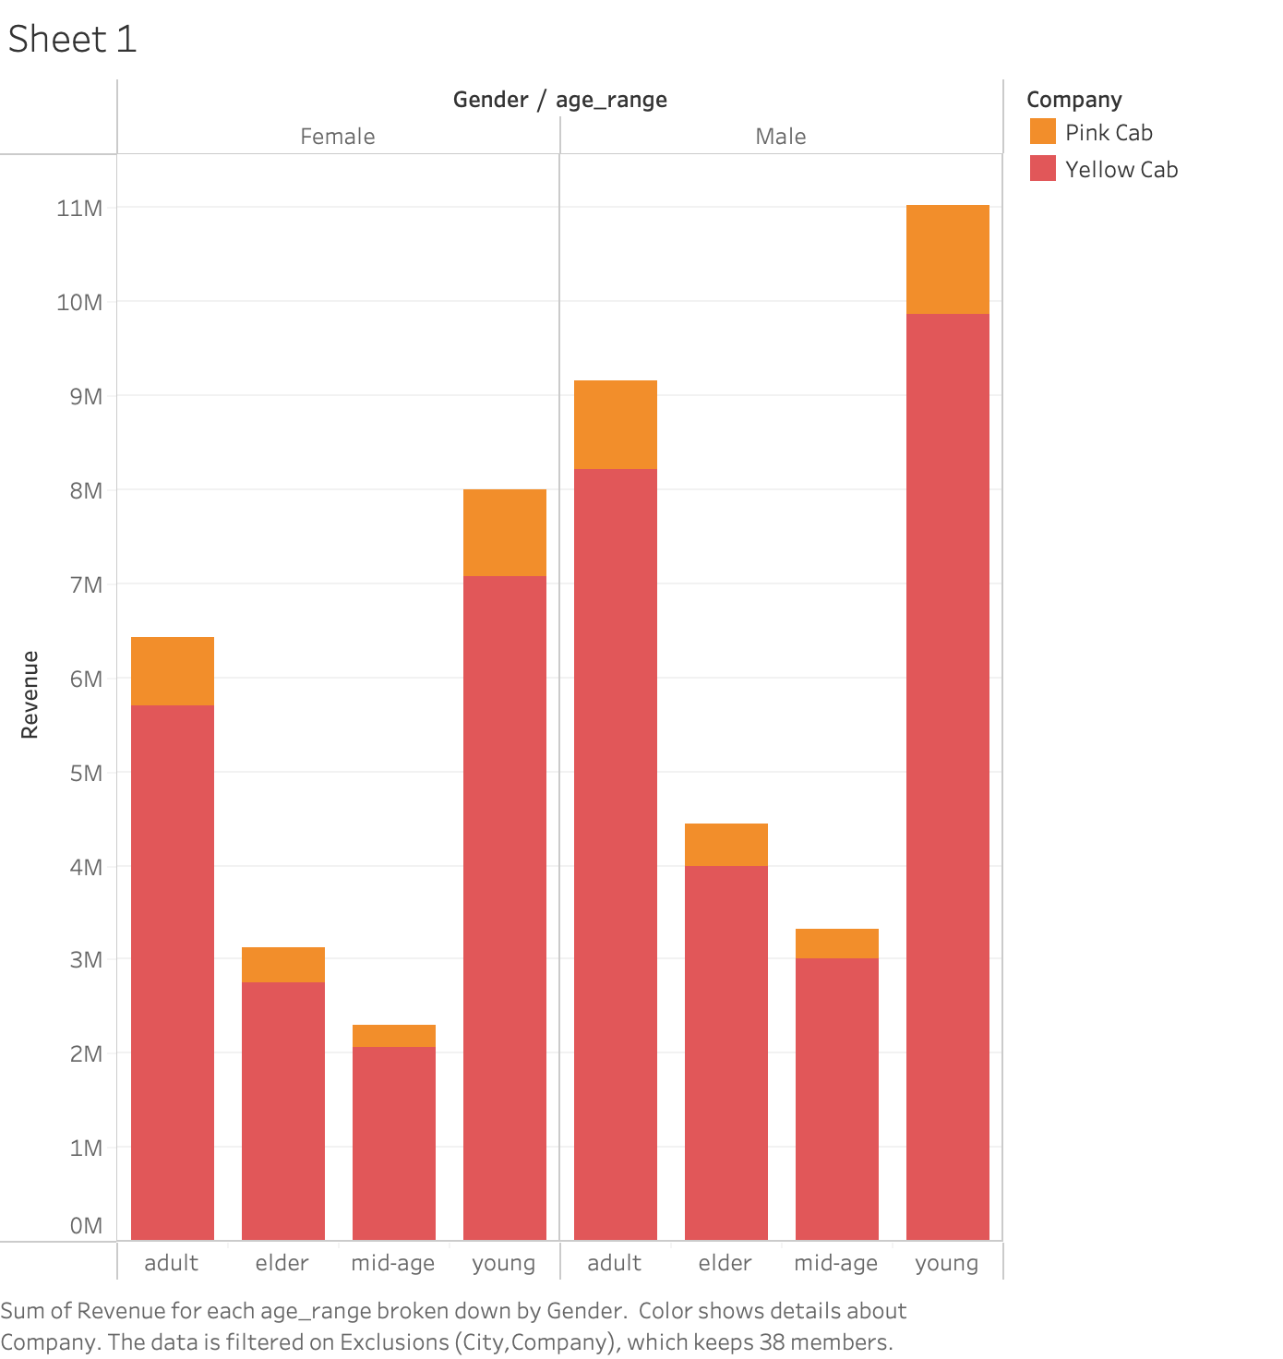
EDA
Profit vs age and gender

Slide 13
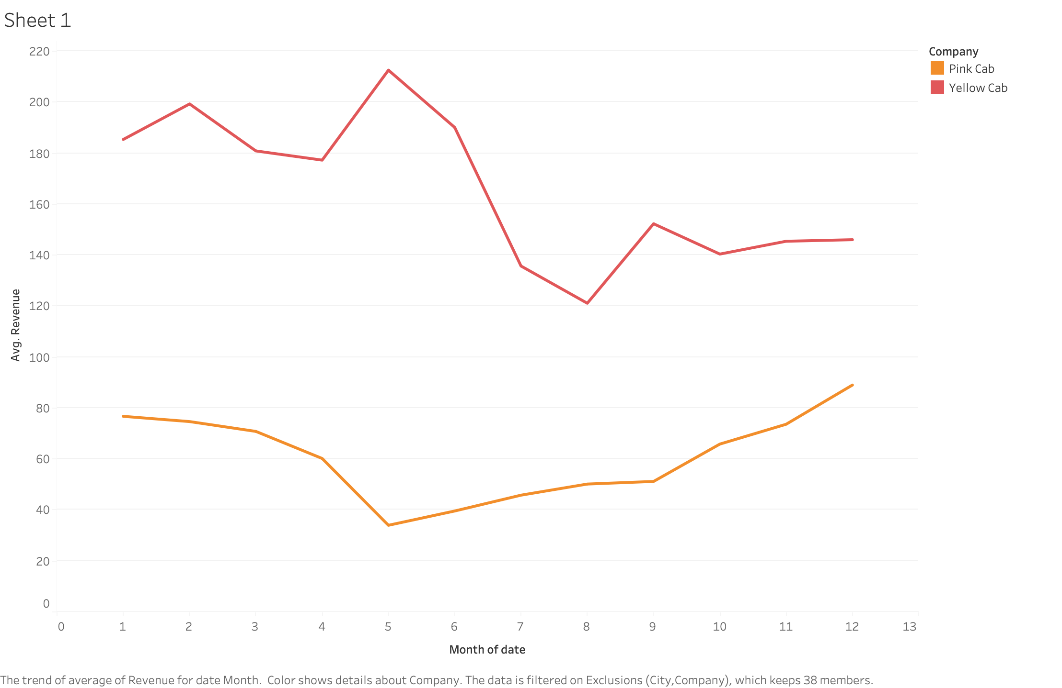
EDA
Explore the Seasonality with profit

Slide 14
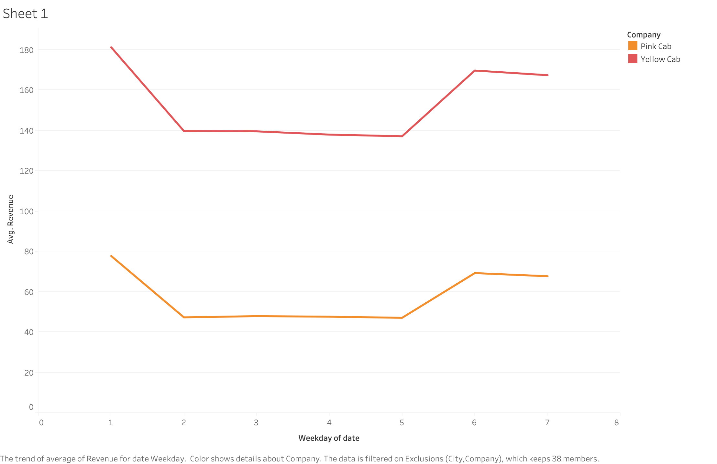
EDA
Explore the Seasonality with profit

Slide 15
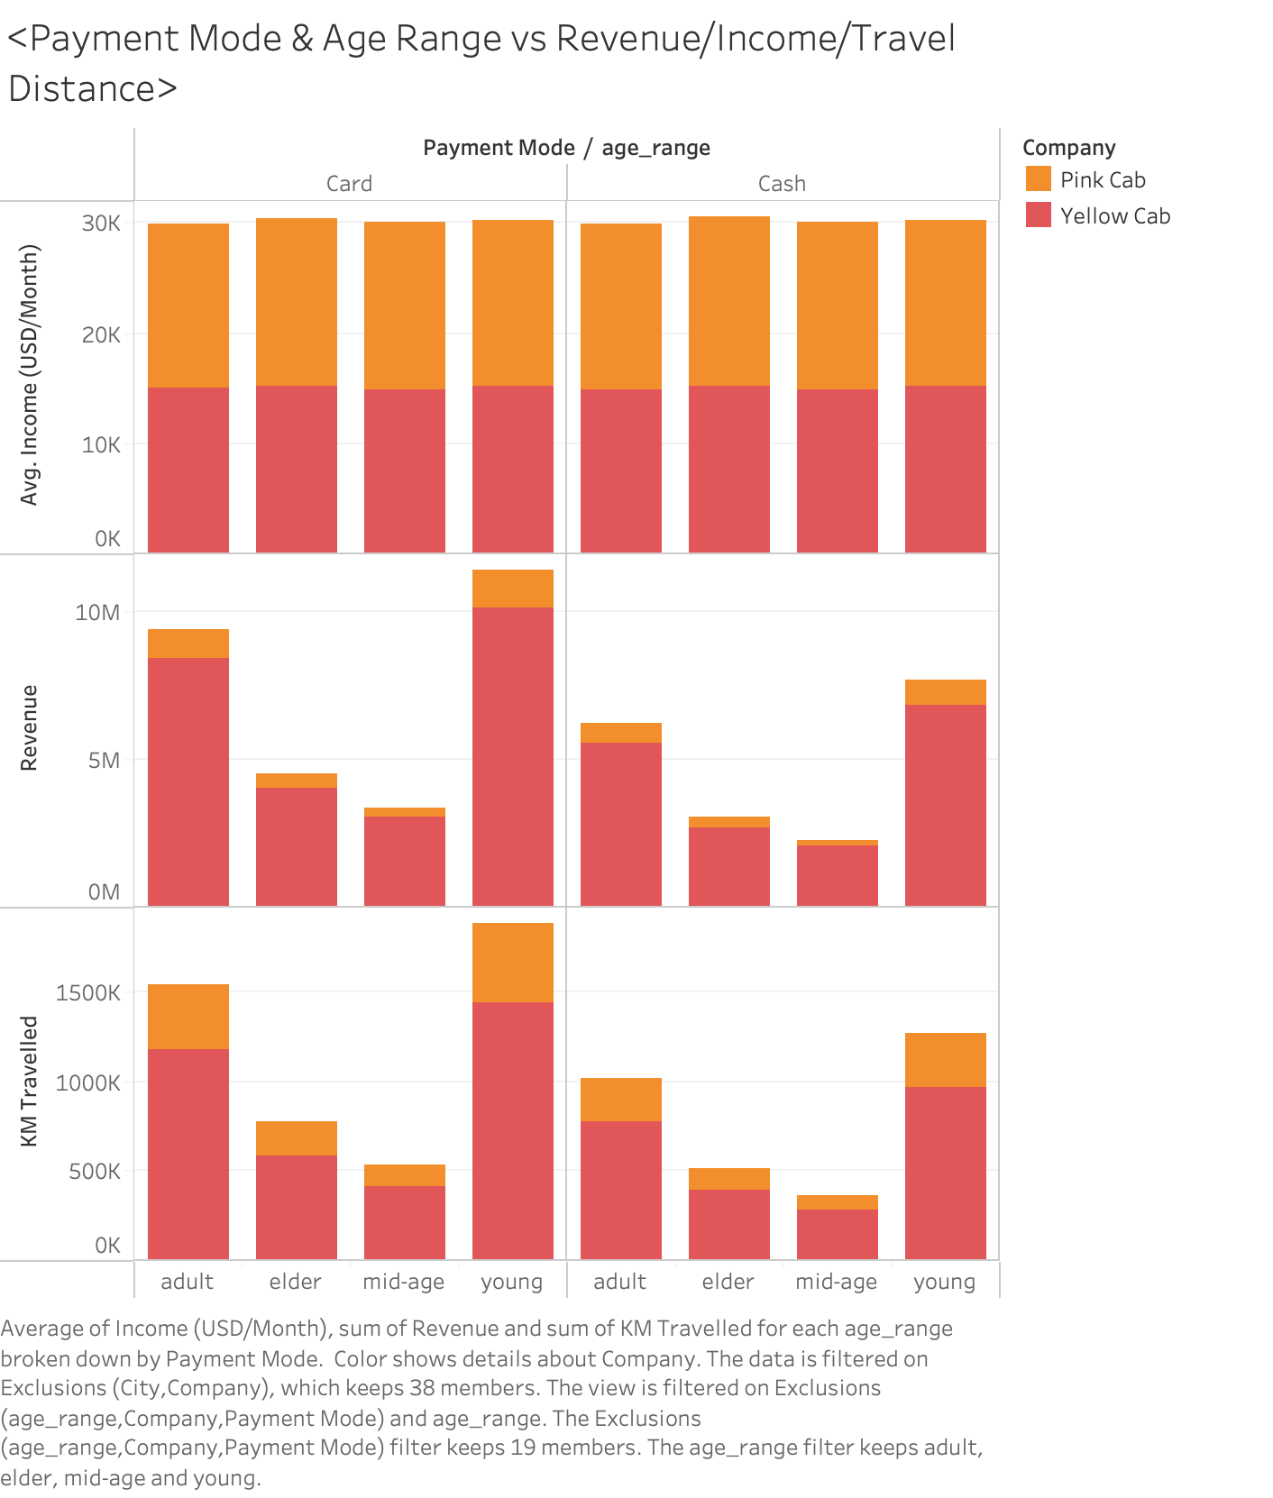
EDA
Payment Mode & Age Range vs Profit/Income/Travel Distance

Slide 16
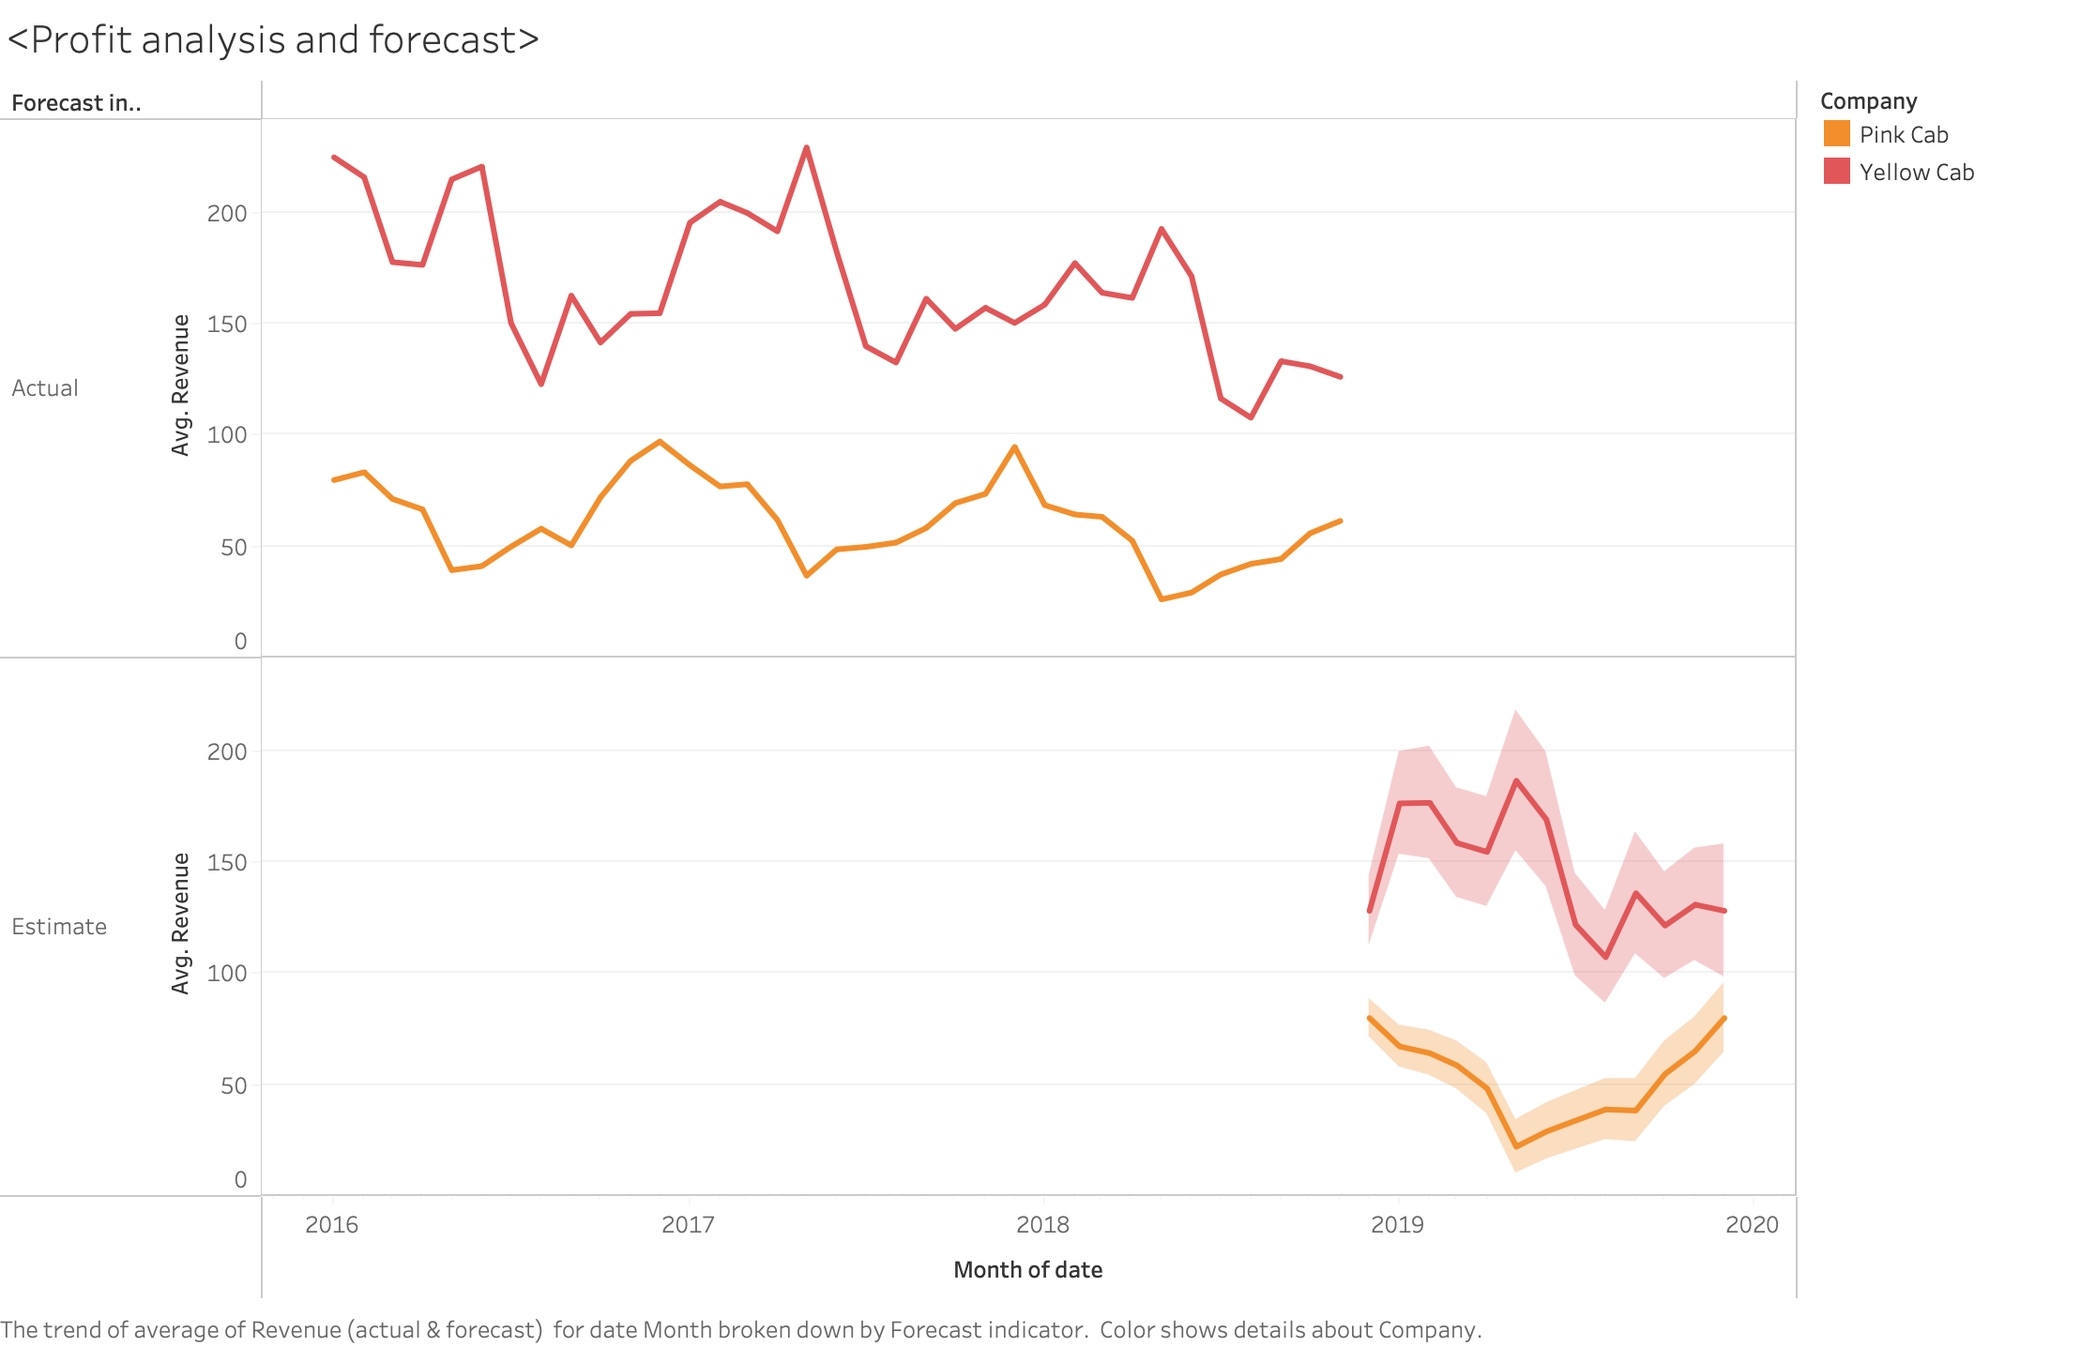
EDA
Profit Summary and Forecast

Slide 17
EDA Summary
Within each age group/location, Yellow Cab made more profits and more distance travelled.
Within all months/weekdays, Yellow Cab made more profits than the Pink Cab.
Starting from 2016, Yellow Cab kept making more profit for over three years, without any exception.

Slide 18
Recommendations
Yellow Cab has more travel distance in all the places.
Yellow Cab has customers with more income when summed up.
Yellow Cab yield more profit in all age and gender groups.
Yellow Cab has more profit in all time pieces, over 3 years.
Yellow Cab has more profit over ages and payment modes.
Yellow Cab has greater profit in both current and future according to forecast.
Based on the above reasons, I recommend Yellow Cab for investment purpose.

Slide 19
Thank You

