Slide 1
EPIC MEGAGRANT SUBMISSION
Traffic Simulation Plugin
for Unreal Engine 5
Believable street traffic as ordinary Actors — spline road networks, signalised junctions with real right-of-way arbitration, and the tooling to see why the traffic is doing what it is doing.
Zeshan Rasul
Working prototype · MIT licensed · Unreal Engine 5.8

Slide 2
THE GAP
Most projects aren't building CitySample
Unreal already ships a large-scale traffic system in CitySample, built on Mass Entity and ZoneGraph. It is impressive and it scales to a city.
It is also sample content rather than a supported drop-in plugin, and using it means adopting an ECS architecture and learning its tooling.
The far more common need is a few hundred believable vehicles on a handful of streets — configured by designers, inspectable when something looks wrong.
 | This plugin | MassTraffic
Architecture | Ordinary Actors | Mass Entity (ECS)
Configuration | Details panel | ECS traits
Scale | Hundreds | Tens of thousands
Learning curve | Place an actor | Learn Mass
Form | Plugin | Sample content
It is not a MassTraffic replacement.
If you need city-scale crowds, use Mass. This is the option for the case where traffic has to read convincingly and be reasoned about.

Slide 3
ARCHITECTURE
Three ideas do most of the work
01
02
03
One lane abstraction
Junction arbitration
Car following
Roads and junctions both implement ITrafficLaneProvider, so a vehicle drives a junction connector with exactly the same code it uses on a road. Roads evaluate lanes from their spline; junctions interpolate baked samples. A vehicle never needs to know which it is on.
Conflicts are derived from actual path crossings, then resolved FIFO by arrival ticket. Entry is refused unless the exit lane has room — no blocking the box. Clearance is per-pair and positional: a turning vehicle blocks oncoming traffic only until it is past the meeting point.
Target speed is the minimum of the desired speed, a Gipps-style safe speed √(v² + 2·b·gap), and a time-headway comfort limit. The safe-speed term is the collision guarantee; the headway term is what makes queues look natural.
Connectors are sampled by true arc length, so speed stays constant through a turn.
This cannot deadlock: the earliest movable ticket is always grantable.
Both account for the leader's speed, so a steady platoon is not slowed merely for being close.
11 automation tests cover the lane maths and junction arbitration, including a test that every queued vehicle eventually gets through.

Slide 4
PERFORMANCE
500 vehicles, 16 signalised junctions, 3.4 ms
Simulation time is measured directly, not inferred from frame time — a frame-rate cap makes frame time meaningless, because the engine simply idles to hit the deadline.
HOW IT SCALES
T = 3.23 µs·N + 7.0×10⁻⁶ ms·N²
Vehicles | Simulation | µs / vehicle | Flow
50 | 0.18 ms | 3.6 | 60%
200 | 0.94 ms | 4.7 | 38%
500 | 3.36 ms | 6.7 | 23%
Fits to within 1.5% across the measured range.
Linear below ~460 vehicles — the per-vehicle update dominates.
Quadratic above it — the O(N²) neighbour search takes over.
~10 ms at 1000 vehicles extrapolated.
A spatial grid is the known fix and is on the roadmap.
Flow is reported beside every timing because a saturated network is a different workload from a free-flowing one, and a timing figure without it is not interpretable. These runs deliberately loaded the network to saturation.

Slide 5
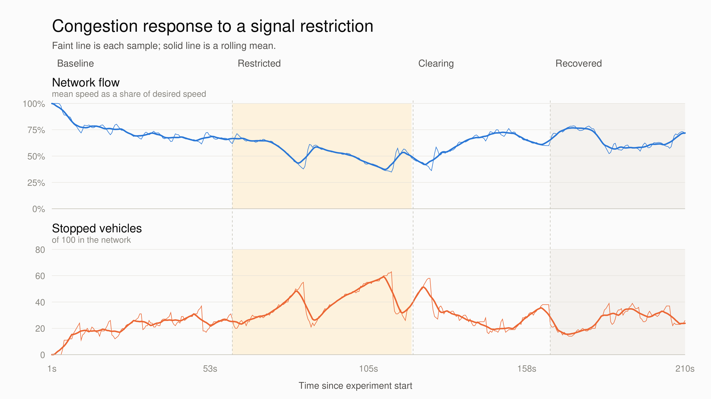
EMERGENT BEHAVIOUR
Congestion forms — and clears — on its own
One signal plan is swung to starve an axis across all 16 junctions, then biased back to work the backlog off.
WHAT THE RUN SHOWS
68% → 45%
network flow, baseline to the deepest point of the restriction
63 of 100
vehicles stopped at once at peak queue
66%
flow recovered, back to baseline
Flow keeps falling for 11 seconds after the restriction is lifted.

Slide 6
WHERE IT GOES NEXT
Known limits, and what closes them
KNOWN LIMITS
ROADMAP
No rerouting. Vehicles pick a random successor at each junction. A blocked route stays blocked.
No lane changing. One slow lorry holds up everything behind it.
Hundreds, not thousands. Actor-based, so ~500 vehicles at 3.4 ms.
O(N²) neighbour search. Deliberately unoptimised until it is the dominant cost.
No pedestrians or parking. Junction approaches are single-lane.
1
Congestion-aware routing
Per-lane cost and successor choice that avoids blocked routes. The single largest improvement available.
2
Lane changing and overtaking
Needed before routing is fully useful.
3
Spatial partitioning
Lifts the practical ceiling past a thousand vehicles.
4
Editor tooling
Junction placement and signal-phase authoring in the viewport.
5
Multi-lane approaches
With turn-restricted lanes.
Actor-based, configured in the details panel, and inspectable when something looks wrong — for the many projects that need believable street traffic rather than city-scale crowds.

Slide 7
THE ASK
$40,000, mapped to the roadmap
Allocation | Delivers | Amount | Share
Congestion-aware routing and lane changing | Roadmap 1–2 | $17,000 | 42.5%
Spatial partitioning, editor tooling, multi-lane | Roadmap 3–5 | $11,000 | 27.5%
Demo content and sample project | Ships with the plugin | $4,000 | 10%
Documentation and tutorials | Ships with the plugin | $3,000 | 7.5%
Fab submission and community launch | Distribution | $2,000 | 5%
Testing, infrastructure and software | Ongoing | $2,000 | 5%
Contingency |  | $1,000 | 2.5%
Total |  | $40,000 | 100%
Delivered over six months, in the roadmap order above. Everything the grant funds is released under the MIT licence — free to the Unreal community, with no revenue share and no exclusivity.

