Slide 1


Layer-Wise Contrastive Learning for Graph Collaborative Filtering
Charles Tian、Changlong Zheng、Yonghui Yang、Le Wu、Meng Wang
Hefei University of Technology, School of Computer and Information Multimedia Laboratory
*As this is a working paper, some details have been omitted

Slide 2
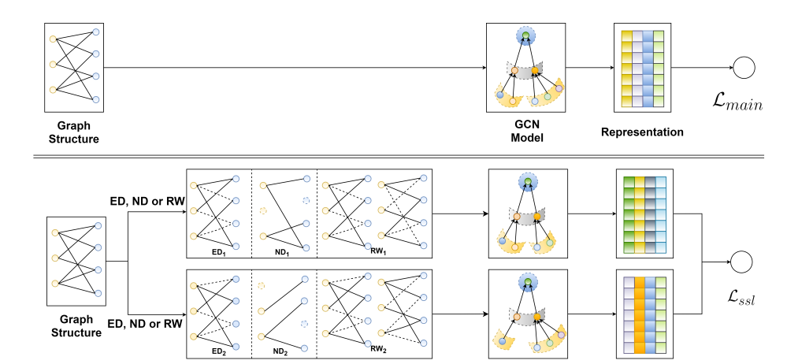
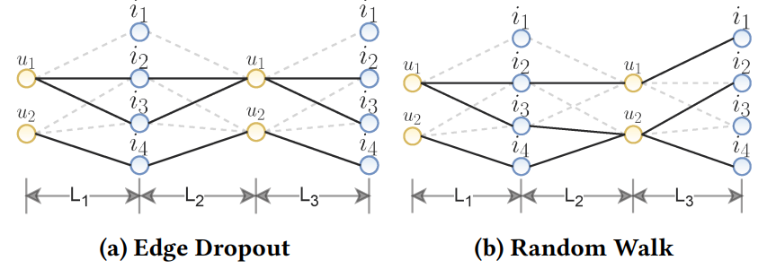
Backgrounds
Collaborative Filtering(CF): The most foundational recommendation paradigm
However, it suffers from data sparsity and popularity bias
A promising solution: Graph Contrastive Learning
Traditional Data Augmentation
Traditional Self-Supervised Framework for CF
Contrastive learning works a lot! Why?

Slide 3
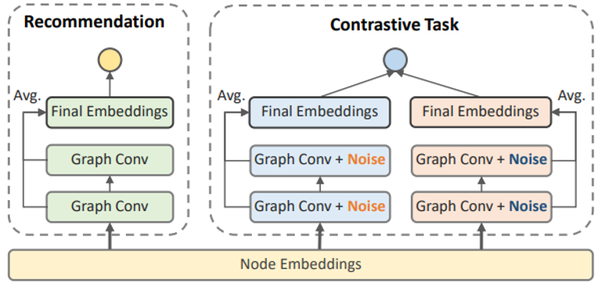
Backgrounds
InfoNCE-based contrastive learning operates by learning more evenly distributed user/item representations, which performs well.
They argue that traditional data augmentation has very limited effectiveness, so they developed a augmentation strategy by simply adding random noise in each layer(i.e. feature-level augmentation) to achieve this target.

Slide 4
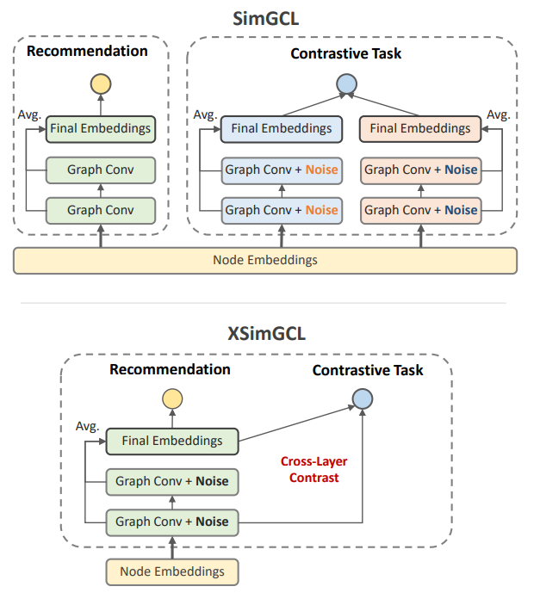
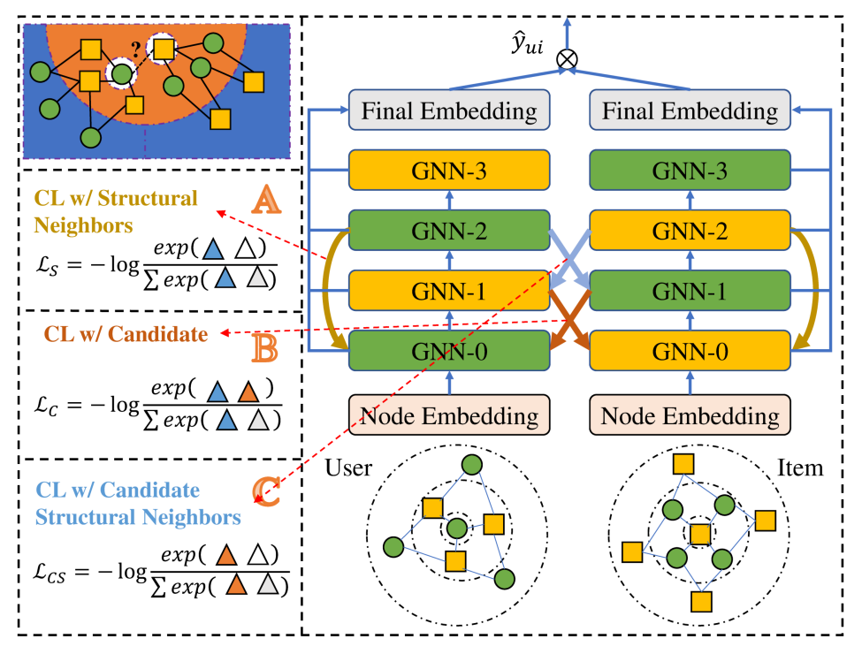
Motivation
Diverse cross-layer contrastive learning
Motivation: can we design a novel contrastive way to learn more even distribution?

Slide 5
Methdology
Layer-wise contrastive learning for collaborative filtering

Slide 6
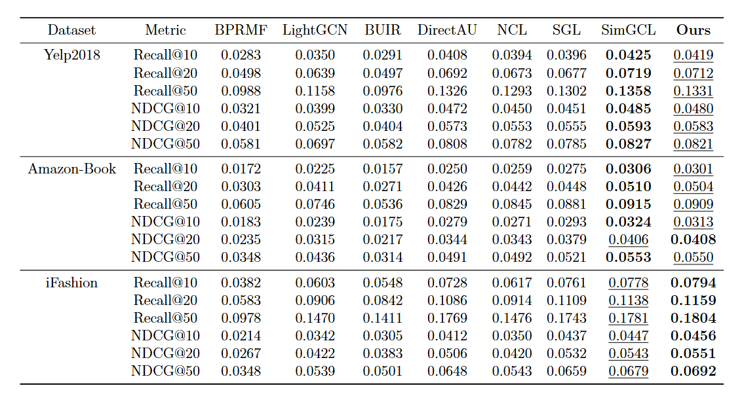
Experiments
Main Experiments

Slide 7
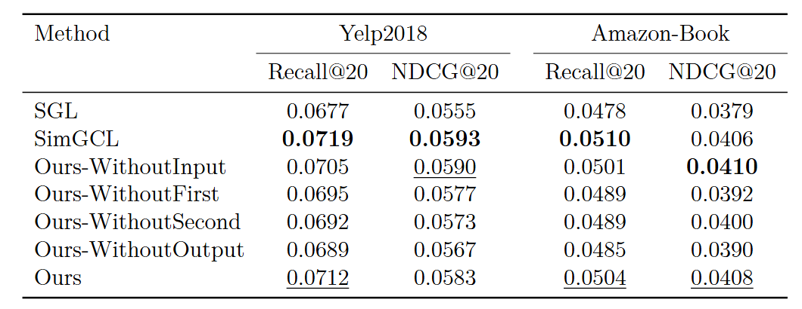
Experiments
Ablation Study

Slide 8
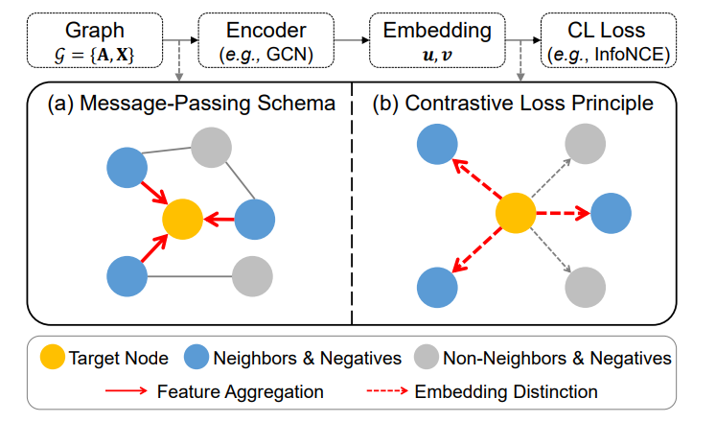
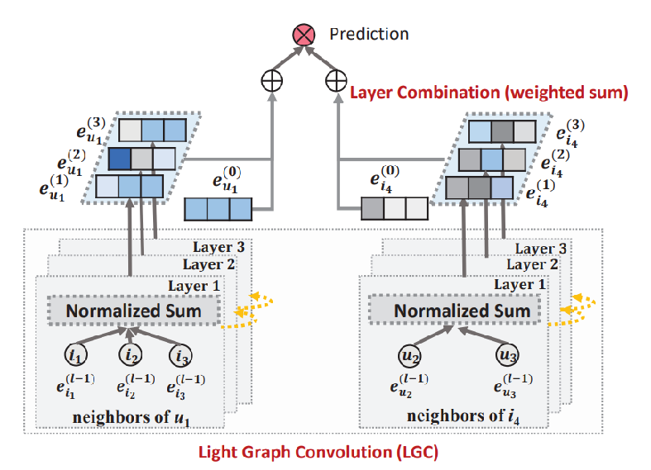
Conclusion
Results:
We found that directly applying layer-wise contrast can achieve a similar effect to adding uniform noise, further demonstrating that the effectiveness of contrastive learning lies in making embeddings smoother.
Future Work:

