Slide 1
MS Studios Analysis for Creative Direction and Timeline
Zeth Abney

Slide 2
Summary
Exploratory analysis of profitability and public appeal of a film as it relates to the genre and release date
Determine best target release date based on specific business needs
Determine best genre to produce in based on branding needs
Understand how these determinations will affect financial and brand success

Slide 3
Outline
Business challenges
Data acquisition and analyses
Observations
Conclusion

Slide 4

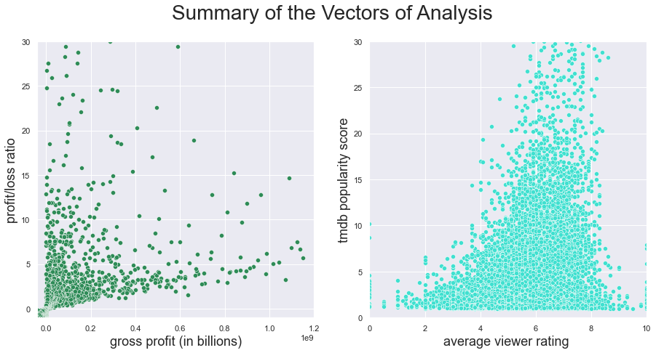
Business Challenges
No data for MS Studios available
Specific goals guide which metric to use
Determine a performing genre and release date based on historical data

Slide 5

Data acquisition and preparation
The dataset measuring financial performance comes from thenumbers.com, after initial cleaning contains nearly three thousand titles
Data used to measure public appeal comes from tmdb (the movie database) after initial cleaning there are nearly 13,000 titles
A dataset from imdb is mapped to the principal datasets to acquire the genre(s) associated with each title.
Data is prepared for plotting and analysis by grouping the titles by genre and by month of the year and removing lean categories.

Slide 6

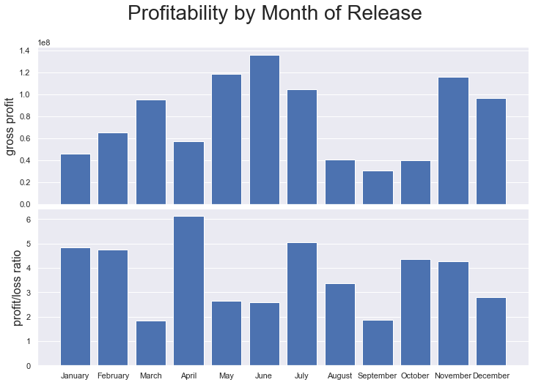
Observations
Timing matters… mostly regarding profits
Need high returns? April, July or January.
Need lots of volume? Mid-summer or late November

Slide 7
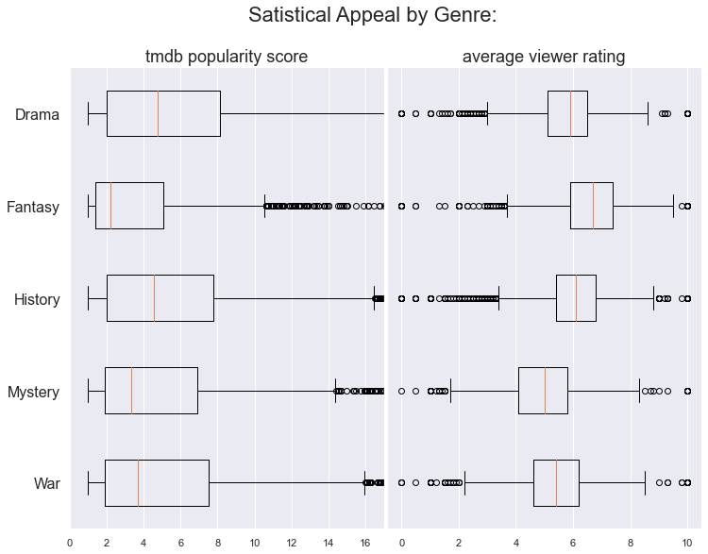
Observations, contd.
Looking to build a long-lasting fanbase? Focus on drama or history.
Need to make a great first impression? Fantasy or history.

Slide 8

Conclusion
To maximize gross profit and make a big first impression on debut, release a fantasy flick in the month of June.
To build long-lasting brand by maximizing ROI and developing a loyal fanbase, release a period-piece drama in April.

