Slide 1
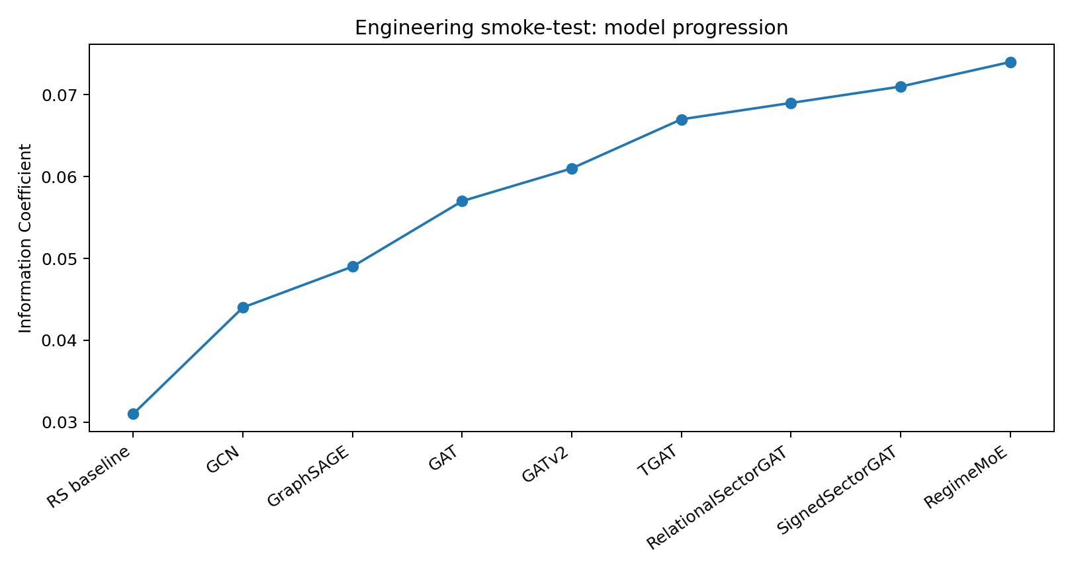
01 Temporal Graph Sector Rotation Network
Rank NSE sectoral indices by relative-strength gain/loss conditional on regime. Core principle: direction over price; explanation over black-box ranking.

Slide 2
02 The Cross-Sectional Question
Given the prevailing regime, identify sectors gaining relative strength and sectors losing it. Output = ranked sectors + edge-level rationale + uncertainty state.

Slide 3
03 Why Static Correlation Fails
Static correlation is symmetric, averaged across regimes and dense. The target system must adapt to structural breaks, asymmetric lead-lag and sparse informative relationships.

Slide 4
04 Data Universe & Feature Stack
14 intended sectors + Nifty 50/500 + USDINR + 10Y Gilt + Brent. Features: 5/21/63/252D momentum, RS, volatility, beta, breadth, valuation, macro sensitivity.

Slide 5
05 Graph Construction
Hybrid prior graph + learned attention. Candidate edges: Pearson, partial correlation, mutual information, Granger lead-lag and flow/co-exposure.

Slide 6
06 Architecture Progression
GCN → GraphSAGE → GAT → GATv2 → TGAT → EvolveGCN → Relational/Signed → RegimeMoE. Complexity survives only if ablation supports it.

Slide 7
07 GAT / GATv2
Attention assigns different weights to different neighbours. Multi-head attention creates several relationship views; GATv2 provides more flexible query-dependent attention.

Slide 8
08 TGAT + Time Encoding
Learned time encoding is injected into node representations so attention depends on state and recency. Compare adaptation speed around structural breaks.

Slide 9
09 Dynamic / Heterogeneous / Signed Graphs
Relational edges: correlation / lead-lag / flows. Signed edges: positive / negative channels. Dynamic edges: top-k similarity from current embeddings.

Slide 10
10 Uncertainty & Conformal Decision Rule
Act only when sector is top-k by mean score, inside conformal set, and below max predictive variance. Otherwise retain benchmark weight.

Slide 11
11 Edge-Level Explainability
Three primitives: attention extraction, GNNExplainer, counterfactual edge ablation. Stability: Kendall tau, top-k persistence, attention entropy.

Slide 12
12 Validation & Ranking Metrics
Primary: cross-sectional IC. Secondary: Rank IC, NDCG@k, top-k hit rate, ICIR. All reported under expanding-window time-series CV.

Slide 13
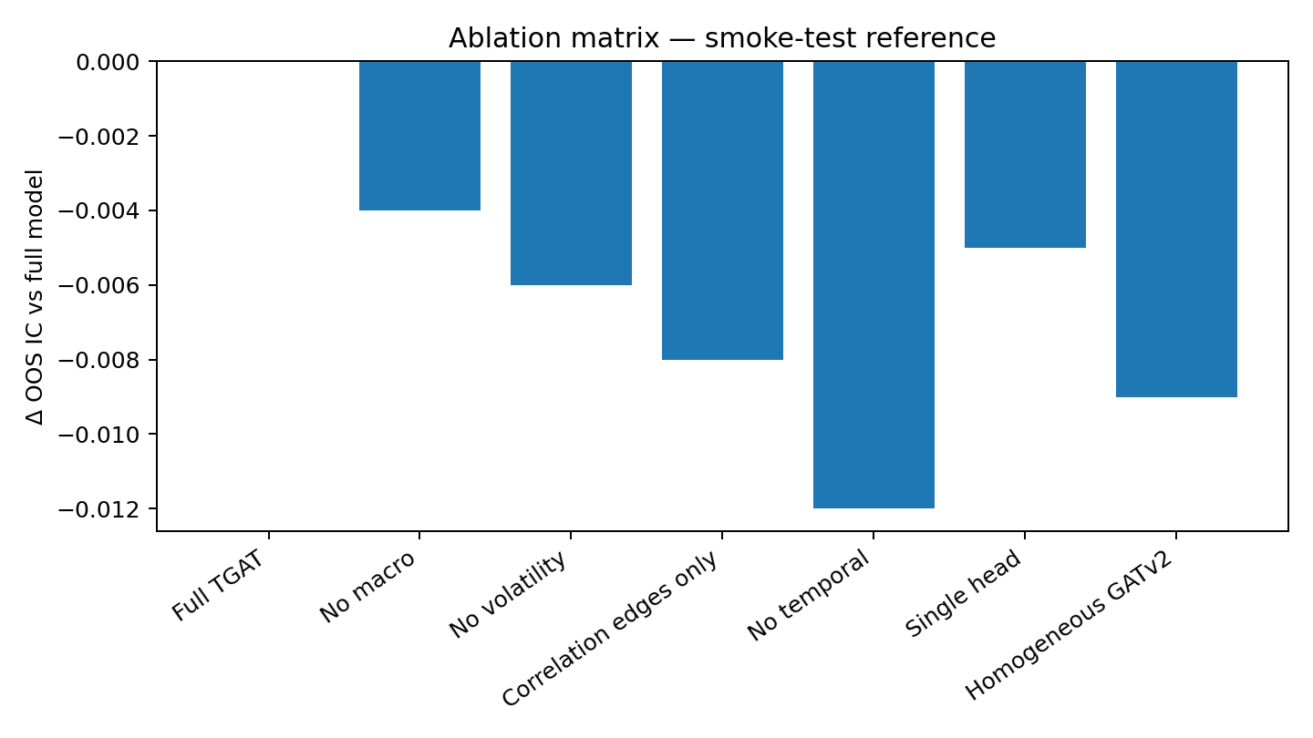
13 Ablation Programme
Remove macro, volatility, edge types, temporal encoding, extra heads and heterogeneous structure one at a time. Re-measure OOS IC on identical folds.

Slide 14
14 Adversarial & Structural Stress Tests
Noise perturbation + edge perturbation. Structural tests: IL&FS decorrelation, OOD regime, liquidity-shock isolation, contagion-path tracing.

Slide 15
15 Case Study Framework
IL&FS 2018, 2020 IT rerating, 2023–24 PSU Bank cluster, 2024 election, 2013 Taper Tantrum. Test attention reassignment, not only returns.

Slide 16
16 Overlay Backtest & Costs
Top-k / linear / concentrated overlays. Report after-cost CAGR, active return, tracking error, IR, drawdown, turnover, sector and regime attribution.

Slide 17
17 Sector Compass Simulation
Eight levels from RS Ranker to Regulator’s Choice; stress-test mode replays historical rotations; coach mode reviews explanations.

Slide 18
18 Audit-Ready Handover
Six mandatory deliverables plus 10-minute video. Model registry stores data hash, configuration, code commit, seed, attention lineage and post-trade attribution.

