Slide 1

Travel Tool
Weekly Report: 4/2/2021 – By Rudolph Hanzes, Gregory Bittinger, Kaleb Piper, Jacob Johnson, and Robert Minerd.

Slide 2


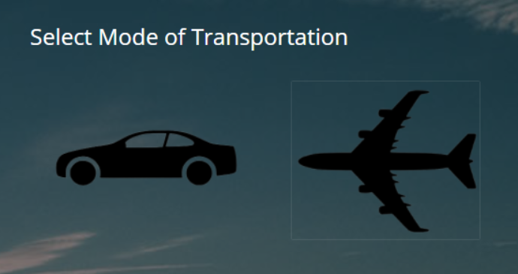
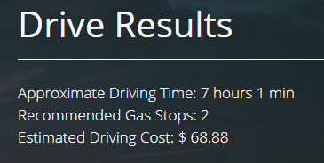
Summary
This week, our team worked to add an estimated driving cost for the driving option and made the hotels able to be sorted alphabetically or by price. We’ve also made an example final cost page as well as a few format changes.

Slide 3
Accomplishments For The Week
We investigated how to add a “hotel stop” portion of program into the website and browsed through various APIs. There was a google API that seemed like it would work, however at the current stage of development it would likely take too long to implement properly.
To move forward on the pricing elements, the cost of driving had to be implemented, and now calculates what it would cost on average for a user to drive to one city to another.

Slide 4
Accomplishments For The Week
We have also added in sorting for the various hotels that are available, and the user can now sort through them alphabetically or by price.
An example version of a final cost page has been made and is currently just to show what a final version could look like.
In addition, we have added a few more tweaks to the design of the website, for example we have made the choice for driving and flying into pictures of a car for driving and a plane for flying.

Slide 5
What Problems Were Encountered?
We found a cause for the “No Rooms Remaining” issue for the hotel API, and that cause is that most of the hotels do not have that portion of the hotel object, which causes the error. We may either remove that section of the hotel tab, or perhaps change what the table displays when an object cannot be found.
The hotel table did not seem to be working on the flight results tab for one of our team members, but when another member went to fix it, it worked. More troubleshooting may be needed to ensure this tab works properly.

Slide 6
Team Progress Alignment with Gantt Chart
This week we planned to start the budgeting portion of the project, and to work towards that goal, we had to implement an estimated cost for the driving portion of our website. We have also added sorting for both the flights and hotels, and can sort by price, which can allow the user to pick what they would prefer. Our plan is to have the user add what they want to their trip, so we can store the price for the final estimated cost which will display on the user’s trip tab.

Slide 7
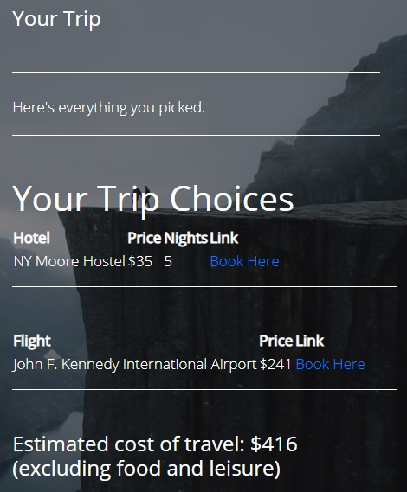
Plan for Next Week
Now that we have the estimated cost for driving and sorting by price working properly, we can move forward on totaling a final estimation amount to display on the final trip tab. The picture is to show a potential version for this “Your Trip” tab.

Slide 8
Member Contributions
Rudolph Hanzes: Rudolph worked on formatting and presentation of text by organizing text and drop boxes to be aligned and more organized. He also worked with Robert on creating usable images to replace the flight and drive text buttons for aesthetic appeal.
Greg Bittinger: Greg began planning the budgeting portion of the project. He created a "Your Trip" page that displays all the choices of hotels, flights etc. that the user has chosen for their trip, and the final estimated price. He has also began writing code to allow the user to add flights and hotels to their travel plan.
Jacob Johnson: Jacob worked to add an estimated cost of driving calculation as well as the hotel table sorting processes to the website, and researched APIs that could work for hotel stops.
Robert Minerd: Robert helped Rudolph with some more formatting on the website. He also helped add images as buttons for the driving and flying options.
Kaleb Piper: Kaleb completed both the documentation and presentation for this week and assisted in the format changes for this week.

