Slide 1

Travel Tool
Weekly Report: 4/16/2021 – By Rudolph Hanzes, Gregory Bittinger, Kaleb Piper, Jacob Johnson, and Robert Minerd.

Slide 2


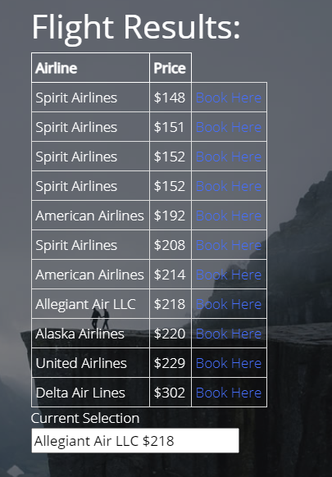
Summary
This week, our team added loading icons, implemented various formatting changes, and completed the storing data portion of the Your Trip tab.

Slide 3
Accomplishments For The Week
We have implemented a loading icon for the flight data, as sometimes the API takes a little while to load.
We have added a small set of basic instructions on the about page for users that may not know how to operate the website, as well as a few changes to the home page.
The continue button does not load until the user picks two destinations and dates to travel.
We have gotten halfway done with the Your Trip Tab, when the user selects which flight/hotel they would like, the data from their selection is stored for later use and will be displayed on the Your Trip tab.

Slide 4
What Problems Were Encountered?
The flight API does not work on some runs, either throwing a 404 error or another error like it, and this could just be that the API was temporarily down or perhaps we have overlooked a small error in our code, but we are confident that it will be fixed by next week.

Slide 5
Team Progress Alignment with Gantt Chart
We are nearing the final stages of the project, and we are confident that we will be on time completing it. All that there is left to do is some bug fixing, finishing the Your Trip tab, and possibly a few layout tweaks and our project should be complete.

Slide 6
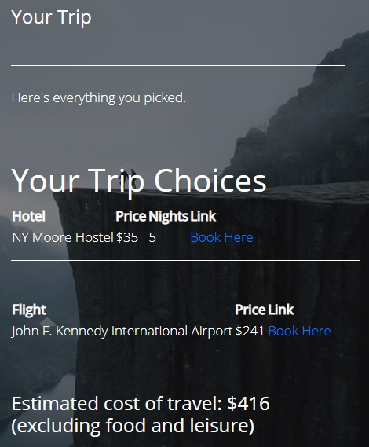
Plan for Next Week
Our plan for next week is simply to finish what we started by completing the user manual and finishing the remaining aspects of the site like the Your Trip tab.

Slide 7
Member Contributions
Rudolph Hanzes: Rudolph Hanzes worked on editing and adding in the loading gif, he also worked on some formatting for various pages. Added a small set of basic instructions on the about page and changed up the home page as well. Finally, Rudolph disabled the continue buttons until the required data has been entered.
Greg Bittinger: Greg worked and received help from Jacob to add selection options for the hotel results. He also continued work on the Your Trip page as well as fixing HTML in the results pages.
Jacob Johnson: Jacob assisted with the addition of the loading icon. He also created a selection process for the tables on the information page. Some error checking was also added to the flight results.
Robert Minerd: Robert assisted with adding the loading gif, he also made the sort buttons on both the flight and hotel results look clickable to the user.
Kaleb Piper: Worked on the Travel Tool User Manual as well as completed the documentation and presentation for this week.

