Slide 1

Travel Tool
Weekly Report: 3/19/2021 – By Rudolph Hanzes, Gregory Bittinger, Kaleb Piper, Jacob Johnson, and Robert Minerd.

Slide 2


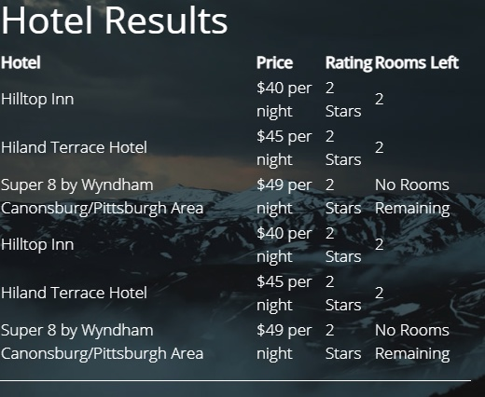
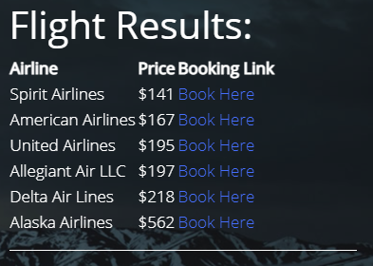
Summary
This week, our team worked more to implement the input and output for both new APIs on our site, including both the flight data and hotel APIs. Some formatting was also changed but is not final.

Slide 3
Accomplishments For The Week
This week our team accomplished:
Displaying several different airlines, along with the price of each airline.
Additionally, for each flight result there is now a link to where the flight can be booked.
A rudimentary display of the hotel data, with the name of the hotel, price per night, star rating, and rooms remaining is now working.

Slide 4
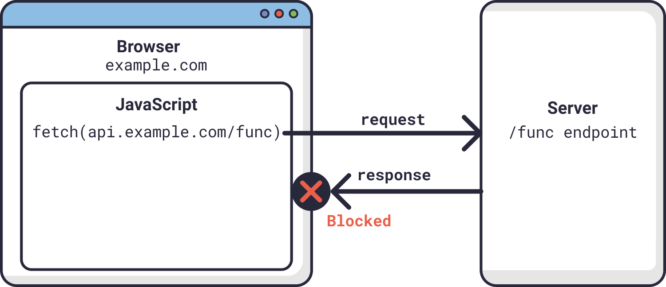
What Problems Were Encountered?
One problem with the flight API was with the cross-origin resource sharing (CORS) policy. This issue made it so that we were unable to fetch the required data from the flight API when using the website. At that point we were able to access the API data only through a certain port when the program was run locally. When trying to push the change to the website, the following error occurred:

Slide 5
Team Progress Alignment with Gantt Chart
We are still aligned with our Gantt chart, as this week we accomplished getting most of the inputs and outputs for both APIs working properly.

Slide 6
Plan for Next Week
For next week, we will continue working on the input and output for both APIs, like sorting through different results based on price and ratings for the hotel API.

Slide 7
Member Contributions
Rudolph Hanzes: Rudolph helped to start the input process for the hotel API, as well as formatting the input on the website.
Greg Bittinger: Greg worked on displaying the results for the hotel data, including hotel names, price per night, star rating, and rooms remaining. He also began implementing user data input for the hotel results and began to work on sorting results based on different parameters such as price and rating.
Jacob Johnson: Jacob worked on the displaying the results for the flight data. This included selecting one ticket for each possible airline and displaying them alongside a URL where the user can purchase the ticket. Also began work on sorting the results based on price or alphabetical airline names.
Robert Minerd: Robert started to work on some formatting for the user input page to attempt to make the website have a cleaner look.
Kaleb Piper: Kaleb completed both the documentation and presentation for this week.

