Slide 1

Travel Tool
Weekly Report: 3/26/2021 – By Rudolph Hanzes, Gregory Bittinger, Kaleb Piper, Jacob Johnson, and Robert Minerd.

Slide 2


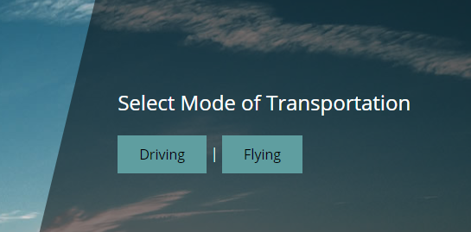
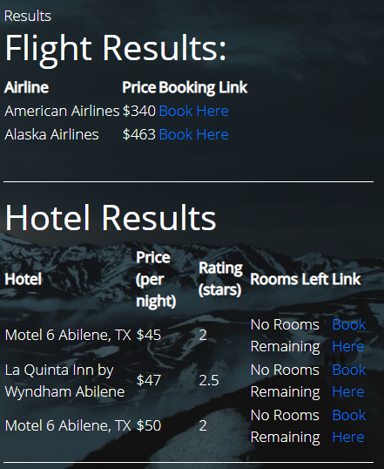
Summary
This week, our group was able to fix the CORS policy issue and was able to push the new flight data API to the website. We also separated the driving and flying options on the website. Along with this, we finally added the hotel API into the website.

Slide 3
Accomplishments For The Week
This week our team accomplished:
The previous issue of the website not being able to fetch the flight data has been resolved by using a CORS proxy. This proxy attaches the required headers to the fetch request and in turn allows the API results to pass through the block that our website was making. This was implemented using a cloud service called CloudFlare, that allowed us to set up a worker with a small script to attach the CORS headers. The only necessary change to our code was prefixing our API’s URL with the URL for the worker on the cloud.
Example: https://test.cors.workers.dev/?https://httpbin.org/post

Slide 4
Accomplishments For The Week
This week our team accomplished:
The driving and flying options are now separated on the website, as the user will likely not want to drive and fly at the same time.
Hotel data input and output is now on the website for both the flying and driving options and has a basic method of linking to a google search using the hotels name.

Slide 5
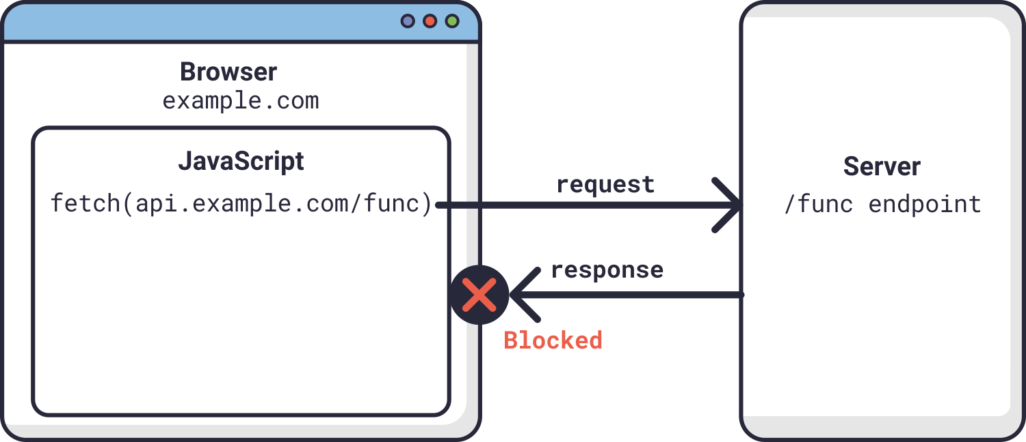
What Problems Were Encountered?
We still had some issues getting things to work properly with the flight data API and CORS policy, but as mentioned previously that was resolved using a CORS proxy. The hotel data gave some issues when pushing the code, as multiple members of our team were using the GitHub desktop to edit it, and the issue was resolved by all members refreshing their repositories to the most recent version. We also were not able to get links to certain hotels, so instead we worked to build a link that will automatically link a google search using the hotel’s name.

Slide 6
Team Progress Alignment with Gantt Chart
This week was supposed to be focused on the formatting user interface design, but instead was mainly focused on testing data retrieval and website functionality. So, we may be behind on the design of the website but have made up for it by working on future parts of the project instead. The user interface design will likely be put on the back burner until we know for a fact all the parts of the program we would like to have displayed on the final version.

Slide 7
Plan for Next Week
The plan for next week will involve doing a major part of our original objective, which is to provide combinations of flights and hotels that would be under a budget provided by the user. The user would enter a certain budget, and the website will show certain combinations of flights and hotels that would be less than or equal to that budget. In this manner, the overall price for these combinations will also be shown so the user will know how much they will have to pay. After this is accomplished next week, we will return to formatting the website in the following weeks and make it look as sleek as possible.

Slide 8
Member Contributions
Rudolph Hanzes: Rudolph worked on various formatting issues within multiple pages as well as assisted with the discussion and development of the future data input/results format.
Greg Bittinger: Greg implemented user input hotel data and output tables for both driving and flying option pages.
Jacob Johnson: Jacob worked on the CORS policy issue and was able to resolve it by using a CORS proxy. He also split the user input pages into two separate pages, one for driving and one for flying. Lastly, he helped formulate a plan to create combinations based on user budget.
Robert Minerd: Robert worked on formatting for the website and helped figure out how the input and output information should look in the final version.
Kaleb Piper: Kaleb completed both the documentation and presentation for this week and helped to plan the final look of the website.

