Slide 1
Loan Management System BY Bat4ch 4, Team 2
DHAIRYA SHAH
SHASHANK MISHRA
ARYAN GUPTA
VAIBHAV RAJ SAHNI
SHIVAM KUMAR
MIHIR JOSHI

Slide 2
Sub divisions of LMA
Loan Management System
Admin interface
User Interface

Slide 3
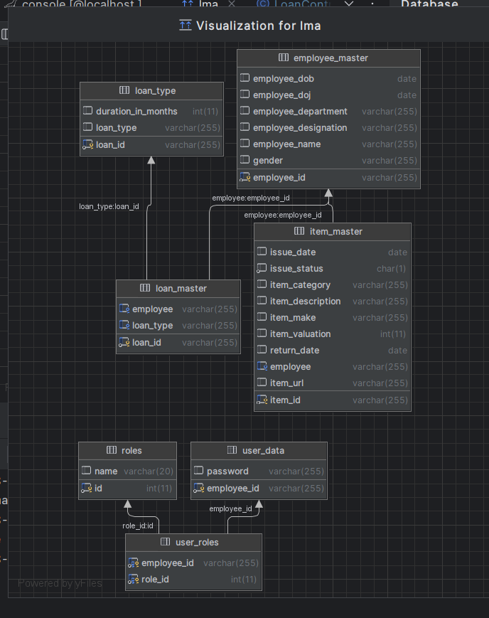
database schema

Slide 4
Admin functions
Item Master Data: providing CRUD functionality to add items and allow them to be available for issue to employees.
Loan Card Management: performing the basic operations to add, edit or delete the loan cards
Customer Data Management: adding employee details and the ability to add, edit or delete an employee profile
Admin Login: including login functionality and verifying permissions via the JWT token

Slide 5
Login functionality
Backend :
JWT token to get role as ROLE_ADMIN and verify credentials from Database
Providing the /login page with access to all.
Credentials are type checked and validated.
Frontend :
Sign in button to redirect and send POST request and get back JWT token.

Slide 6
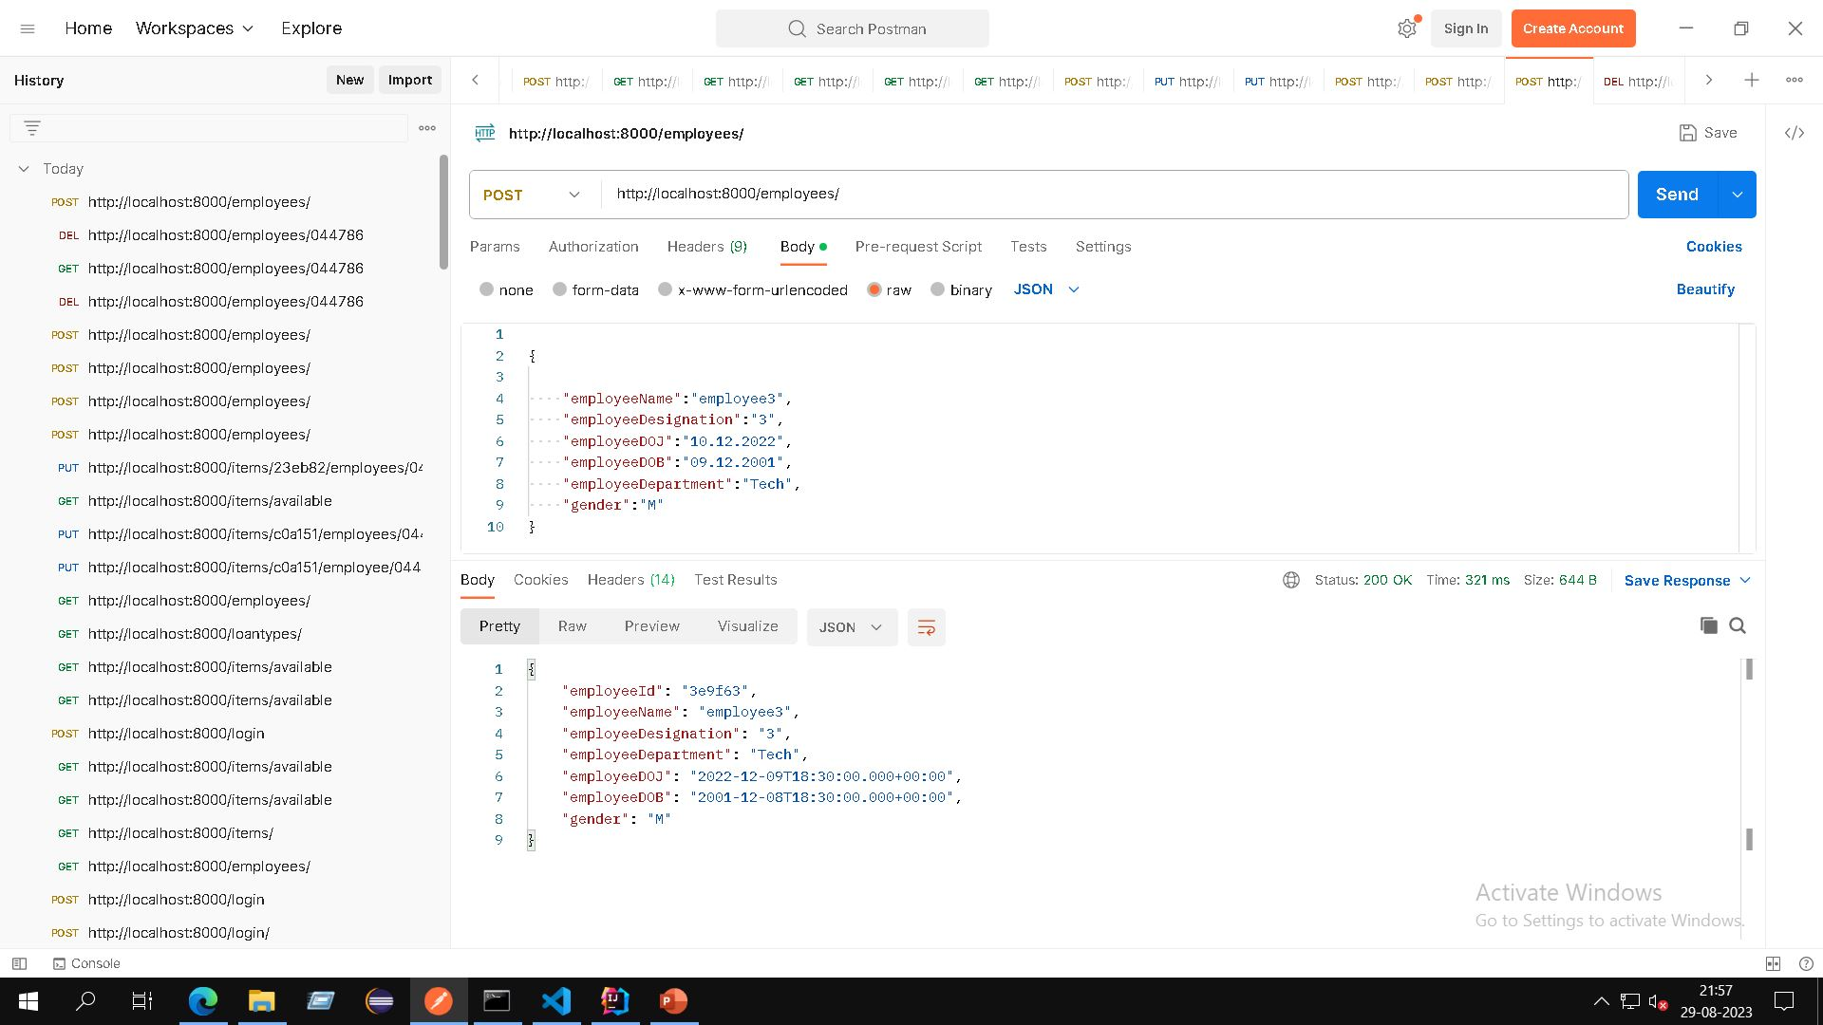
Post employee request

Slide 7
Loan Card management
Admin creates a loan card type with category name and duration
Employee applies for a loan by selecting from a list of available items, the category, return date ,issue date is automatically filled
The user can now see the item and its details in the issued items list.

Slide 8
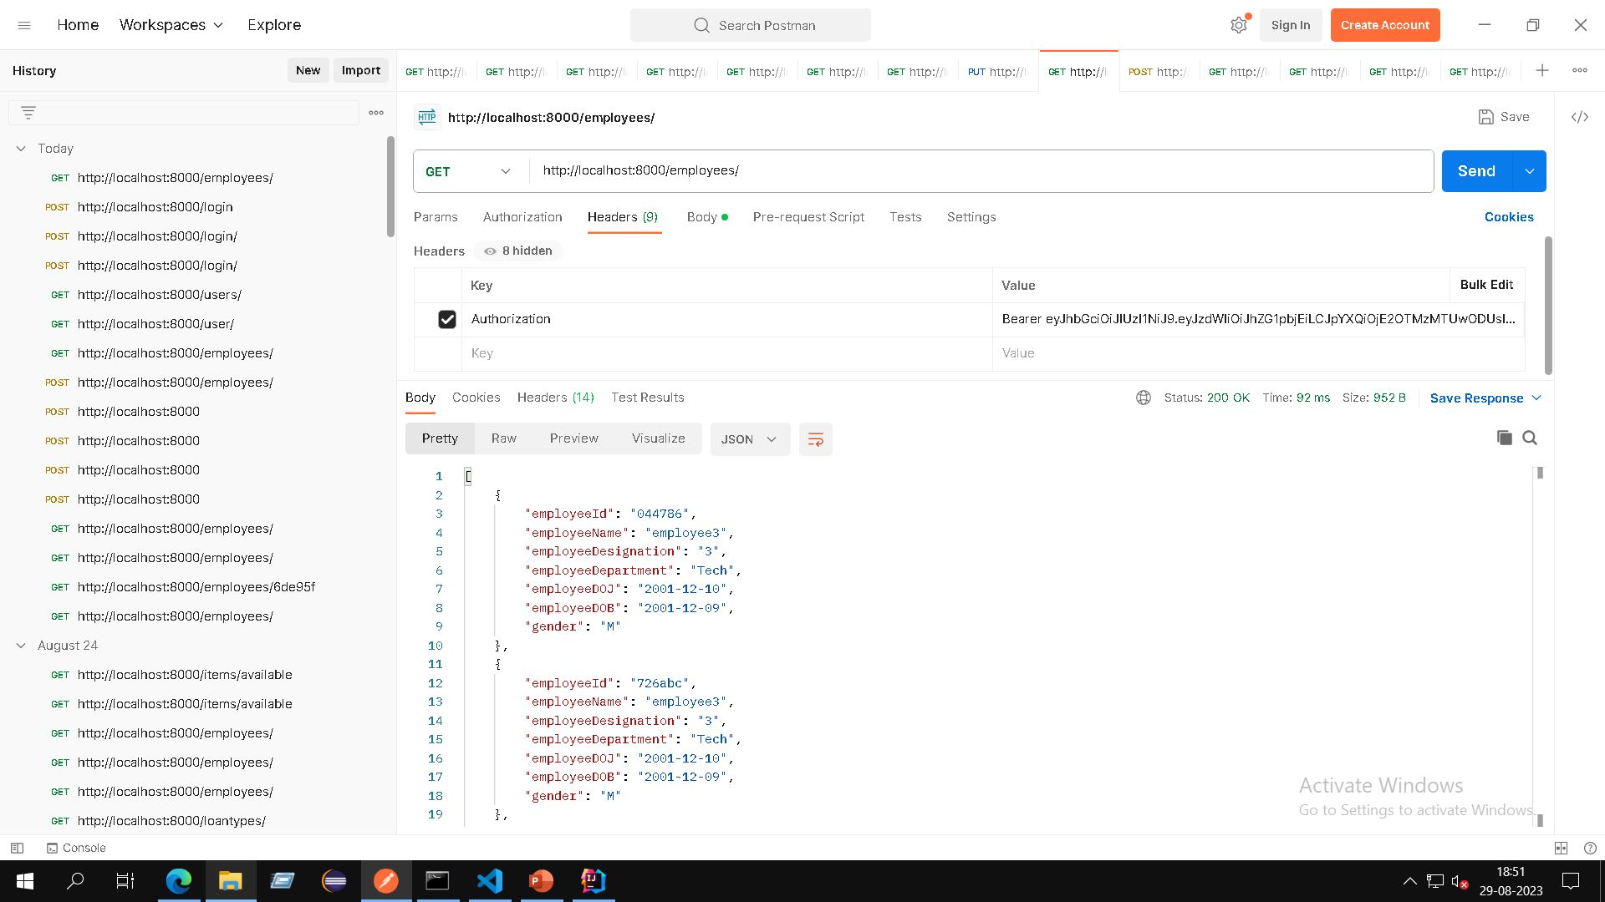
get employees request

Slide 9
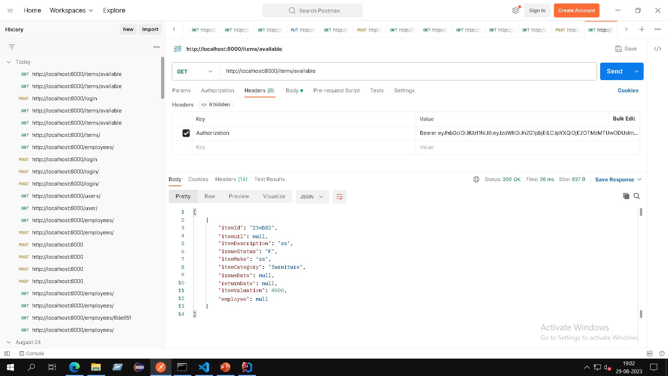
get Items available request

Slide 10
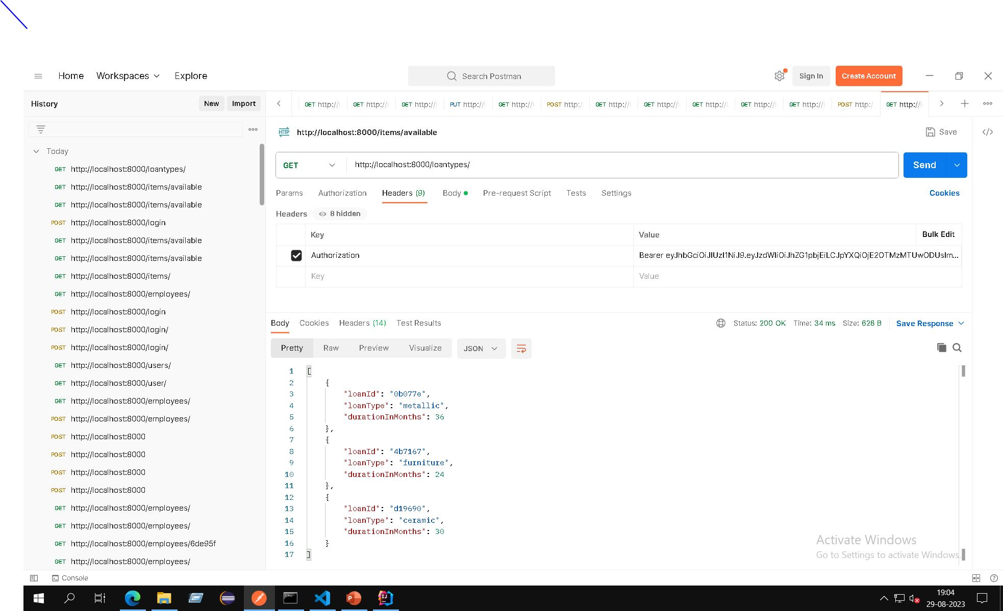
get loan types request

Slide 11
Item management
Admin adds an item
User issues an item
User may de-issue an item or admin may modify the item.

Slide 12
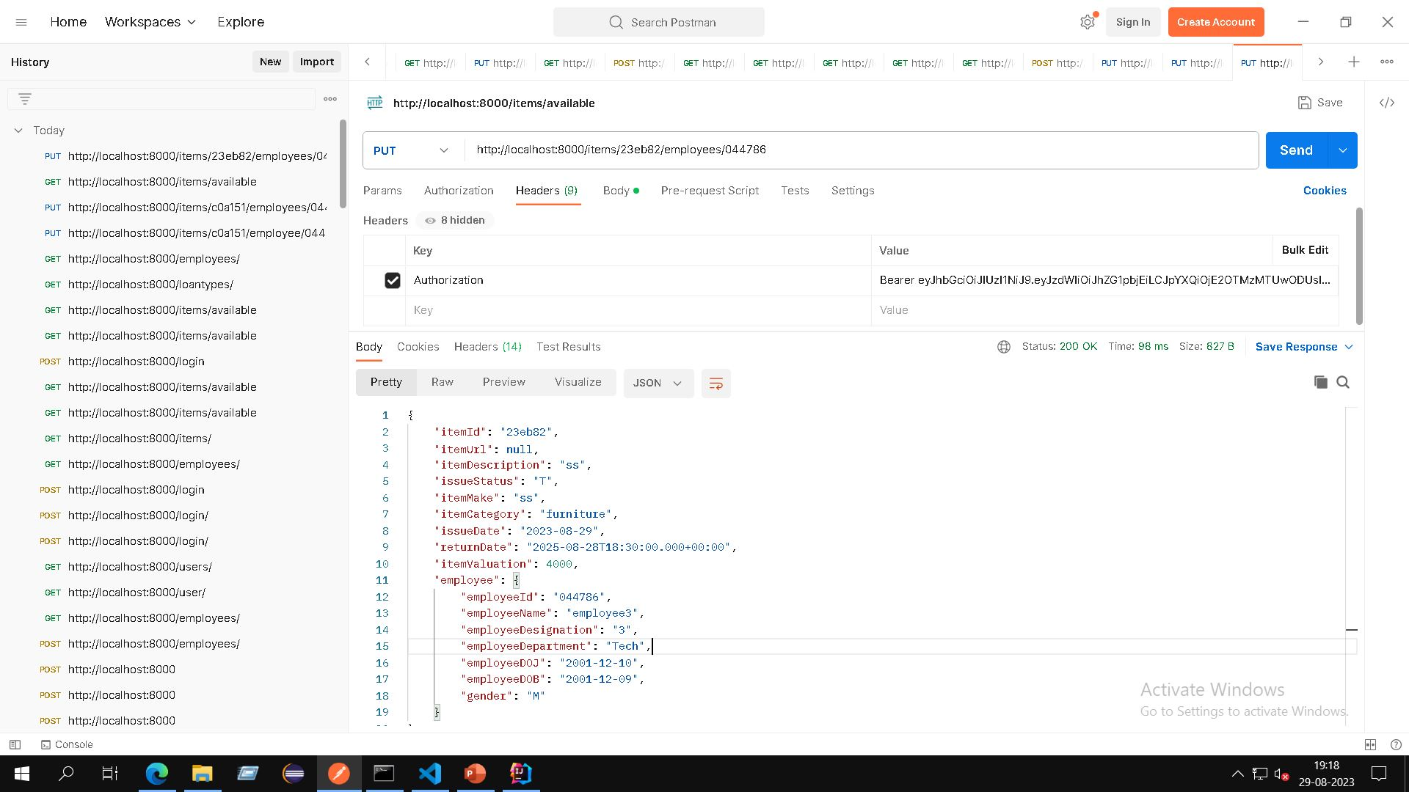
Put item to employee request

Slide 13
CUSTOMER DATA MANAGEMENT
Employee data
User originally created by admin
Editable by both admin and employee
Password set by user while signing up
Deleted by admin

Slide 14
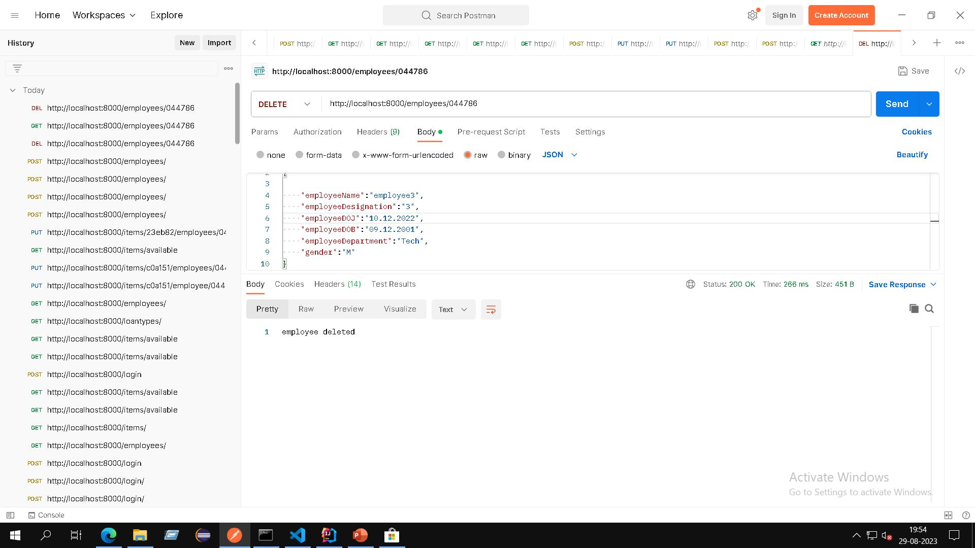
Delete employee request

Slide 15
Item master data
Admin creates a loan category and adds items which are by default available for issue
User selects an item and applies for a loan, the item becomes issued to that user and a loan ID is generated.
The loan card as well as the item is visible to the user. The item details can be edited by the admin.

Slide 16
Implementation DETAILS
A simplified Database schema with greater independence between the components and at the same time being able to fetch all the required details.
Validation and testing at all endpoints to ensure no unauthorized access as well as concurrency for the update and delete operations.
User friendly dashboards with easy access to all the functionalities.

Slide 17
Future work
Adding functionality such as viewing items by groups and creating a cart to add multiple items at once.
Further optimization of the database for faster querying.

Slide 18
Challenges

