Slide 1
CIS 240 : Final Project
Turning Amsterdam’s AirBnB Data Into Intelligence For Business Optimization
By - Kathan C Thakkar (30873032)

Slide 2
Amsterdam Listings (AirBnB Provided .CSV)
Source :- http://insideairbnb.com/get-the-data.html (October 2020 listings.csv for Amsterdam)
This data is published by the AirBnB Data Analytics team after cleaning it up fairly well. However there is still discrepancies that arise since they use essentially the same database structure for all cities and states across the world. For example, I am using Amsterdam data, where the neighborhood group table placeholder is all NULL, where as the same placeholder has data if you download Austin, TX data. The Amenities is full of list of amenities for every single listing, so we would have to group them together using complex coding before we can use that row of data. The neighborhood table in the Amsterdam data has addresses rather than just the neighborhood area name. When we visualize, we should utilize the host neighborhood table if we wanted to just group the output by neighborhood, because that is the most concise data point here. (Compared to other available).
There are also tons of listings without any reviews on them, so it is hard to gauge exactly how well they are for their price (there are very expensive listings with essentially not a lot of reviews to go on)

Slide 3
What does this data consist of?
The data consists of host information, as in what the host ID, name, host status, does the host have a profile picture, etc. This is all dimensional and not measures. The host status (superhost), profile pic (t/f) are simply boolean values. This part of our dataset gives us a rough description of the host whose property we are going to visualize. We can use SQL and populate tables to view this data alongwith the visuals we will be creating later on.
The dataset also contains information on each listing, linking it back to it’s host. It includes what neighborhood, what price, what amenities, how many bedrooms, how many bathrooms, etc. for each listing (unless left blank by listing owner). We will utilize average reviews and average price for neighborhood, host status, property type (alongwith average bedroom count and bathroom count) to create a bubble like visual. This is extremely powerful and can give us a very nice brief overview what type of neighborhood/property type is maximizing utility for consumers as well as our business. (We can choose to boost profits by hammering down and expanding the well performing areas and listings, or we can choose to maximize customer satisfaction by improving on areas with bad feedback comparatively)

Slide 4
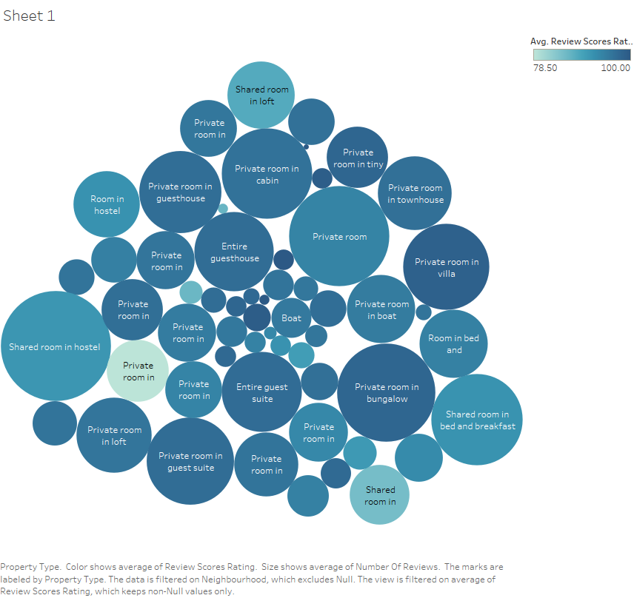

Slide 5
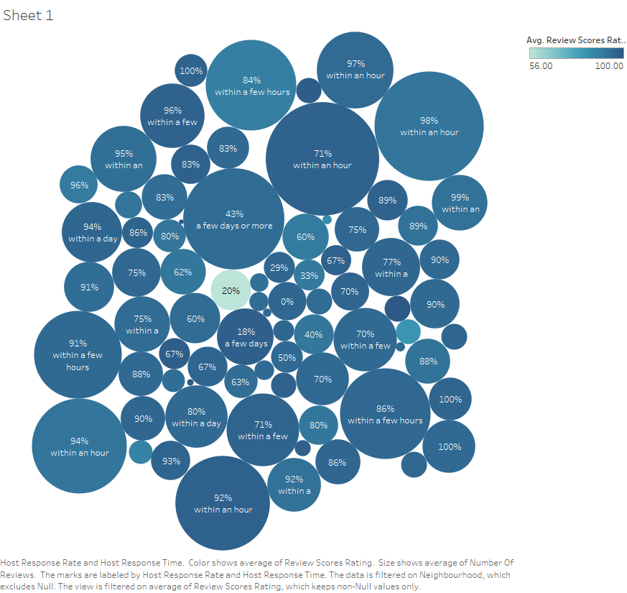

Slide 6
Shortfalls of Tableau on my 13” Macbook
Tableau visuals are meant to be viewed in real time for maximum information (labels, details are more clear when you can hover over them and view what exact details that particular spot has on the map, we will see later on that latitude longitude visual on AirBnB data looks a little too hard to decipher, but I promise it is very useful and powerful in making robust business decisions when explored on Tableau framework live-time)
You can see in my previous two visuals the bubbles are too small for my screen to show the full label, this would be fixed and you would know exactly what bubble represents what when you hover over it.

Slide 7
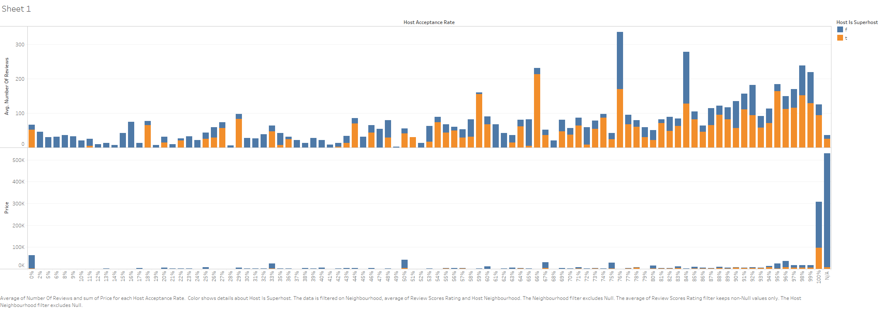

Slide 8
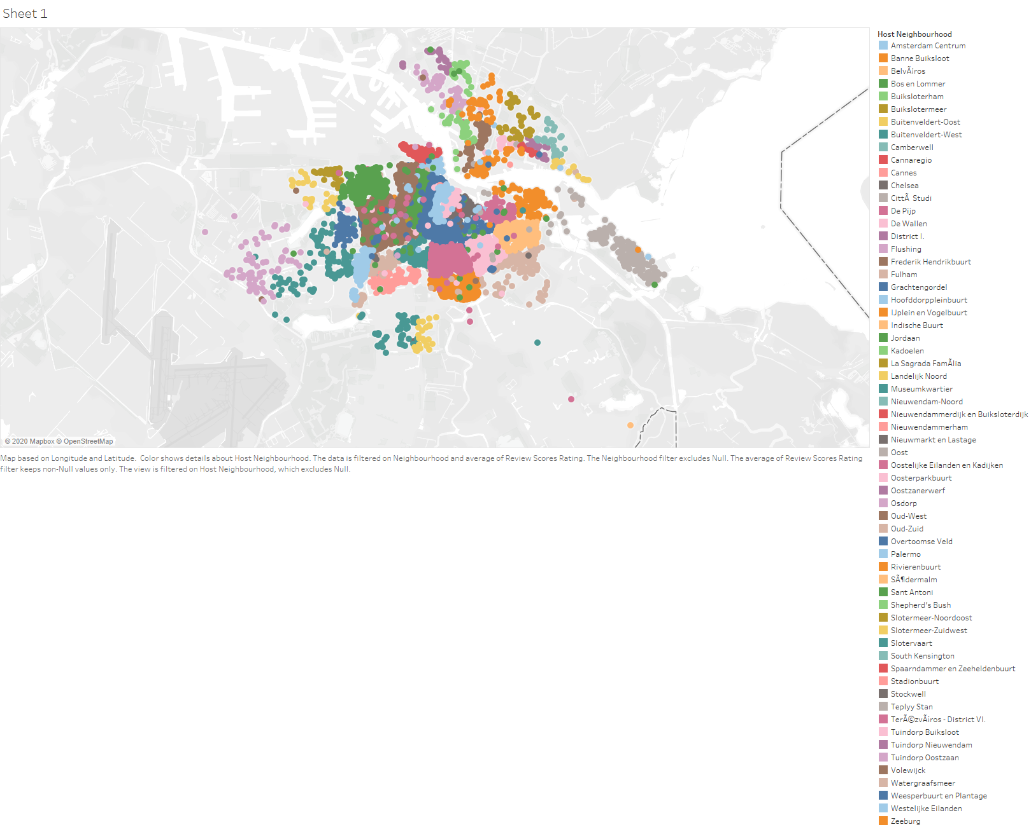

Slide 9
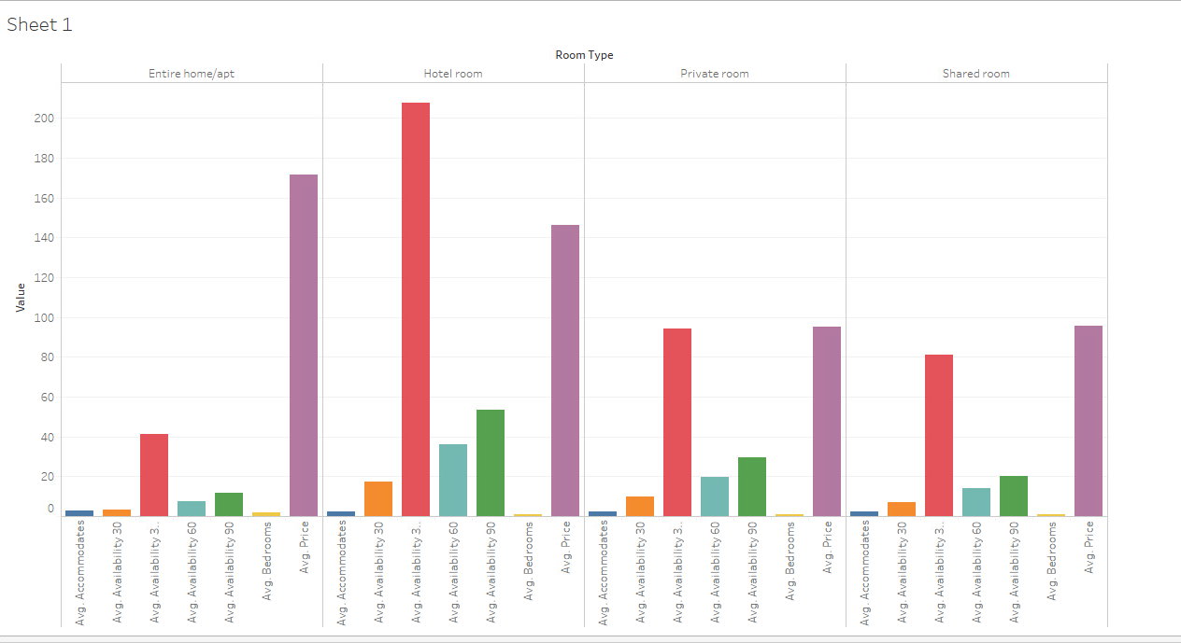

Slide 10
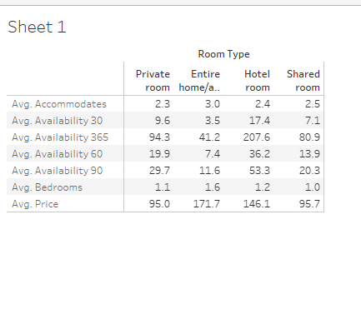
A little background the last visual^
This visual is generated using this table of data. I dragged all the measure values and then grouped by neighborhood area (here is where I discovered there is only NULL values in neighborhood area), so I then changed it from neighborhood area to just grouping the data via property type.
The avg rooms is not really clear so here is the table of values for more insight.

Slide 11
The Data Cleanup
I cleaned up the data using excel filtering where if the values were NULL, I replaced it with Amsterdam (for region), however, this does not really make any difference in the visuals (it just makes it so that null values are not returned)
If there was no review score, I added an average score (as in 2.5/5) to start off the property. We can make this a little complex by analyzing it with a benchmark score and then basing the average review score off of that (I talk about benchmark scores later on)
The data has lot of null values where the review scores were not given. You can view this on the visual in slide number 7. This is what led me to clean the data. I have left the visual in there so you can see that the most pricy listings have no reviews (which is kind of natural, they probably don’t get booked as much)

Slide 12
Why would you visualize all this weird stuff?
Few slides ago, I talked about listings which are expensive but have no reviews, (or limited reviews), and suppose we see that listings with more reviews and an active host (response rate > 60%) yield into higher conversions (bookings). We could offer people who have previously stayed at the AirBnB to review it for some reward, or we can launch an AirBNB travel guide and hire some people who travel blog, or are connected in the travel industry to come review it for our holiday guide (for discounts or FREE)
I am visualizing response rate and time along with the Host’s listing average rating. This will help me gauge how much does the host response need to be for it to be optimal (so we can maintain it on a large scale by mixing up hosts in the specified neighborhood or region)
The bar chart with average statistics gives me an overview of the avg. utility that the consumer is assigning to the properties listed in a specific category. We see how entire homes and apt have historically less availability (AirBnB’s primary business model)

Slide 13
Why Visualize...Continued
The map shows me where there is maximum number of visits occurring (according to average reviews being higher) by people who engage. It also helps me gauge how much the host response rate helps towards that factor. (also, does them being a superhost make the size bigger, as in more reviews? We may be able to reverse engineer how AirBnB picks superhosts if there are multiple visualizations we can analyze)
When we visualized the map one more time, we visualized using average price as the size controller, and the review count as the color.
I also use property type data to make bubble chart which shows what property has the maximum review score (satisfaction, darkest blue and biggest bubble means the best). Now let’s look at some tableau visuals

Slide 14
What to do next?
I would want to know the average income per property, and then use the bubble chart again to size it using that. The color would be property type or the number of bookings done on average in a month. I thought about how to do this but failed. However, I think this would be an awesome visual in my opinion since we can gauge exactly how a property is doing directly by looking at the size and then the color can quickly tell us what type of property it is. I would also want to include the amenities in the label, so as to hovering over it would additionally tell us more info about it. Neighborhood description can also be added to the hover over details.
I would also want an AirBnB benchmark score for each property based on previous data and amenities for similarly priced properties. This would be fairly easy to do by regressing all the data of the amenities and salient features (assign them a point value score based off of surveying users what they value the most when booking), and assign an internal benchmark score to suggest properties to consumer based off of their previous bookings (what type of specific benchmark score they prefer)

Slide 15
Conclusion
AirBnB’s data set is really huge and complex, especially if you choose any major city in US like NYC or Austin. However, there was a little less complexity in the Amsterdam data in the sense that some of the attributes did not really contain data that made any difference (NULL values, etc.) AirBnB makes the most money from direct hosts according to this October data set. AirBnB listed hotels do worse than anything else. Being a superhost actually increases the odds of you getting a reply. (this visualization was done on map and it shows up really bad if I try to put it on here, but on tableau it is really beautiful, if you want to take a look, you can email me!)
-Kathan Thakkar (kthakkar@u.rochester.edu)

