Slide 1
Protocol Controlling System
Allan Landsberger
Andreas Hilmer
Stephan Nöhmeier

Slide 2
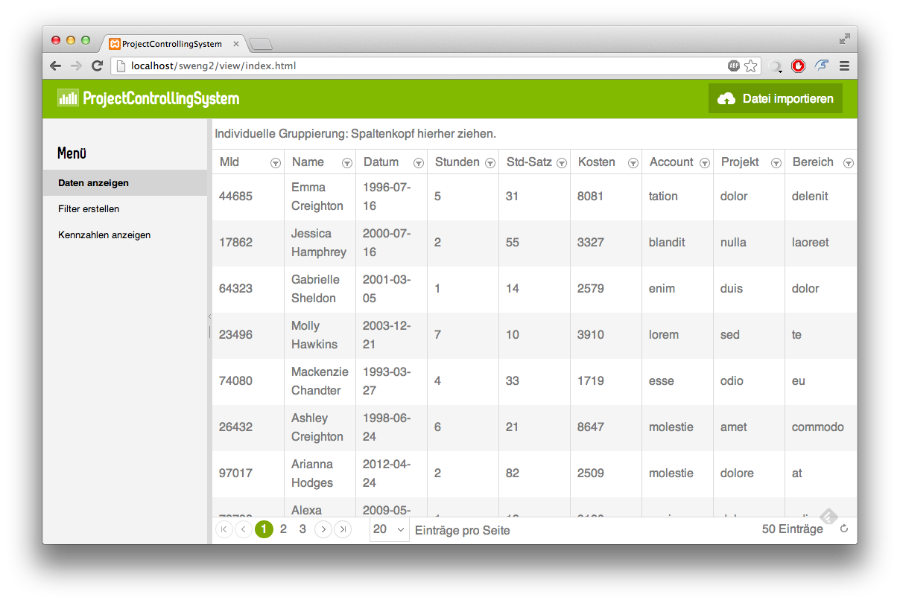
Mockup

Slide 3
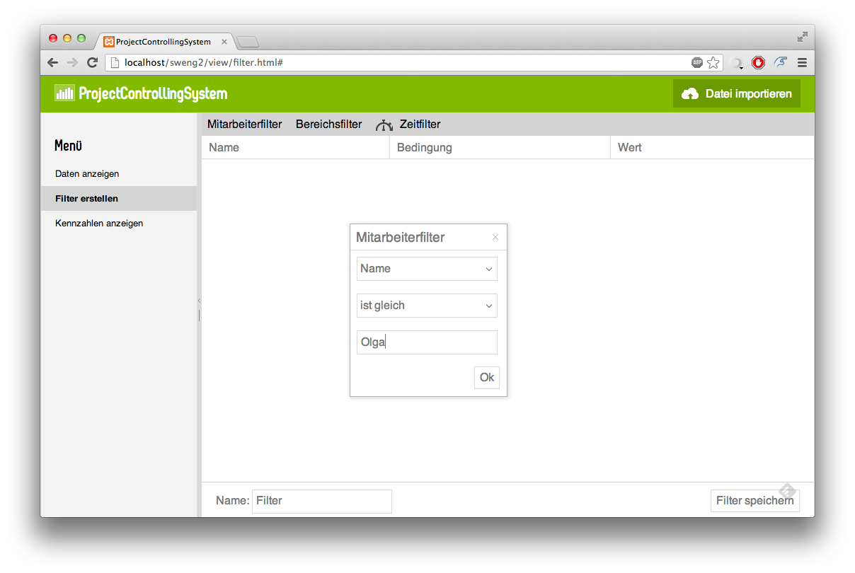
Mockup

Slide 4
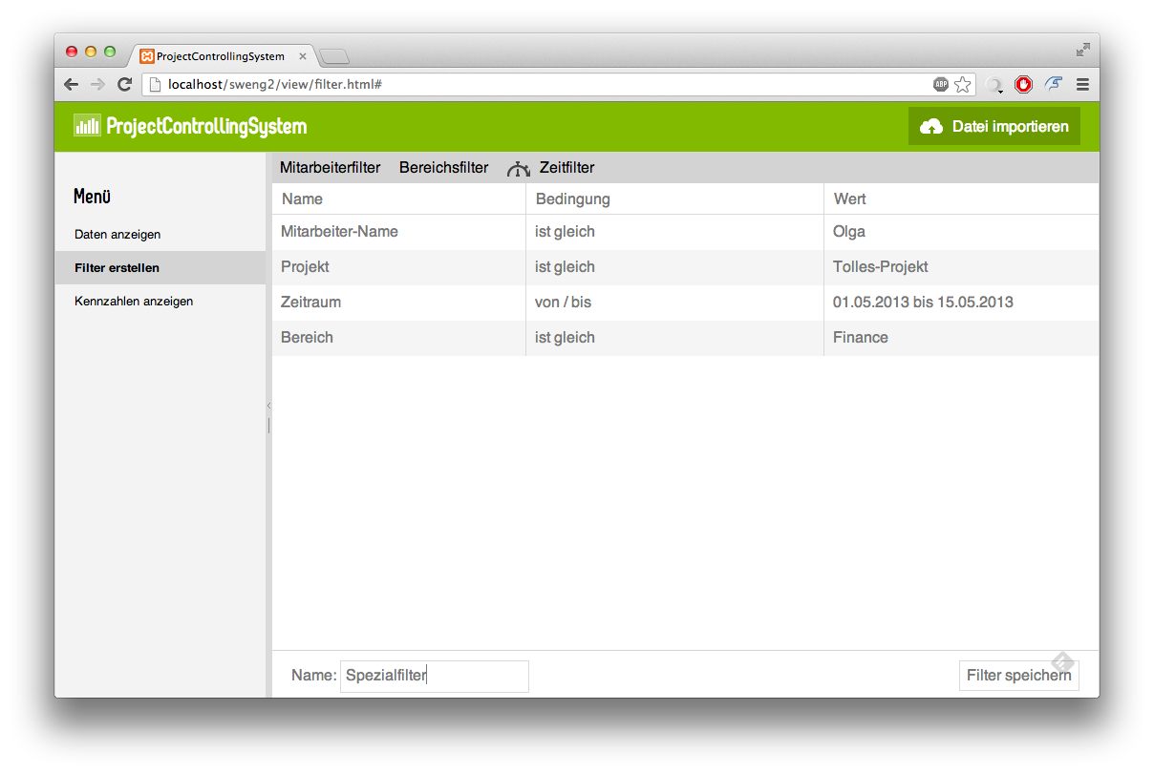
Mockup

