Slide 1


TinyOlap
VISUALLY
October 2021

Slide 2
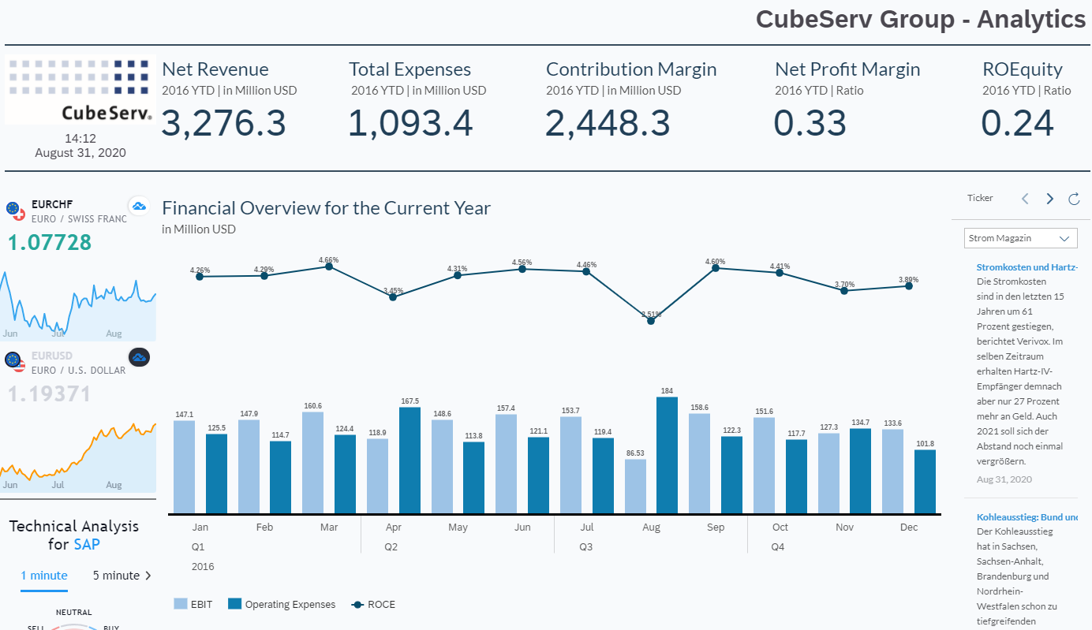
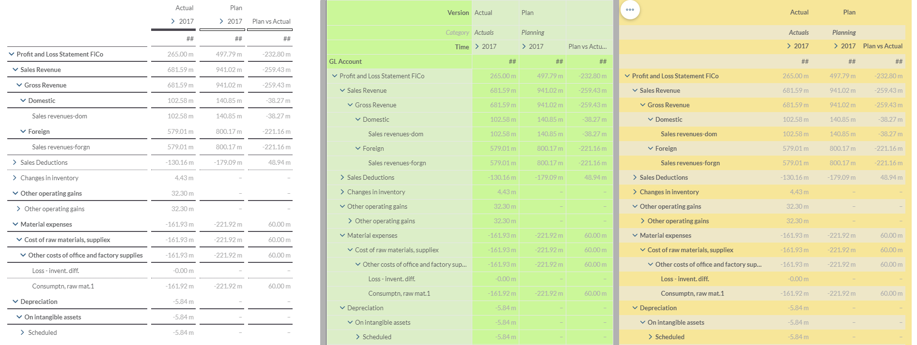
SPREADSHEETS Becomes WorkspaceS
SOMETHING NEW IS REQUIRED!
Reports haven’t evolved over the last decade. Nothing New!
Reason: visually, there is not much that you can change or that can be done dramatically better.
https://blogs.sap.com/2021/01/06/best-practice-dashboarding-with-sap-analytics-cloud-sac/

Slide 3
SPREADSHEETS Becomes WorkspaceS
SOMETHING NEW IS REQUIRED!
Basic requirements for a modern spreadsheet component:
Clean look, minimal chrome
Smooth and sexy anything. Elegant and minimalistic animations.
Cell based navigation, cursor on PC, finger on mobile devices.
Direct cell entry, start to type (as in Excel)
Fixed rows and columns (freeze panes in Excel)
Styles and stylesheets for easy adaptability
Q: How to behave with mobile devices? These growing in importance, size and resolution
Realtime updates (max. refresh cycle 500ms)

Slide 4
SPREADSHEETS Becomes WorkspaceS
SOMETHING NEW IS REQUIRED!
So, if we can not innovate how reports look like, we need to innovate how reports behave!
Going “mobile first”, but 100% mouse & keyboard ready.
The basic idea: “interaction with anything!”
3 principles for finger and mouse:
Tap or click to select.
2x tap or 2x click to take an action!
Swipe or drag to change context!
Long tap or Right click to go elsewhere!
1 ½ principles for keyboard:
1 – Start typing to change!
½ - Cursor navigation with arrow keys

Slide 5
SPREADSHEETS Becomes WorkspaceS
SOMETHING NEW IS REQUIRED!
Ideas – Swiping col header
Swipe header ‘2017’ move one year forward or backwards. Life Preview while swiping.
Swipe ‘Plan vs. Actual’ move one element forward or backwards. Life Preview while swiping. e.g. showing ‘Actual’, Plan’, ‘Plan vs Actual’, ‘Act vs Plan %’ or whatever is in the member list or subset. Same for ‘Actual’ and ‘Plan’ in column header.
After swipping & lifting the finger or mouse
after 2 sec. jump back to original report
After single tap: fix it (show a pin)
Reset a changed report? Shake your mobile phone or your mouse.

Slide 6
SPREADSHEETS Becomes WorkspaceS
SOMETHING NEW IS REQUIRED!
Ideas – Swiping row header
Swiping rows behave “totally” different!!!!
By dragging ‘Domestic’ over ‘Gross Revenue’ all figures will be shown as percent of the drag target ‘Gross Revenue’
By dragging ‘Domestic’ over the value cell 102.58. will make that cell = 100% and all others relative to that.
Maybe show also in-cell bars to also visually indicate the relations.
By dragging ‘Domestic’ out of the screen, it will be removed.
Reset a changed report? Shake your mobile phone or your mouse.

Slide 7
SPREADSHEETS Becomes WorkspaceS
SOMETHING NEW IS REQUIRED!
Ideas – Swiping row header
Swipping short fast within the cell = change to next/previos element in member list or subset
After swipping & lifting the finger or mouse
after 2 sec. jump back to original report
After single tap: fix it (show a pin)
Ideas – 2x tap row header
Expand or collapse the element.

Slide 8
SPREADSHEETS Becomes WorkspaceS
SOMETHING NEW IS REQUIRED!
Ideas – Swiping cells
Swiping slightly will show email-program alike red delete option.
Dragging cells on other cell will put them in relation. When the finger or mouse is down, then. The drag target is always the basis (=100%).
Long tap will change the visual style of the cell. You are now in copy mode (if supported by the underlying database configuration). When dragging and dropped the cells (it should be translucent), the value will get copied from source to target.

Slide 9
SPREADSHEETS Becomes WorkspaceS
SOMETHING NEW IS REQUIRED!
Ideas – Cells double tap
Double tab shows a visual/graphical cell context (not a boring normal context menu).
Focus should be on changing the value without typing. Some ideas:
Buttons for +1, +5, +10, +25% increase and -1, -5, -10, -25% decrease. E.g.: tap 1x +5 and 2x +1 to get 7% percent increase.
Provide a slider to change value, do meaningful rounding of values
Clear cells, or Lock/Unlock cells
Move backward / forward in history of cell values. Visually indicate from when and maybe whom these values are/were.
Share or comment.

Slide 10
SPREADSHEETS Becomes WorkspaceS
SOMETHING NEW IS REQUIRED!
Ideas – Cells collapse expand
For mobile only: Drilldown or roll up over the selected area only.

