Slide 1
Geometry prediction using GANs Initial Strategy
Parvez Mohammed
01.02.2021

Slide 2
Goal
Parameter
Control
Model
Vary
Process
Parameters
Press
Hardening
Process
Time/Labor
Expensive
Final
Geometry
Because it is tedious to experiment wether a set of process parameters produce a good part
Want to use Gans to predict the geometry for some set of process parameters
Vary
Process
Parameters
Geometry
Prediction
(Cheap)
GAN
Model

Slide 3
Why GANs?
Why use Gan instead of some surrogate model to generate images (in our case “Geometry”)?
It is really difficult to encode what we want from a model in terms of a loss function.
GANs can automatically learn the best loss function depending on the problem instance.
The Generator tries to draw better and better images so as to fool the Discriminator
The Discriminator tries to learn better loss function in order to best distinguish between real and fake
Hence the optimisation problem is now a mini-max game!
Notes:
Because there are plethora of different types of loss funcitons with many differernt variations to accomplish different tasks this step is extremely dificult.
It is often the case that the prediction with a very less is no that satisfactory
What if I told you there exists a magical way to automatically learn the best loss function?

Slide 4
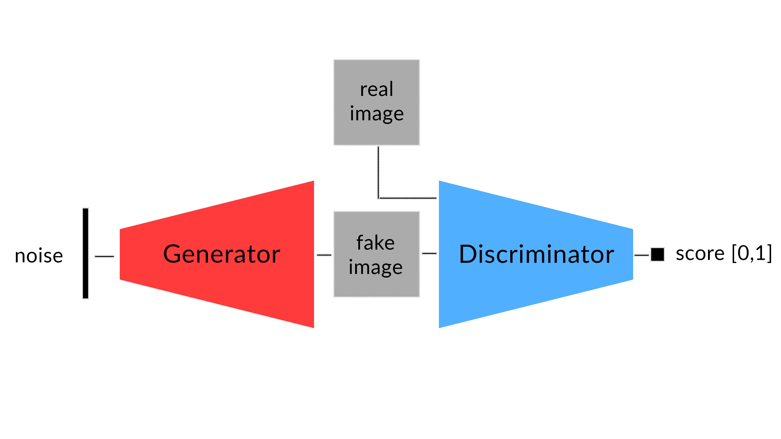
Traditional Gan
$\min_{G}{\max_{D}{V(D,G)}}=E_{x∼p_{data} (x)}$[$\log{D(x)}$] + $E_{z∼p_{z} (z)}[log({1−D(G(z)))]}$
[3]

Slide 5
Problem with traditional GAN
The Generator never sees the actual real images
Also, there is no direct relation between images produced by the Generator and the process parameters.
The Latent vector space (Random Vector) could be any features that the Generator feels as important and are not necessarily correlated with our process parameters.
We could use conditional GAN but in practice the Generator then only becomes deterministic and learns to ignore the randomized input.

Slide 6
Solution?
Use Pix2Pix Gan
It takes directly our process Parameters as input
It introduces a distance term in the loss function of the Generator
i.e. L1 norm between Real img and Fake img
Pix2Pix Gan
input
vector
[3]
$\min_{G}{\max_{D}{V(D,G)}}=E_{y∼p_{data} (y)}$[$\log{D(y)}$] + $E_{x∼p_{input} (x)}[log({1−D(G(x)))]}$ + $λE_{x,y}\text{[}\text{|}\text{y}\text{−}G(x$)|]

Slide 7
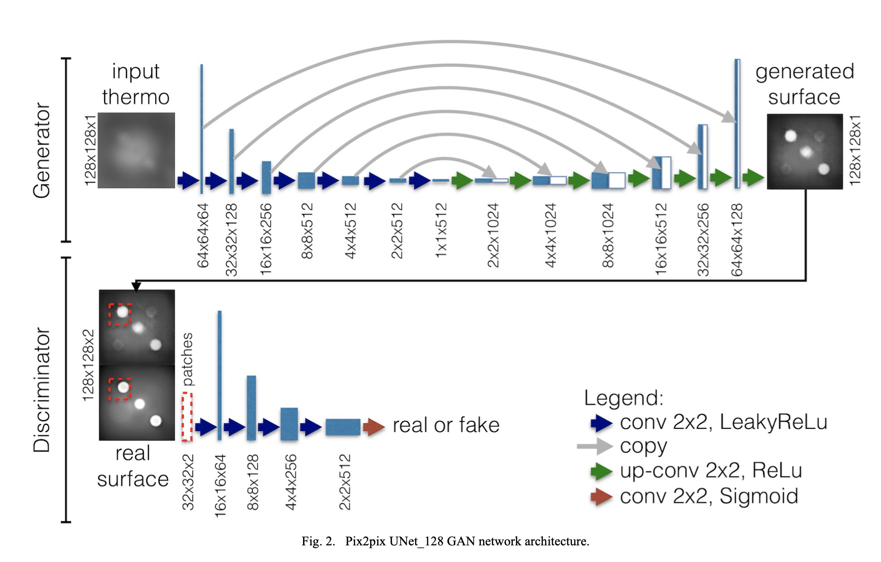
Pix2Pix Gan
Thus, the generator must fool the discriminator and minimize the L1 Manhattan distance with the real image
[2]

Slide 8
Modification of Pix2Pix
Why?
Our Experimental data is the process parameters and geometrical data of the deep drawn cups
But Pix2Pix is a Deep Convolutional NN which expects image data
How?
Use Fully Connected ANN model architecture for both Generator and Discriminator
Sneha’s (ANN)implementation looked promising with good predictions
Use residual shortcut gates to account for the copy layers in U-Net Gan

Slide 9
Proposed Architecture
Generator:
A FC ANN with encoder and decoder parts with residual layers in between
Discriminator:
Similar architecture (just the encoder part)
Just as L1 norm between real and images we can introduce L1 distance between real and predicted geometry
Training:
Could use Non-saturating or Wasserstein formulation
Adam or SGD optimiser
Train for ~100 epochs
Lr= 1e^-4

Slide 10
References
Image-to-Image Translation with Conditional Adversarial Networks
Generative Adversarial Networks for geometric surfaces prediction in injection molding
https://towardsdatascience.com/a-new-way-to-look-at-gans-7c6b6e6e9737

