Slide 1

Word Vectors
Zewei Chu
zeweichu@gmail.com
法律声明
本课件、大数据文摘x稀牛学院网站、社群内所有内容，包括但不限于演示文稿、软件、声音、图片、视频、代码等，由发布者本人和大数据文摘共同享有。未经大数据文摘明确书面授权，任何人不得翻录、发行、播送、转载、复制、重制、改动或利用大数据文摘的局部或全部内容或服务，不得在非大数据文摘所属的服务器上作镜像，否则以侵权论，依法追究法律责任。本网站享有对用户在本网站活动的监督和指导权，对从事非法活动的用户，有权终止对其所有服务。
课程合作请联系
info@bigdatadigest.cn
扫码添加客服进群交流
微信15510583366

Slide 2
目录
01
02
03
04
05
Text
Text
Text
Text
Text

Slide 3





Slide 4
Meaning
What is the meaning of a word?
How do we represent the meanings of word? Synonym?

Slide 5
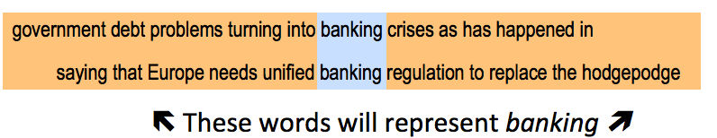
Distributed representation
You can get a lot of values by representing a word by means of its neighbors.

Slide 6
Neighbors to represent words
With co-occurrence matrix X.
Window around each word → captures syntactic and semantic information.

Slide 7
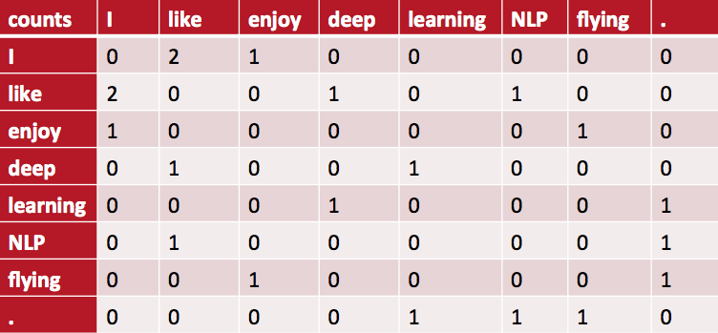
Neighbors to represent words
Example corpus:
I like deep learning.
I like NLP.
I enjoy flying.

Slide 8
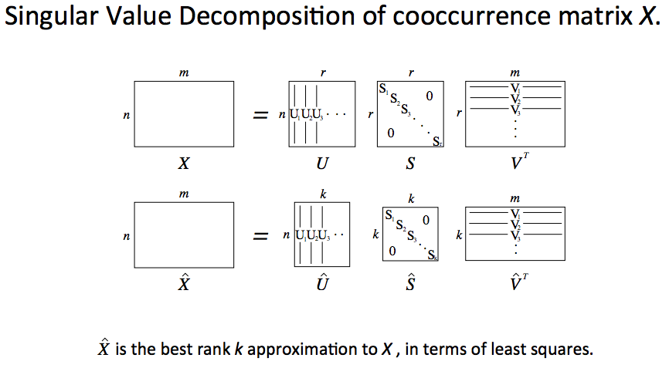
Dimension reduction on X

Slide 9



Slide 10
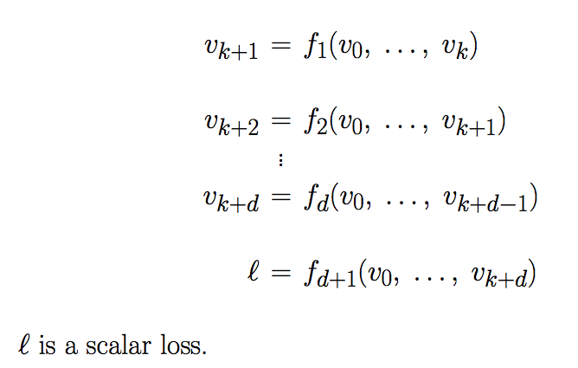
Feed-Forward Computation Graph

Slide 11
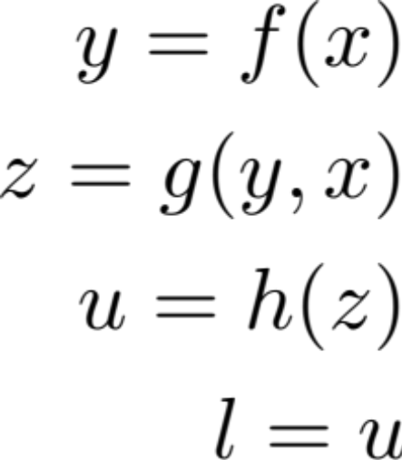
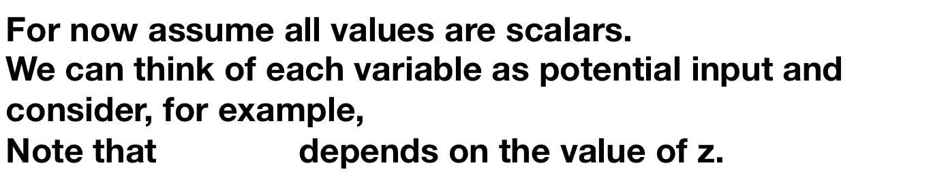

Backpropagation

Slide 12
Backpropagation

Slide 13
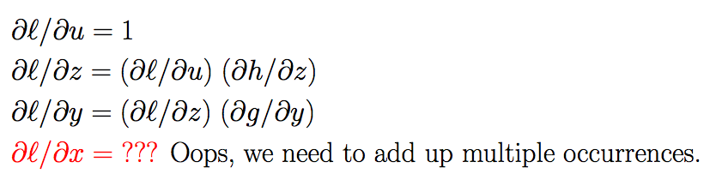
Backpropagation

Slide 14
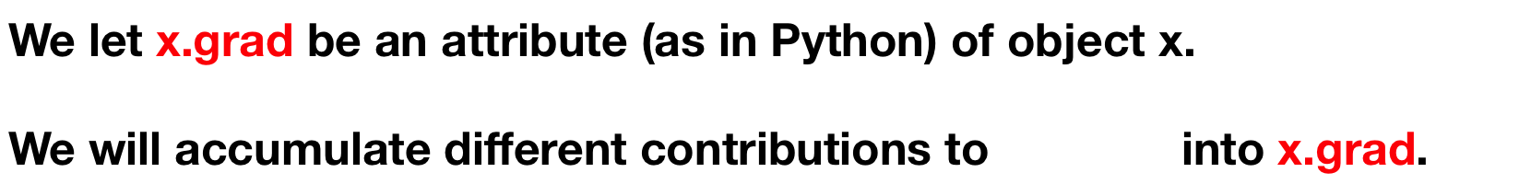

Backpropagation

Slide 15
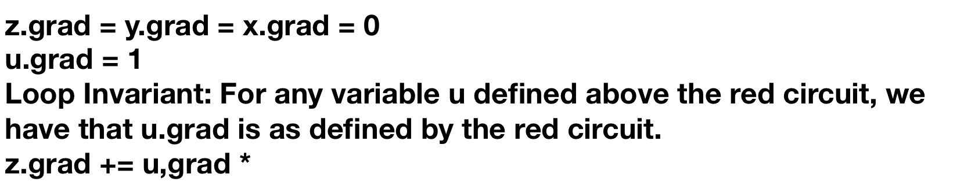
Backpropagation

Slide 16
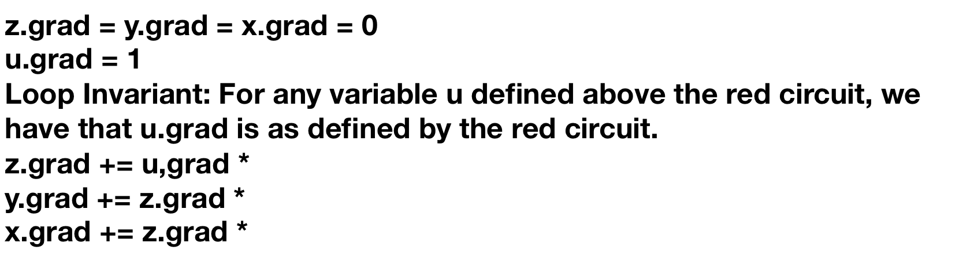



Backpropagation

Slide 17
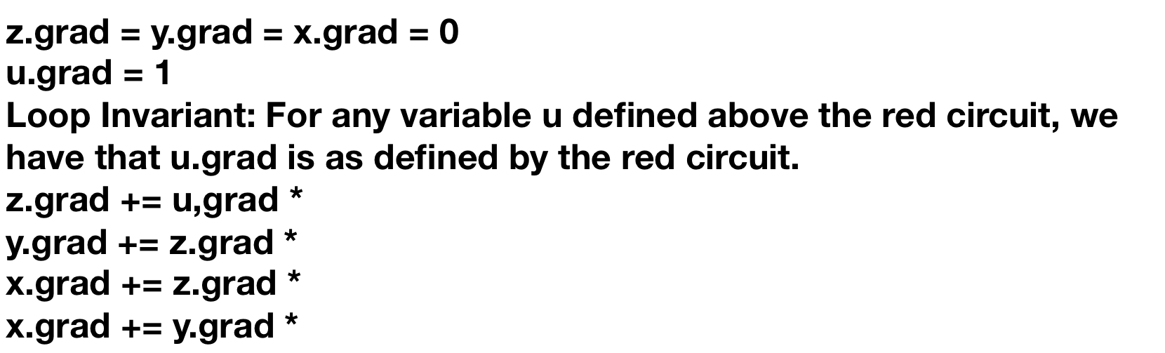

Backpropagation

Slide 18
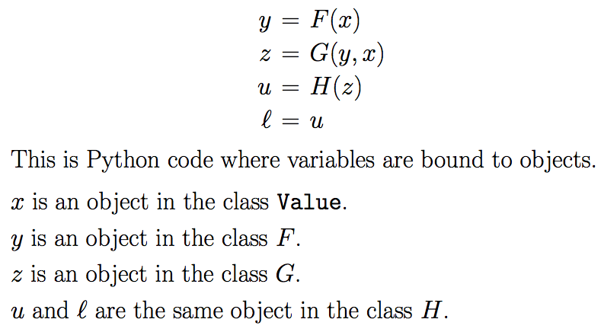
Implementation of Backpropagation

Slide 19
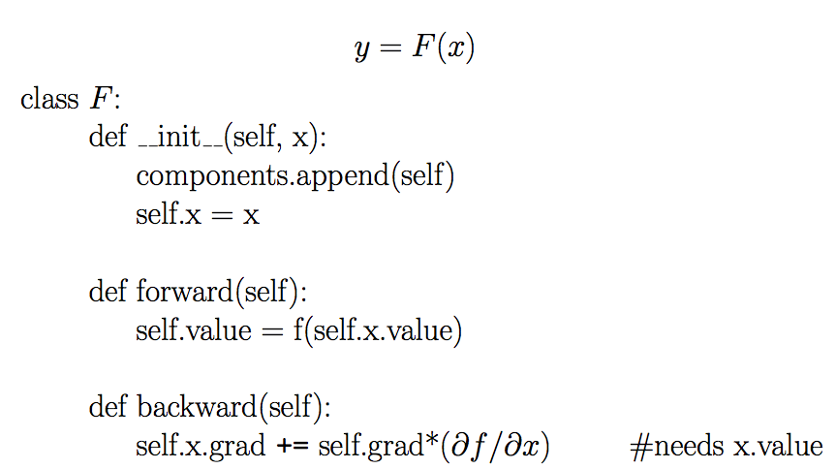

Slide 20
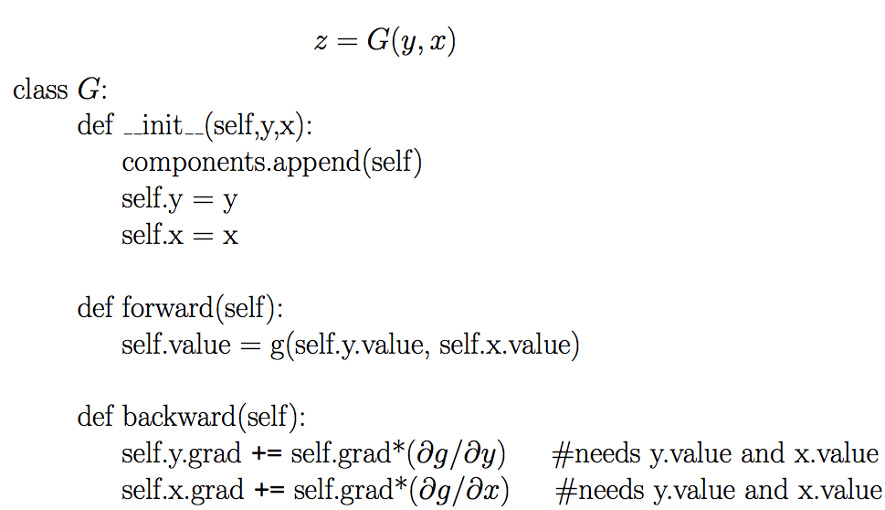

Slide 21
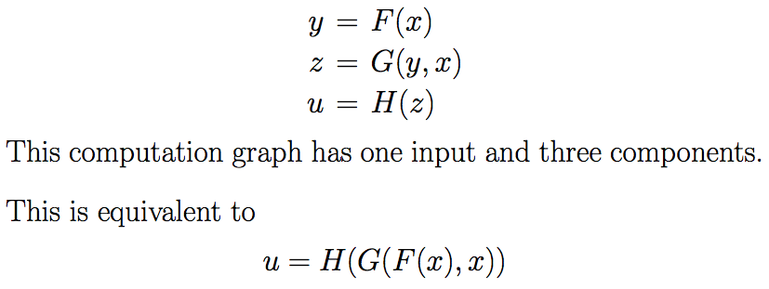

Slide 22
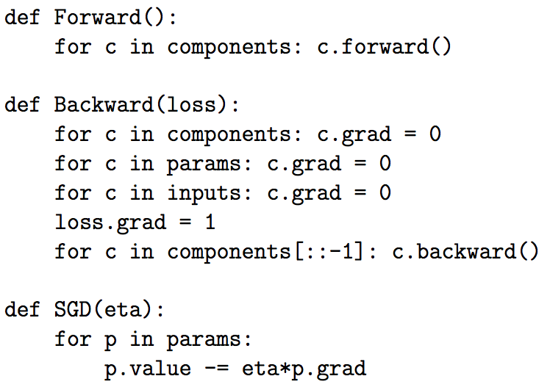
Backpropagation

Slide 23
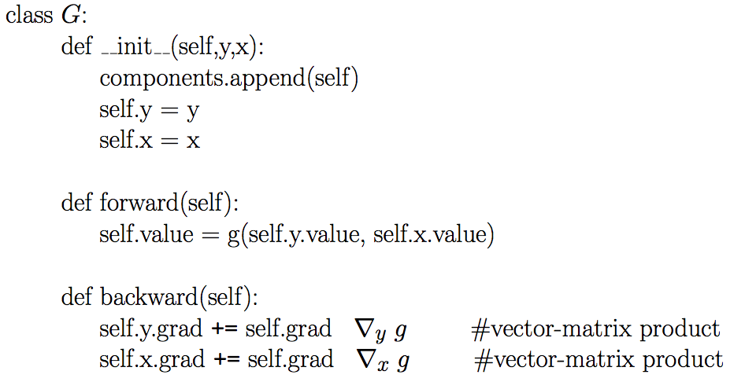
Vector case

Slide 24
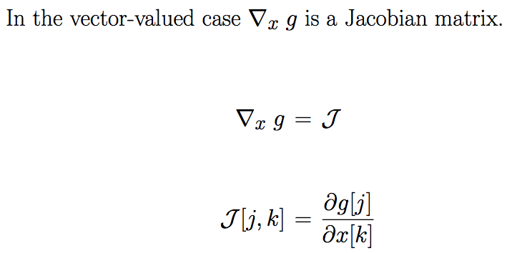
The Jacobian Matrix

Slide 25



Slide 26
Word2vec
A group of models to directly learn low-dimensional word vectors.
Paper reading:
Mikolov et. al., Distributed Representations of Words and Phrases and their Compositionality
Mikolov et. al., Efficient Estimation of Word Representations in Vector Space

Slide 27



Skip-Gram model
Main idea: predicting surrounding words of every word.
Generate one hot input vector x
Get embedded word vectors for the context
Generate 2m target word vectors using
Turn each of the scores into probabilities with softmax,
Train the parameters V and U to make it match the true probabilities

Slide 28
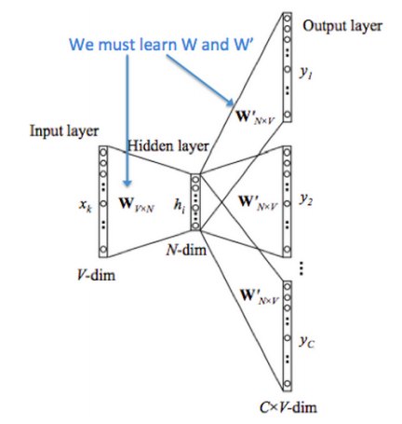
Skip-Gram model

Slide 29
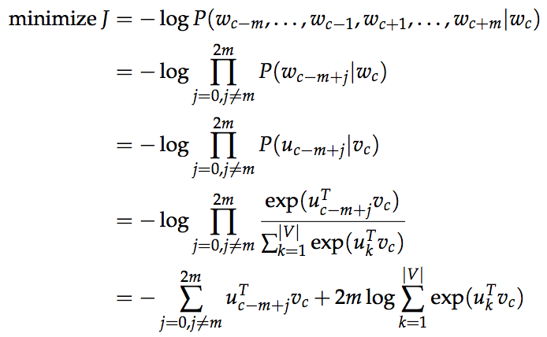
Skip-Gram model

Slide 30
Problem with Skip-Gram
The loss function sums over the whole vocabulary, which is computationally expensive.
We don’t have to go over the whole vocabulary, do negative sampling.

Slide 31
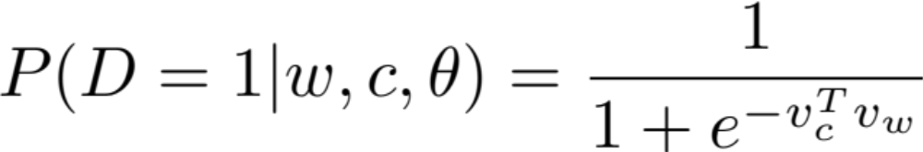
Negative Sampling (Mikolov et. al.)
Consider a pair (w, c) of target and context word. Let P(D = 1 | w, c) be the probability that (w, c) comes from the corpus data, and P(D = 0 | w, c) be the probability that (w, c) does not come from the corpus data. We model P(D = 1 | w, c) as
The objective function tries to maximize the probability of a target and context word pair being in the corpus data if they indeed are, and maximize the a pair not being in the corpus if it indeed is not.

Slide 32
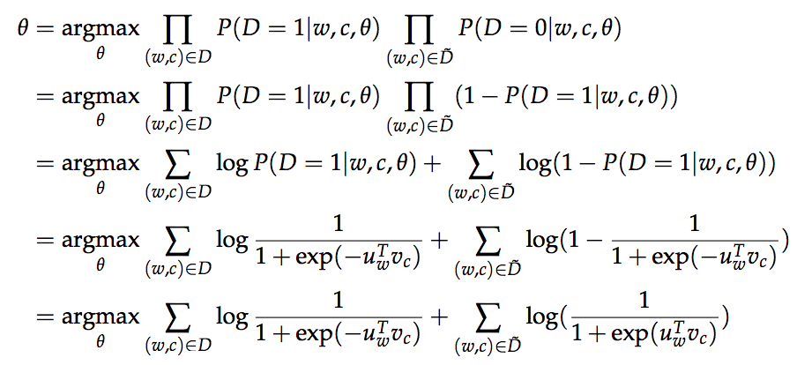
Negative Sampling (Mikolov et. al.)

Slide 33
Project
Skip-Gram model with tensorflow

Slide 34
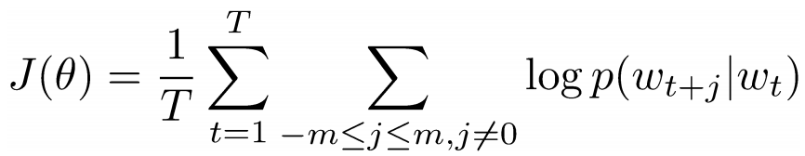

Skip-Gram model
Main idea: predicting surrounding words of every word.
Objective function: Maximize the log probability of any context word given the current center word.
represents the parameters to optimize.

Slide 35
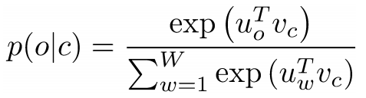
Skip-Gram model
Main idea: predicting surrounding words of every word.
where o is the outside (or output) word id, c is the center word id, u and v are “center” and “outside” vectors of o and c.
Every word has two vectors.

Slide 36
Title
What is the meaning of a word?
How do we represent the meanings of word? Synonym

Slide 37
Title
What is the meaning of a word?
How do we represent the meanings of word? Synonym

Slide 38
Title
What is the meaning of a word?
How do we represent the meanings of word? Synonym

Slide 39



Slide 40
Title
What is the meaning of a word?
How do we represent the meanings of word? Synonym

Slide 41


Slide 42
Title

Slide 43
Title
https://cs224d.stanford.edu/lecture_notes/notes1.pdf

Slide 44
Title
What is the meaning of a word?
How do we represent the meanings of word? Synonym

Slide 45


Slide 46
Title
TextTextText
TextTextText

Slide 48
Title
TextTextText
TextTextText

Slide 49
感谢
Zewei Chu
zeweichu@gmail.com
法律声明
本课件、大数据文摘x稀牛学院网站、社群内所有内容，包括但不限于演示文稿、软件、声音、图片、视频、代码等，由发布者本人和大数据文摘共同享有。未经大数据文摘明确书面授权，任何人不得翻录、发行、播送、转载、复制、重制、改动或利用大数据文摘的局部或全部内容或服务，不得在非大数据文摘所属的服务器上作镜像，否则以侵权论，依法追究法律责任。本网站享有对用户在本网站活动的监督和指导权，对从事非法活动的用户，有权终止对其所有服务。
课程合作请联系
info@bigdatadigest.cn
扫码添加客服进群交流
微信15510583366

Slide 50


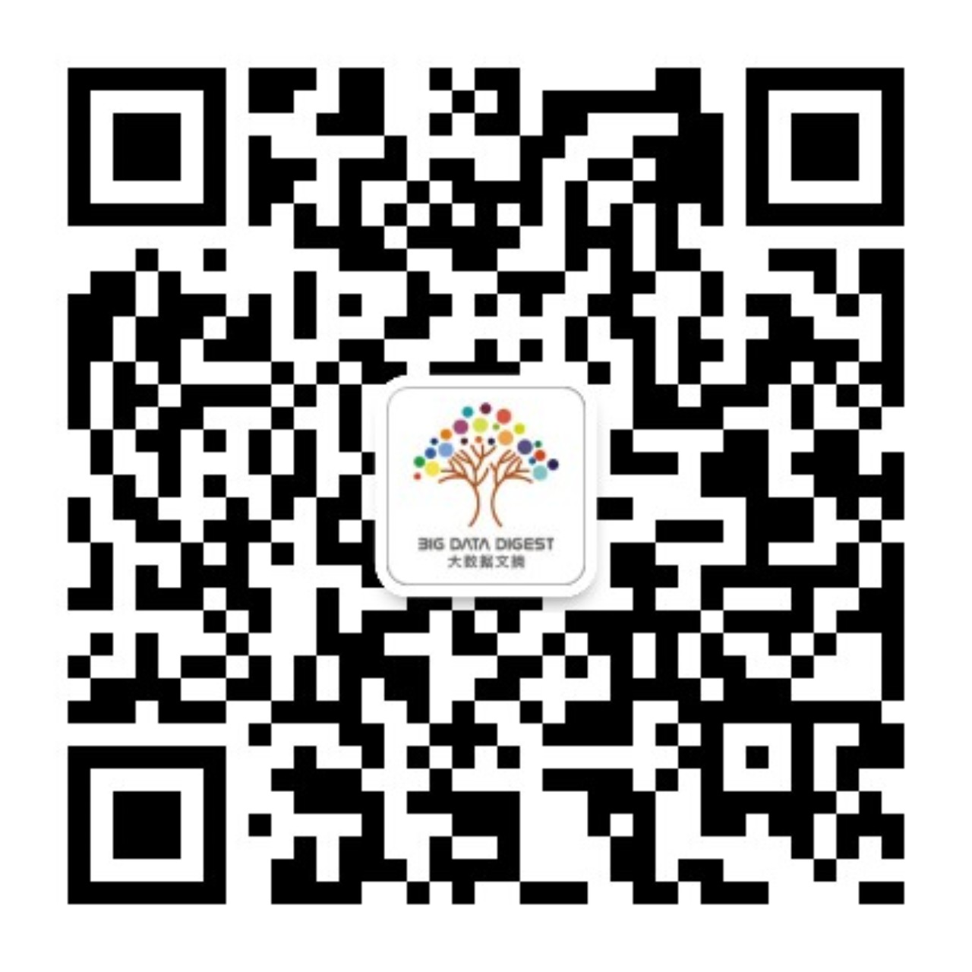

扫码获取最新数据科学资讯

