Slide 1

Language Model & Recurrent Neural Networks
Zewei Chu
zeweichu@gmail.com
法律声明
本课件、大数据文摘x稀牛学院网站、社群内所有内容，包括但不限于演示文稿、软件、声音、图片、视频、代码等，由发布者本人和大数据文摘共同享有。未经大数据文摘明确书面授权，任何人不得翻录、发行、播送、转载、复制、重制、改动或利用大数据文摘的局部或全部内容或服务，不得在非大数据文摘所属的服务器上作镜像，否则以侵权论，依法追究法律责任。本网站享有对用户在本网站活动的监督和指导权，对从事非法活动的用户，有权终止对其所有服务。
课程合作请联系
info@bigdatadigest.cn
扫码添加客服进群交流
微信15510583366

Slide 2
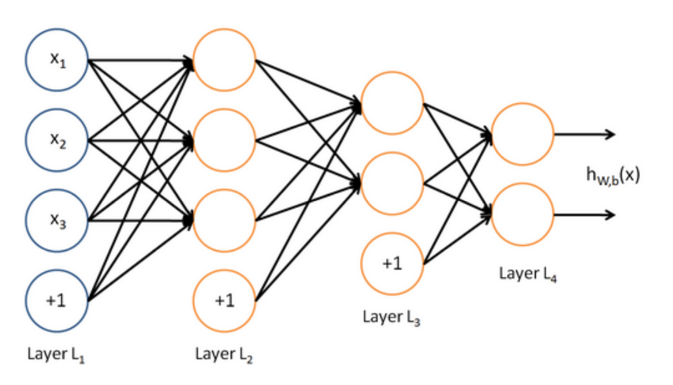
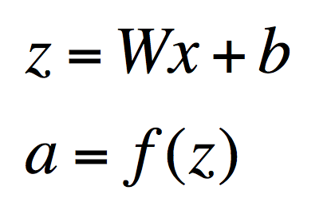
More about Neural Networks
Each layer

Slide 3
目录
01
Language Model
02
Recurrent Neural Network
03
Long Short-term Memory
04
char-rnn Project

Slide 4





Slide 5


Language model
A language model computes a probability for a
sequence of words
Assumption: Word in a sentence depends on its previous words.

Slide 6
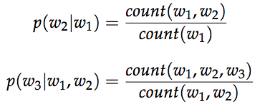
N-Gram model
Bigram and trigram models:

Slide 7
N-Gram model
Bigram and trigram models:
Backoff: use lower-order model only when count is zero in higher-order model
Smoothing: Search online if interested

Slide 8
Problems of N-Gram model
High memory usage
Only takes information from past n-1 words, sometimes we need longer dependency

Slide 9
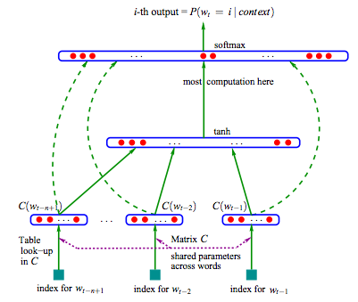
Neural language models
Bengio et. al. A Neural Probabilistic Language Model

Slide 10
Neural language models
Bengio et. al. A Neural Probabilistic Language Model
An early neural network based language model
Check out publications of
Yoshua Bengio
http://www.iro.umontreal.ca/~bengioy/yoshua_en/

Slide 11
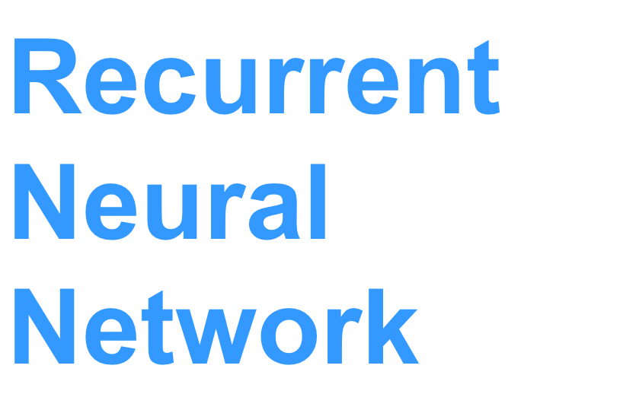


Slide 12
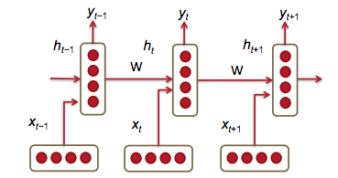
Recurrent Neural Network
Goal: predict the next word conditioned on all previous words.

Slide 13

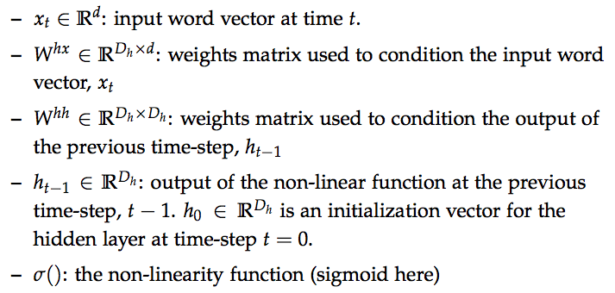

Recurrent Neural Network

Slide 14


Loss function
Cross Entropy Loss
Over the whole corpus

Slide 15
Loss function
Cross Entropy Loss
Over the whole corpus
Back propagation and stochastic gradient descent

Slide 16
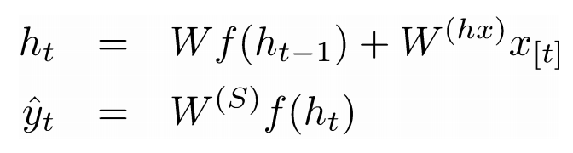
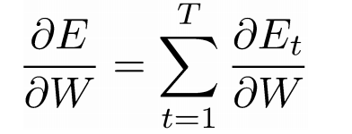
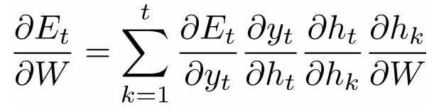
Vanishing Gradient & Gradient Explosion
Total loss sums over all time steps t
Think about back propagation (chain rule)

Slide 17
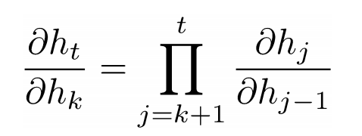
Vanishing Gradient & Gradient Explosion
Total loss sums over all time steps t
Think about back propagation (chain rule)

Slide 18
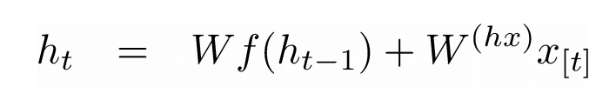
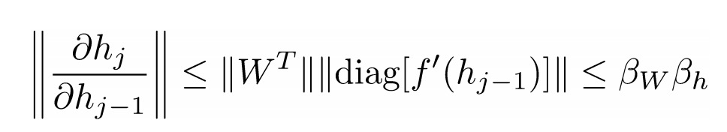
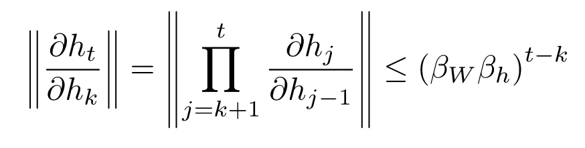
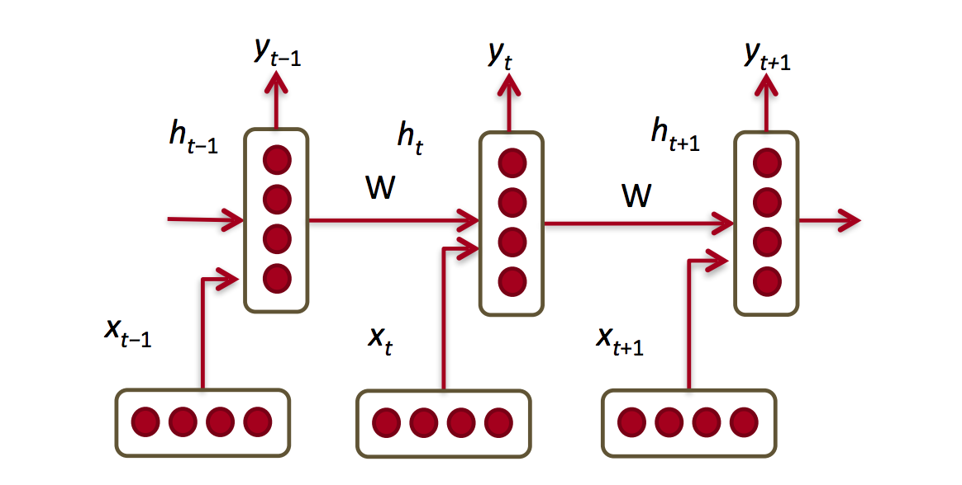
Vanishing Gradient & Gradient Explosion

Slide 19
Vanishing Gradient & Gradient Explosion
Gradient explosion: Get NAN error
Gradient vanishing: Stochastic Gradient Descent hardly learn anything

Slide 20
Vanishing Gradient & Gradient Explosion
Solution to gradient explosion: gradient clipping
Solution to vanishing gradient:
initialize W matrix with identity matrix
Use ReLU activation function

Slide 21
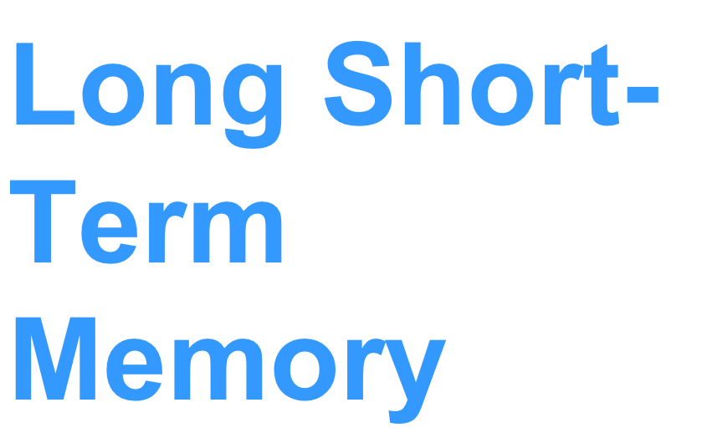


Slide 22
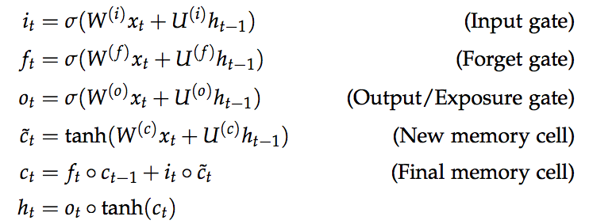
Long Short-term Memory

Slide 23
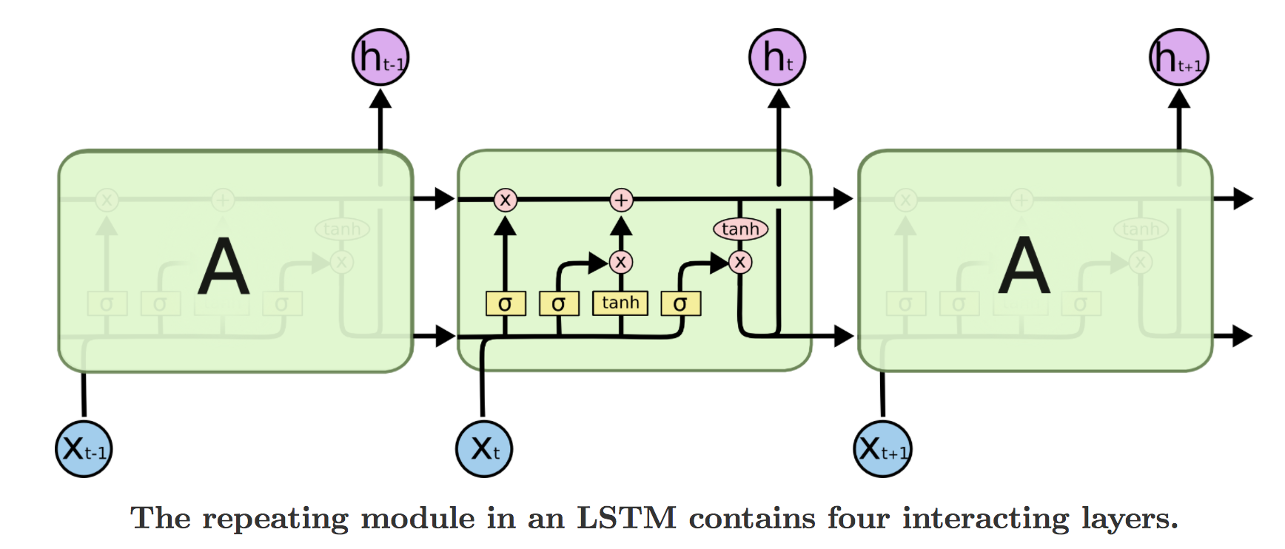
Long Short-term Memory
From http://colah.github.io/posts/2015-08-Understanding-LSTMs/

Slide 24
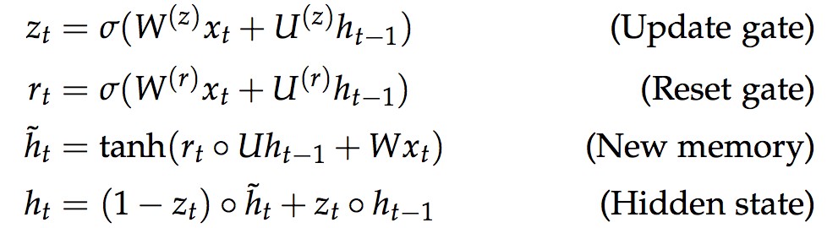
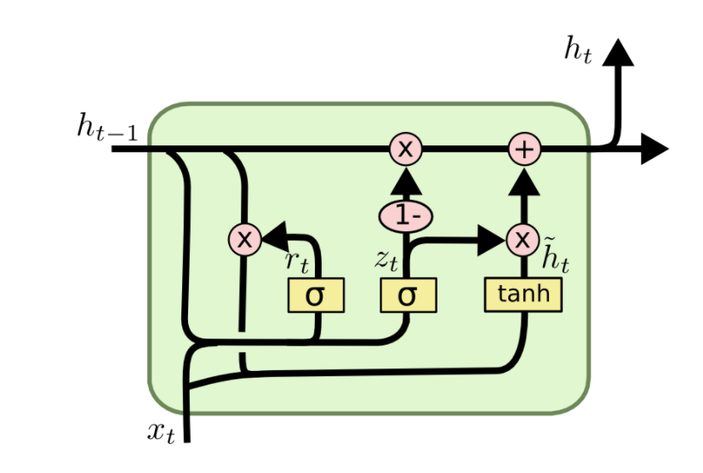
Gated Recurrent Units

Slide 25



Slide 26
char-rnn Project
Example from the following blog post
http://karpathy.github.io/2015/05/21/rnn-effectiveness/

Slide 27
感谢
Zewei Chu
zeweichu@gmail.com
法律声明
本课件、大数据文摘x稀牛学院网站、社群内所有内容，包括但不限于演示文稿、软件、声音、图片、视频、代码等，由发布者本人和大数据文摘共同享有。未经大数据文摘明确书面授权，任何人不得翻录、发行、播送、转载、复制、重制、改动或利用大数据文摘的局部或全部内容或服务，不得在非大数据文摘所属的服务器上作镜像，否则以侵权论，依法追究法律责任。本网站享有对用户在本网站活动的监督和指导权，对从事非法活动的用户，有权终止对其所有服务。
课程合作请联系
info@bigdatadigest.cn
扫码添加客服进群交流
微信15510583366

Slide 28




扫码获取最新数据科学资讯

