Slide 1

Investment Simulation Report
19SpringFBE555
Kelei Zhu Zeya Yu
Yiyao Jiao Lan Yang

Slide 2
Outline
Index ETFs
Nasdaq
S&P 500
Anomaly
IPO
News
Merger
Other investments
Technical Analysis
Exiting strategy
Value at risk

Slide 3

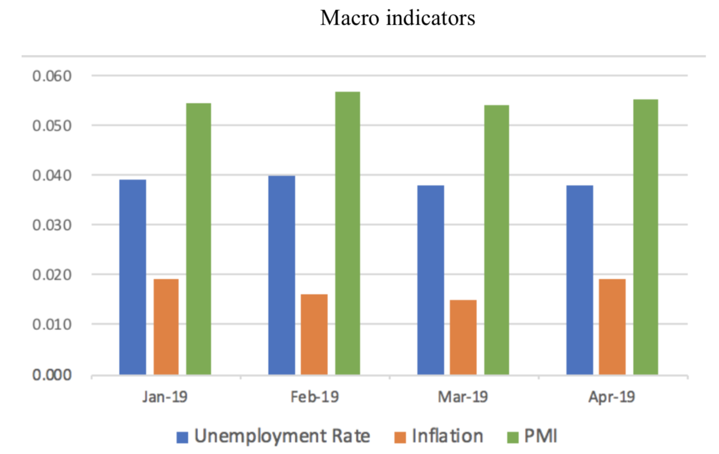
Index ETFs
Return
TQQQ : + 42.2% CCC J
IVV : + 8.7%
Macro Indicators
Fundamental Indicators
Unemployment Rate
PMI
Inflation
10-year Government Bond
Crude Oil Price (WTI)

Slide 4
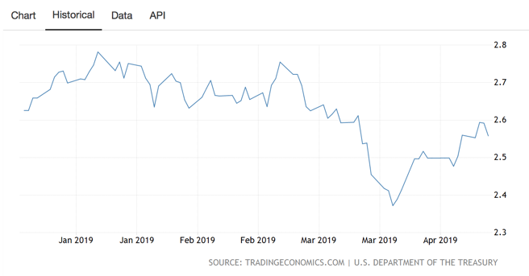
Index ETFs
10-year government bond rate

Slide 5
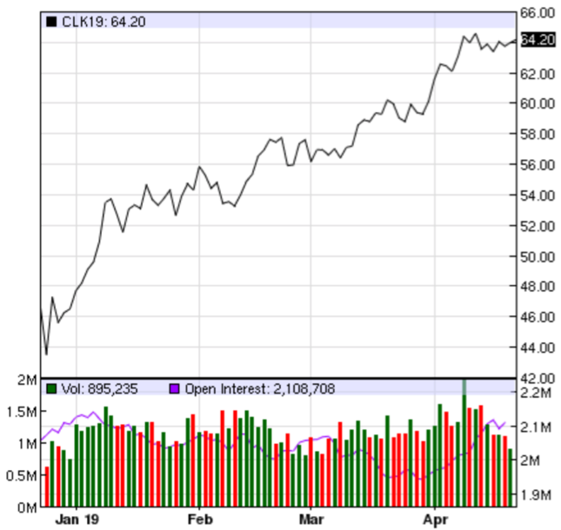
Index ETFs
Price of Crude Oil WTI (NYMEX)

Slide 6
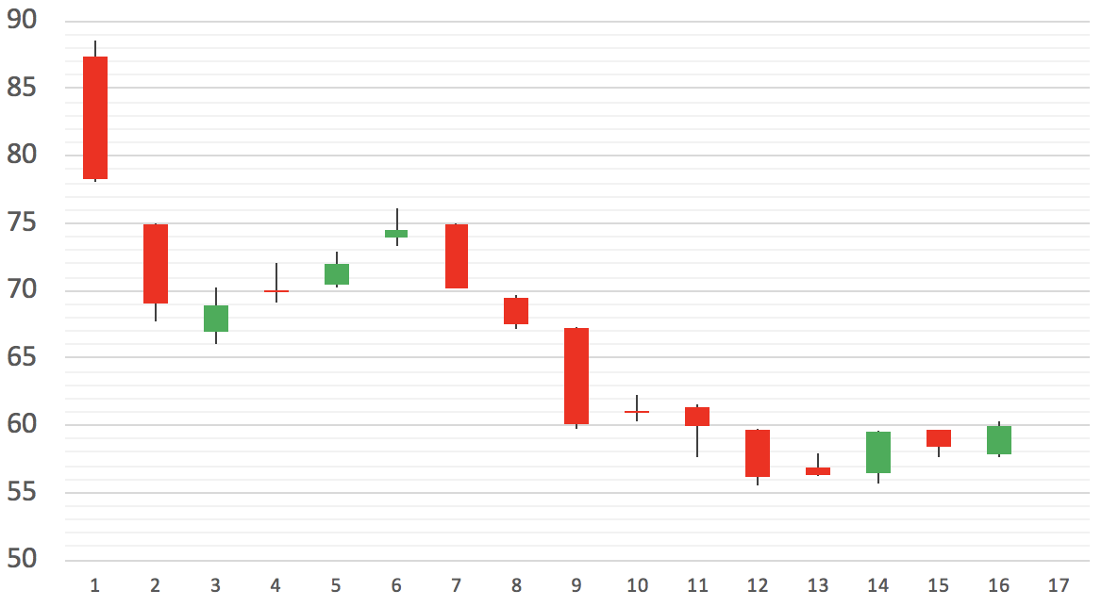
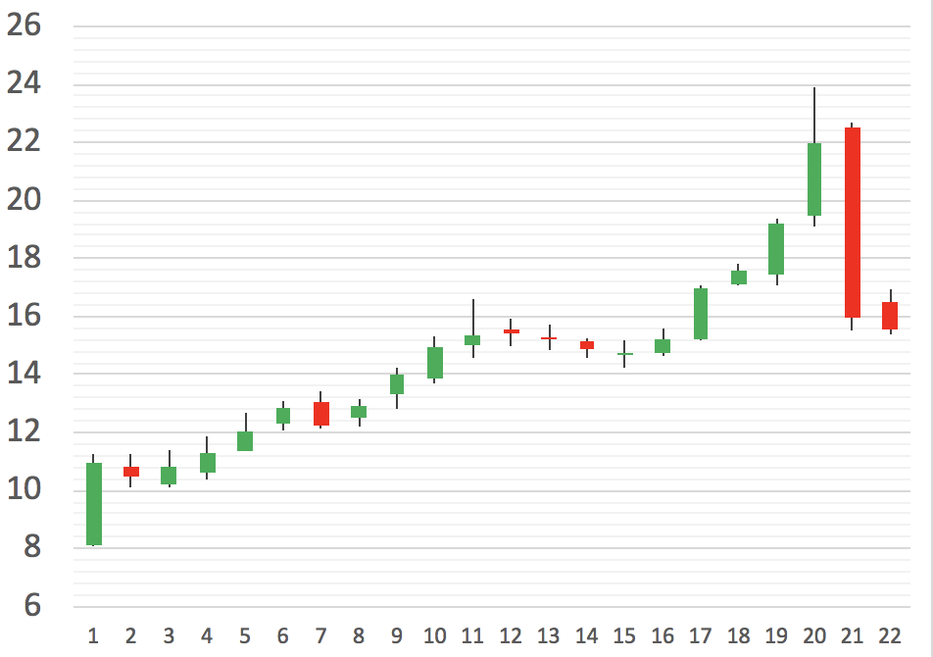
IPO
IPO
Bring positive return on average
Short LYFT at $83: + 2%
Long TIGR at $9.9 : + 8.2%
Daily stock price of Lyft since IPO
Reasons
$87 is too high for Lyft, and market shows trends of going down
TIGR is a leading company among its peers
Result
After covering Lyft drops to $60
After selling TIGR goes up to $20
Daily stock price of TIGR since IPO

Slide 7
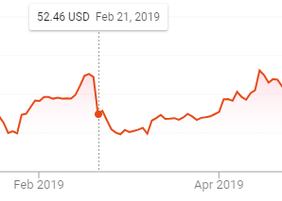
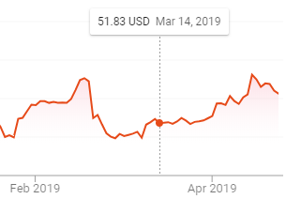
News
News
CyrusOne(CONE) 4th quarter earnings dropped on Feb 20th
CONE reported Proxy Statement on Mar 14th
Price of CONE 1 day after 2018 Q4 financial report
Reasons for buying
Fast growing data center REITs underestimated by investors
CONE is a leading company among its peers
Result
Stock price rises +8.6% till Apr 22
Other stocks
APPL: +4.5%
BA: +3%
Price of CONE report its Proxy Statement

Slide 8
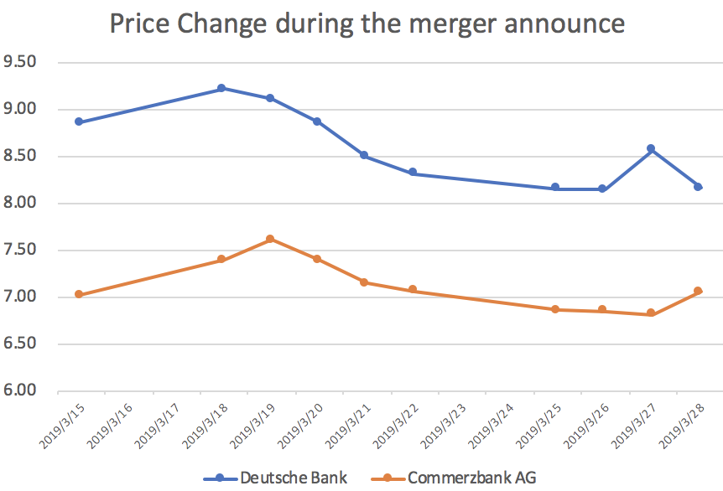
Merger
Basic Strategy
Invest the bidder
On Mar 17th the 2 were in talks about merger
Long the Deutsche Bank(DB)
Price around the merger announced
Result and Lesson
DB: -0.38%
Predict the probability of successful merger
Time to buy and sell

Slide 9
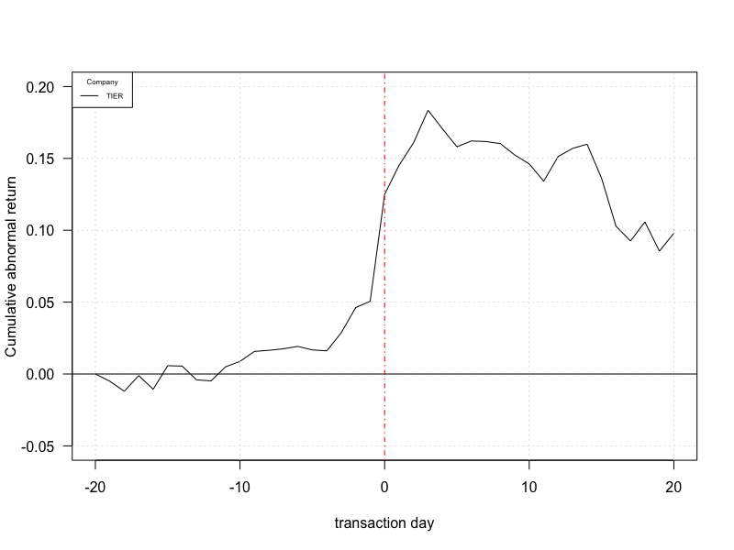
Merger
Cumulative abnormal return for TIER on Mar 25th

Slide 10
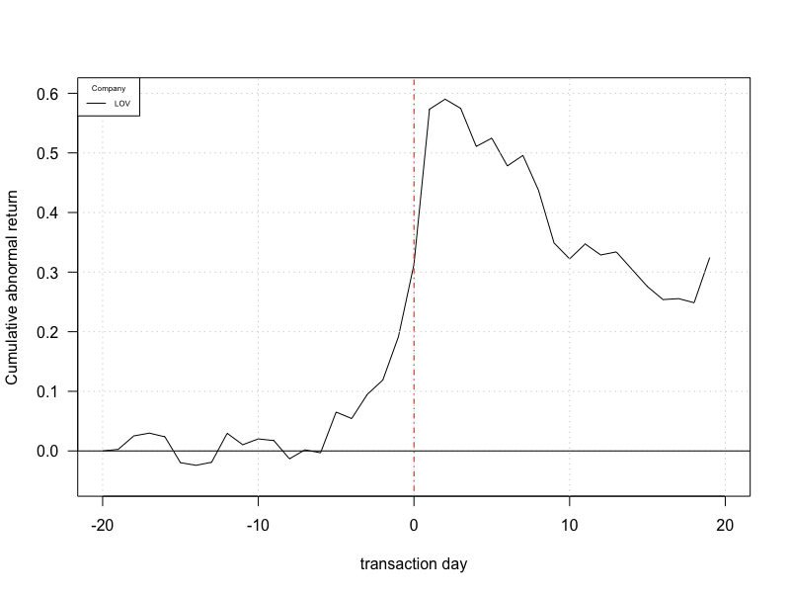
Merger
Cumulative abnormal return for LOV on Mar 22th

Slide 11

Merger
Strategy
Searching news for merger in the market, find the target company.
Investment in bidders should be thoroughly examined.
Just holding for 1 or 2 days before the anomaly has been digested.

Slide 12
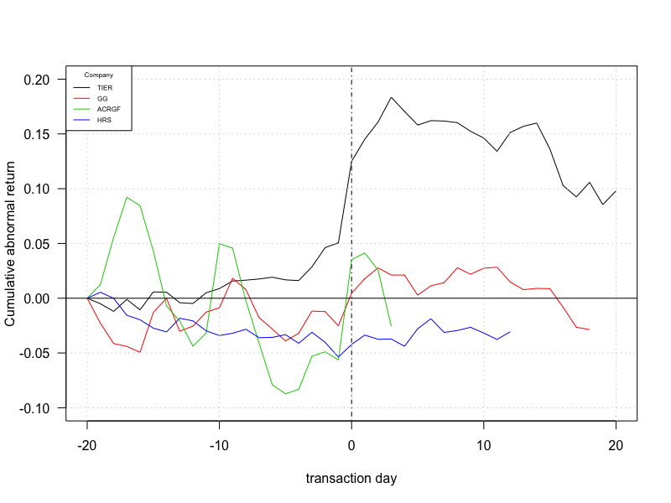
Merger
Cumulative abnormal return for other stocks

Slide 13

Other investments
We also try the following assets
Bond: +3%. quite low rate
REITs: +5.3%. an alternative to Bond
Gold: white noise; Hard to predict
VIX: -60% YTM. Large volatility; too expensive

Slide 14

Technical Analysis
Screening
MA50 > MA200
Stock Price > MA200
Outperform S&P 500 for 6 months
Outperform industrial average for 6 months
Not outperforming industrial average for 9 months
0 < PEG Ratio < 1
Manually Second Screening

Slide 15
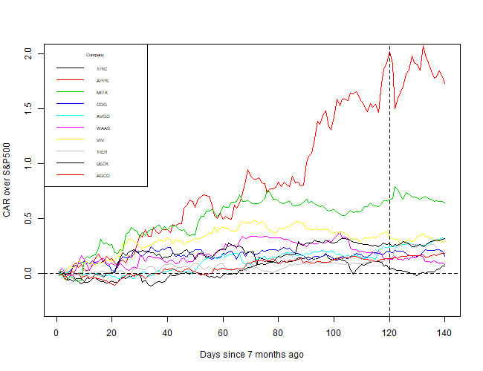
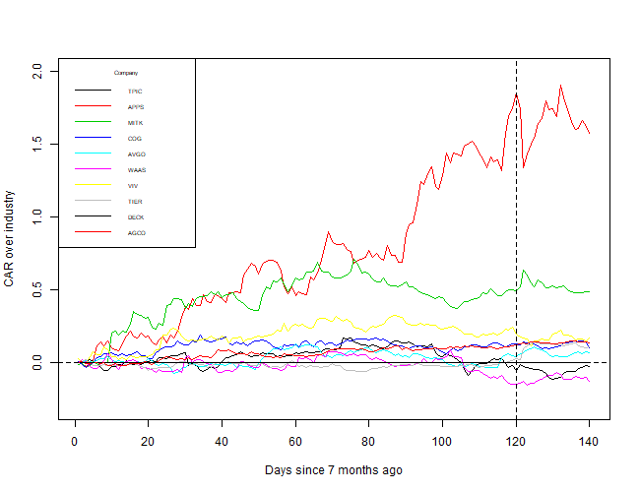
Technical Analysis
7 months CAR over S&P 500
7 months CAR over industry

Slide 16
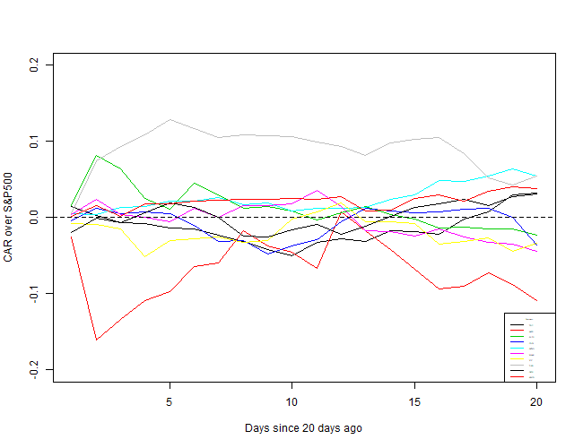
Technical Analysis
Overall return of 2.5%, should be 6%
Exiting Strategy

Slide 17
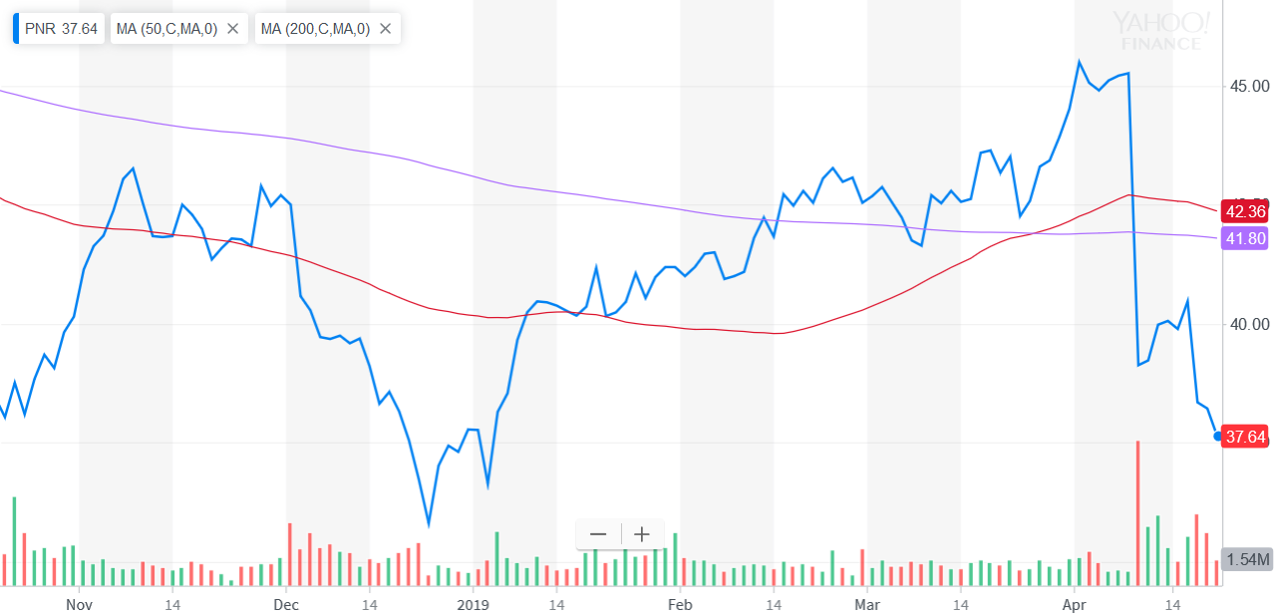
Technical Analysis
Pentair plc (PNR): -15.3%
Value at risk

Slide 18
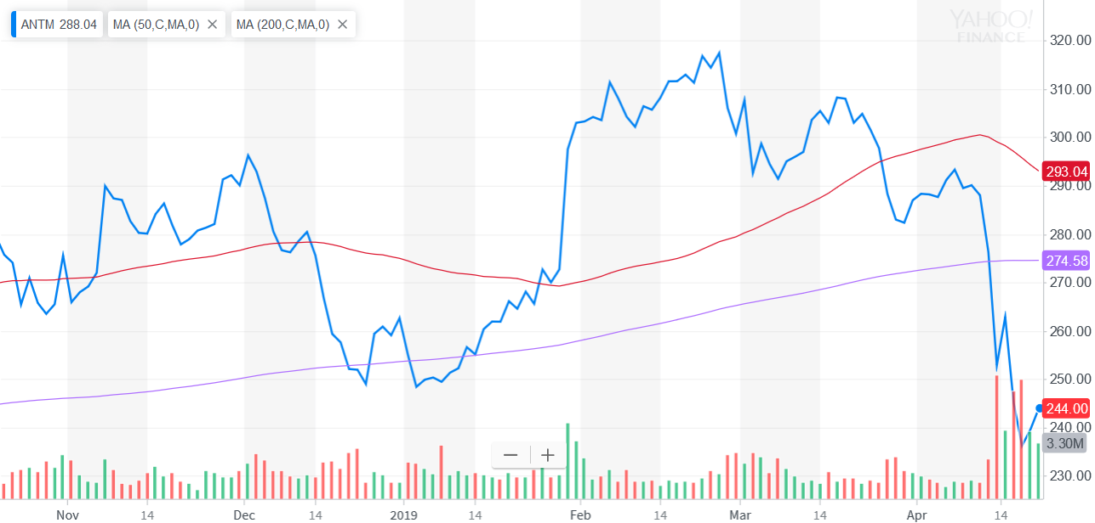
Technical Analysis
Anthem, Inc. (ANTM)：-17.2% DDD L
Value at risk

Slide 19
Investment Simulation Report
Thanks for listening

