Slide 1

Building an E-Learning Knowledge Graph
Zeyad Mohamed Fouad 2101777
Reyad Mohamed Fathy 2101507
Rehab mahmoud saad 2101494
Shahd khaled rezk 2101600
Eslam mokhtar mohamed 2100639

Slide 2
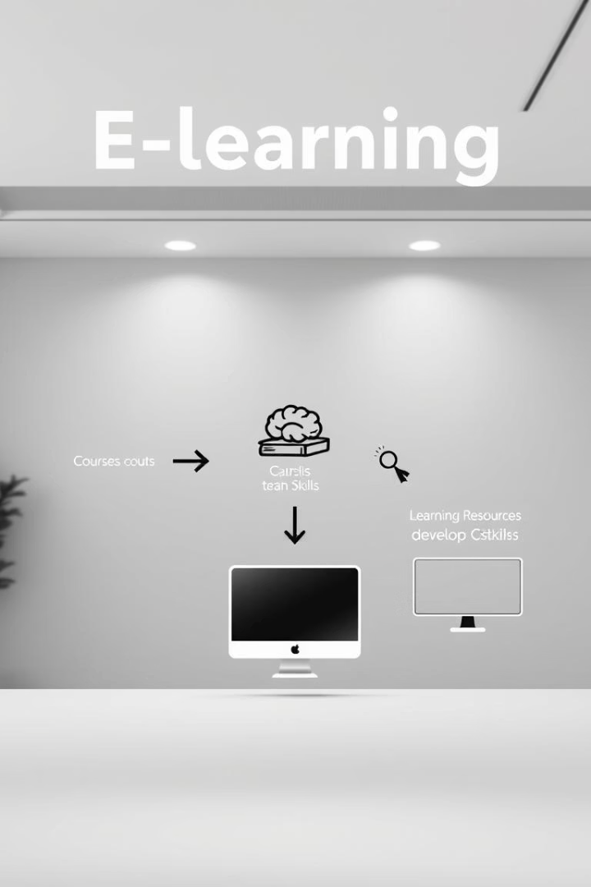
Knowledge Graph Construction and Application
Ontology Design
Use Protégé and OWL to define courses, topics, skills, and relationships.
Example: "Advanced Calculus" requires "Calculus I".
Semantic Rules
SWRL enables personalized learning by creating inference rules.
Example: Mastery of "Calculus I" suggests "Calculus II".
Query & Reasoning
SPARQL retrieves relevant resources; reasoning identifies skill gaps.
Example: Find resources teaching "Differentiation" requiring "Limits".
Applications
Personalized learning recommendations
Adaptive assessments and intelligent tutoring
Semantic search and competency alignment

Slide 3

Motivation & Objectives
Unified Data: Integrate courses, lessons, and user profiles into one graph.
Semantic Search: Enable intelligent recommendations powered by graph relations.
Project Goals: Build OWL ontology, populate data, add SWRL rules, and query with SPARQL.

Slide 4
Ontology Scope & Vocabulary
Domain Concepts: Include Courses, Lessons, Topics, Instructors, Students.
Standards Alignment: Map key terms to SCORM and IEEE LOM standards.
Deliverable: An OWL ontology file compatible with Protégé.

Slide 5
OWL Schema: Classes & Hierarchy
Top-Level Classes
Subclasses
Disjointness
Core entities include Course, Lesson, Topic, Instructor, Student, and Assessment.
VideoLesson is a type of Lesson
VideoLesson and QuizAssessment are explicitly disjoint classes.
QuizAssessment is a type of Assessment

Slide 6
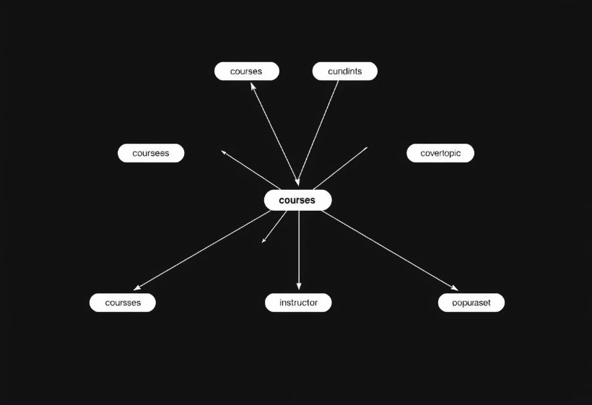
OWL Schema: Properties
Object Properties
hasLesson (Course → Lesson)
coversTopic (Lesson → Topic)
teaches (Instructor → Course)
enrolledIn (Student → Course)
instructs (Instructor → Student)
Data Properties
courseTitle (xsd:string)
lessonDuration (xsd:decimal)
studentEmail (xsd:string)

Slide 7
Sample Individuals in the Knowledge Graph
Course Instance
Lesson Instance
Course_CS101: "Intro to Semantic Web" with lessons and assessments linked.
Lesson1: A VideoLesson lasting 1.5 hours covering "Semantic Web" topic.
Participants
Assessment
Instructor_DrSmith teaches the course.
Assessment_Quiz1: A QuizAssessment associated with the course.
Student_Alice is enrolled in the course.

Slide 8
SWRL Rules Overview
Propagate Topics: Courses inherit topics covered by their lessons using logical rules.
Infer Instructors: Rules identify when an instructor teaches a student enrolled in their course.
Classify Advanced Courses: Courses covering specific topics like Semantic Web are marked as advanced.

Slide 9
Reasoning & Inference
Run Reasoners: Use HermiT or Pellet within Protégé for inference.
Consistency Check: Ensure no logical conflicts in the ontology.
Classification: Infer Course_CS101 as an AdvancedCourse automatically.
Individual Realization: Infer relationships like DrSmith instructing Alice.
Topic Propagation: Link courses to topics through lesson relations.

Slide 10
SPARQL Queries for Knowledge Graph Insights
Query 1: Advanced Courses
Query 2: Semantic Web Lessons
Query 3: Students of DrSmith
Retrieve courses classified as AdvancedCourse for targeted curriculum planning.
Identify students instructed by DrSmith to support personalized learning paths.
List lessons covering the "Semantic Web" topic within the knowledge graph.

Slide 11
Demo & Next Steps
Live Demo: Explore classes, individuals, and SWRL rules in Protégé
Run Sample SPARQL Queries to extract knowledge insights
Extensions: Import real course catalog data from CSV to RDF
Add additional topics, assessments, and restriction axioms
Expose the knowledge graph via a SPARQL endpoint for apps

Slide 12
Conclusion
Semantic Discovery
Automated Reasoning
Enables meaningful insights through linked structured data.
Supports inferencing for deeper understanding and decision-making.
Extensible Integration
Deployment Ready
Easily incorporates diverse educational data for wider use.
Integrates with platforms for smarter search and recommendations.

