Slide 1
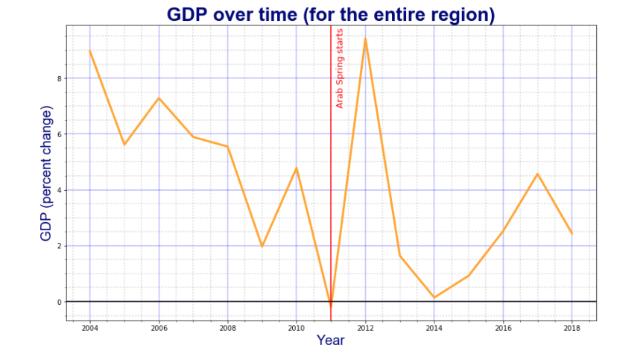
The same graph was generated for the 4 other indicators.

Slide 2
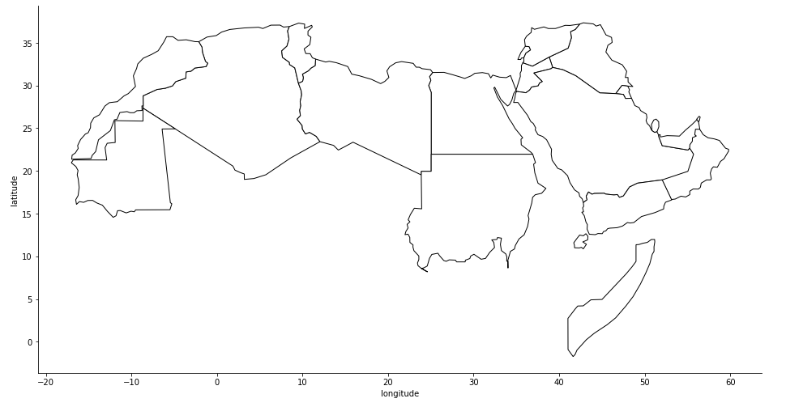

Slide 3
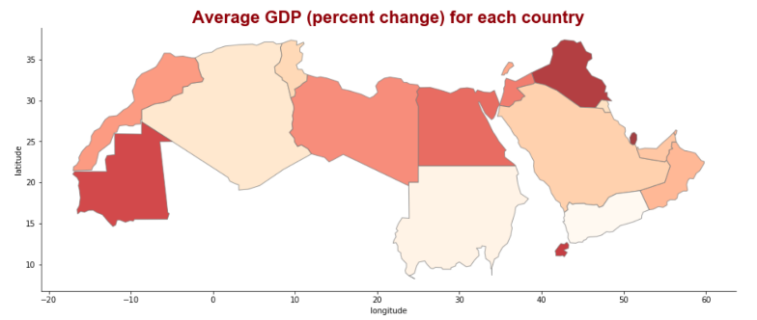
The same map was generated for the 4 other indicators.

Slide 4
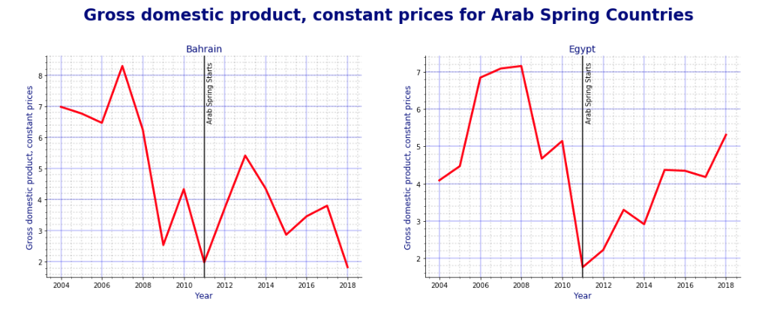
The same graph was generated for all other Arab Spring Countries. The process is repeated for the other four indicators.

Slide 5
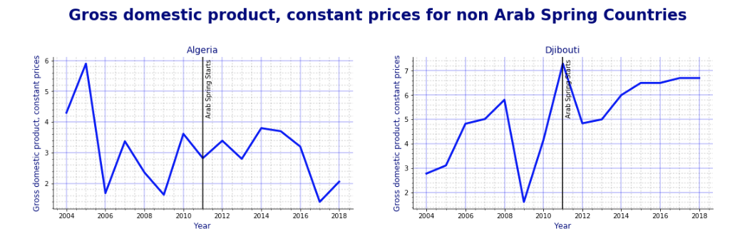
The same graph was generated for all other non Arab Spring Countries. The process is repeated for the other four indicators.

