Slide 1
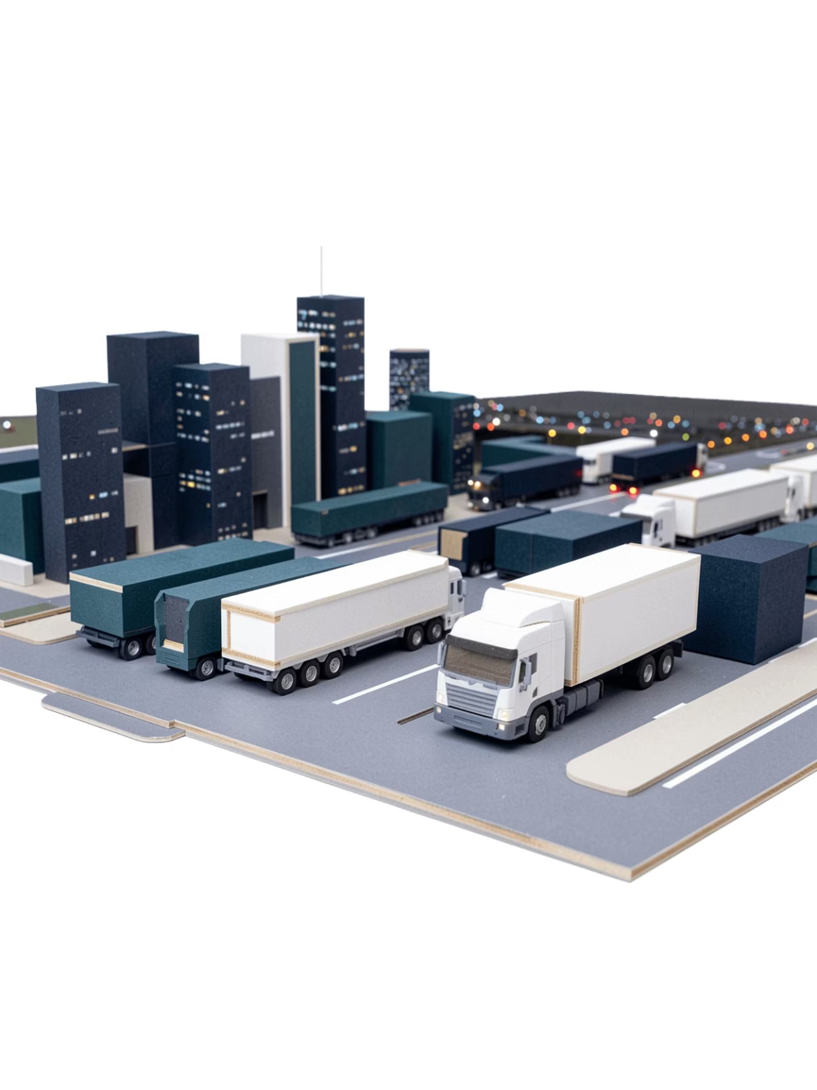

Logistics Operations Analytics Dashboard
Transforming Logistics Performance Through Data-Driven Insights
Presented by Zeyaul Haque
"Today I'll walk you through how we transformed raw logistics data into actionable insights using Power BI."

Slide 2

Executive Summary & Business Problem
What We Built
The Business Problem
An end-to-end Power BI analytics solution for logistics operations, converting 1,000+ raw data records into a real-time decision-making platform for leadership and operations teams.
Before this solution, the organization operated with critical blind spots. Data existed in silos with no unified view of performance.
No centralized logistics performance view
High shipment delay rates with no root cause visibility
Poor fleet utilization and resource allocation
No tracking of external factors like weather or traffic
Manual reporting led to slow, reactive decisions
56.6% of shipments identified as delayed
Key delay drivers uncovered: Weather, Traffic, Mechanical Failure
Actionable insights delivered to improve efficiency at scale
"The company had data, but no clear visibility into performance or root causes."

Slide 3

Project Objectives & Data Approach
Strategic Objectives
Data & Approach
The goal was to shift the organization from reactive firefighting to proactive, data-driven operations management.
Data quality is the foundation of any reliable analytics solution. Rigorous preparation ensured trustworthy outputs.
Centralized Dashboard
Data Source
Build a single source of truth for all logistics KPIs, accessible to leadership and ops teams in real time.
Excel-based dataset with 1,000+ logistics records spanning shipments, fleet activity, locations, and environmental data.
Root Cause Identification
Go beyond surface-level metrics to pinpoint the specific drivers behind shipment delays and fleet inefficiencies.
Data Cleaning
Removed duplicates, handled missing values, and standardized column naming conventions for consistency.
Enable Proactive Decisions
Equip teams with the visibility needed to act before problems escalate, improving delivery performance continuously.
Transformation
Data was restructured and processed in Power Query to enable efficient modeling and DAX calculations.

Slide 4

Data Modeling & KPI Framework
Data Model Architecture
Core KPI Measures
A robust data model is the backbone of any high-performance Power BI solution. The model was designed for speed, flexibility, and accurate time-based analysis.
Six key measures were built using DAX to directly reflect business performance and operational efficiency at a glance.
Date Table via DAX
Table Relationships
Total Shipments
On-Time Delivery %
A custom Date Table was created using DAX to enable full time-intelligence capabilities — year-over-year, month-to-date, and rolling averages.
The Logistics Table and Date Table were connected via optimized relationships, ensuring accurate cross-filtering and consistent KPI calculations.
Aggregate count of all shipments processed within the selected period.
Percentage of shipments arriving within the committed delivery window.
"This model enables powerful time-based analysis and high performance across all dashboard pages."
Delayed Shipments %
Fleet Utilization & Avg Waiting Time
Share of total shipments that exceeded the scheduled delivery timeline.
Tracks active vs. idle fleet assets and average dwell time at facilities.

Slide 5

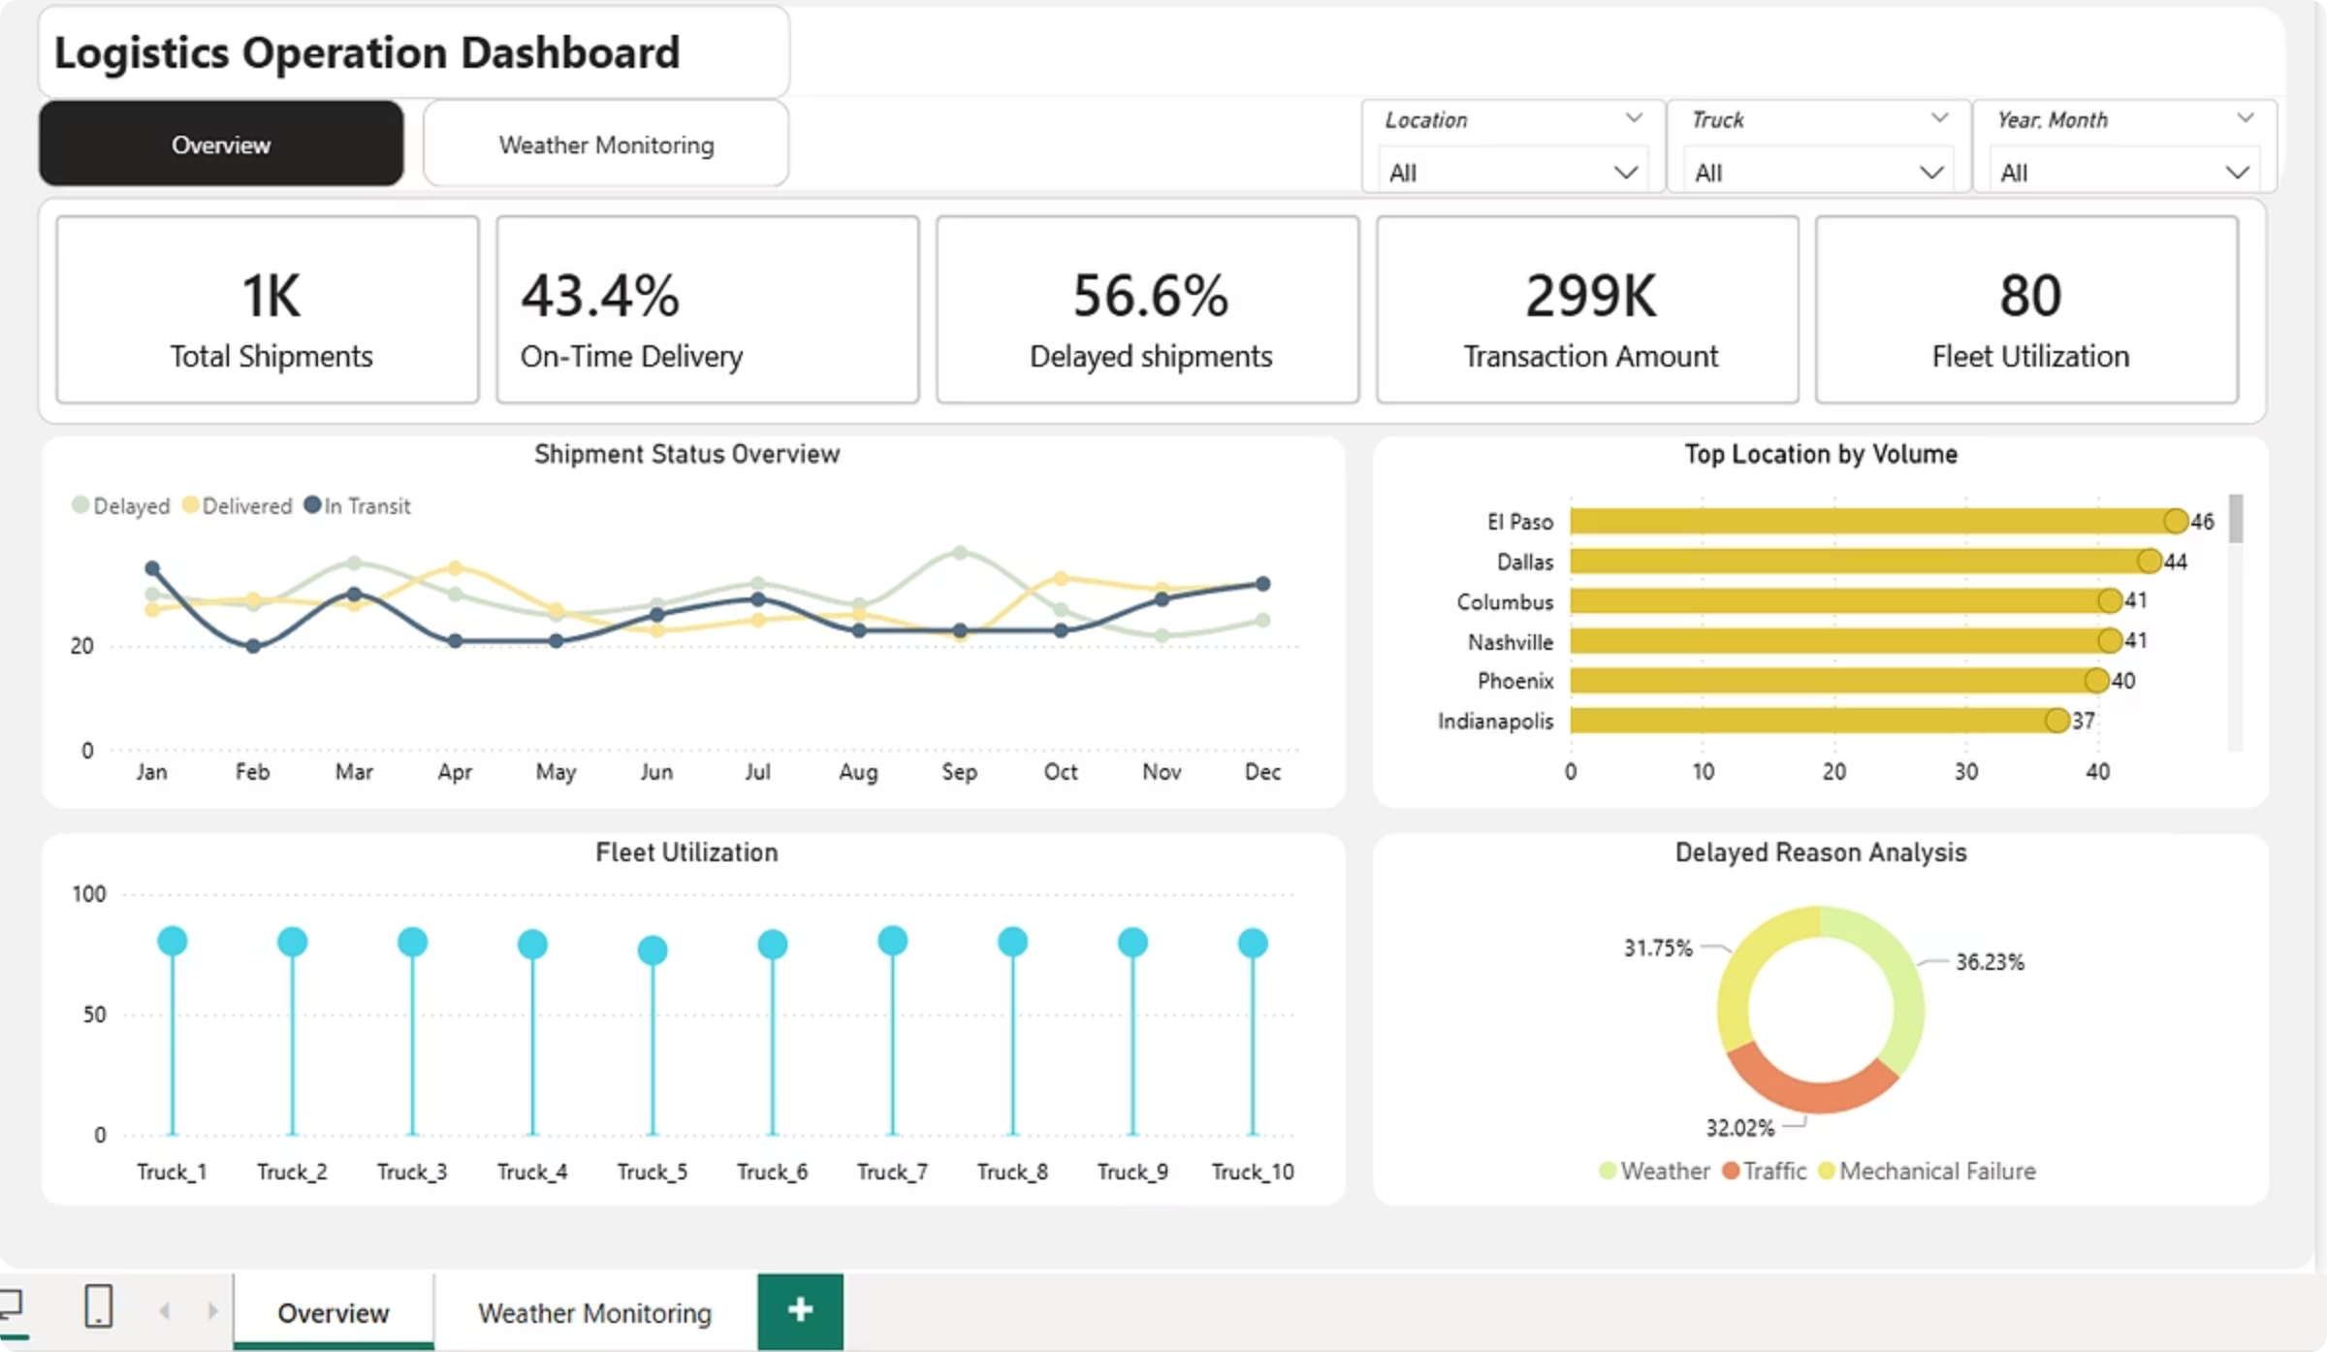
Overview Dashboard
The Overview Dashboard provides leadership with a complete, real-time snapshot of logistics operations — from shipment trends to fleet utilization and delay root causes — all in one view.
KPI Summary
Shipment Trends
Top-line metrics — Total Shipments (1K), On-Time Delivery (43.4%), Delayed Shipments (56.6%), Transaction Amount (299K), Fleet Utilization (80) — instantly visible to leadership.
Monthly trend lines segmenting Delayed, Delivered, and In-Transit shipments to reveal seasonality and performance patterns over time.
Top Locations & Delay Reasons
Bar chart of highest-volume locations (El Paso leading at 44) paired with a breakdown of delay causes: Weather 36.23%, Traffic 32.02%, Mechanical Failure 31.75%.

Slide 6

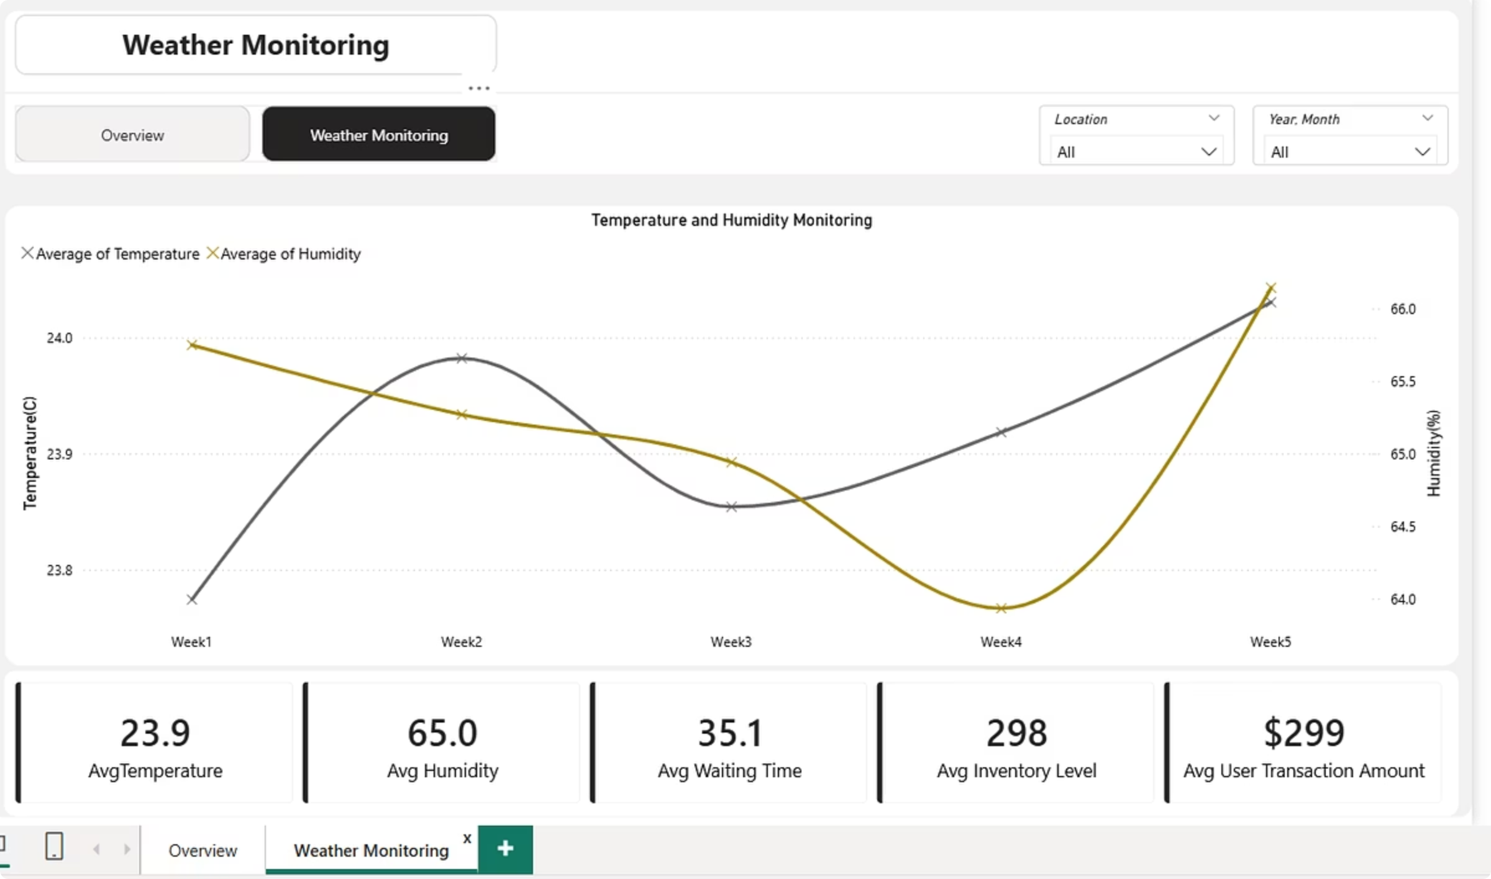
Weather Monitoring Dashboard
The Weather Monitoring page adds a critical external dimension to logistics analysis — revealing how environmental conditions directly correlate with shipment delays and waiting times.
23.9
Avg Temperature
Average temperature (°C) recorded across all monitored weeks, correlated against delay frequency.
65.0
Avg Humidity %
Average humidity level, a key environmental variable affecting road conditions and driver safety.
35.1
Avg Waiting Time
Average waiting time (mins) at facilities, rising notably during adverse weather periods.
298
Avg Inventory Level
Average inventory level tracked alongside weather trends to assess supply chain resilience.

Slide 7
Key Insights & Problem Diagnosis
🚨 What the Data Revealed
🔍 Root Cause Diagnosis
Moving beyond symptoms, the analysis identified the systemic causes driving underperformance across the network.
56.6% Shipments Delayed
Location-Specific Hotspots
More than half of all shipments failed to meet delivery commitments — a critical performance gap with direct customer impact.
Certain locations disproportionately contribute to delay counts, signaling infrastructure or process issues at those nodes.
1
Inefficient Route Planning
Routes were not optimized for traffic patterns or weather conditions, leading to predictable yet avoidable delays.
2
Lack of Predictive Insights
Fleet Imbalance & High Waiting Time
Weather as a Major Delay Factor
Operations reacted to problems after they occurred, with no forward-looking analytics to anticipate disruptions.
Uneven truck utilization and elevated waiting times point to poor resource scheduling and yard management practices.
Weather accounts for 36.23% of all delay reasons — yet most operations had no weather-aware planning protocols in place.
3
Poor Fleet Allocation
Trucks were not distributed based on demand signals, resulting in overloaded routes and idle assets elsewhere.
4
No Weather-Based Planning
Environmental data was entirely absent from operational planning, leaving teams blind to one of the biggest delay drivers.

Slide 8
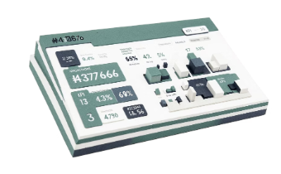
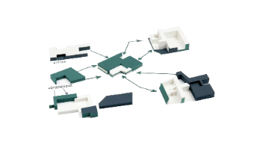
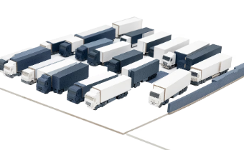
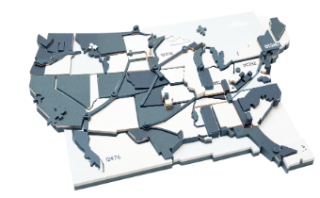
Solution & Measurable Impact
The Power BI solution directly addresses each identified root cause, transforming the logistics function from a reactive cost center into a proactive, data-driven operation.
Real-Time KPI Monitoring
Root Cause Analysis
Fleet Optimization Insights
Weather Correlation Analysis
Leadership can now track Total Shipments, On-Time Delivery %, Delayed Shipments %, Fleet Utilization, and Transaction Amount on a live dashboard — eliminating lag from manual reporting cycles.
Drill-through capability enables teams to pinpoint whether delays stem from weather, traffic, or mechanical failure — by location, truck, or time period — enabling targeted corrective action.
Per-truck utilization visibility reveals idle assets and overloaded routes, giving operations managers the data to rebalance fleet deployment and reduce inefficiency.
Temperature and humidity trend data is now integrated into the logistics view, enabling weather-aware planning that reduces weather-related delays before they occur.
📉 Reduced Delays
⚡ Improved Efficiency
🧠 Faster Decisions
Targeted interventions guided by root cause data drive measurable reductions in delay rates.
Optimized fleet allocation and routing reduce waste and idle time across the network.
Real-time dashboards replace manual reports, compressing decision cycles from days to minutes.

Slide 9

Recommendations & Conclusion
Actionable Next Steps
Conclusion
These five recommendations translate dashboard insights into sustained operational improvements across the logistics network.
This project delivered more than a dashboard — it built a scalable analytics foundation that gives the organization ongoing operational visibility and the capability to act on data, not intuition.
01
Built a scalable, enterprise-ready Power BI analytics solution
Enabled data-driven logistics decisions at every level of the organization
Improved operational visibility across shipments, fleet, and external factors
Established a reusable data model and KPI framework for future expansion
Implement Predictive Analytics
Extend the current descriptive model to incorporate forecasting — predicting delay probabilities by route, weather forecast, and historical patterns.
02
"This dashboard is not just reporting — it's a decision-making engine that grows with the business."
Optimize Fleet Allocation
Use utilization data to dynamically reassign trucks based on demand signals, reducing both idle assets and overloaded routes.
03
Adopt Weather-Based Routing
Integrate live weather feeds into route planning tools to proactively reroute shipments when adverse conditions are forecast.
04
Target High-Delay Locations
Focus operational improvement programs on the specific nodes and lanes with the highest delay concentrations.
05
Reduce Waiting Time
Investigate facility-level bottlenecks contributing to elevated average waiting times and implement process changes to reduce dwell time.

Slide 10
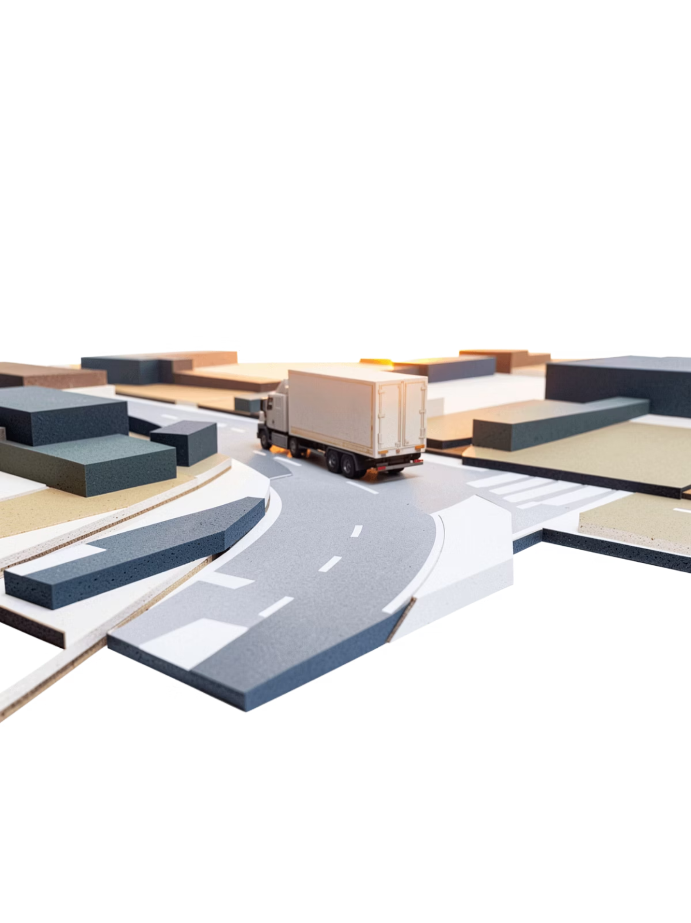
Transforming Logistics Data Into Strategic Advantage
"This solution empowers the organization to achieve efficiency, profitability, and better customer satisfaction — turning every data point into a competitive edge."
Operational Efficiency
Business Profitability
Reduced delays and optimized fleet utilization through real-time, data-driven decision-making.
Lower operational costs through smarter routing, reduced idle time, and targeted interventions.
Customer Satisfaction
Reliable on-time delivery performance builds trust and strengthens long-term customer relationships.
Presented by Zeyaul Haque — Power BI Logistics Analytics Project

