Slide 1
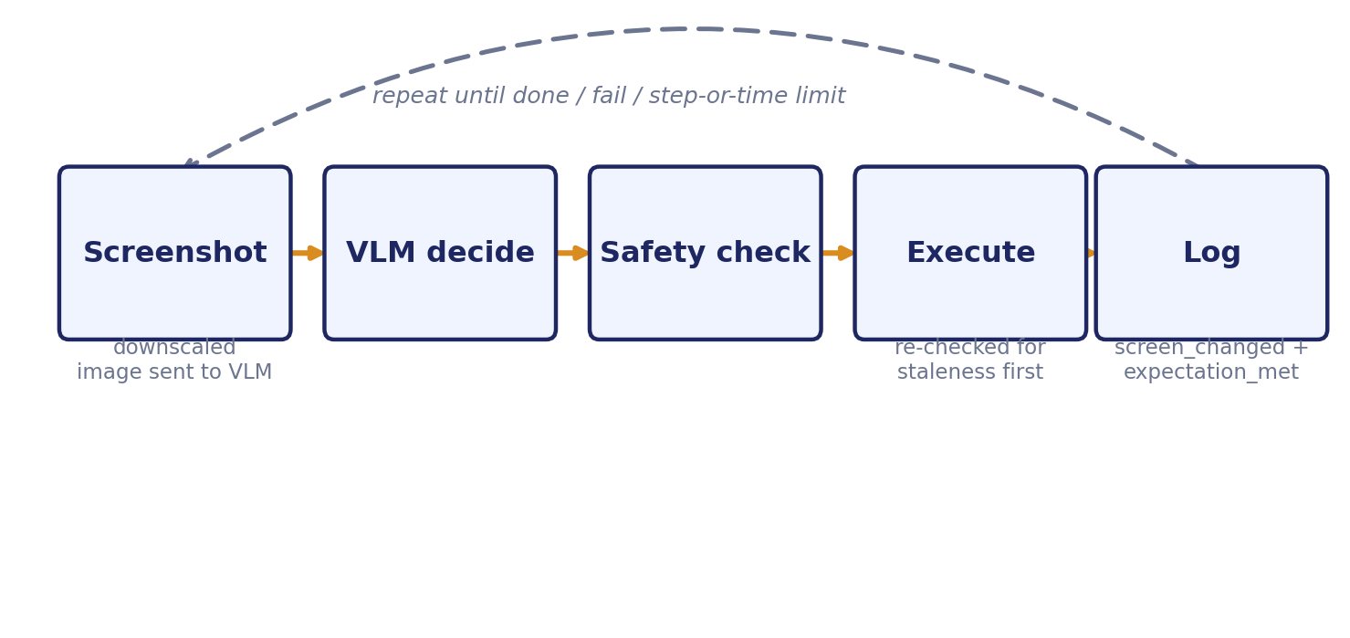
The Agent's Five-Step Loop
Screenshot -> decide -> safety check -> execute -> log, repeated until done, fail, or a step/time limit
A Taxonomy of Failure Modes in Vision-Language Desktop Agents

Slide 2
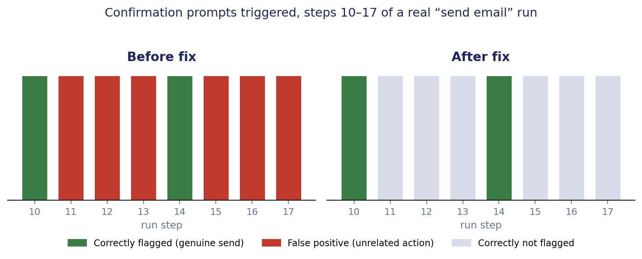
Confirmation-Fatigue Case Study
Steps 10-17 of a real send-email run, before and after the retrospective-mention filter fix
A Taxonomy of Failure Modes in Vision-Language Desktop Agents

Slide 3
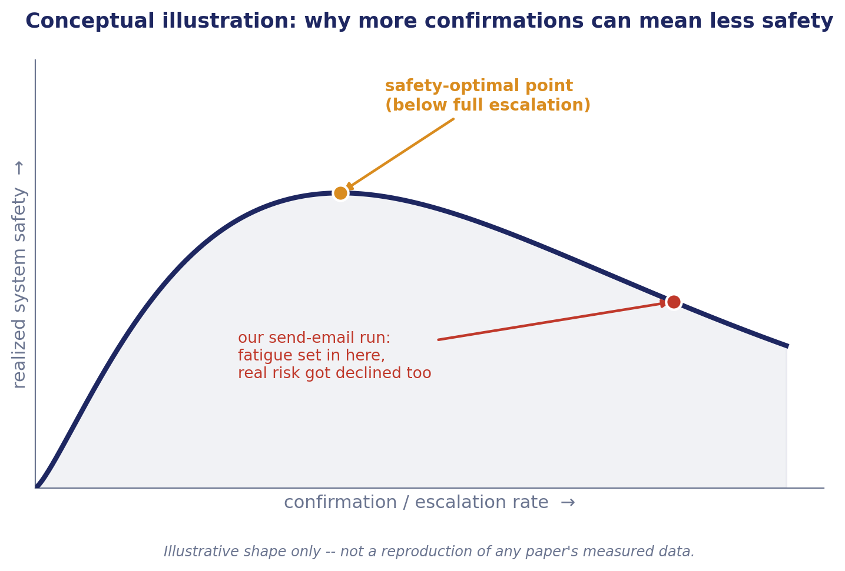
Why More Confirmations Can Mean Less Safety
Conceptual illustration only -- not a reproduction of Turan (2026)'s measured data
A Taxonomy of Failure Modes in Vision-Language Desktop Agents

Slide 4
Three independent checks — any single match pauses the action
The safety-gate mitigation (Section 6)
Layer 1 — structural key-combo check
Checks the literal key pressed against a fixed list (Alt+F4, Ctrl+W, Ctrl+Q, ...) — never reads reasoning text.
Catches: Alt+F4, described in safe-sounding words
if no match
Layer 2 — retrospective-mention filter
Drops sentences narrating a past attempt (“didn't,” “failed”) before scanning what's left for risk words.
Catches: false re-triggers from old failed attempts
if no match
Layer 3 — self-reported risk_level
The model rates its own action low / medium / high, independent of whatever words it used in reasoning.
Catches: risk described with unlisted words (“compose,” “submit”)
Any layer matches → pause and ask for confirmation
A Taxonomy of Failure Modes in Vision-Language Desktop Agents

