Slide 1





1
SCIENTIFIC AND RESEARCH CENTER OF INTERDISCIPLINARY SCHOOLS
Title of the lesson : fMRI image processing , CONN toolbox
Subject Title : ROI to ROI connectivity and graph measures
Teacher’s Name: Zeynab Haghani
Year and Season : Summer 2026
@IDSchools
@Interdisciplinaryschools
@interdisciplinary-schools
https://interdisciplinaryschools.com
Interdisciplinary schools|2026

Slide 2
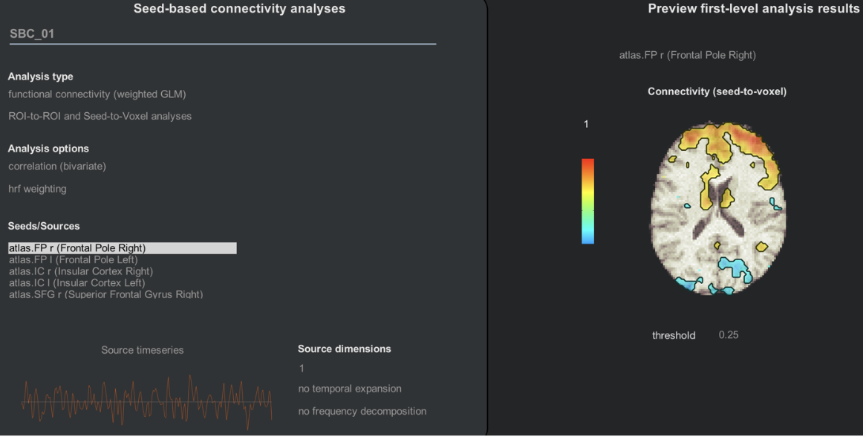
2
ROI-to-ROI Connectivity (RRC)
Instead of comparing one seed to every voxel, it computes connectivity only between selected ROIs.
1- Define ROIs
2-Extract Mean and Time Series from each ROI
3-Pairwise Correlation between all ROI time series
5-Statistical Analysis (GLM) for condition/group differences.
Interdisciplinary schools|2026

Slide 3
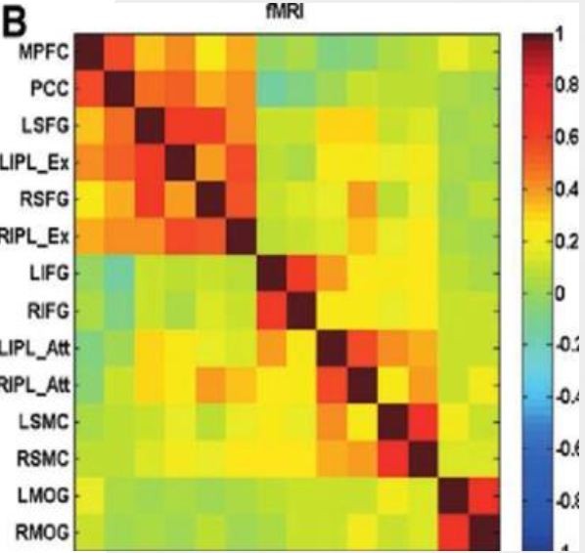
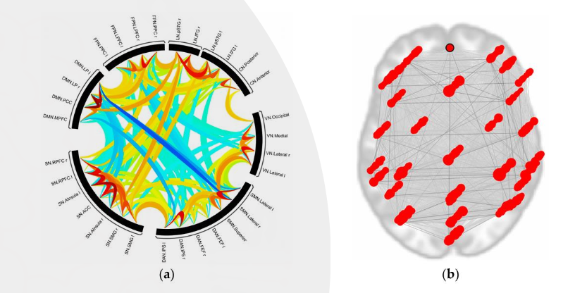
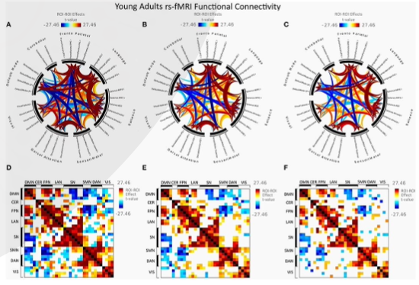
3
RRC-second level analysis
Figure4.the functional connectivity map of the nodes : (a) The darker red lines show strong connectivity, whereas the blue lines show weaker connectivity in the connectome ring.(b) The topological locations of the determined nodes in the brain. The darker red lines show that even though the nodes settle in distinct regions, they are connected with strong functional connectivity.
Note how symmetric the matrix is
Interdisciplinary schools|2026

Slide 4
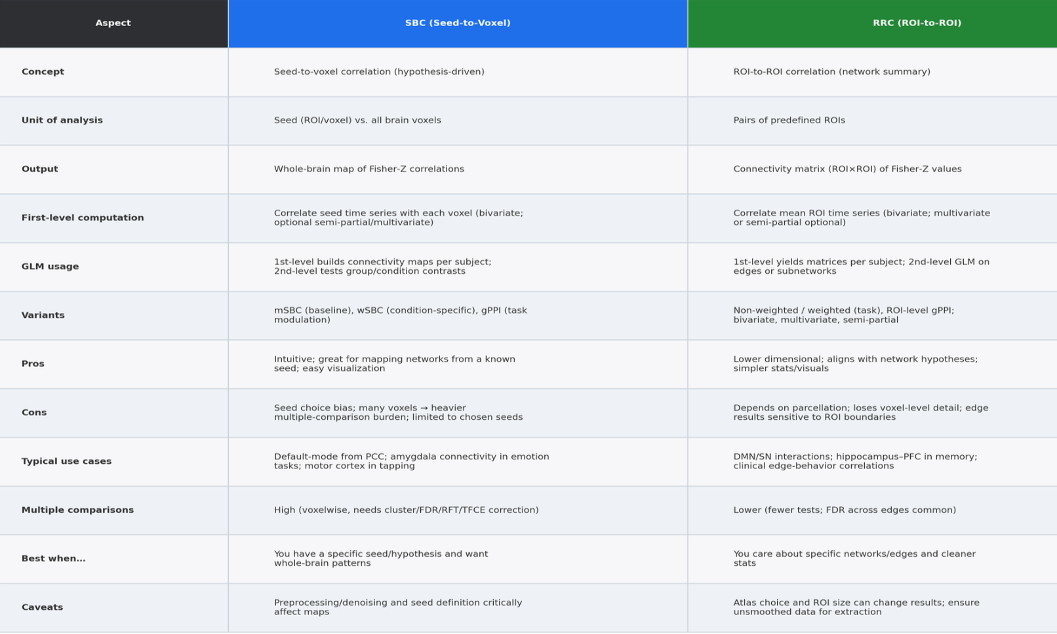
4
RRC vs. SBC comparison
Interdisciplinary schools|2026

Slide 5
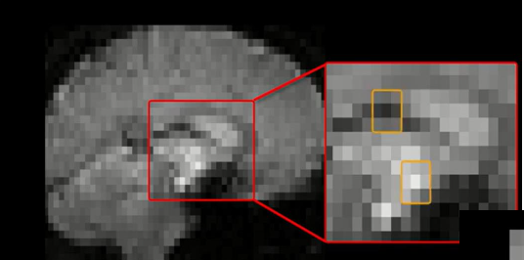

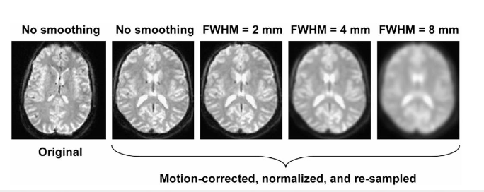
5
What statistics we’re working on
Voxel-wise ? Does our smoothing cause any Noise?
Cluster-wise?
What error rate we’re controlling
Uncorrected
FWER
FDR
Note: There are two thresholds typically used when looking at voxel-level results, the first at the voxel-level (height threshold, limiting which voxels are considered in the results ) and the second at the cluster-level (extent threshold, limiting which clusters are considered in the results). The values considered acceptable are a matter of convention, but typically you will find :
Height-threshold : either uncorrected p-values <.001 or FDR- or FEW- corrected p-values<.05
b) extent-threshold : FEW-corrected or FDR-corrected p-values<.05
Interdisciplinary schools|2026

Slide 6
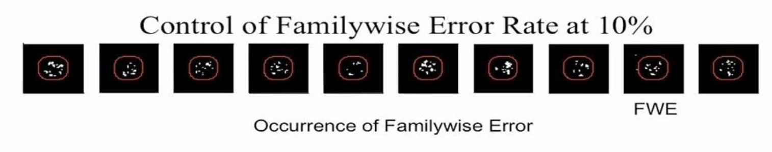
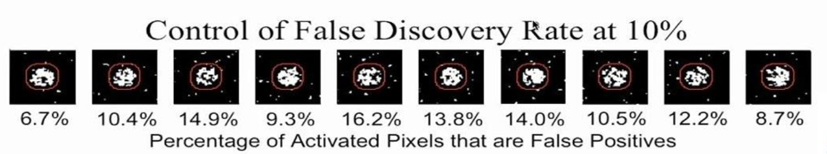
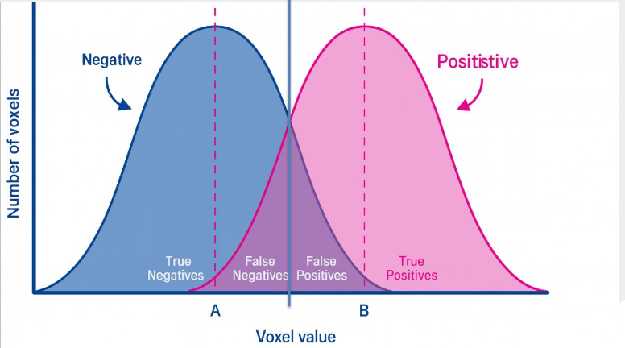
6
Interdisciplinary schools|2026

Slide 7
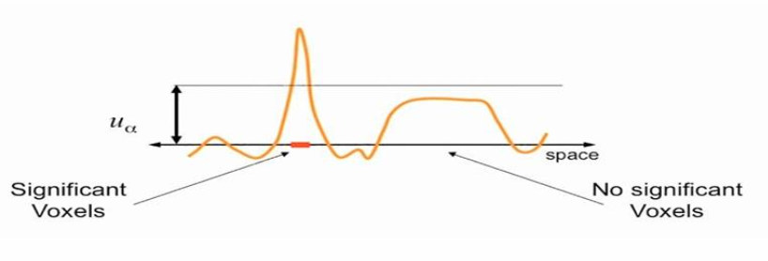
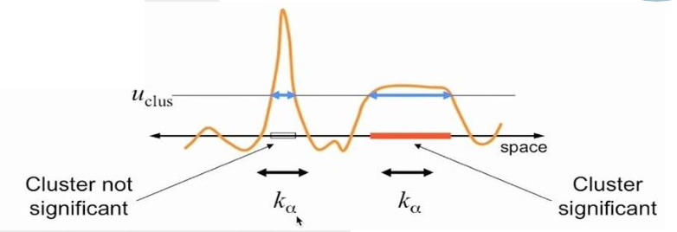
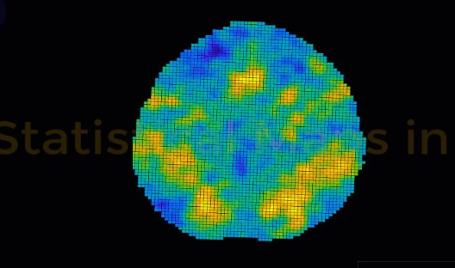
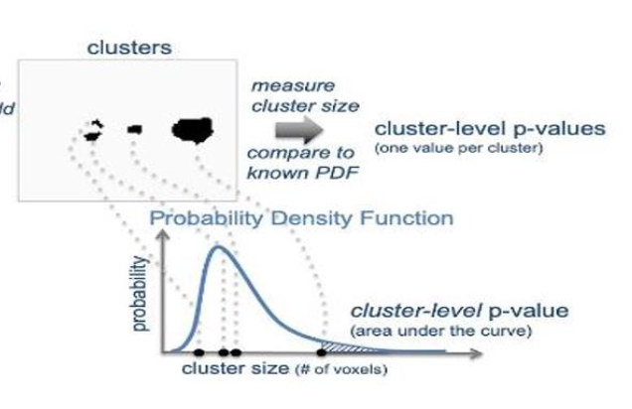
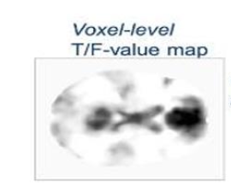
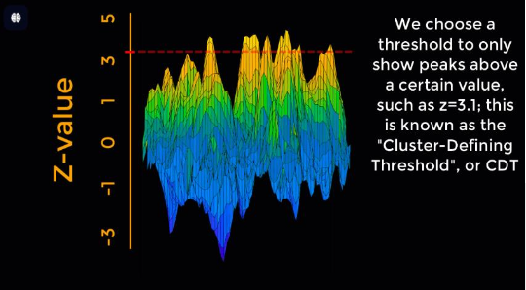
7
Voxel-level vs. Cluster-level inferences
“height”
threshold
Interdisciplinary schools|2026

Slide 8
8
A rule of thumb is to use more conservative height thresholds(e.g. FDR-or FWE-corrected p-values <.05) when the expected effects are focal(i.e. strong effects over small areas), while using more liberal height threshold (e.g. uncorrected p-value <.001 or higher ) when the expected effects are broad but weak .
Interdisciplinary schools|2026

Slide 9
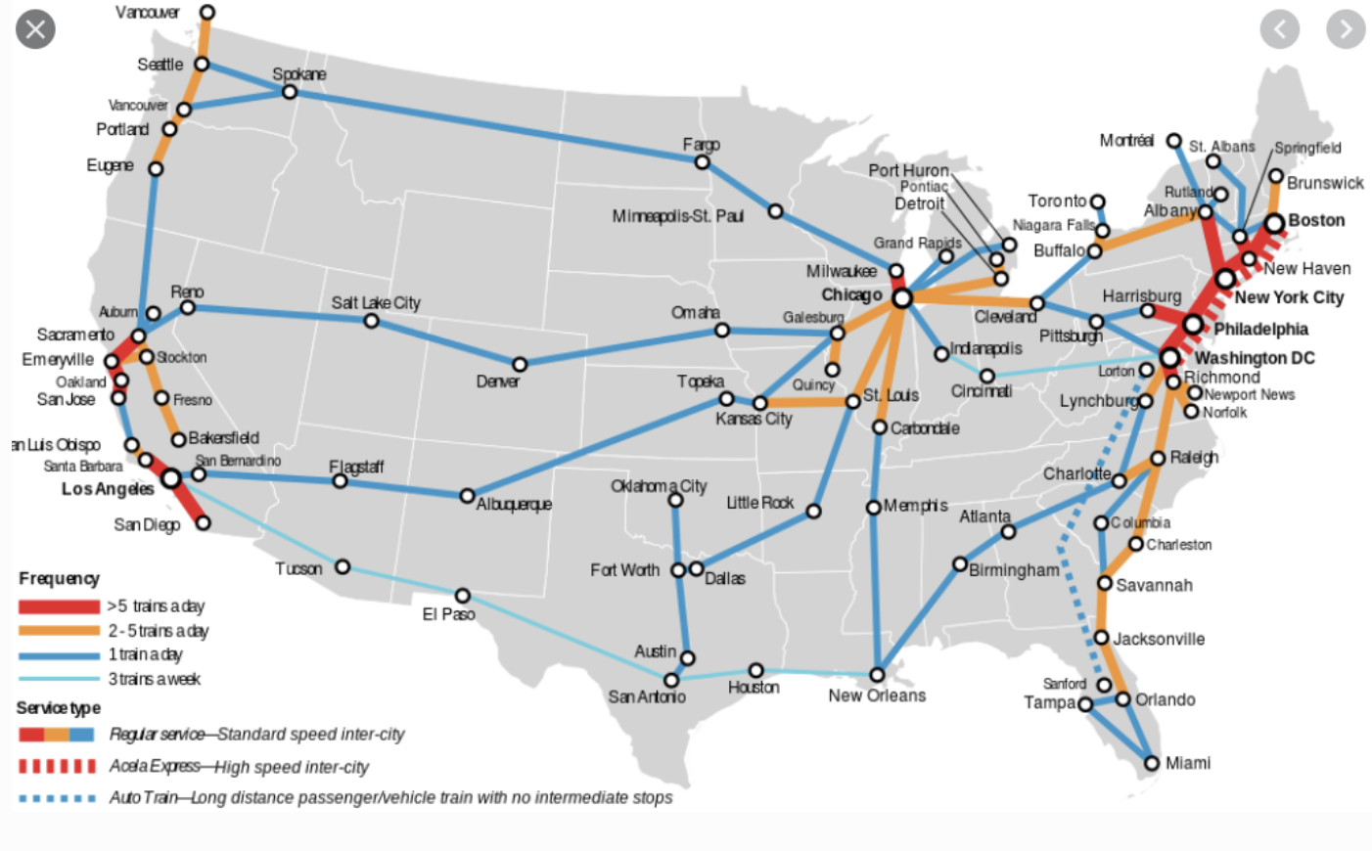
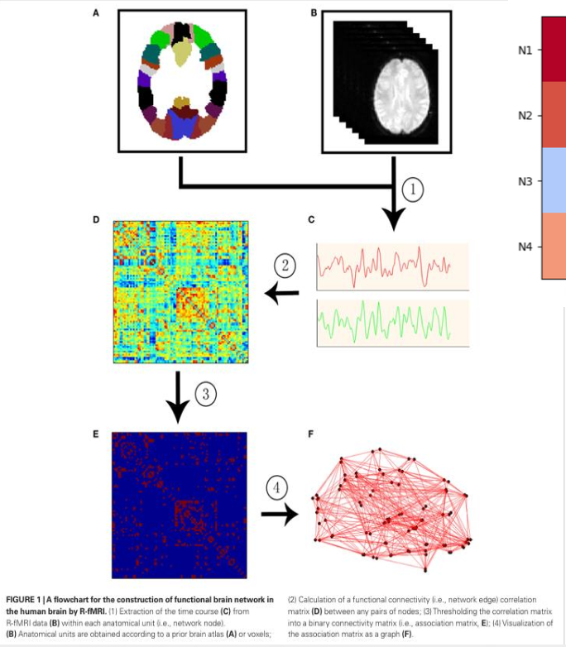
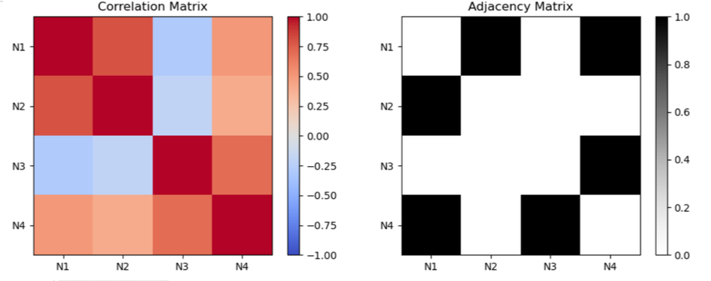
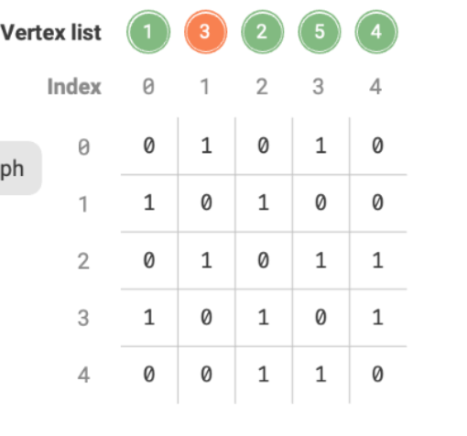
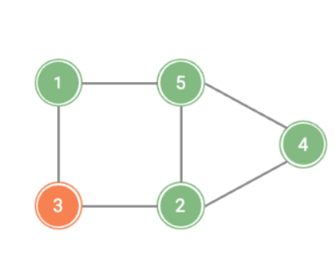
9
Graph Based Measures
Concepts : Brain = a complex network, Nodes(ROIs)= brain regions, Edges = functional connectivity between ROIs
Initialize graph
Why?
1-Understand Local vs. global organization of the brain
2-Identify hubs and network integration/segregation
3-Compare groups (e.g., healthy vs. patient, rested vs. sleep deprived)
Interdisciplinary schools|2026

Slide 10
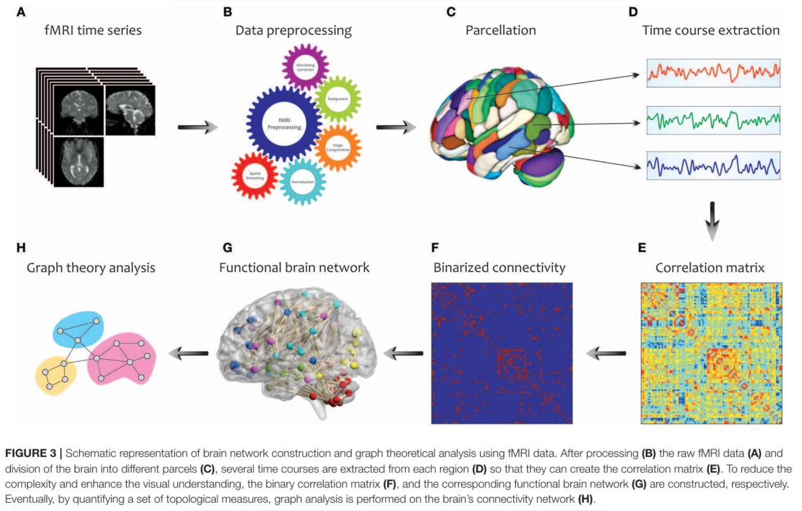
10
Interdisciplinary schools|2026

Slide 11
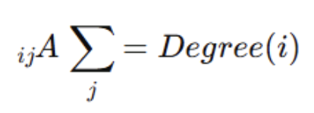
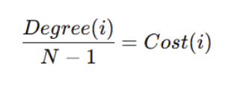
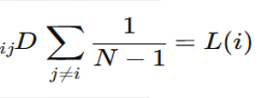

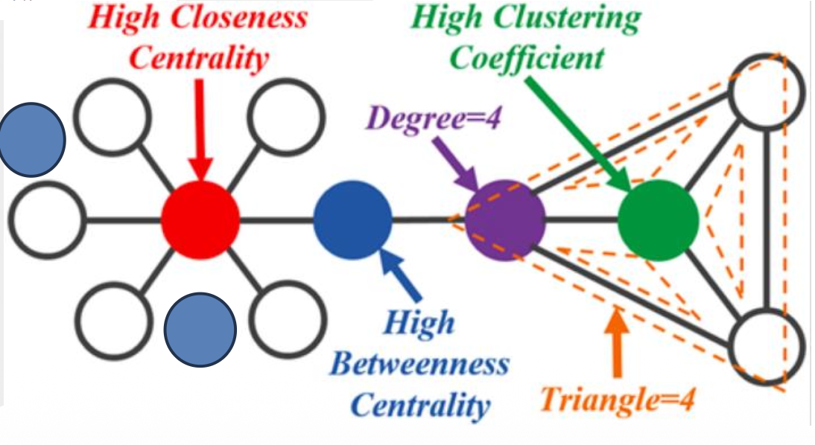
11
Key Graph-Based Measures
Node-level Metrics
Degree: number of connection of a nodes(hub)
Cost: proportion of a node’s actual connections relative to the maximum possible connections
Clustering Coefficient: how interconnected neighbors are (local integration)
Betweenness Centrality : how often a node lies on shortest paths(bridging role)
Network-level Metrics
Average Path Length : how many steps on average to reach others (global integration)
Global Efficiency : speed of information transfer across the network
Local Efficiency :efficiency of information transfer within a node’s neighbors
Interpretation
High clustering + high efficiency :small-word , organization (hallmark of healthy brain networks )

Slide 12
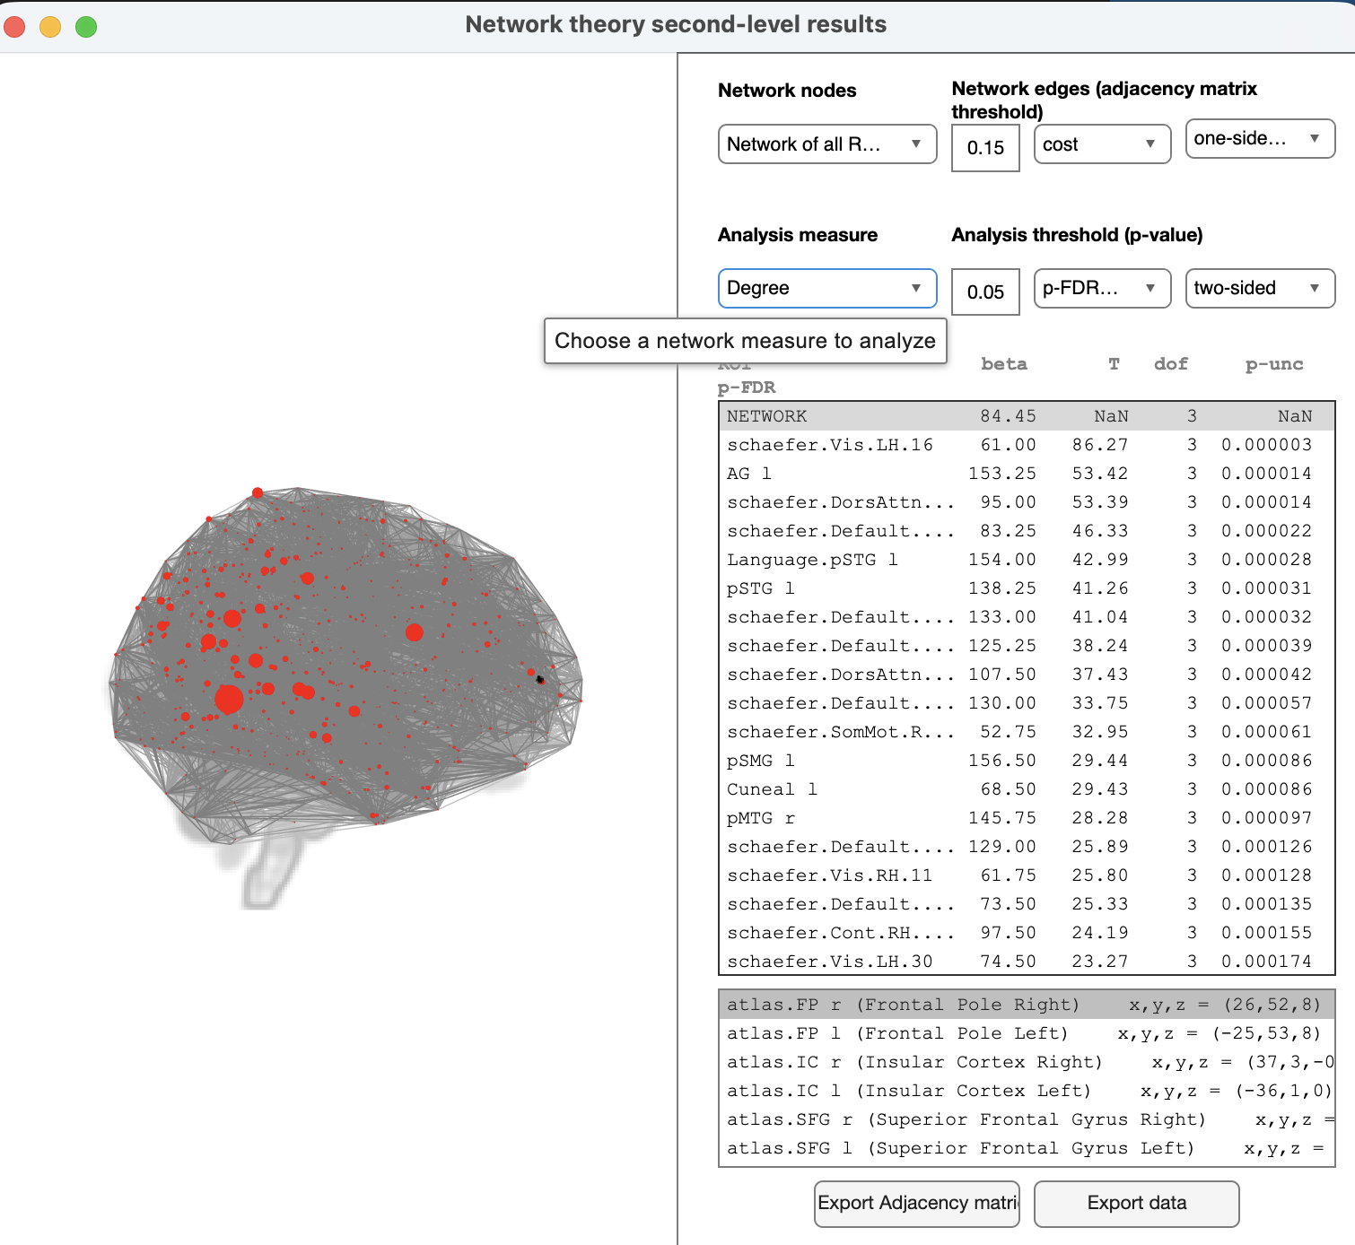

Slide 13
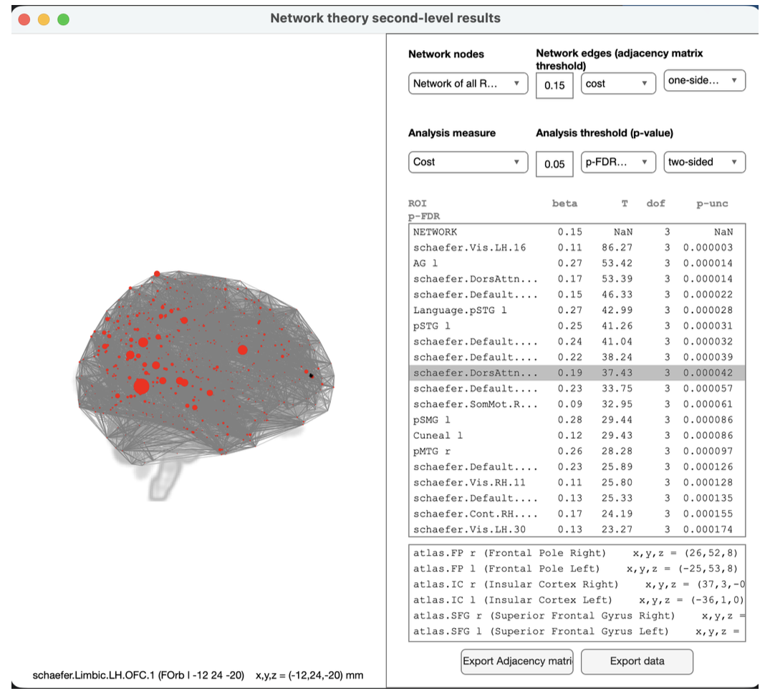

Slide 14
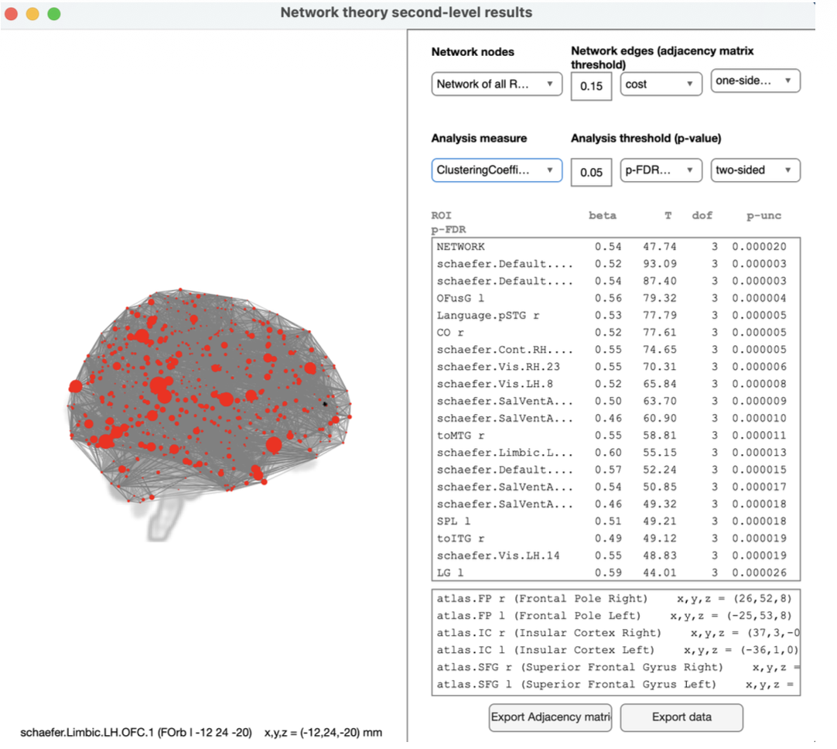

Slide 15
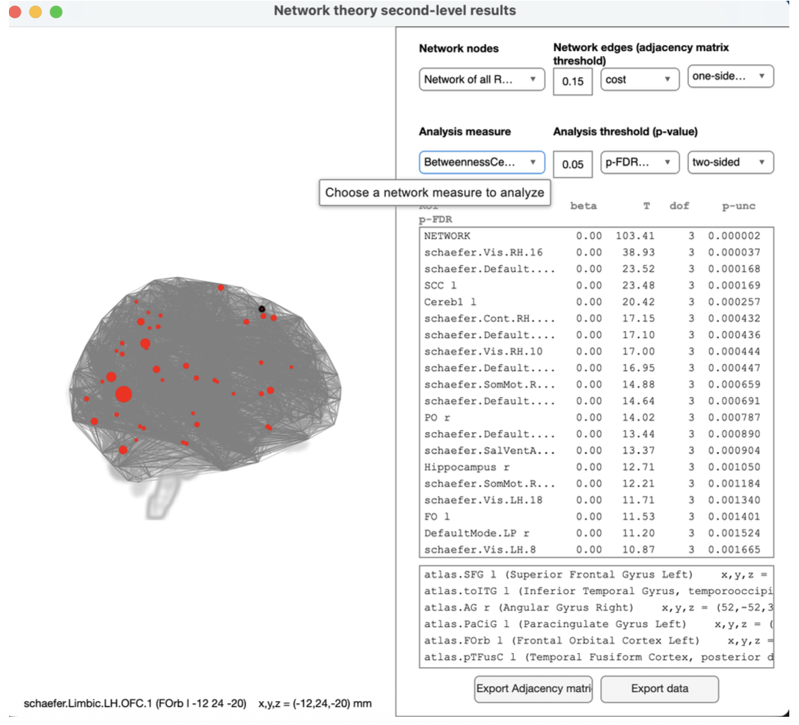

Slide 16
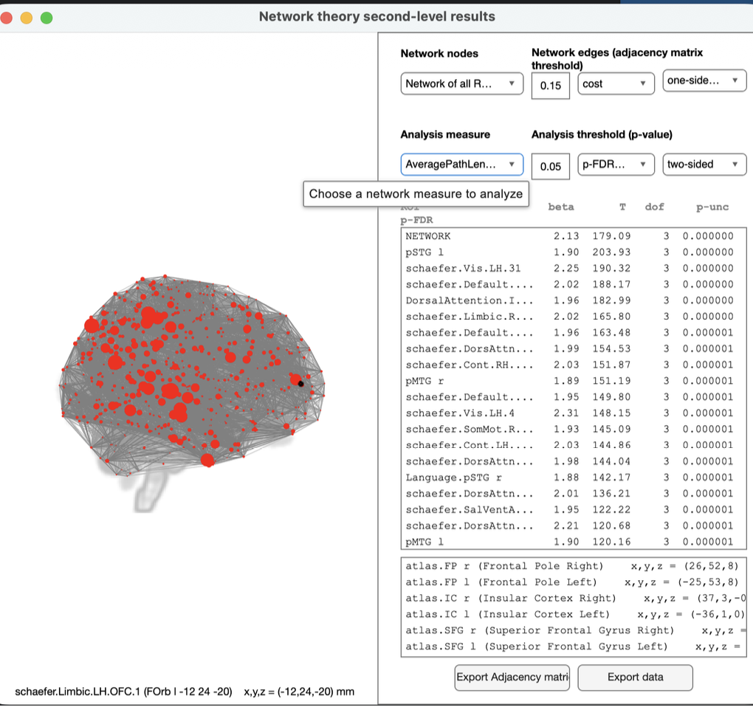

Slide 17
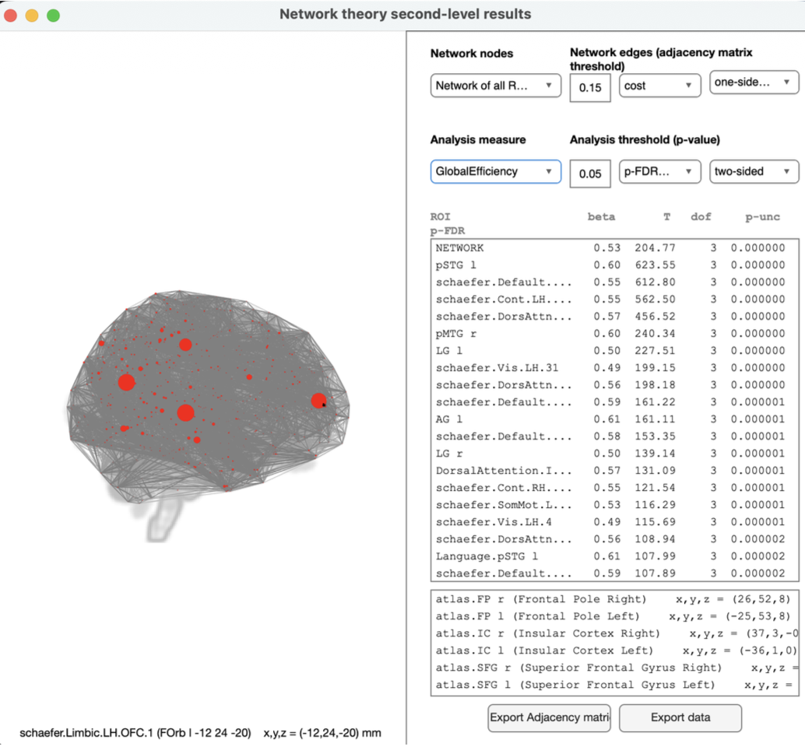

Slide 18
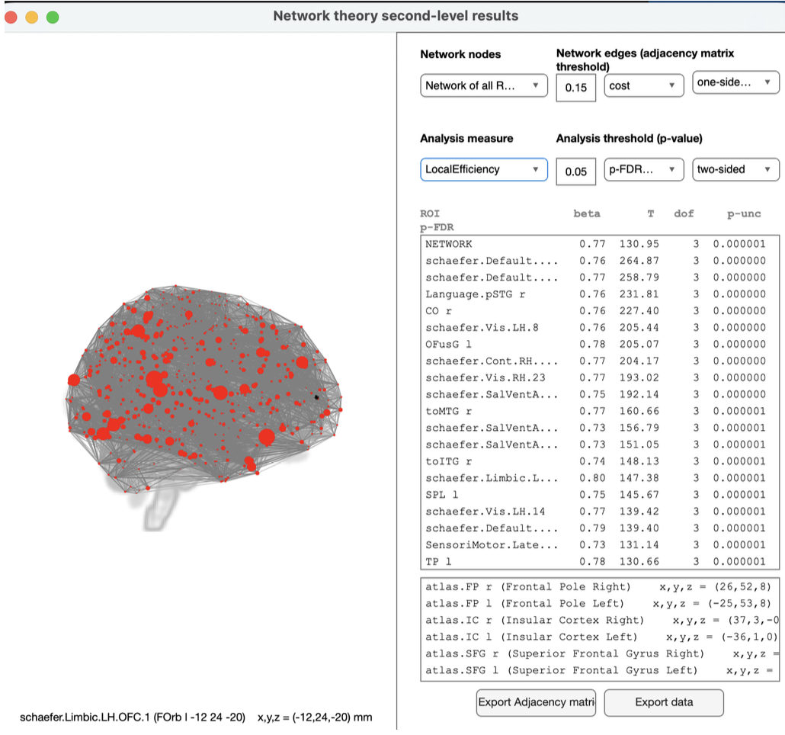

Slide 19
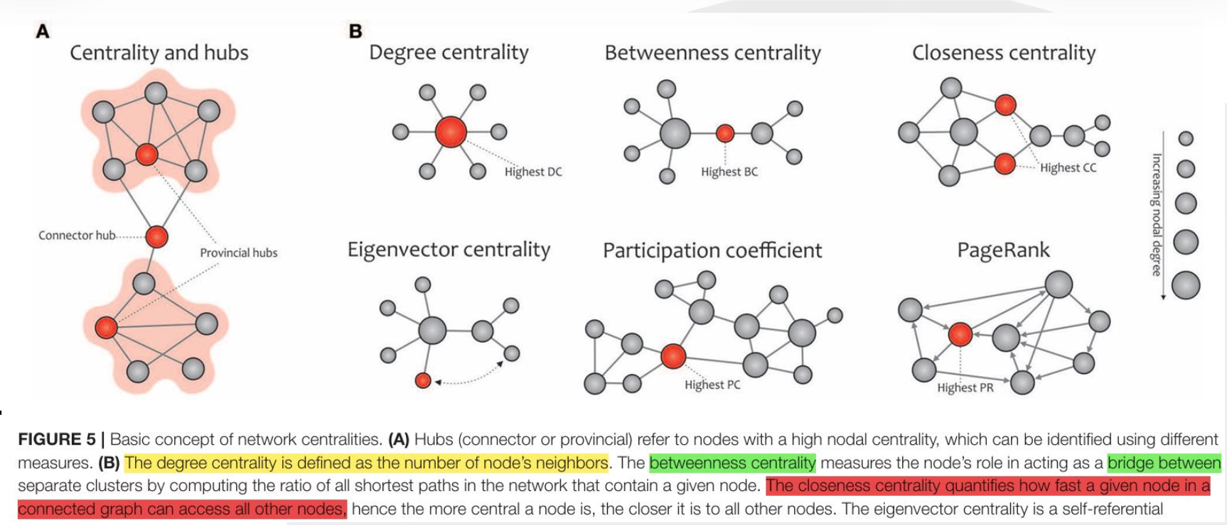
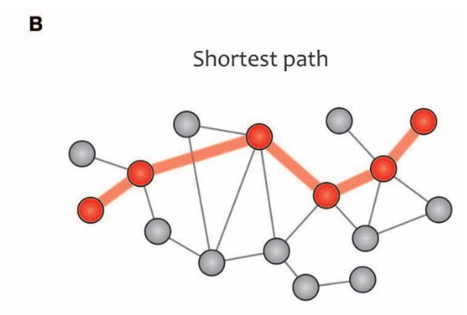
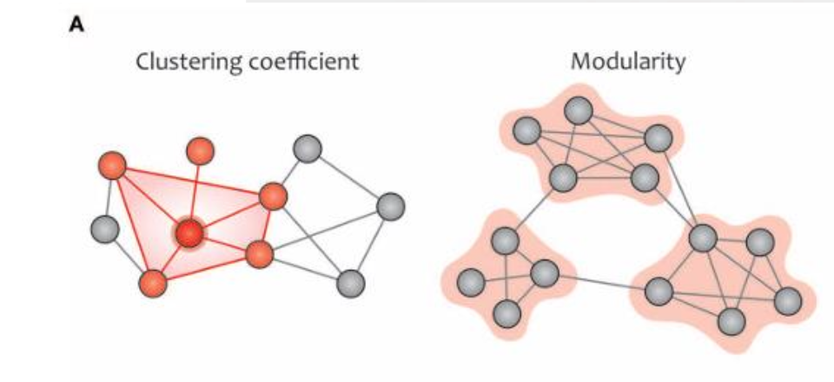
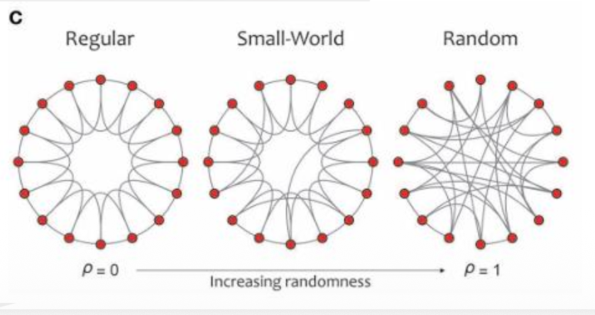
12
Modularity: related to clusters of nodes, called modules, that have dense interconnectivity within clusters but sparse connections between nodes in different clusters.
Regular network (left) displays high clustering and a long average path length, while a random network(right) displays a low clustering coefficient and a short average path length. A small-world network(middle) illustrates an intermediate balance between regular and random networks(i.e., they consist of many short-range links alongside a few long-range links ), reflecting a high clustering coefficient and a short path length.

Slide 20
13
Thank You
@IDSchools
@Interdisciplinaryschools
@interdisciplinary-schools
https://interdisciplinaryschools.com
Interdisciplinary schools|2026

