Slide 1





1
SCIENTIFIC AND RESEARCH CENTER OF INTERDISCIPLINARY SCHOOLS
Title of the lesson : fMRI image processing , CONN toolbox
Subject Title : ICA
Teacher’s Name: Zeynab Haghani
Year and Season : Summer 2026
@IDSchools
@Interdisciplinaryschools
@interdisciplinary-schools
https://interdisciplinaryschools.com
Interdisciplinary schools|2026

Slide 2
2
Network measures (voxel-level)
-functional connectivity at the voxel level
Data-driven
-calculate correlations between every voxel and every other voxel in the brain (massive matrix: millions of pairs).
Types
IC(Intrinsic Connectivity): RMS of correlation with all voxels
GCOR(Global Correlation): Mean correlation with all voxels
LCOR(local Correlation) : Mean correlation with local neighborhood (Gaussian Kernel)
Group ICA : Identify spatially independent brain networks
Group PCA: Identify principal variance components (no ICA rotation)
Interdisciplinary schools|2026

Slide 3
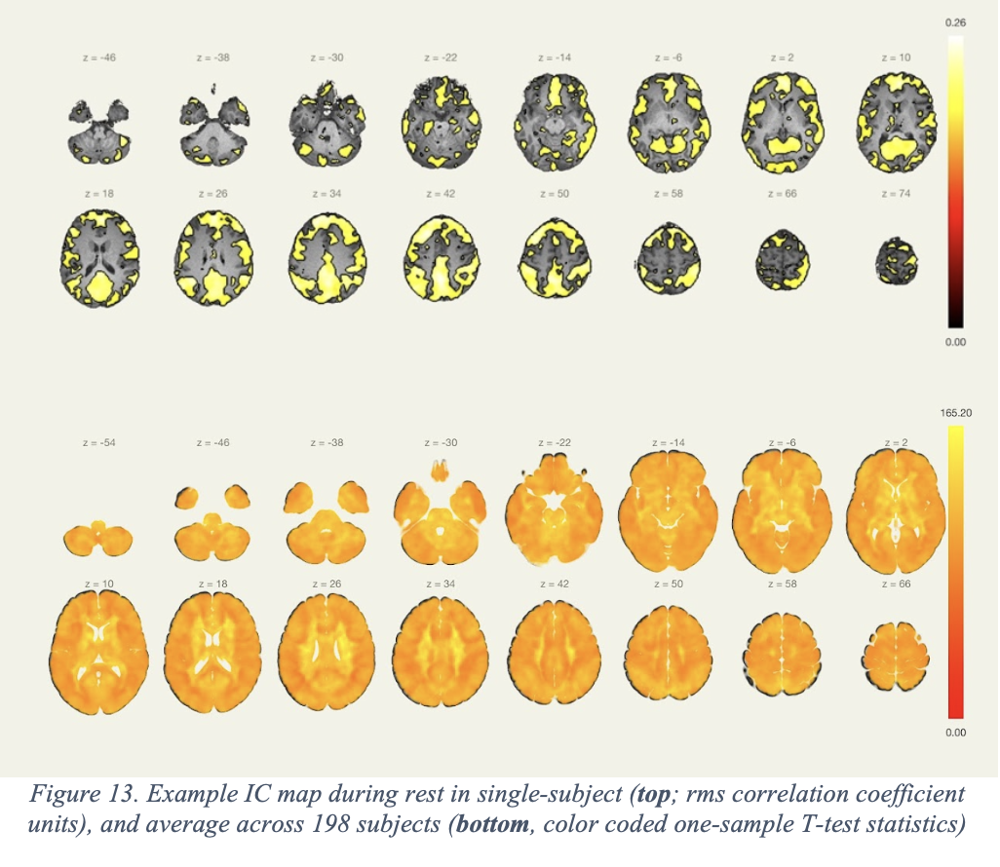
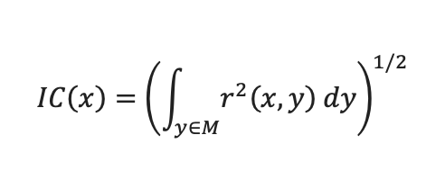
3
Intrinsic Connectivity (IC)
Interdisciplinary schools|2026

Slide 4
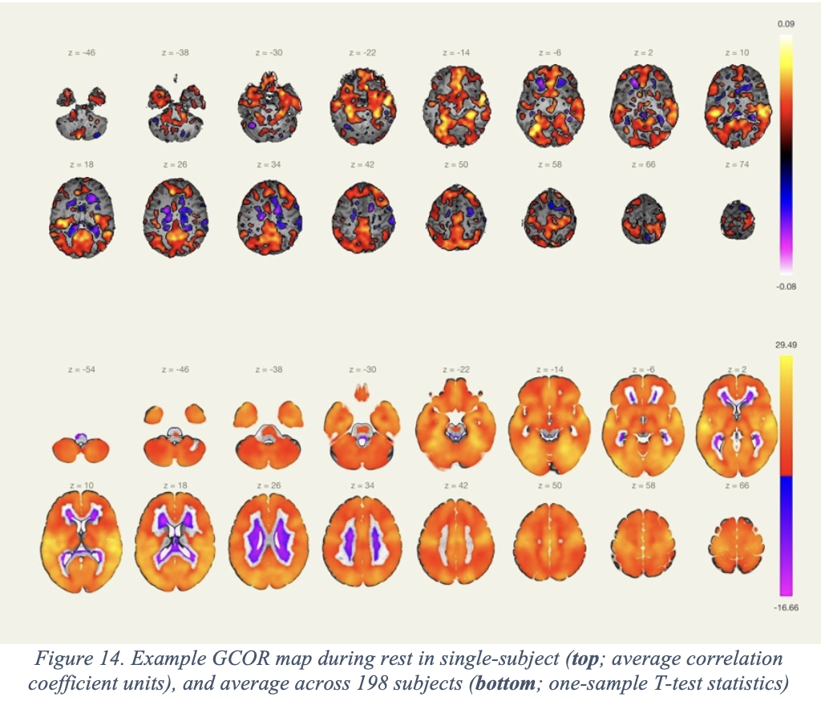
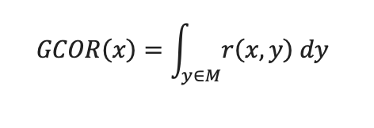
Global Correlation(GCOR)
4
Interdisciplinary schools|2026

Slide 5
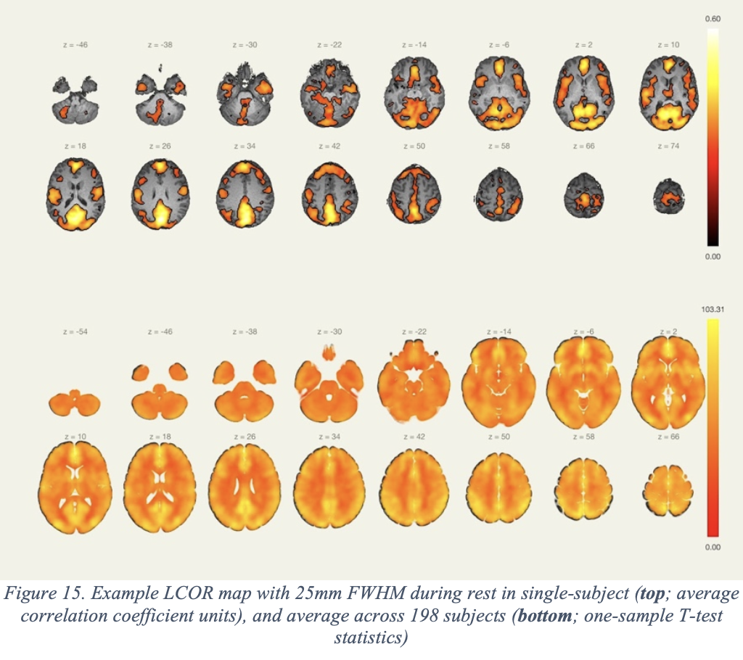
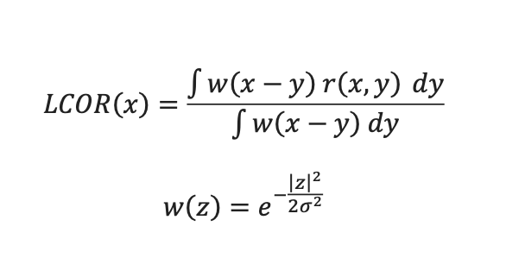
Local Correlation(LCOR)
5
Interdisciplinary schools|2026

Slide 6
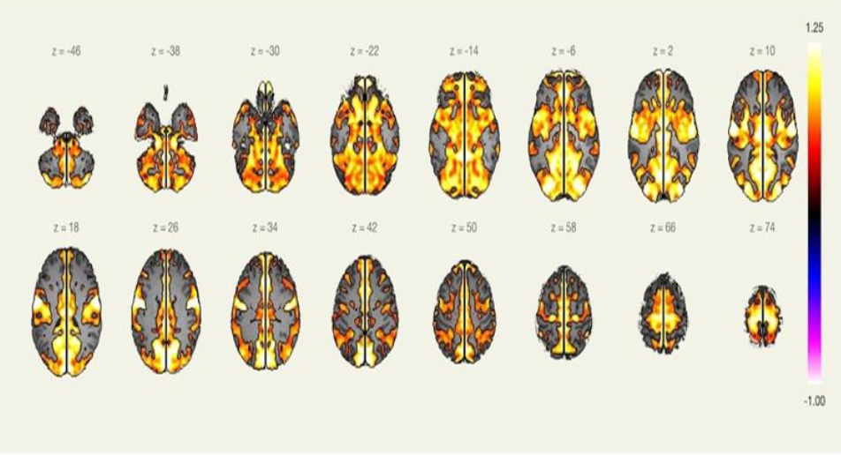
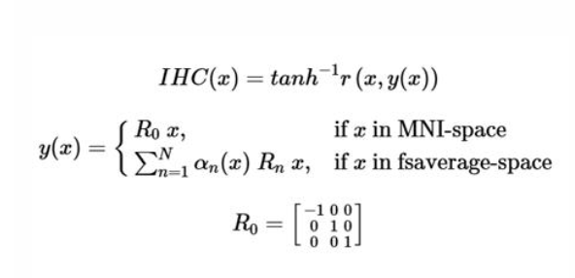
6
Interhemisferic Correlation (IHC)
Interdisciplinary schools|2026

Slide 7
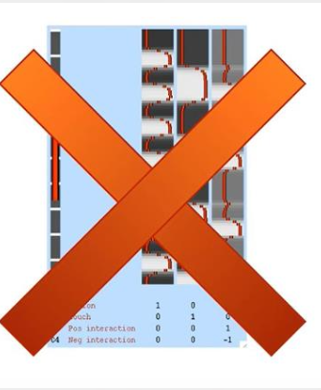
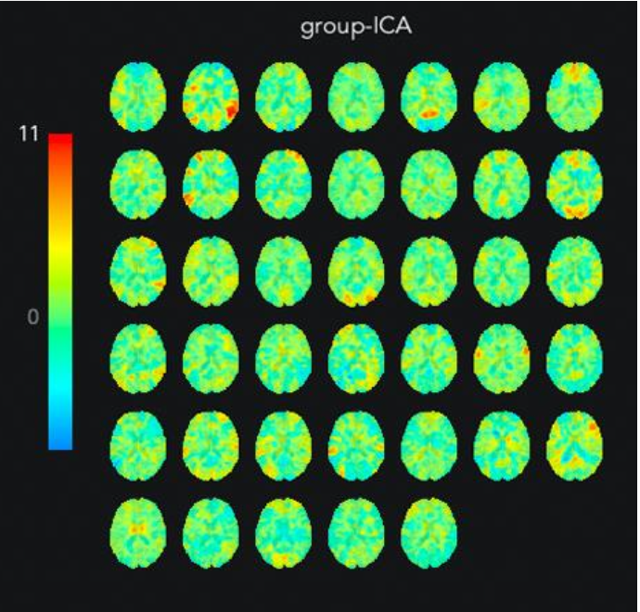
Independent Component Analysis (ICA)
7
Model Free
Purpose:
1- To identify components within millions of voxels (Note it’s difference with ROI/Seed definition we previously had.
2- To extract time-series of each component
Interdisciplinary schools|2026

Slide 8
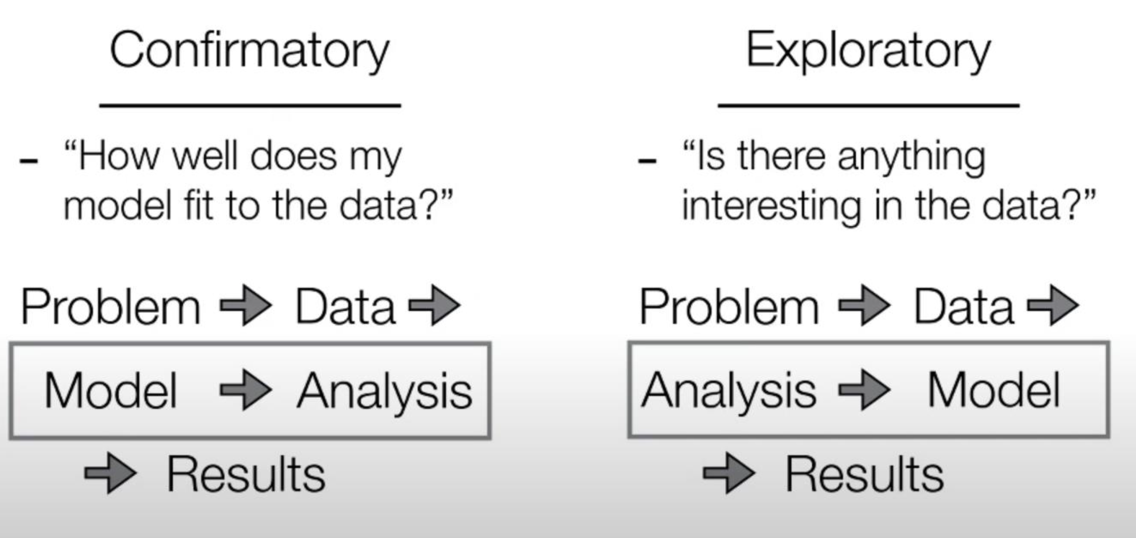
8
-Results depend on the model
-Can give unexpected results
Interdisciplinary schools|2026

Slide 9
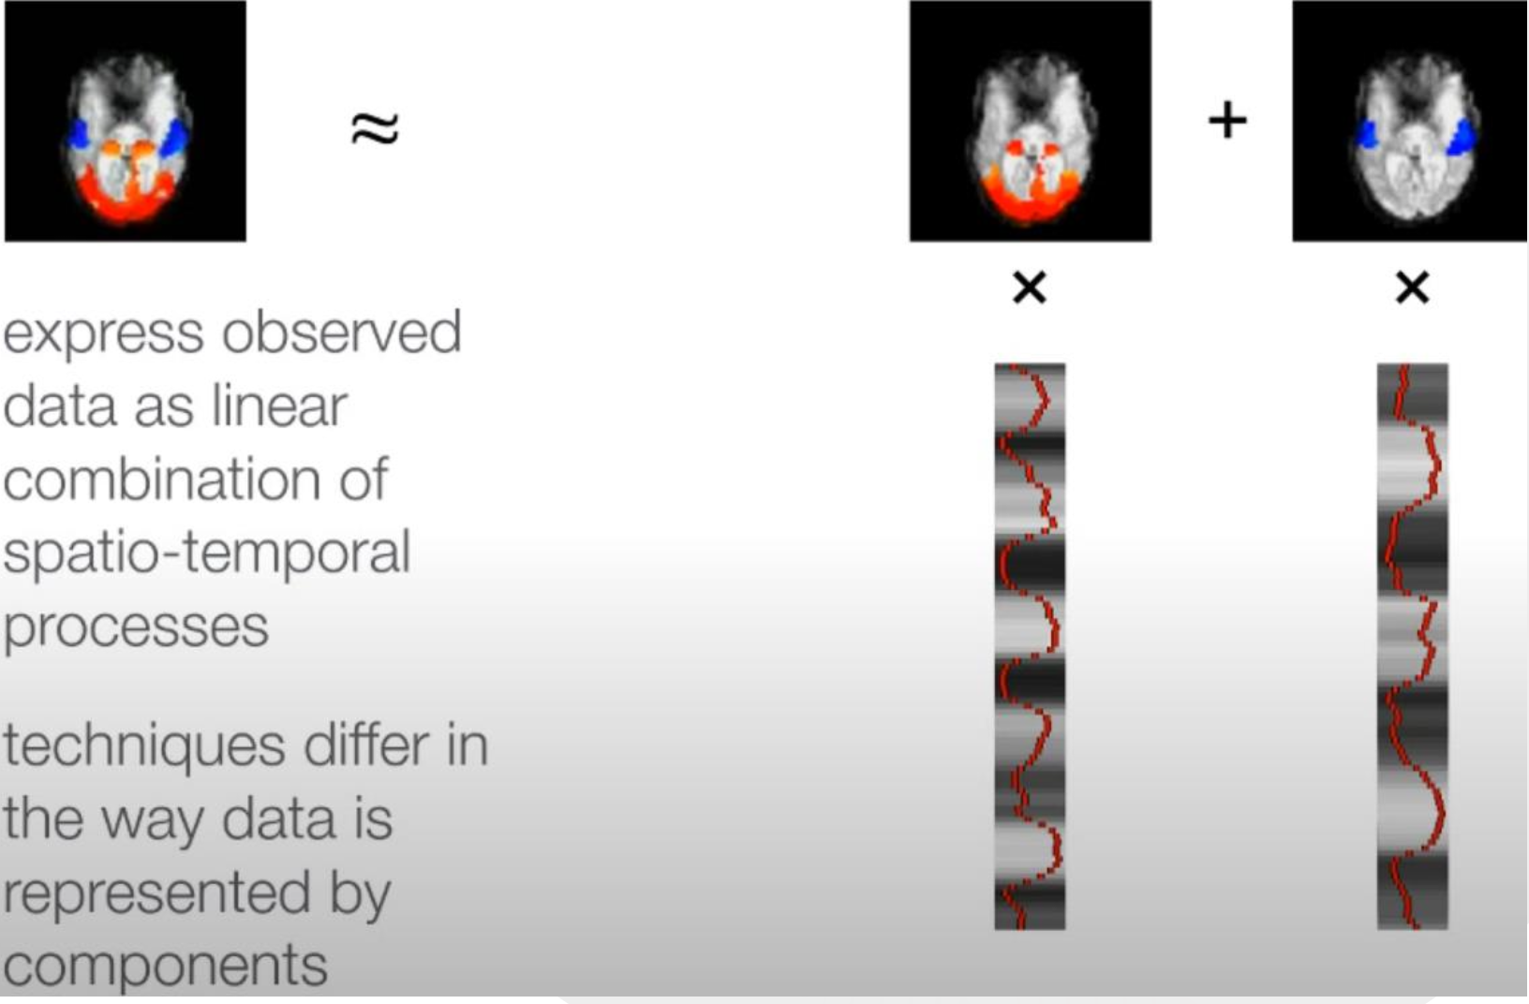
9
What are components?
Interdisciplinary schools|2026

Slide 10
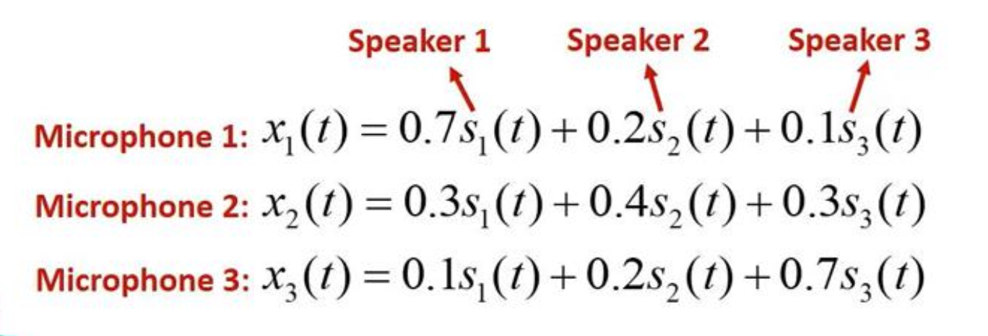
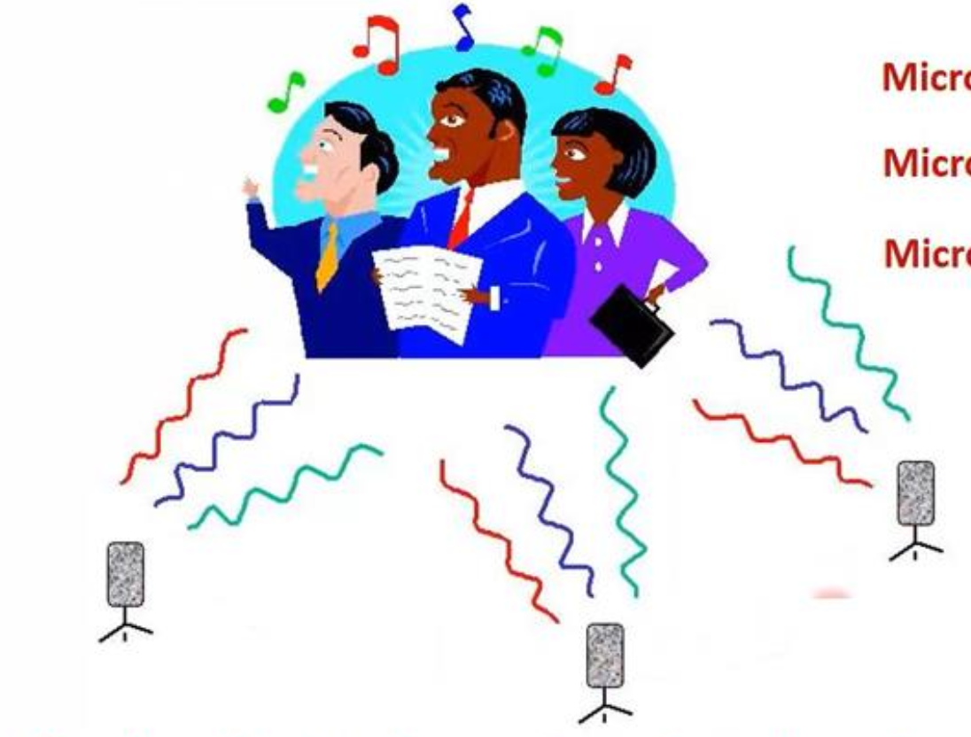
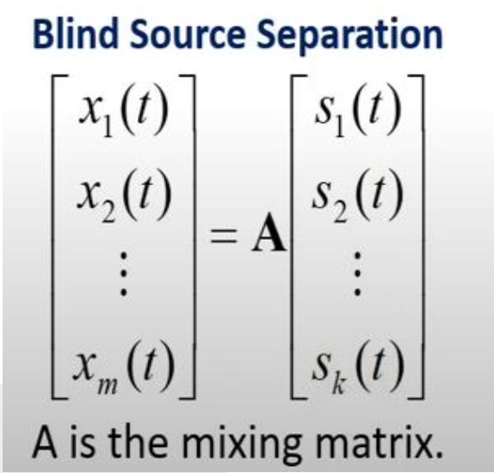

10
A cocktail-party problem
Number of microphones ٰٰٰٰ <number of speakers
Interdisciplinary schools|2026

Slide 11
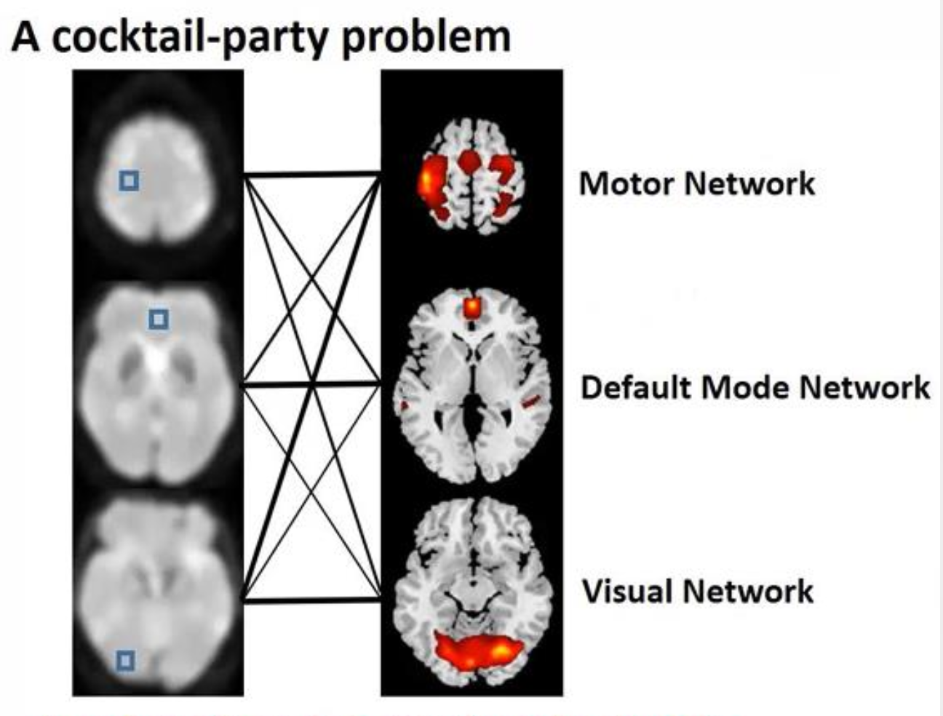
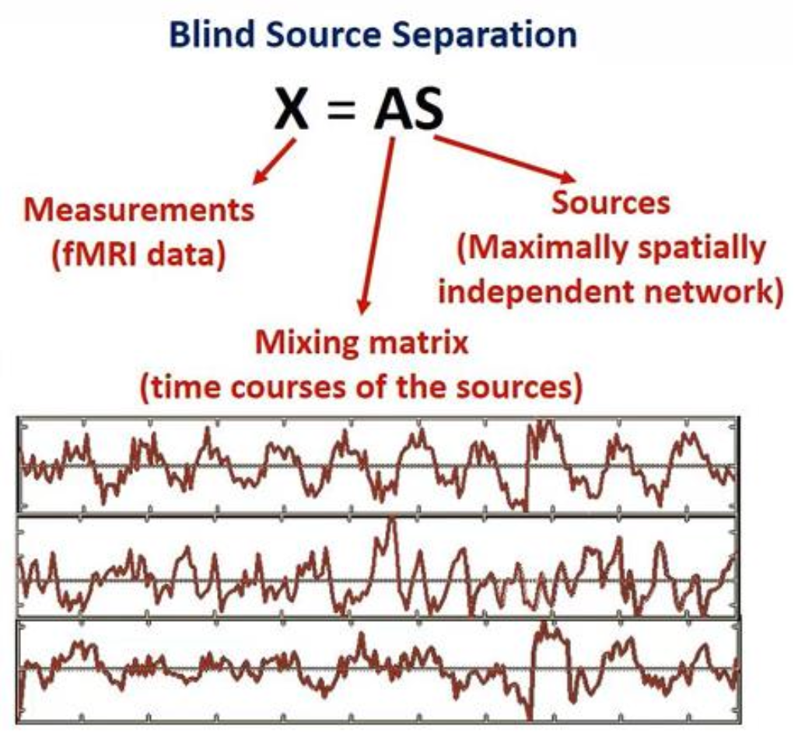
11
Number of voxels > number of networks
Interdisciplinary schools|2026

Slide 12
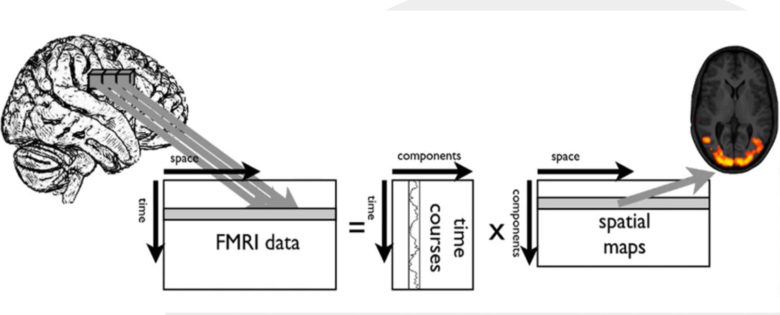
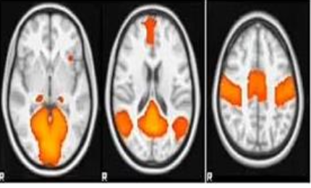
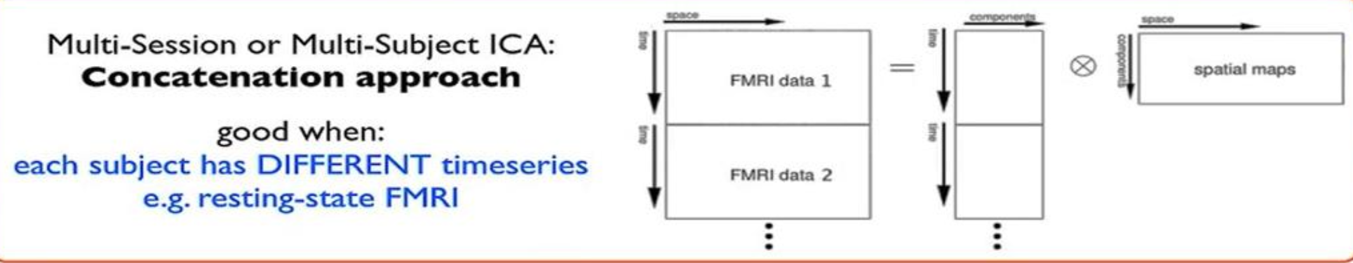
12
Interdisciplinary schools|2026

Slide 13
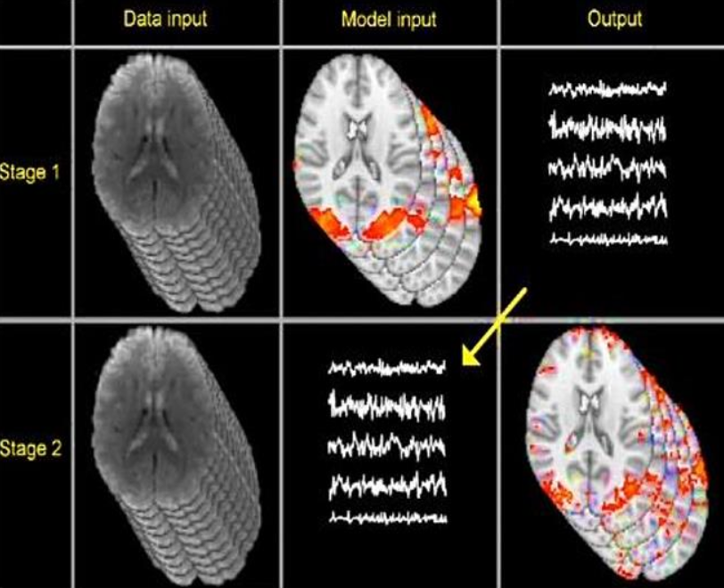
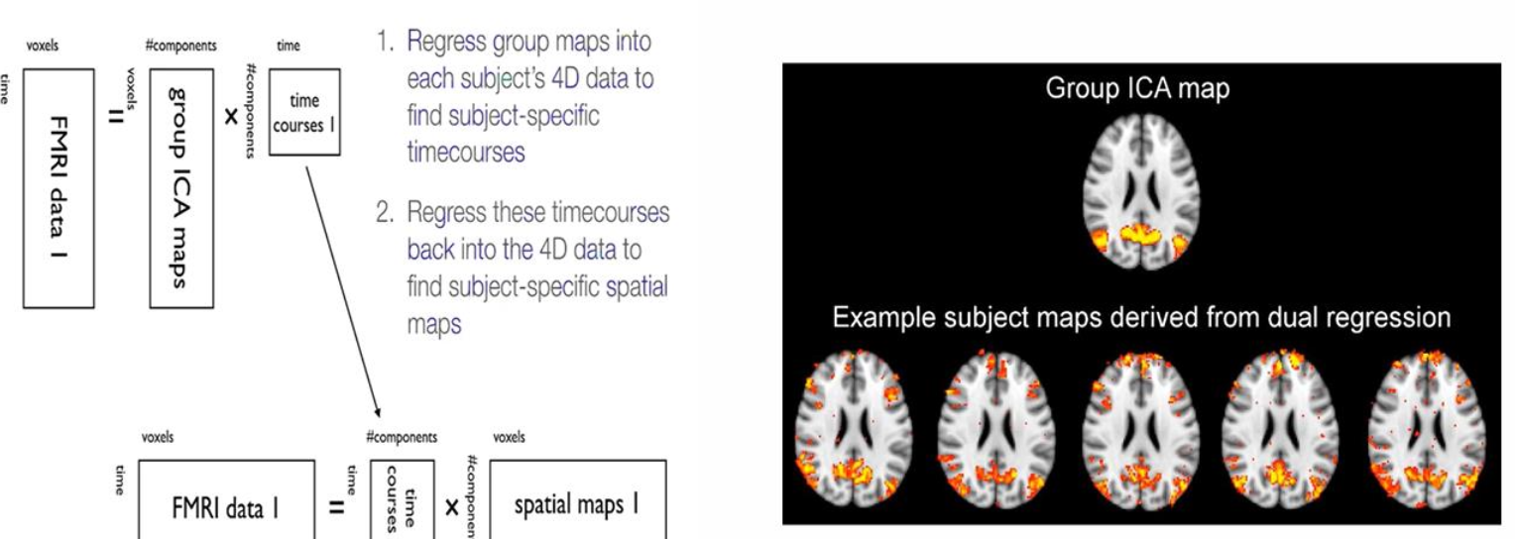
13
Dual Regression
Two steps that both involve multiple regression:
-Extract subject time-series
-Extract subject maps
Interdisciplinary schools|2026

Slide 14
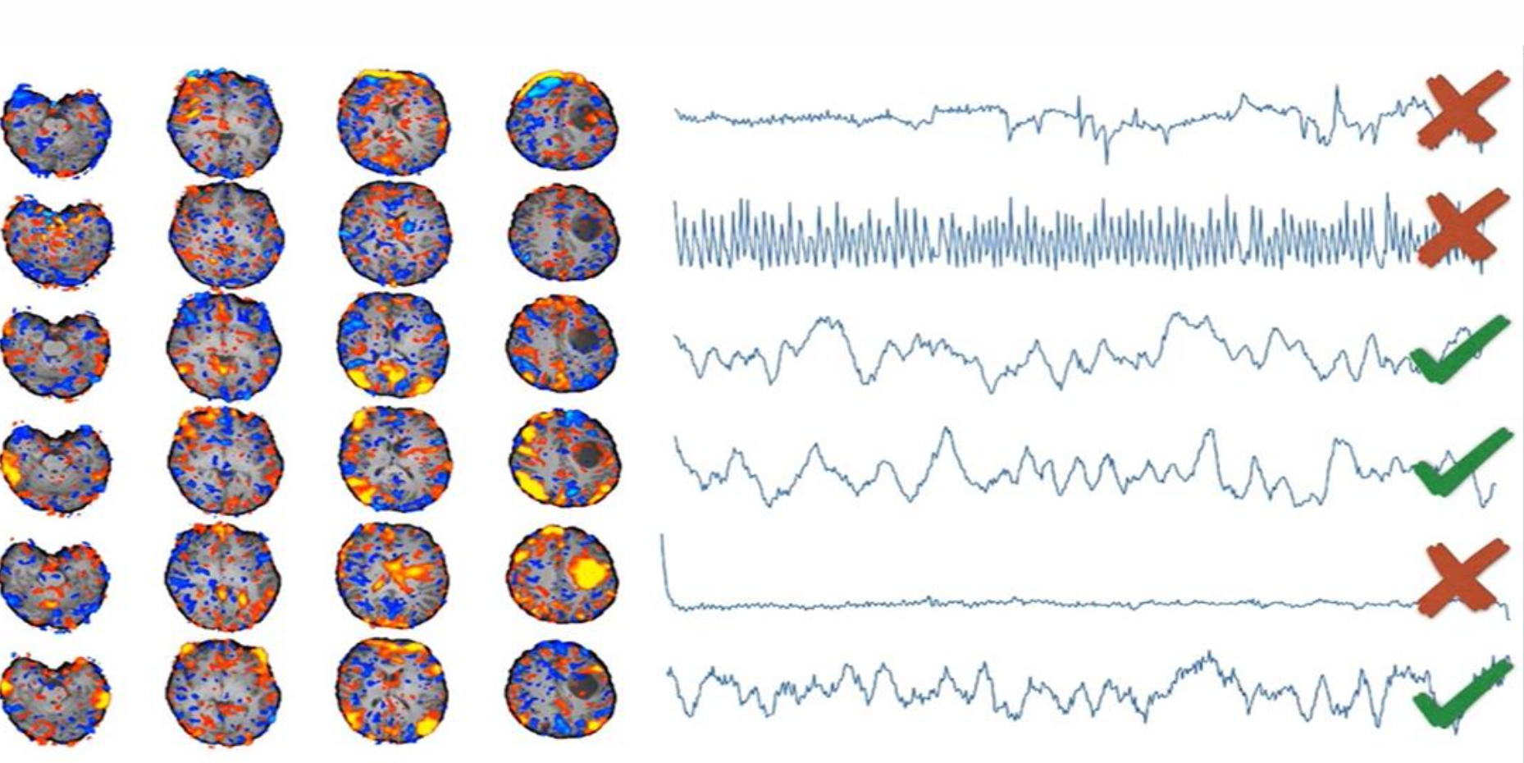
14
ICA in Denoising
Interdisciplinary schools|2026

Slide 15
17
Thank You
@IDSchools
@Interdisciplinaryschools
@interdisciplinary-schools
https://interdisciplinaryschools.com
Interdisciplinary schools|2026

