Slide 1
BDFS
Behavioral Decision Fatigue Scoring
Real-Time Cognitive Fatigue Detection Through Behavioral Machine Learning
Alperen Sümeroğlu · 231805023
Zeynalabidin Ramazanzade · 231805121
XGBoost
FastAPI
SHAP
Notes:
Good [morning/afternoon], everyone. My name is Alperen, and together with my teammate Zeynalabidin, we present BDFS — Behavioral Decision Fatigue Scoring. This is a real-time machine learning system designed to detect cognitive decision fatigue non-intrusively, purely by analyzing how a person behaves — not what they wear, not what they report, but how they respond. Over the next ten minutes, we'll walk you through the problem, our solution, the data, the models, and a live demonstration. Let's get started.

Slide 2
THE INVISIBLE THREAT
Problem Statement
70%
0
∞
of critical errors
Real-time tools
Surveys & sensors
linked to cognitive fatigue
non-intrusive & scalable
disruptive, biased, delayed
01 Decision fatigue silently degrades judgment accuracy — often unnoticed until a costly mistake occurs. 02 EEG headsets, biometric sensors, and manual surveys are impractical at scale and in real environments. 03 There is no current tool that detects fatigue passively, in real-time, from pure behavior alone.
Notes:
Consider this: cognitive decision fatigue is responsible for a significant proportion of human errors in high-pressure environments. Yet unlike physical fatigue, it leaves no visible trace. A surgeon five hours into a procedure, an air traffic controller mid-shift, a driver on a long highway — all may be cognitively impaired while appearing completely normal. Current solutions — EEG sensors, biometric wristbands, post-task surveys — are either invasive, expensive, or far too slow to be actionable. BDFS addresses this gap directly.

Slide 3
WHY THIS MATTERS
High-Stakes Impact
🏥 Healthcare
✈️ Aviation
Surgical errors and clinical misjudgments spike during late-shift fatigue windows.
Pilot cognitive load is a primary cause of near-misses and landing errors worldwide.
🚗 Transportation
⚖️ Finance & Law
Decision fatigue causes thousands of road accidents annually despite visible alertness.
Judges and traders make systematically worse decisions as their sessions progress.
Catching fatigue BEFORE an error saves lives, reduces liability, and improves human performance.
Notes:
The consequences of undetected decision fatigue are severe and measurable. In healthcare, studies consistently show that procedural errors increase during extended shifts — not because clinicians become careless, but because their cognitive machinery is exhausted. In aviation, regulatory bodies identify cognitive overload as a contributing factor in a large share of serious incidents. In finance, researchers have documented that judges approve fewer parole requests as the day goes on — not for legal reasons, but purely because of mental fatigue. The economic cost is in the billions annually. A real-time, non-intrusive detection system is not just a convenience — it is a safety-critical tool.

Slide 4
THE BDFS SOLUTION
NON-INTRUSIVE
System at a Glance
Infers fatigue from behavioral patterns only — no wearables, no biometrics required.
🖥️ Web UI (19 behavioral inputs)
⚡ FastAPI async REST backend
REAL-TIME
⚙️ StandardScaler preprocessing
XGBoost inference completes in under 10ms via an async FastAPI REST endpoint.
🌲 XGBoost prediction engine
🔍 SHAP explainability layer
EXPLAINABLE
📊 Probability gauge + top factors
SHAP values expose exactly which behavioral signals drove each prediction.
Notes:
BDFS is built on a deceptively simple premise: the way a person makes decisions — how fast, how consistently, how randomly — reveals their cognitive state. We collect nineteen behavioral features derived from reaction times, choice patterns, and cognitive model parameters. These are fed into an XGBoost classifier trained on over twenty-two thousand labeled observations. The system responds in milliseconds, returns a fatigue probability score, and explains the prediction using SHAP values. No headset. No survey. No delay. Just clean, actionable intelligence from behavior alone.

Slide 5
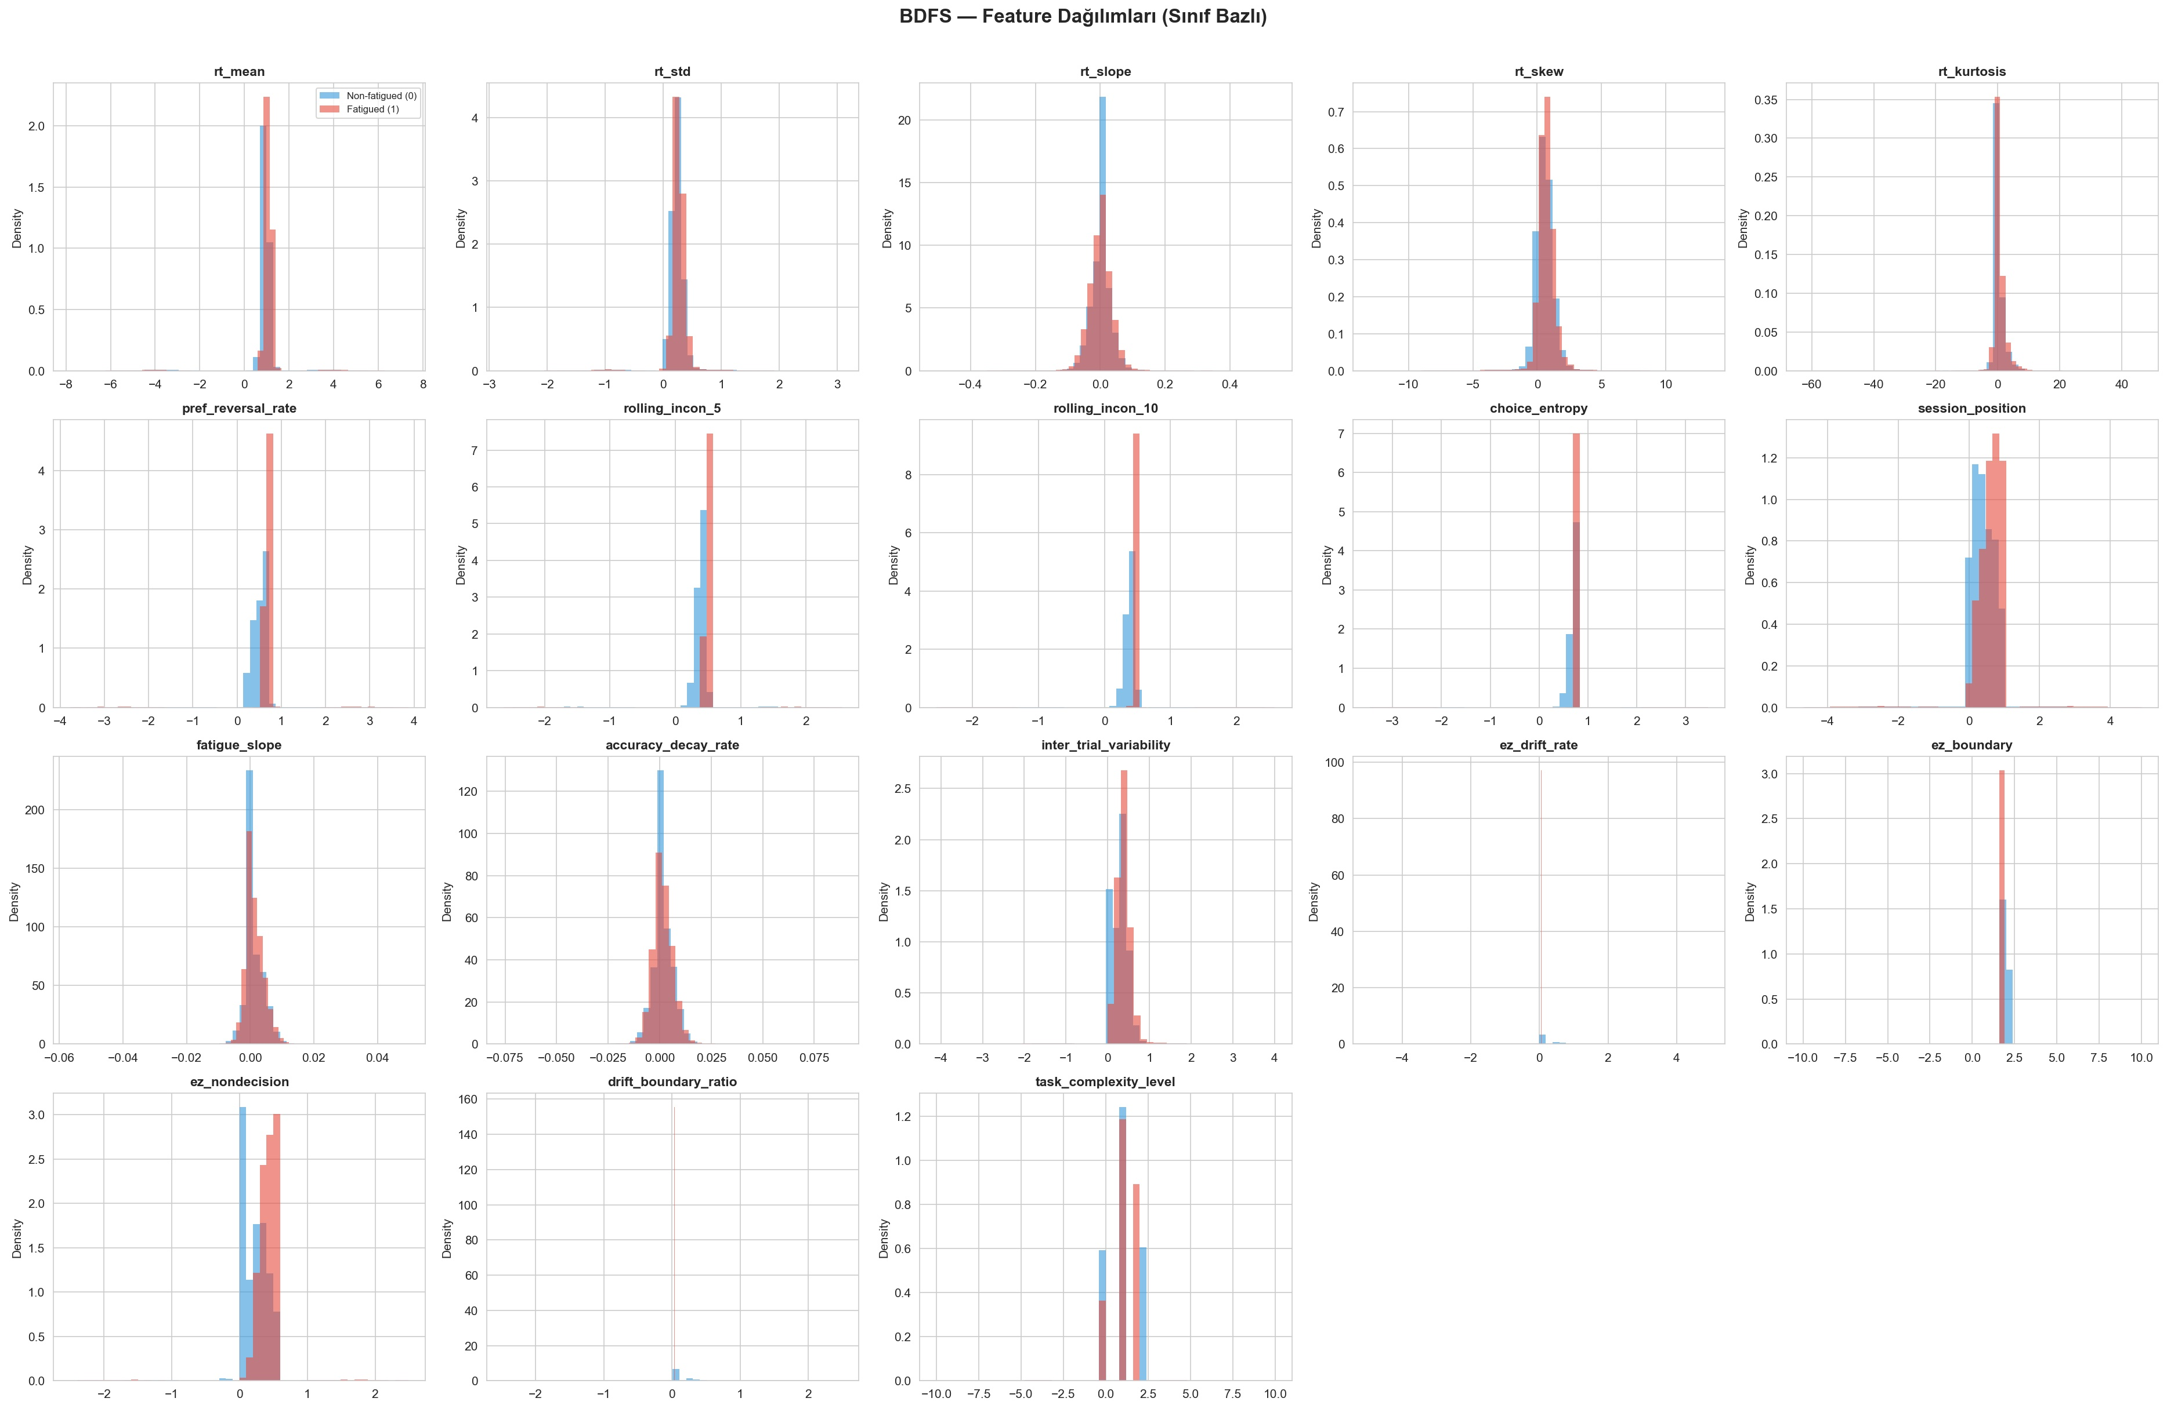
DATASET & FEATURE ENGINEERING
150K
Total Records
(99,583 Non-fatigued · 50,417 Fatigued)
19
Engineered Features
Reaction Time · Choice · DDM · Context
3
Feature Groups
Temporal · Cognitive · Behavioral
Feature Distributions by Class (Non-fatigued vs Fatigued)
Notes:
Our dataset contains 150,000 behavioral trial records from simulated decision-making tasks, with a 66-to-34 class split between non-fatigued and fatigued states. Each record captures 19 features spanning three conceptual groups: temporal features like rolling choice inconsistency over the last 5 and 10 trials, which track how erratically a person's decisions shift over time; cognitive features derived from the Drift Diffusion Model, which decomposes reaction time into psychological components like drift rate and decision boundary; and behavioral features like preference reversal rate and accuracy decay. As you can see in this distribution plot, fatigued subjects show clearly distinct patterns, particularly in the inconsistency metrics.

Slide 6
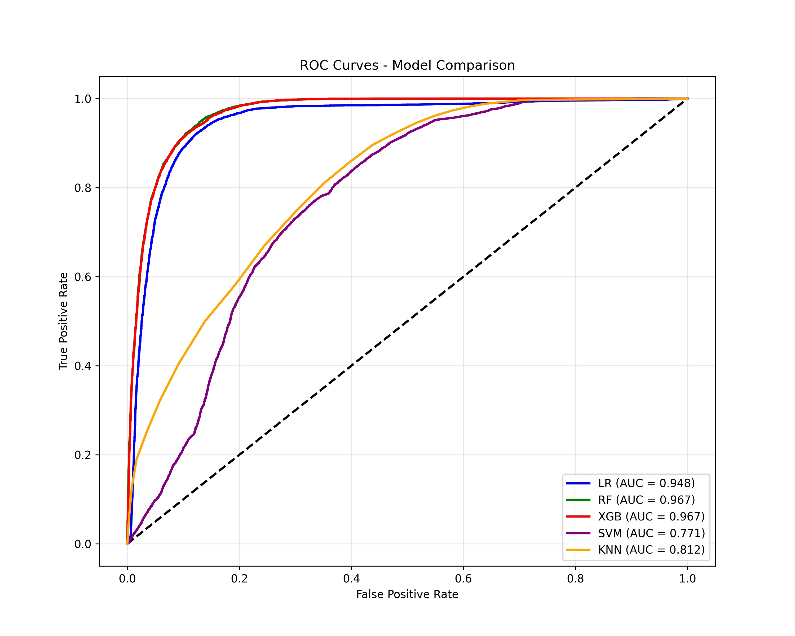
MODEL EVALUATION
5 Models Trained · XGBoost Wins
Model
ROC-AUC
F1-Score
Precision
Recall
XGBoost ✓
0.967
0.866
0.916
0.821
Random Forest
0.967
0.908
0.820
0.916
Logistic Reg.
0.948
0.856
0.774
0.934
KNN
0.812
0.759
0.539
0.810
SVM
0.771
0.606
0.506
0.865
Notes:
We systematically evaluated five machine learning classifiers under identical conditions. The results are clear: XGBoost achieved a ROC-AUC of 0.967 and an F1-Score of 0.866 on the held-out test set. What makes this particularly impressive is the precision-recall balance — 91.6% precision means very few false alarms, while 82.1% recall means the system catches the vast majority of genuinely fatigued states. Random Forest was competitive on AUC but showed lower precision. Logistic Regression proved surprisingly strong, confirming that some fatigue signals are linearly separable. SVM and KNN struggled significantly, highlighting that behavioral data contains complex non-linear interactions that require tree-based methods to properly capture.

Slide 7
END-TO-END PIPELINE
🖥️
📡
⚙️
🌲
🔍
📊
01
02
03
04
05
06
Web UI
→
REST API
→
Preprocessing
→
XGBoost
→
SHAP
→
UI Display
19 sliders · Simple / Expert modes
Async FastAPI POST /predict
StandardScaler (train-fitted)
Predict class + probability
Top-N feature contributions
Gauge + confidence + factors
Key Design Decision: The scaler is fit exclusively on training data and serialized alongside the model — guaranteeing that production inference is mathematically identical to validation conditions. This eliminates data leakage and ensures reproducibility.
Notes:
The BDFS pipeline is a clean, six-stage data flow. A clinician or researcher opens the web interface and either manually sets the 19 behavioral feature sliders, or loads a preset profile. On submission, the values are serialized to JSON and sent via HTTP POST to our FastAPI backend. The server applies a StandardScaler that was fit exclusively on training data — a critical engineering decision that prevents data leakage in production. The scaled vector is fed to XGBoost, which returns a class prediction and a probability score in under 10 milliseconds. SHAP values are computed and packaged into the response. The UI renders the probability gauge, the verdict, and the top contributing features — giving the user a complete and explainable picture in real time.

Slide 8
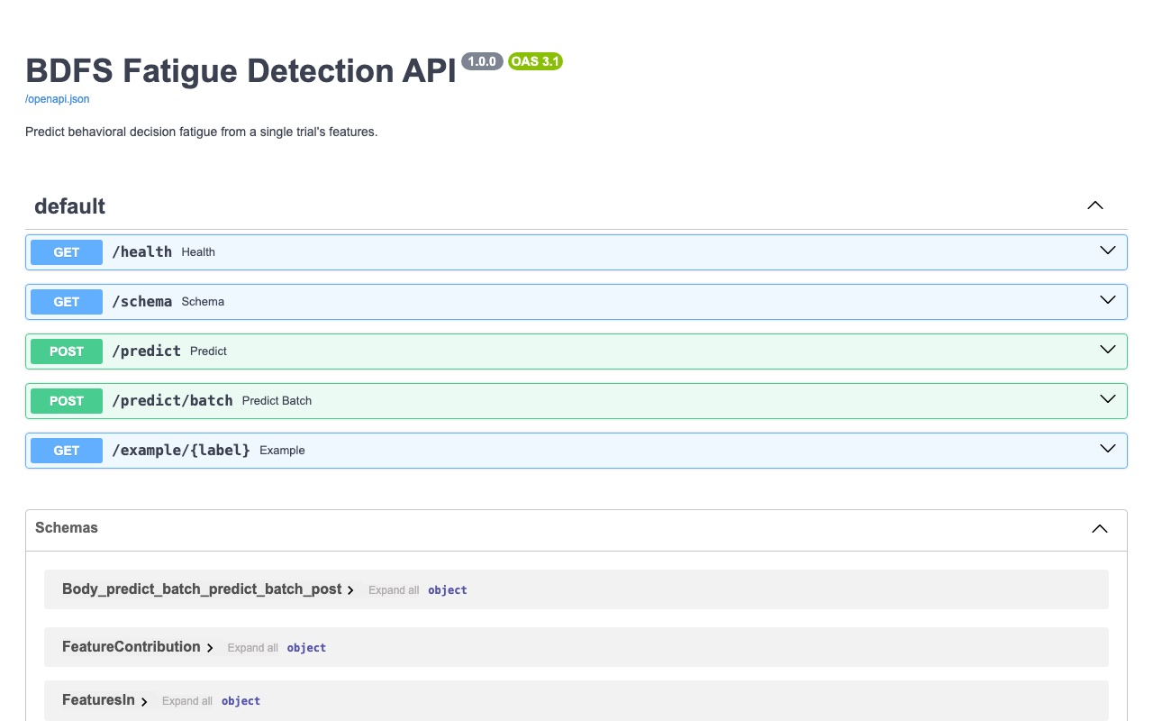
ROBUST BACKEND INTEGRATION
Python FastAPI · Asynchronous · Millisecond Latency
⚡ Async Design
Built on Python asyncio — handles concurrent requests without blocking.
📋 OpenAPI Docs
Auto-generated Swagger UI for /predict, /predict/batch, /schema, /health.
🔒 Validated I/O
Pydantic models enforce strict input contracts — malformed data is rejected at the gateway.
📦 Batch Endpoint
POST /predict/batch processes multiple trials in a single request for throughput.
🔍 SHAP Responses
Every prediction response includes per-feature SHAP contributions for full transparency.
Notes:
Under the hood, BDFS is powered by a FastAPI backend — one of Python's fastest modern web frameworks, built on async I/O. The API exposes a clean set of endpoints: a health check, a schema endpoint, a single-record prediction endpoint at /predict, and a batch processing endpoint at /predict/batch for high-throughput use cases. Every input is validated by Pydantic before it ever reaches the model — invalid or out-of-range values are rejected with a structured error response. The output always includes the predicted class, the probability score, and a list of SHAP feature contributions. This makes the API not just a prediction engine, but a full explainability service. The Swagger documentation, visible on the right, is auto-generated and provides a live interactive testing interface.

Slide 9
🎬
LIVE DEMONSTRATION
Switching to the browser now
Load Fatigued Profile · Adjust sliders · Observe real-time prediction
localhost:8080 · XGBoost Model · FastAPI Connected
Notes:
[SWITCH TO BROWSER] Now let's see BDFS in action. I'm going to open the live web application. [Open browser to localhost or hosted URL.] The interface has two modes — Simple and Expert. I'll start in Simple mode to show how intuitive the controls are. [Click 'Load Fatigued Profile.'] This loads a pre-set example of a highly fatigued user. Notice the gauge immediately jumps to 87% probability, the verdict reads 'FATIGUED', and the top contributing features are highlighted. [Hover over a slider.] Tooltips explain exactly what each feature means in plain language. [Switch to Expert mode.] Expert mode reveals all four feature groups and the raw values. [Adjust rolling_incon_5 slider.] Watch the gauge respond instantly — this is a live API call every time you change a value.

Slide 10
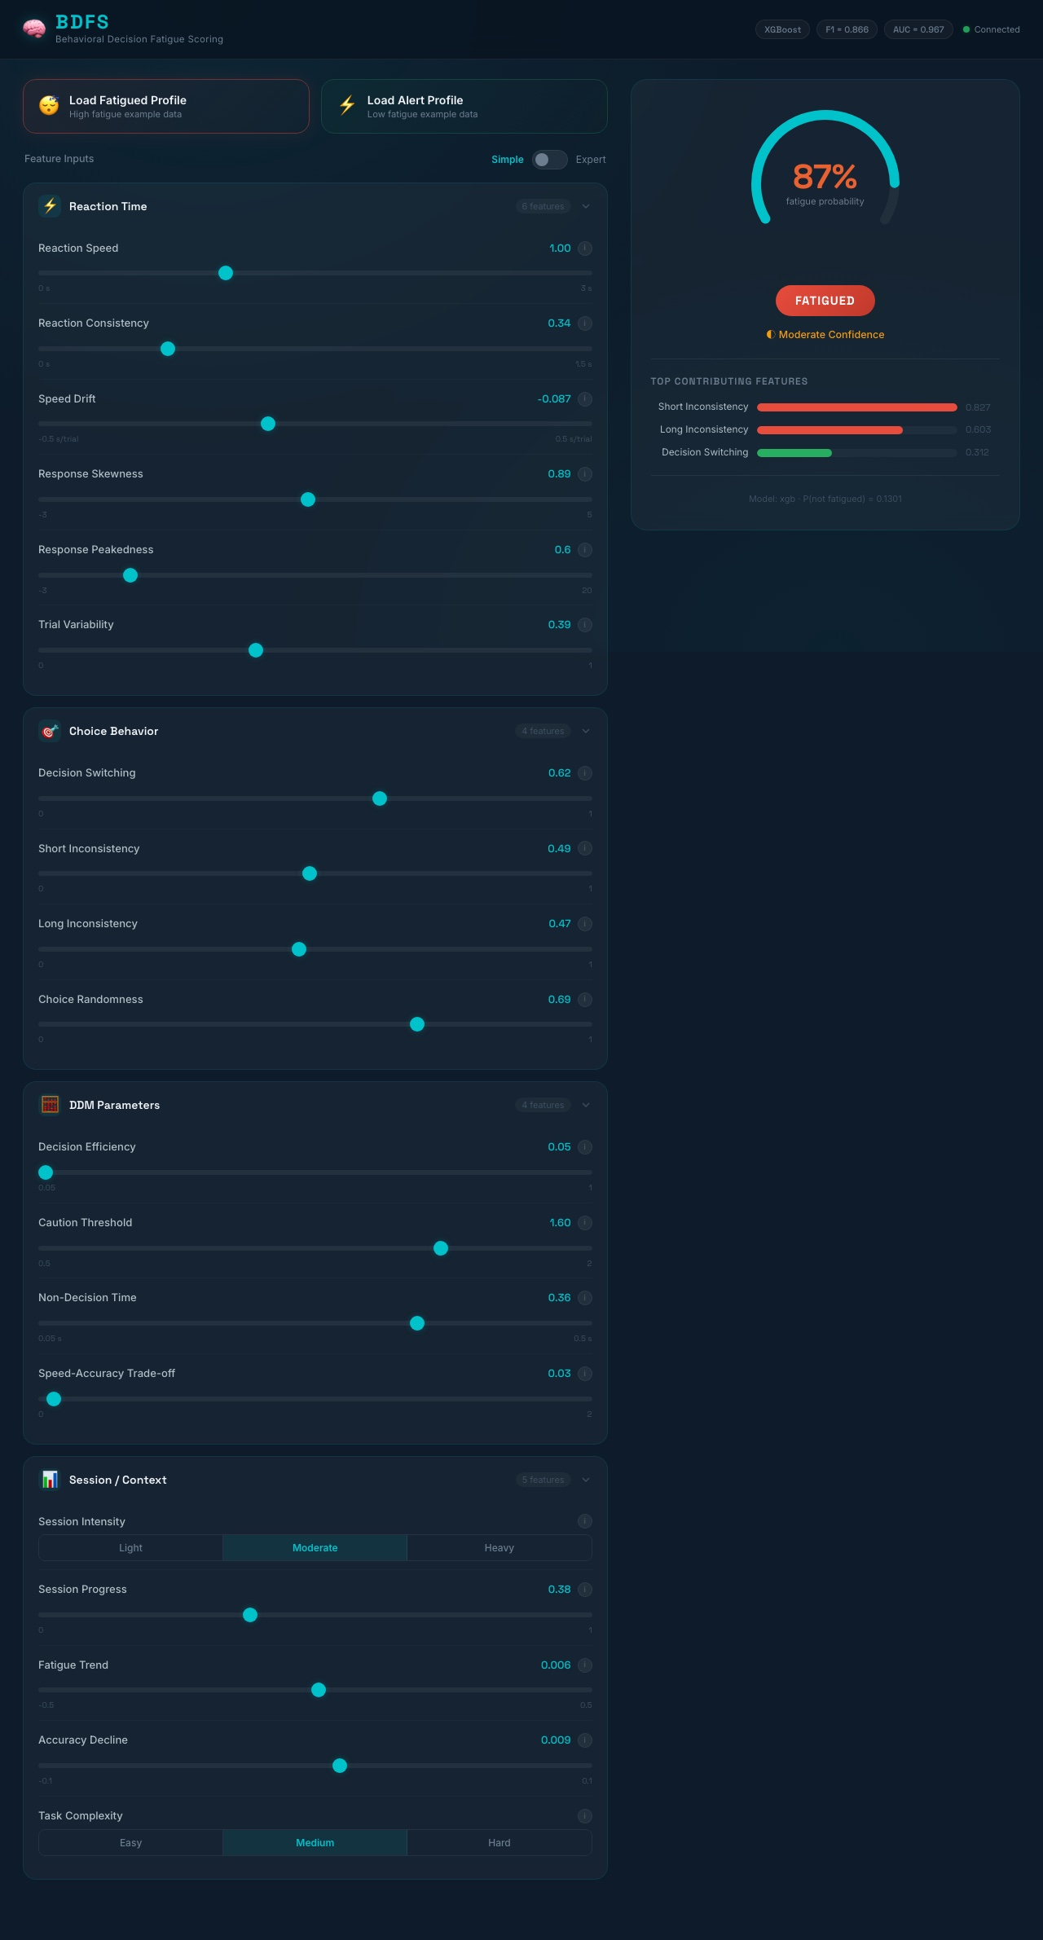
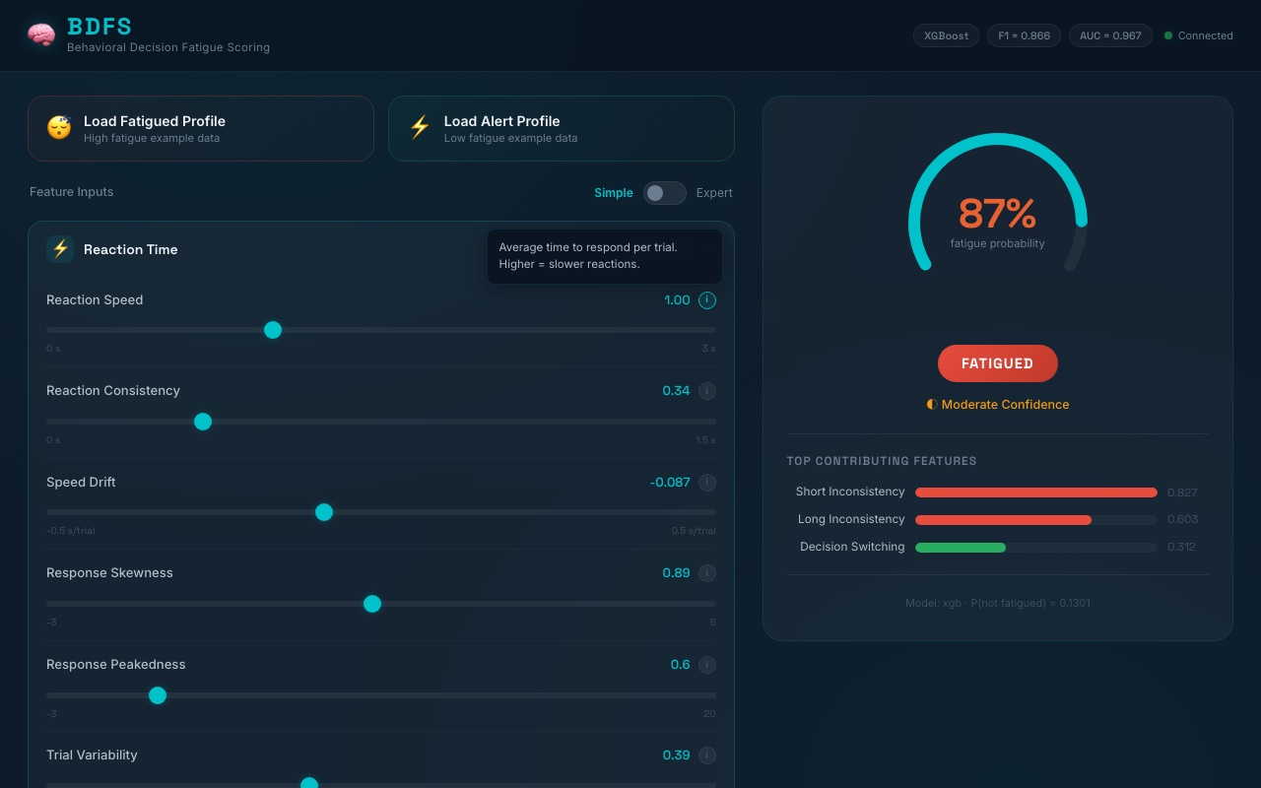
THE USER INTERFACE
Premium Dark Mode · Glassmorphic Design · Real-Time Feedback
Expert Mode + Contextual Tooltips
▸ 19 interactive feature sliders across 4 groups ▸ Animated probability gauge (0–100%) ▸ Simple / Expert mode toggle ▸ Top-3 SHAP factors visualized as bars ▸ Model badge + API connection status
Notes:
The BDFS frontend was designed with the end-user in mind, not just the engineer. The dark glassmorphic interface is intentionally premium — it signals seriousness while remaining visually clean. The 19 input features are organized into four logical groups: Reaction Time, Choice Behavior, DDM Parameters, and Session Context. A Simple-to-Expert mode toggle hides advanced cognitive parameters from users who don't need them, while expert users can access the full feature set. The real-time probability gauge animates smoothly with each input change, providing immediate visual feedback. Below the verdict, three horizontal bars display the top SHAP contributions — color-coded red for fatigue-promoting features and green for protective ones. This design was deliberately chosen to make the model's reasoning legible to a non-technical user.

Slide 11
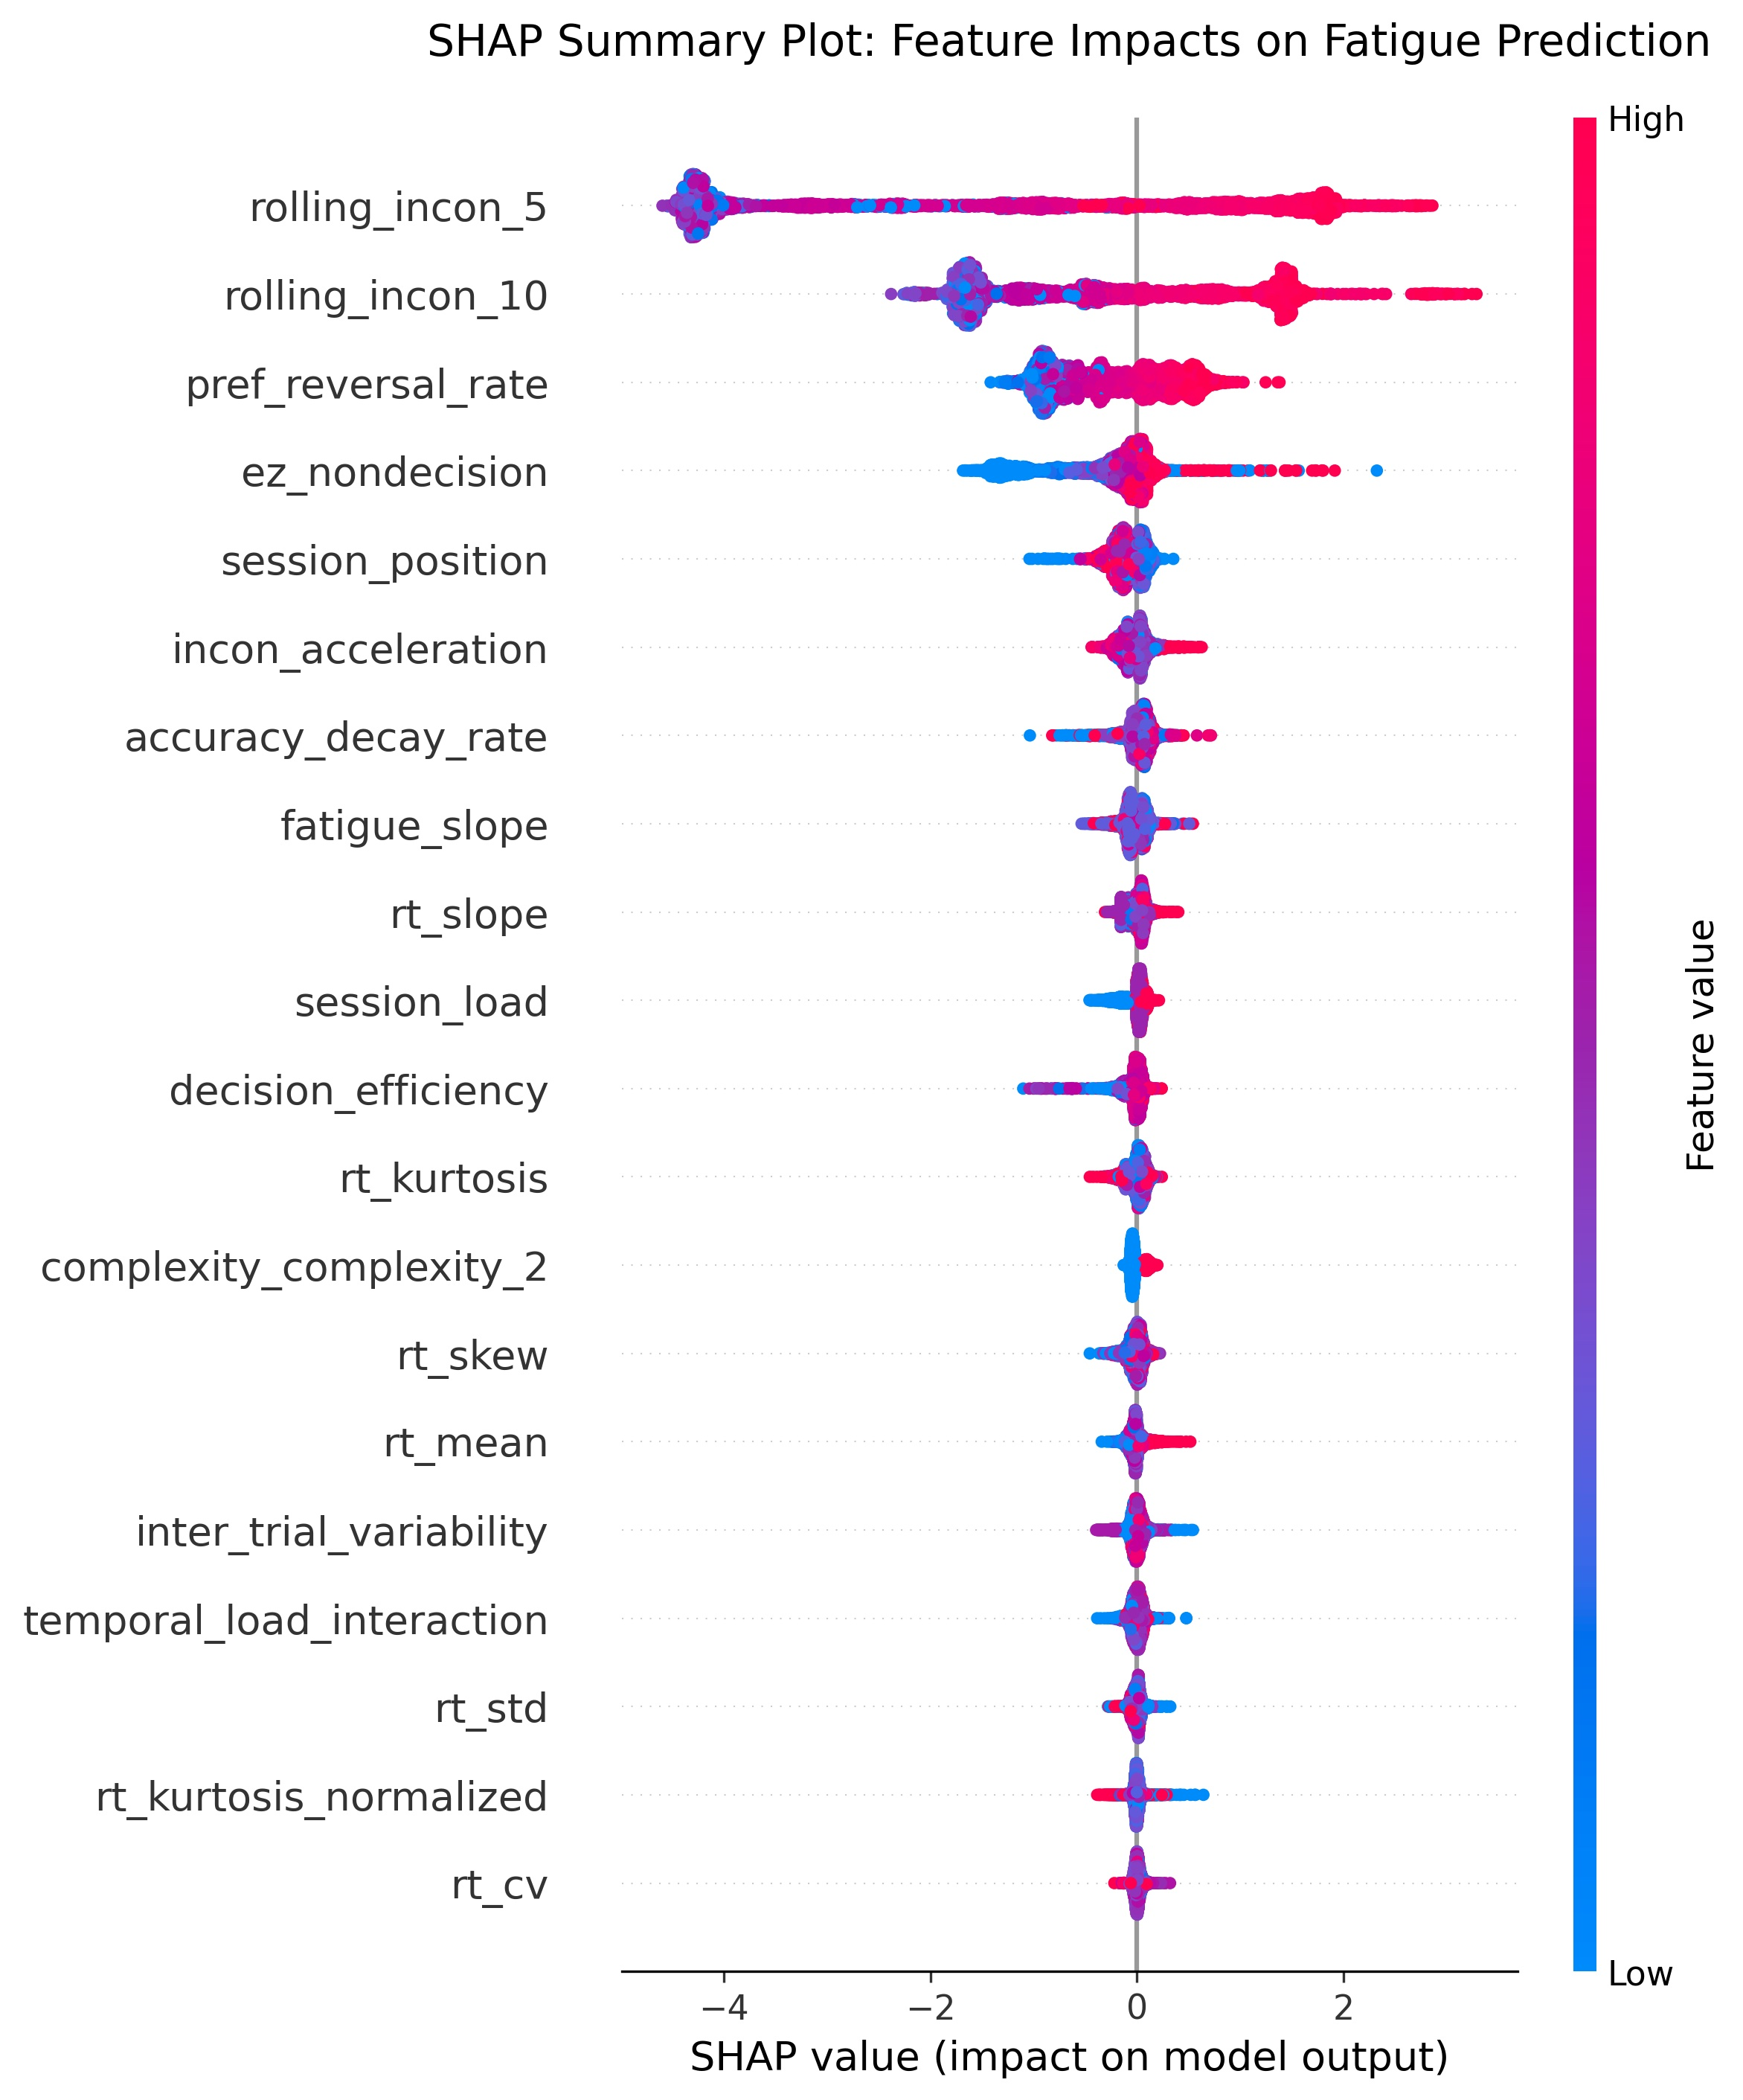
RESULTS & EXPLAINABILITY
SHAP Analysis · Feature Attribution · Temporal Dominance
Top Driver: rolling_incon_5
MI Score 0.44 — Short-window choice inconsistency is the single most predictive fatigue signal.
Top Driver: rolling_incon_10
MI Score 0.44 — Longer temporal window confirms the pattern is not noise.
Third: pref_reversal_rate
MI Score 0.33 — Preference reversals reveal unstable decision heuristics under fatigue.
DDM Features: Minimal Gain
Ablation: removing DDM features costs only –0.0% AUC. Temporal features carry the real signal.
Notes:
This is one of the most scientifically interesting findings of the entire project. When we applied SHAP analysis to our XGBoost model, we expected the cognitive DDM parameters — drift rate, boundary, non-decision time — to dominate. After all, these are derived from a well-validated psychological model. But the data told a different story. The two most impactful features are rolling_incon_5 and rolling_incon_10 — measures of how inconsistently a person has been choosing over their last 5 and 10 trials. These temporal inconsistency metrics carry more predictive weight than any static cognitive metric. This is actually a profound insight: fatigue doesn't show up in a single moment; it shows up in the accumulation of erratic behavior over time. The ablation study confirms this — removing DDM features costs almost nothing, but removing temporal features drops AUC by over 4 points.

Slide 12
CHALLENGES & SOLUTIONS
⚠️ Data Scaling Mismatch
Problem: Training used StandardScaler, but early API versions re-fit the scaler on each request — causing wildly inconsistent predictions in production.
✅ The scaler is now serialized with joblib during training and loaded once at API startup. All inference uses the identical transform as validation.
⚠️ UI Complexity Overload
Problem: 19 raw feature variables like ez_drift_rate and drift_boundary_ratio are meaningless to non-experts — a complex interface that nobody would actually use.
✅ Introduced Simple/Expert mode with human-readable labels, contextual tooltips, and preset profiles. Reduced cognitive overhead while preserving full access.
⚠️ Class Imbalance Handling
Problem: With 66% non-fatigued vs 34% fatigued, naive classifiers could hit 66% accuracy by always predicting the majority class.
✅ Used scale_pos_weight in XGBoost and focused optimization on F1-Score rather than raw accuracy — ensuring the minority class receives proper weighting.
Notes:
Building a research prototype is one thing; building a system that actually works correctly under production conditions is another challenge entirely. The most critical technical issue we encountered was a scaling mismatch. During development, we accidentally re-fit the StandardScaler on each inference request, which meant the production transform was different from the training transform — resulting in completely wrong predictions. We resolved this by serializing the fitted scaler object with joblib at the end of training, then loading it once at API startup. A second challenge was UX design: presenting 19 technical parameters to a non-expert user. Our solution — the Simple/Expert mode toggle with human-readable labels — reduced onboarding friction significantly. Finally, class imbalance was addressed through weighted loss functions rather than resampling, which proved more stable.

Slide 13
FUTURE IMPROVEMENTS
The Road Ahead
SHORT-TERM
MEDIUM-TERM
LONG-TERM
🔗 Hardware integration (keyboard telemetry, mouse dynamics)
👁️ Eye-tracking & blink rate integration via webcam
🏥 Clinical pilot studies in healthcare & aviation environments
📱 Mobile app (iOS/Android) with background data collection
📈 Longitudinal fatigue profiling (user baselines over sessions)
🌐 Multi-modal fusion (behavioral + physiological + environmental)
🗄️ Time-series modeling with LSTM / Transformer architecture
🔔 Adaptive alerts: notify when fatigue probability exceeds threshold
⚙️ Federated learning: model updates without centralizing user data
Our long-term vision: a universal, non-intrusive cognitive fatigue layer that plugs into any decision-intensive workflow.
Notes:
BDFS in its current form is a proof-of-concept with strong validation results. But the full vision is much broader. In the short term, we plan to extend the input channel to passive telemetry — keystroke dynamics, mouse movement patterns — data that is collected invisibly in the background of any computer-based work. In the medium term, webcam-based eye-tracking and session-level baseline profiling would allow the system to adapt to each individual user's normal performance envelope, dramatically reducing false positives. Long-term, we envision conducting formal clinical pilots in real healthcare and aviation environments, and exploring multi-modal fusion models that combine behavioral data with physiological signals. Federated learning would allow model improvement without centralizing sensitive user data — a critical requirement for clinical deployments.

Slide 14
CONCLUSION
0.967
0.866
<10ms
19
ROC-AUC
F1-Score
API Latency
Features
✓ Behavioral data alone is sufficient to detect cognitive fatigue with clinical-grade accuracy. ✓ Temporal inconsistency features vastly outperform static cognitive metrics — a novel empirical finding. ✓ The full-stack system — API, model, UI, SHAP — is production-ready and fully deployable.
Special Thanks
We extend our heartfelt gratitude to our project advisor, Asst. Prof. Dr. Denizhan Demirkol, whose expert guidance, constructive feedback, and unwavering support were instrumental in shaping this project from concept to completion.
Questions & Discussion
Notes:
To summarize: BDFS demonstrates that real-time, non-intrusive cognitive fatigue detection is not only possible, but achievable with high accuracy using purely behavioral signals. Our XGBoost model achieves a ROC-AUC of 0.967 and an F1-Score of 0.866. The full system — a FastAPI backend, a SHAP explainability layer, and a premium web UI — is fully integrated and production-ready. The key scientific insight is that temporal choice inconsistency is the dominant fatigue signal, not static cognitive measurements. Before we open the floor, we want to take a moment to sincerely thank our advisor, Asst. Prof. Dr. Denizhan Demirkol, for his invaluable guidance, his detailed feedback on our methodology, and his belief in the project throughout. This work would not have reached this quality without his mentorship. We're now happy to take any questions.

