Slide 1

Obesity and Income Level Data Analysis
by
Michelle Giezeman
Elif Ecer
Zeynep Diker

Slide 2
Healthier people. Healthier communities. Healthier world.
Your mission: Striving to build a healthier society.
Goal: Deliver real results and develop effective models that can be replicated for success in communities everywhere.
Our mission: To help Aetna Foundation in their decision making and prioritization strategies with regards to awarding grants to Nonprofits working with underserved population.

Slide 3
Grants and Partnerships
Aetna Foundation will award $2 million in grants to nonprofits through the Cultivating Healthy Communities program.
Foundation will make awards between $50,000 and $100,000 to organizations that can improve health outcomes at the local level.
Focus is on non-medical determinants of health - outside the doctor’s office - for underserved communities.
Programs addressing obesity, especially where there is a large gap in obesity rates between low and high income groups, should be a main focus.

Slide 4
Why It Matters
Obesity is dangerous and costly.
Obesity is getting worse for all income groups.
Obesity disproportionately affects the poor.
The gap in obesity between rich and poor is increasing, and is much worse in some states than others.

Slide 5
Survey Data
Nutrition, Physical Activity, and Obesity - Behavioral Risk Factor Surveillance System.
Datastore: Centers for Disease Control and Prevention of the US Department of Health and Human Services.
Includes national and state specific annual data between 2011 to 2015 on adults aged 18 years or older.
Subcategories are age, gender, race, education and income.
Dataset reports the rates of obesity, overweight status, fruit and vegetable consumption beyond a certain threshold and exercise being a certain intensity level on all of these subcategories by asking 9 questions over 5 years for each state.

Slide 6
Simple Statistics
Raw data has 48,772 observations (rows) and 33 variables (columns)
Unit of observation is state (not individual responses)
Dataset is aggregated by various demographic variables, as opposed to each row being one individual’s response.
For each demographic category we have a set of panel data. Therefore, our panel data has more than one cross sectional dimension.

Slide 7
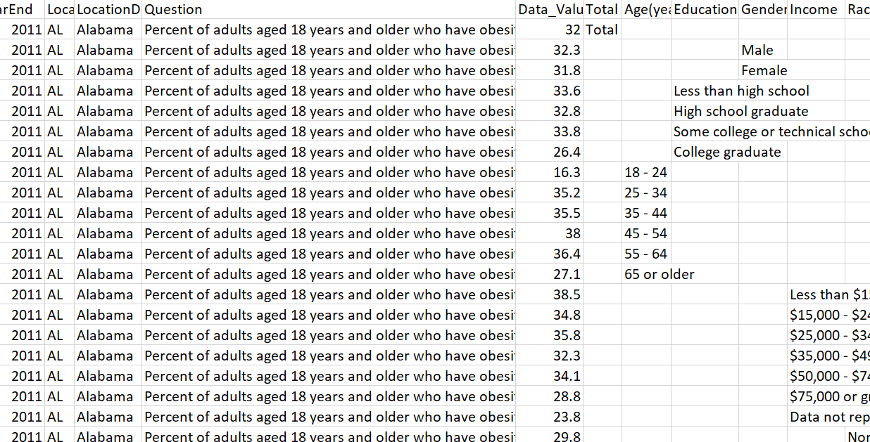

Slide 8
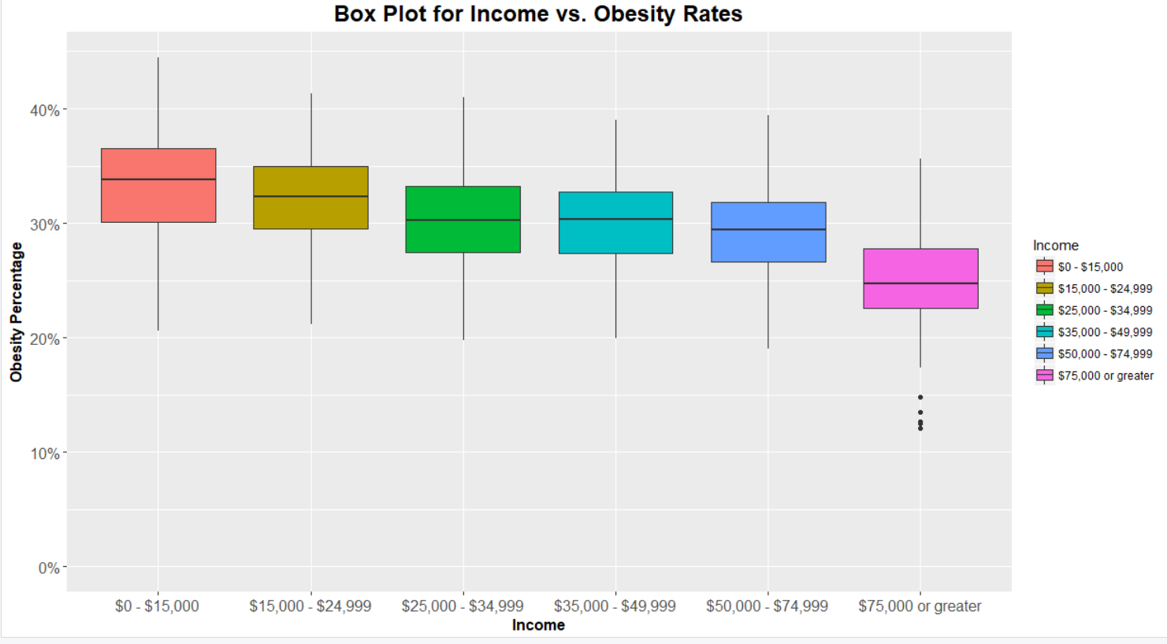
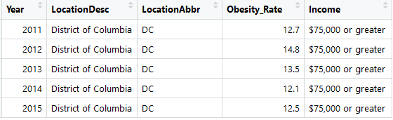

Slide 9
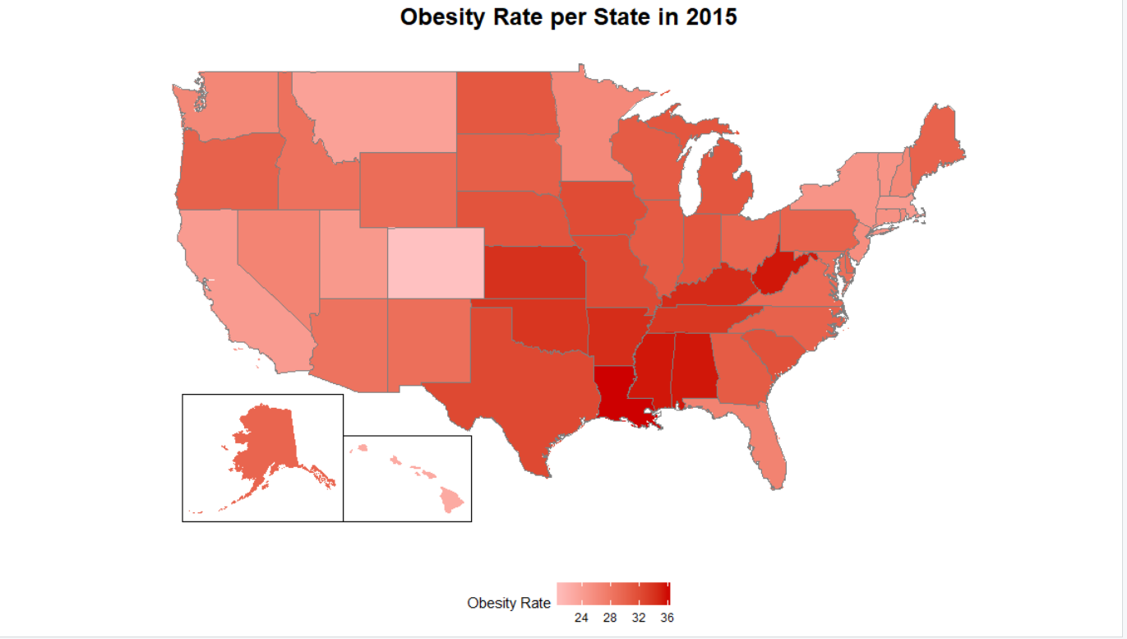

Slide 10
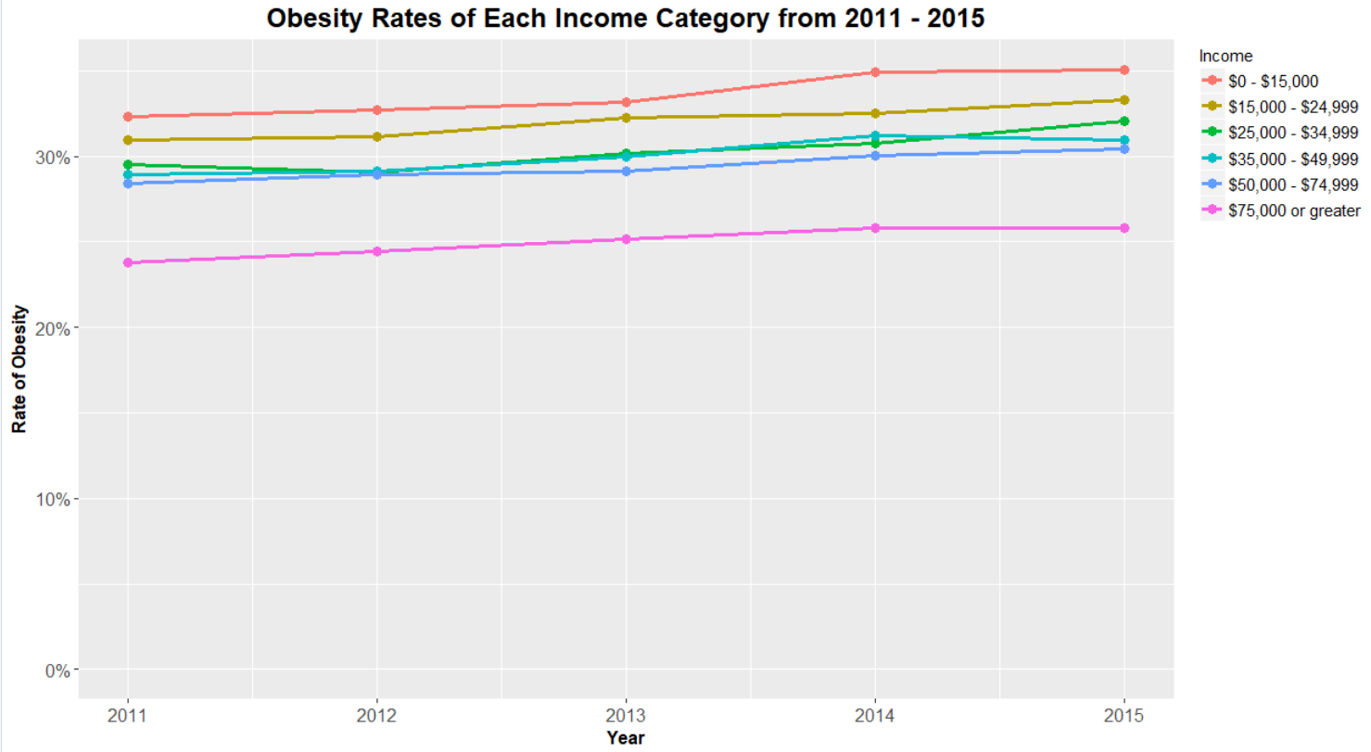

Slide 11
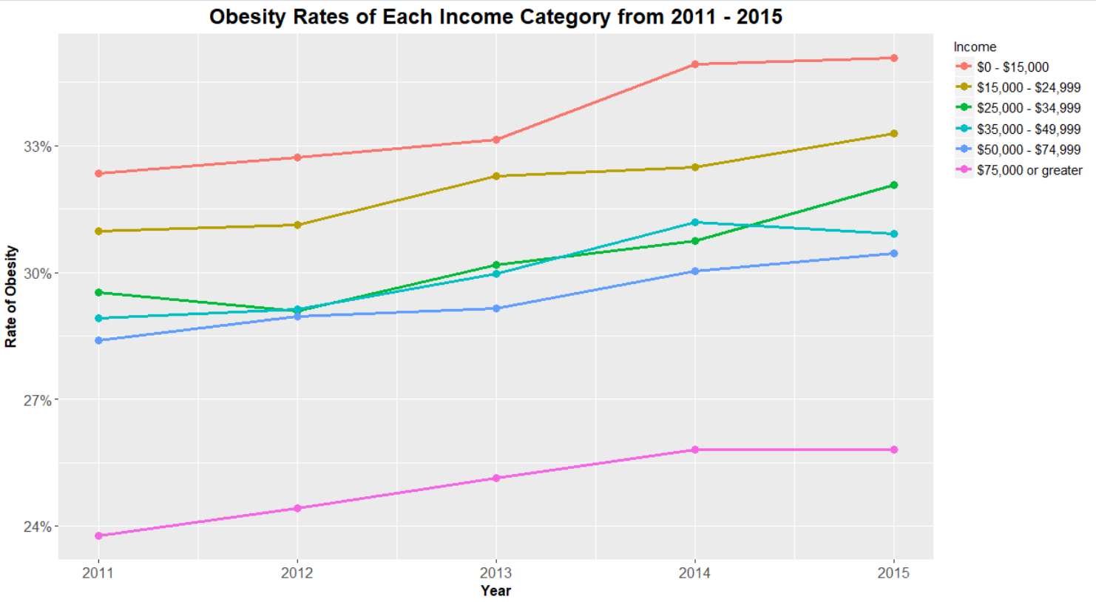

Slide 12
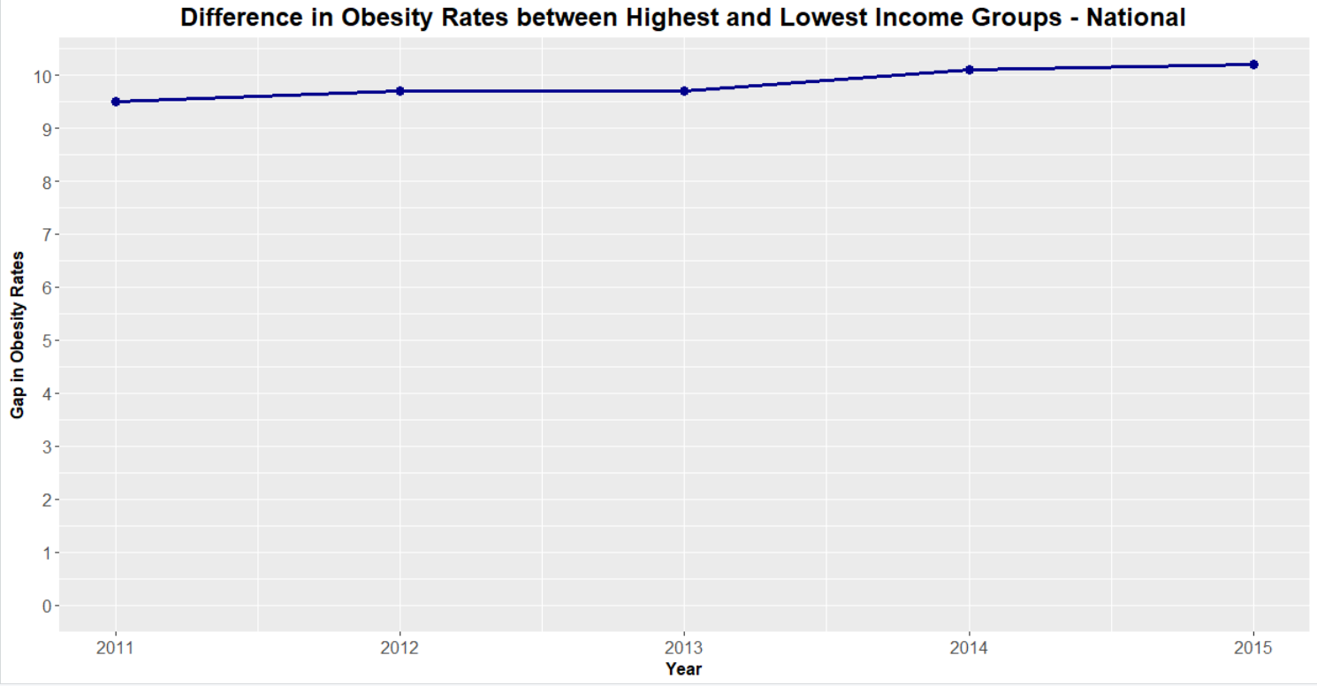

Slide 13
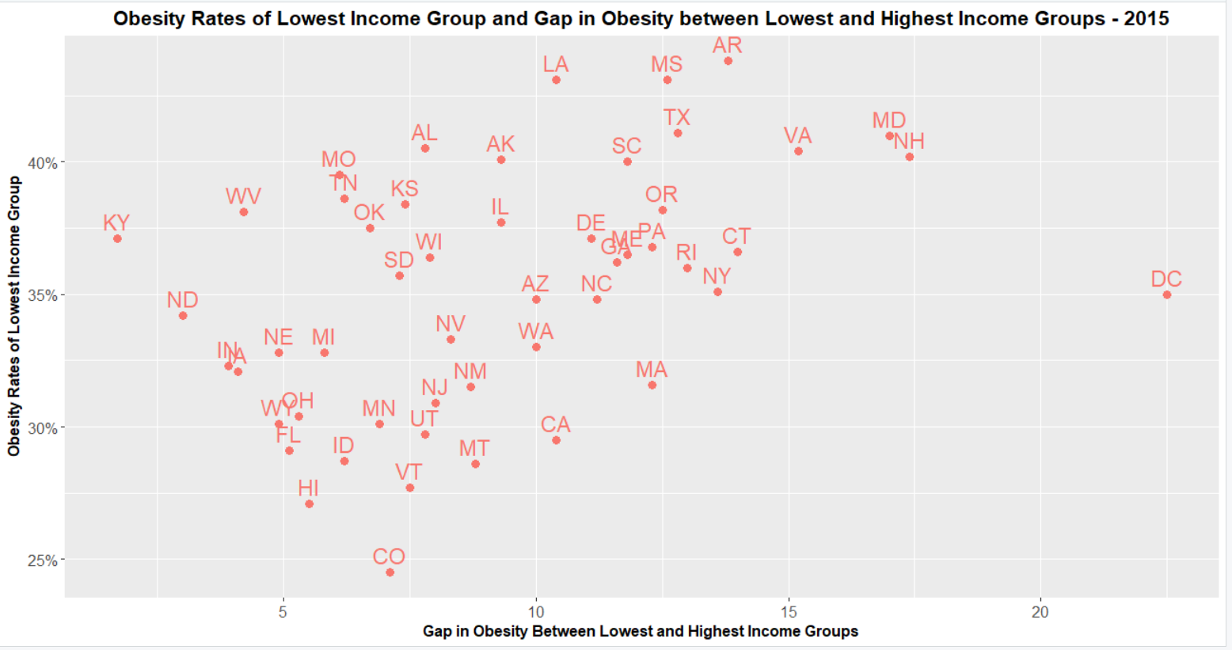

Slide 14
Conclusions and Recommendations
Aetna Foundation should strengthen its focus on programs that address obesity
In line with Aetna Foundation’s mission to help underserved communities
Disproportionately affects low income groups, and increasingly so
Aetna Foundation should look for programs where obesity gap is largest
DC, New Hampshire, Maryland, Virginia, Arkansas, Connecticut
Better measure of where income is a larger factor in obesity rates and programs can address community needs.

Slide 15
Thank you!

