Slide 1
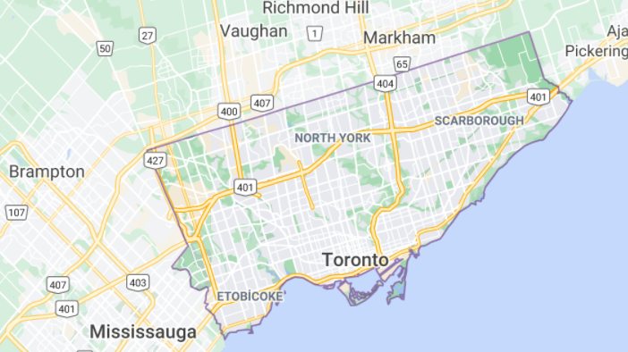
Opening Turkish Restaurant in Toronto
Zeynep Melisa Taşdemir

Slide 2
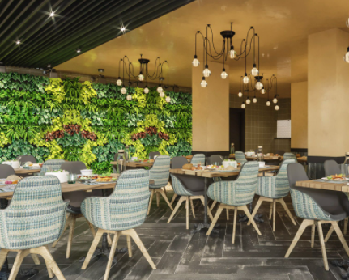
INTRODUCTION
The purpose of this Capstone Project is to make smart and efficient decision on selecting great neighbourhood for a new Turkish restaurant opening in Toronto.

Slide 3
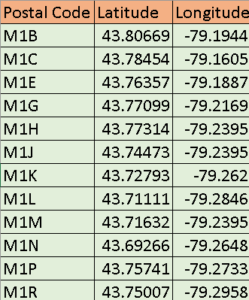
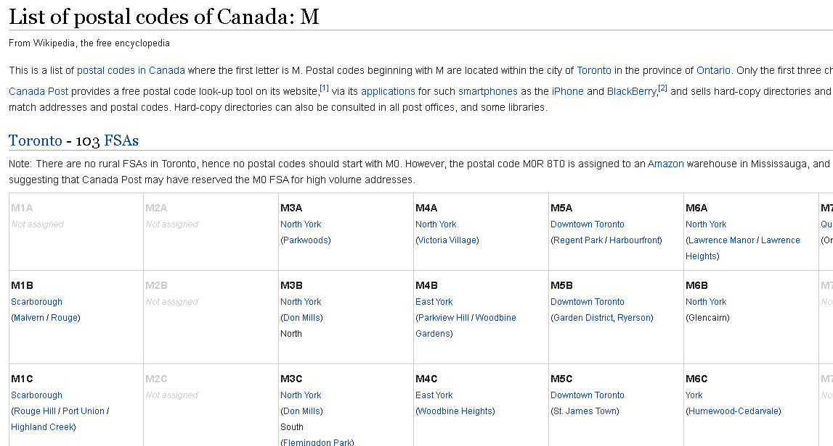
Downloading and Prepping Data
I used Toronto's geospatial coordinate data and in order to obtain the data that is in the table of postal codes I used https://en.wikipedia.org/wiki/List_of_postal_codes_of_Canada:_M .
Also I used Foursquare API for getting venues of neighborhoods.

Slide 4
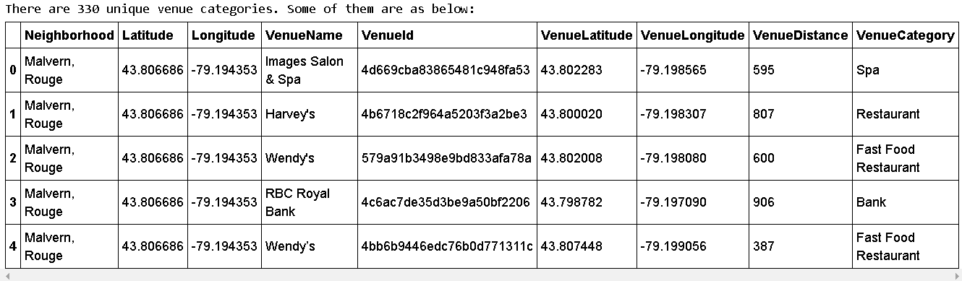
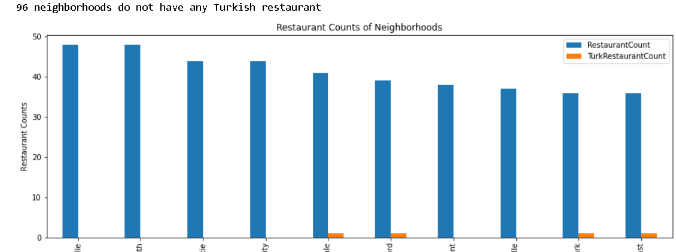
Methodology
By using Foursquare API I got venues 1 km around center of each neighbourhood with limit 100 venue.
I merged data with Neighbourhood data.
Filtered restaurants out of all venues.
Obtained how many neighbourhoods do not have any Turkish restaurant.

Slide 5
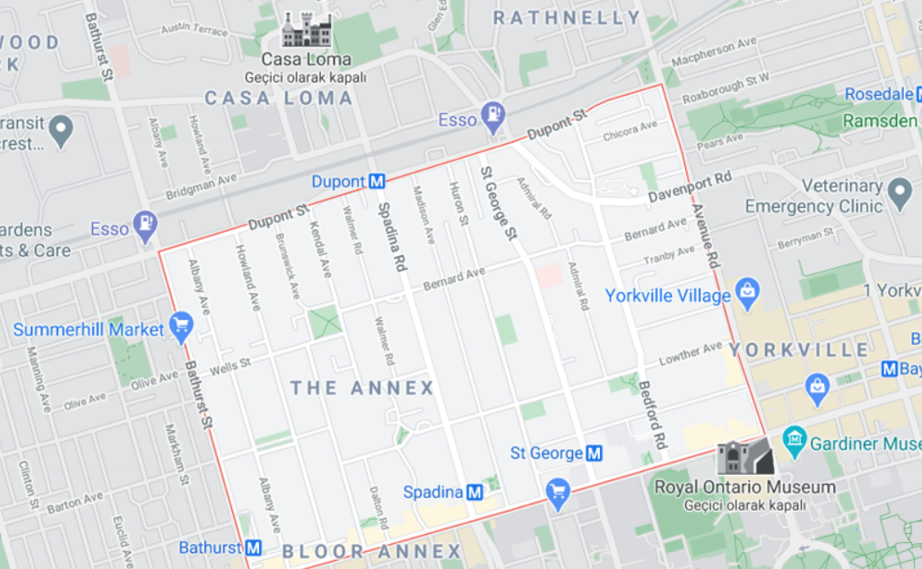
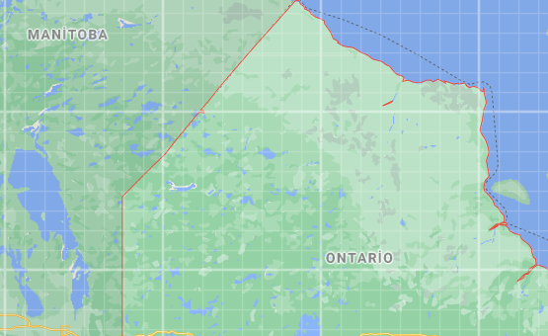
Results
Too many restaurants in top 4, that means too much competition.
The other 6 is ideal for opening a new restaurant but there are only 2 of them is not already have a Turkish restaurant, so we will decide between Ontario Provincial Government and The Annex North Middletown.

Slide 6
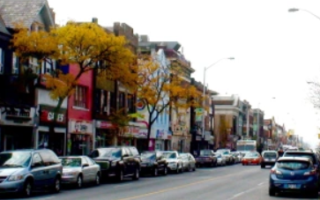
Discussion
To decide between Ontario Provincial Government and The Annex North Middletown, we can consider the population of these 2 areas:
Ontario Provincial Government Population: 14,745
The Annex North Middletown Population: 16,834
Annex looks like a better choice.

Slide 7

Conclusion
This report may be helpful for someone planning on opening a Turkish restaurant in Toronto, by comparing the current offers and neighbourhoods profiles, however it may not cover all variables such as access to public transportation or even the restaurants profiles, so it shall not be used as a single decision making tool.

