Slide 1
Harmony in sight or how vowel harmony modulates visual word recognition in Turkish
𐰽𐰑𐰯𐰖𐰴𐰽𐰯𐰽𐰑𐰴𐰖𐰣𐰯𐰽𐰑𐰯𐰴𐰯𐰖𐰍𐰣𐰺𐰤𐰀𐰀𐰆𐰣𐰋𐰀𐰾𐰓𐰯𐰚𐰾𐰘𐰏𐰦𐰯𐰠𐰚𐰏𐰾𐰚𐰾𐰯𐰯𐰴𐰯𐰀𐰠𐱁𐰴𐰀𐰠𐰇𐰀𐰯𐰯𐰚𐰴𐰆𐰞𐰀𐱁𐰾𐰇𐰠𐰯𐰀𐰚𐰯𐰆𐰴𐰍𐰀𐰞𐱁𐰾𐰀𐰢𐰯𐰚𐰡𐰯𐰚𐰏𐰚𐰢𐰓𐰯𐰚𐰚𐰏𐰯𐰓𐰚𐰓𐰚𐰼𐰘𐰏𐰤𐰀𐰠𐰚𐰤𐰀𐰼𐰚𐰲𐰋𐰢𐰍𐰃𐰀𐰺𐰆𐰉𐰲𐰴𐱃𐰉𐰆𐰃𐰺𐰏𐰀𐰘𐰚𐰍𐰃𐱃𐰆𐰆𐰀𐰯𐰘𐰚𐰠𐰤𐰚𐰼𐰏𐰴𐰃𐰞𐰖𐰴𐰆𐰀𐰯𐰖𐰆𐰞𐰴𐰭𐰺𐰴𐰃𐰴𐰞3𐰆𐰆𐰼𐰀𐰴𐰘𐰠𐰚𐰢𐰯𐰤𐰏𐰼𐰴𐰃𐰖𐰴𐰆𐰆𐰀𐰴𐰘𐰠𐰯𐰚𐰤𐰴𐰃𐰺𐱃𐰆𐰆𐰀𐰘𐰠𐰯
Zeynep G. Özkan ¹, Berceste Özdemir ², Pablo Gomez ³, Manuel Perea ¹
Universitat de Valencia
Üsküdar Üniversitesi
Skidmore College
Notes:
Hello everyone Im zeynep özkan and today I would like to talk about vowel harmony in Turkish.

Slide 2
Vowel Harmony
𐰽𐰑𐰯𐰖𐰴𐰽𐰯𐰽𐰑𐰴𐰖𐰣𐰯𐰽𐰑𐰯𐰴𐰯𐰖𐰍𐰣𐰺𐰤𐰀𐰀𐰆𐰣𐰋𐰀𐰾𐰓𐰯𐰚𐰾𐰘𐰏𐰦𐰯𐰠𐰚𐰏𐰾𐰚𐰾𐰯𐰯𐰴𐰯𐰀𐰠𐱁𐰴𐰀𐰠𐰇𐰀𐰯𐰯𐰚𐰴𐰆𐰞𐰀𐱁𐰾𐰇𐰠𐰯𐰀𐰚𐰯𐰆𐰴𐰍𐰀𐰞𐱁𐰾𐰀𐰢𐰯𐰚𐰡𐰯𐰚𐰏𐰚𐰢𐰓𐰯𐰚𐰚𐰏𐰯𐰓𐰚𐰓𐰚𐰼𐰘𐰏𐰤𐰀𐰠𐰚𐰤𐰀𐰼𐰚𐰲𐰋𐰢𐰍𐰃𐰀𐰺𐰆𐰉𐰲𐰴𐱃𐰉𐰆𐰃𐰺𐰏𐰀𐰘𐰚𐰍𐰃𐱃𐰆𐰆𐰀𐰯𐰘𐰚𐰠𐰤𐰚𐰼𐰏𐰴𐰃𐰞𐰖𐰴𐰆𐰀𐰯𐰖𐰆𐰞𐰴𐰭𐰺𐰴𐰃𐰴𐰞3𐰆𐰆𐰼𐰀𐰴𐰘𐰠𐰚𐰢𐰯𐰤𐰏𐰼𐰴𐰃𐰖𐰴𐰆𐰆𐰀𐰴𐰘𐰠𐰯𐰚𐰤𐰴𐰃𐰺𐱃𐰆𐰆𐰀𐰘𐰠𐰯
It is a phonological phenomenon in which vowels within a word share certain phonetic features (frontness vs. backness harmony, roundness harmony, among others).
It occurs in several families of languages (e.g., Altaic languages [Turkish, Mongolian], Uralic languages [Finnish, Hungarian], and others).
It also affects morphological processes (e.g., suffixes) and word formation.
Notes:
Vowel harmony is a phonological phenomenon. It is, the vowels in the word share some phonological characteristics among themselves. There are different kind of harmony types like frontness vs backness harmony or roundness harmony. In this presentation I will focused on frontless and backness harmony. Vowel harmony, occurs in several families of languages. It helps speech production as it facilitates pronunciation.

Slide 3
Vowel Harmony in Turkish
𐰽𐰑𐰯𐰖𐰴𐰽𐰯𐰽𐰑𐰴𐰖𐰣𐰯𐰽𐰑𐰯𐰴𐰯𐰖𐰍𐰣𐰺𐰤𐰀𐰀𐰆𐰣𐰋𐰀𐰾𐰓𐰯𐰚𐰾𐰘𐰏𐰦𐰯𐰠𐰚𐰏𐰾𐰚𐰾𐰯𐰯𐰴𐰯𐰀𐰠𐱁𐰴𐰀𐰠𐰇𐰀𐰯𐰯𐰚𐰴𐰆𐰞𐰀𐱁𐰾𐰇𐰠𐰯𐰀𐰚𐰯𐰆𐰴𐰍𐰀𐰞𐱁𐰾𐰀𐰢𐰯𐰚𐰡𐰯𐰚𐰏𐰚𐰢𐰓𐰯𐰚𐰚𐰏𐰯𐰓𐰚𐰓𐰚𐰼𐰘𐰏𐰤𐰀𐰠𐰚𐰤𐰀𐰼𐰚𐰲𐰋𐰢𐰍𐰃𐰀𐰺𐰆𐰉𐰲𐰴𐱃𐰉𐰆𐰃𐰺𐰏𐰀𐰘𐰚𐰍𐰃𐱃𐰆𐰆𐰀𐰯𐰘𐰚𐰠𐰤𐰚𐰼𐰏𐰴𐰃𐰞𐰖𐰴𐰆𐰀𐰯𐰖𐰆𐰞𐰴𐰭𐰺𐰴𐰃𐰴𐰞3𐰆𐰆𐰼𐰀𐰴𐰘𐰠𐰚𐰢𐰯𐰤𐰏𐰼𐰴𐰃𐰖𐰴𐰆𐰆𐰀𐰴𐰘𐰠𐰯𐰚𐰤𐰴𐰃𐰺𐱃𐰆𐰆𐰀𐰘𐰠𐰯
Frontness and backness harmony:
Words contain either front vowels or back vowels.
Turkish Vowels
Front Back
e (/e/)
a (/a/)
güven [trust]
kabul [accept]
i (/i/)
ı (/ɯ/)
ü (/y/)
u (/u/)
ö (/ø/)
o (/o/)
Notes:
güven [trust]; Harmonic
kabul [accept]; Harmonic

Slide 4
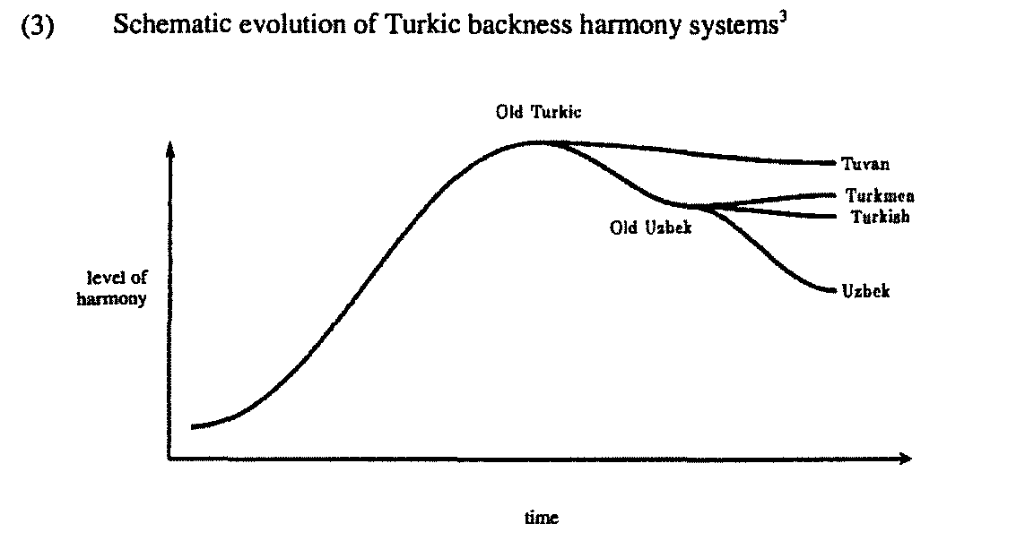
Vowel Harmony in Turkish
𐰽𐰑𐰯𐰖𐰴𐰽𐰯𐰽𐰑𐰴𐰖𐰣𐰯𐰽𐰑𐰯𐰴𐰯𐰖𐰍𐰣𐰺𐰤𐰀𐰀𐰆𐰣𐰋𐰀𐰾𐰓𐰯𐰚𐰾𐰘𐰏𐰦𐰯𐰠𐰚𐰏𐰾𐰚𐰾𐰯𐰯𐰴𐰯𐰀𐰠𐱁𐰴𐰀𐰠𐰇𐰀𐰯𐰯𐰚𐰴𐰆𐰞𐰀𐱁𐰾𐰇𐰠𐰯𐰀𐰚𐰯𐰆𐰴𐰍𐰀𐰞𐱁𐰾𐰀𐰢𐰯𐰚𐰡𐰯𐰚𐰏𐰚𐰢𐰓𐰯𐰚𐰚𐰏𐰯𐰓𐰚𐰓𐰚𐰼𐰘𐰏𐰤𐰀𐰠𐰚𐰤𐰀𐰼𐰚𐰲𐰋𐰢𐰍𐰃𐰀𐰺𐰆𐰉𐰲𐰴𐱃𐰉𐰆𐰃𐰺𐰏𐰀𐰘𐰚𐰍𐰃𐱃𐰆𐰆𐰀𐰯𐰘𐰚𐰠𐰤𐰚𐰼𐰏𐰴𐰃𐰞𐰖𐰴𐰆𐰀𐰯𐰖𐰆𐰞𐰴𐰭𐰺𐰴𐰃𐰴𐰞3𐰆𐰆𐰼𐰀𐰴𐰘𐰠𐰚𐰢𐰯𐰤𐰏𐰼𐰴𐰃𐰖𐰴𐰆𐰆𐰀𐰴𐰘𐰠𐰯𐰚𐰤𐰴𐰃𐰺𐱃𐰆𐰆𐰀𐰘𐰠𐰯
Old Turkic had full consistent word harmony. Modern Turkish still keeps 75% of this pattern despite cultural influences over time.
Mucize [miracle] Arabic
Egzotik [exotic] French
Efsane [legend] Persian
Harrison et al. (2002)
Notes:
While all words in old Turkic were harmonious, with the influence of other cultures across time like borrowed words from Arabic, Persian, and, Western languages, has reduced this percentage in most Turkic languages. Yet modern Turkish maintains a distinct vowel harmony pattern in approximately 75% of its vocabulary.

Slide 5
Vowel Harmony and speech segmentation
𐰽𐰑𐰯𐰖𐰴𐰽𐰯𐰽𐰑𐰴𐰖𐰣𐰯𐰽𐰑𐰯𐰴𐰯𐰖𐰍𐰣𐰺𐰤𐰀𐰀𐰆𐰣𐰋𐰀𐰾𐰓𐰯𐰚𐰾𐰘𐰏𐰦𐰯𐰠𐰚𐰏𐰾𐰚𐰾𐰯𐰯𐰴𐰯𐰀𐰠𐱁𐰴𐰀𐰠𐰇𐰀𐰯𐰯𐰚𐰴𐰆𐰞𐰀𐱁𐰾𐰇𐰠𐰯𐰀𐰚𐰯𐰆𐰴𐰍𐰀𐰞𐱁𐰾𐰀𐰢𐰯𐰚𐰡𐰯𐰚𐰏𐰚𐰢𐰓𐰯𐰚𐰚𐰏𐰯𐰓𐰚𐰓𐰚𐰼𐰘𐰏𐰤𐰀𐰠𐰚𐰤𐰀𐰼𐰚𐰲𐰋𐰢𐰍𐰃𐰀𐰺𐰆𐰉𐰲𐰴𐱃𐰉𐰆𐰃𐰺𐰏𐰀𐰘𐰚𐰍𐰃𐱃𐰆𐰆𐰀𐰯𐰘𐰚𐰠𐰤𐰚𐰼𐰏𐰴𐰃𐰞𐰖𐰴𐰆𐰀𐰯𐰖𐰆𐰞𐰴𐰭𐰺𐰴𐰃𐰴𐰞3𐰆𐰆𐰼𐰀𐰴𐰘𐰠𐰚𐰢𐰯𐰤𐰏𐰼𐰴𐰃𐰖𐰴𐰆𐰆𐰀𐰴𐰘𐰠𐰯𐰚𐰤𐰴𐰃𐰺𐱃𐰆𐰆𐰀𐰘𐰠𐰯
Vowel harmony facilitates speech segmentation in infants and adults.
7-month-old infants from UK can detect vowel harmony patterns without language exposure.
Vowel harmony patterns aid infants in segmenting continuous speech into proto-word forms (Mintz et al., 2018).
In adults:
They use vowel harmony as a cue when segmenting words in disharmonious spoken nonword strings (Suomi et al., 1997; Vroomen et al., 1998)
Notes:
, 7-month-old infants who have never been exposed to a language with vowel harmony can detect the harmony patterns.
Also when no other cues to word boundaries are present, infants segment word forms from continuous speech based on harmony patterns.
So, infants are predisposed to detect harmony patterns and to use vowel harmony to segment continuous speech into words.

Slide 6
What about the visual domain?
𐰽𐰑𐰯𐰖𐰴𐰽𐰯𐰽𐰑𐰴𐰖𐰣𐰯𐰽𐰑𐰯𐰴𐰯𐰖𐰍𐰣𐰺𐰤𐰀𐰀𐰆𐰣𐰋𐰀𐰾𐰓𐰯𐰚𐰾𐰘𐰏𐰦𐰯𐰠𐰚𐰏𐰾𐰚𐰾𐰯𐰯𐰴𐰯𐰀𐰠𐱁𐰴𐰀𐰠𐰇𐰀𐰯𐰯𐰚𐰴𐰆𐰞𐰀𐱁𐰾𐰇𐰠𐰯𐰀𐰚𐰯𐰆𐰴𐰍𐰀𐰞𐱁𐰾𐰀𐰢𐰯𐰚𐰡𐰯𐰚𐰏𐰚𐰢𐰓𐰯𐰚𐰚𐰏𐰯𐰓𐰚𐰓𐰚𐰼𐰘𐰏𐰤𐰀𐰠𐰚𐰤𐰀𐰼𐰚𐰲𐰋𐰢𐰍𐰃𐰀𐰺𐰆𐰉𐰲𐰴𐱃𐰉𐰆𐰃𐰺𐰏𐰀𐰘𐰚𐰍𐰃𐱃𐰆𐰆𐰀𐰯𐰘𐰚𐰠𐰤𐰚𐰼𐰏𐰴𐰃𐰞𐰖𐰴𐰆𐰀𐰯𐰖𐰆𐰞𐰴𐰭𐰺𐰴𐰃𐰴𐰞3𐰆𐰆𐰼𐰀𐰴𐰘𐰠𐰚𐰢𐰯𐰤𐰏𐰼𐰴𐰃𐰖𐰴𐰆𐰆𐰀𐰴𐰘𐰠𐰯𐰚𐰤𐰴𐰃𐰺𐱃𐰆𐰆𐰀𐰘𐰠𐰯

Slide 7
Vowel Harmony when reading compounds
𐰽𐰑𐰯𐰖𐰴𐰽𐰯𐰽𐰑𐰴𐰖𐰣𐰯𐰽𐰑𐰯𐰴𐰯𐰖𐰍𐰣𐰺𐰤𐰀𐰀𐰆𐰣𐰋𐰀𐰾𐰓𐰯𐰚𐰾𐰘𐰏𐰦𐰯𐰠𐰚𐰏𐰾𐰚𐰾𐰯𐰯𐰴𐰯𐰀𐰠𐱁𐰴𐰀𐰠𐰇𐰀𐰯𐰯𐰚𐰴𐰆𐰞𐰀𐱁𐰾𐰇𐰠𐰯𐰀𐰚𐰯𐰆𐰴𐰍𐰀𐰞𐱁𐰾𐰀𐰢𐰯𐰚𐰡𐰯𐰚𐰏𐰚𐰢𐰓𐰯𐰚𐰚𐰏𐰯𐰓𐰚𐰓𐰚𐰼𐰘𐰏𐰤𐰀𐰠𐰚𐰤𐰀𐰼𐰚𐰲𐰋𐰢𐰍𐰃𐰀𐰺𐰆𐰉𐰲𐰴𐱃𐰉𐰆𐰃𐰺𐰏𐰀𐰘𐰚𐰍𐰃𐱃𐰆𐰆𐰀𐰯𐰘𐰚𐰠𐰤𐰚𐰼𐰏𐰴𐰃𐰞𐰖𐰴𐰆𐰀𐰯𐰖𐰆𐰞𐰴𐰭𐰺𐰴𐰃𐰴𐰞3𐰆𐰆𐰼𐰀𐰴𐰘𐰠𐰚𐰢𐰯𐰤𐰏𐰼𐰴𐰃𐰖𐰴𐰆𐰆𐰀𐰴𐰘𐰠𐰯𐰚𐰤𐰴𐰃𐰺𐱃𐰆𐰆𐰀𐰘𐰠𐰯
Bertram et al. (2004) investigated the effect of vowel harmony on the parsing of compound words in Finnish.
sähköasentaja [electricity expert]; disharmonious
satuolento [fairytale creature]; harmonious
They found that if the two words in the compound word are harmonically dissonant, eye fixation times on the compound are shorter.
Notes:
As I said before, vowel harmony is a phonological phenomenon, however, there are evidences that this phenomenon also affects visual domains. For example, if a compound word has disharmony between the words, the processing is easier than harmonic. This means that vowel harmony facilitates the segmentation of compound words and acts as a cue.
vowel harmony modulates lexical processing –using harmony as a cue for word-likeness

Slide 8
And what about the role of vowel harmony during word recognition?
𐰽𐰑𐰯𐰖𐰴𐰽𐰯𐰽𐰑𐰴𐰖𐰣𐰯𐰽𐰑𐰯𐰴𐰯𐰖𐰍𐰣𐰺𐰤𐰀𐰀𐰆𐰣𐰋𐰀𐰾𐰓𐰯𐰚𐰾𐰘𐰏𐰦𐰯𐰠𐰚𐰏𐰾𐰚𐰾𐰯𐰯𐰴𐰯𐰀𐰠𐱁𐰴𐰀𐰠𐰇𐰀𐰯𐰯𐰚𐰴𐰆𐰞𐰀𐱁𐰾𐰇𐰠𐰯𐰀𐰚𐰯𐰆𐰴𐰍𐰀𐰞𐱁𐰾𐰀𐰢𐰯𐰚𐰡𐰯𐰚𐰏𐰚𐰢𐰓𐰯𐰚𐰚𐰏𐰯𐰓𐰚𐰓𐰚𐰼𐰘𐰏𐰤𐰀𐰠𐰚𐰤𐰀𐰼𐰚𐰲𐰋𐰢𐰍𐰃𐰀𐰺𐰆𐰉𐰲𐰴𐱃𐰉𐰆𐰃𐰺𐰏𐰀𐰘𐰚𐰍𐰃𐱃𐰆𐰆𐰀𐰯𐰘𐰚𐰠𐰤𐰚𐰼𐰏𐰴𐰃𐰞𐰖𐰴𐰆𐰀𐰯𐰖𐰆𐰞𐰴𐰭𐰺𐰴𐰃𐰴𐰞3𐰆𐰆𐰼𐰀𐰴𐰘𐰠𐰚𐰢𐰯𐰤𐰏𐰼𐰴𐰃𐰖𐰴𐰆𐰆𐰀𐰴𐰘𐰠𐰯𐰚𐰤𐰴𐰃𐰺𐱃𐰆𐰆𐰀𐰘𐰠𐰯

Slide 9
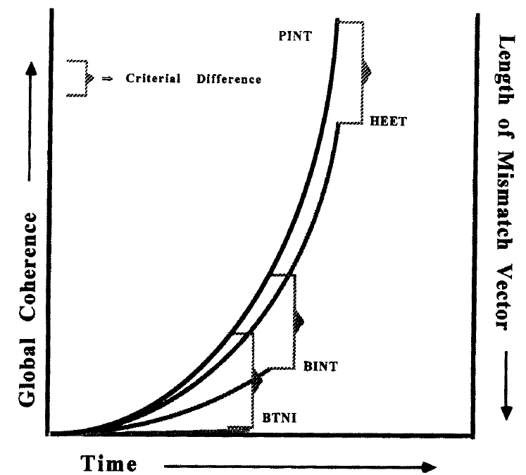
Theoretical framework Global coherence hypothesis
Orthographic and phonological codes from a visually presented word can be combined into a single measure of “quality of evidence” in a lexical decision task, as a measure of coherence—the higher the coherence, the faster their identification (Van Orden & Goldinger, 1998).
If vowel harmony contributes to the formation of coherent phonological codes in Turkish, harmonious words would reach a stable orthographic-phonological state in a lexical decision task faster than disharmonious words.
Conversely, the opposite pattern might be expected for pseudowords.

Slide 10
Vowel Harmony and lexical processing
𐰽𐰑𐰯𐰖𐰴𐰽𐰯𐰽𐰑𐰴𐰖𐰣𐰯𐰽𐰑𐰯𐰴𐰯𐰖𐰍𐰣𐰺𐰤𐰀𐰀𐰆𐰣𐰋𐰀𐰾𐰓𐰯𐰚𐰾𐰘𐰏𐰦𐰯𐰠𐰚𐰏𐰾𐰚𐰾𐰯𐰯𐰴𐰯𐰀𐰠𐱁𐰴𐰀𐰠𐰇𐰀𐰯𐰯𐰚𐰴𐰆𐰞𐰀𐱁𐰾𐰇𐰠𐰯𐰀𐰚𐰯𐰆𐰴𐰍𐰀𐰞𐱁𐰾𐰀𐰢𐰯𐰚𐰡𐰯𐰚𐰏𐰚𐰢𐰓𐰯𐰚𐰚𐰏𐰯𐰓𐰚𐰓𐰚𐰼𐰘𐰏𐰤𐰀𐰠𐰚𐰤𐰀𐰼𐰚𐰲𐰋𐰢𐰍𐰃𐰀𐰺𐰆𐰉𐰲𐰴𐱃𐰉𐰆𐰃𐰺𐰏𐰀𐰘𐰚𐰍𐰃𐱃𐰆𐰆𐰀𐰯𐰘𐰚𐰠𐰤𐰚𐰼𐰏𐰴𐰃𐰞𐰖𐰴𐰆𐰀𐰯𐰖𐰆𐰞𐰴𐰭𐰺𐰴𐰃𐰴𐰞3𐰆𐰆𐰼𐰀𐰴𐰘𐰠𐰚𐰢𐰯𐰤𐰏𐰼𐰴𐰃𐰖𐰴𐰆𐰆𐰀𐰴𐰘𐰠𐰯𐰚𐰤𐰴𐰃𐰺𐱃𐰆𐰆𐰀𐰘𐰠𐰯
In Finnish, there is a very number of disharmonious words, so one can not compare a well-controlled set of harmonious vs disharmonious words.
However, it is possible to do that manipulation with pseudowords. Perea, Hyönä, and Marcet’s (2022) Experiment 3 compared sets of pseudowords:
Höpeä - Harmonious pseudoword
Vöurio - Disharmonious pseudoword
They found that response times in a lexical decision task (word/nonword) were faster for (the less wordlike) disharmonious pseudowords, which is consistent with the global coherence hypothesis.
Notes:
As I said before, vowel harmony is a phonological phenomenon, however, there are evidences that this phenomenon also affects visual domains. For example, if a compound word has disharmony between the words, the processing is easier than harmonic. This means that vowel harmony facilitates the segmentation of compound words and acts as a cue.
vowel harmony modulates lexical processing –using harmony as a cue for word-likeness

Slide 11
Can we directly examine the effect of vowel harmony on words?
𐰽𐰑𐰯𐰖𐰴𐰽𐰯𐰽𐰑𐰴𐰖𐰣𐰯𐰽𐰑𐰯𐰴𐰯𐰖𐰍𐰣𐰺𐰤𐰀𐰀𐰆𐰣𐰋𐰀𐰾𐰓𐰯𐰚𐰾𐰘𐰏𐰦𐰯𐰠𐰚𐰏𐰾𐰚𐰾𐰯𐰯𐰴𐰯𐰀𐰠𐱁𐰴𐰀𐰠𐰇𐰀𐰯𐰯𐰚𐰴𐰆𐰞𐰀𐱁𐰾𐰇𐰠𐰯𐰀𐰚𐰯𐰆𐰴𐰍𐰀𐰞𐱁𐰾𐰀𐰢𐰯𐰚𐰡𐰯𐰚𐰏𐰚𐰢𐰓𐰯𐰚𐰚𐰏𐰯𐰓𐰚𐰓𐰚𐰼𐰘𐰏𐰤𐰀𐰠𐰚𐰤𐰀𐰼𐰚𐰲𐰋𐰢𐰍𐰃𐰀𐰺𐰆𐰉𐰲𐰴𐱃𐰉𐰆𐰃𐰺𐰏𐰀𐰘𐰚𐰍𐰃𐱃𐰆𐰆𐰀𐰯𐰘𐰚𐰠𐰤𐰚𐰼𐰏𐰴𐰃𐰞𐰖𐰴𐰆𐰀𐰯𐰖𐰆𐰞𐰴𐰭𐰺𐰴𐰃𐰴𐰞3𐰆𐰆𐰼𐰀𐰴𐰘𐰠𐰚𐰢𐰯𐰤𐰏𐰼𐰴𐰃𐰖𐰴𐰆𐰆𐰀𐰴𐰘𐰠𐰯𐰚𐰤𐰴𐰃𐰺𐱃𐰆𐰆𐰀𐰘𐰠𐰯
Yes, Turkish has 25% of disharmonious words.
We can compare two sets of words, harmonious vs disharmonious well controlling for other relevant effects (word frequency, length, orthographic neighborhood, … )
 | Word | Pseudoword
Harmonious | sanat [art] | tesil
Disharmonious | zafer [victory] | canit
Notes:
If vowel harmony contributes to the formation of coherent phonological codes, harmonious words will reach a stable orthographic-phonological state more rapidly than disharmonious words.

Slide 12
Experiment 1 Vowel harmony for words
𐰽𐰑𐰯𐰖𐰴𐰽𐰯𐰽𐰑𐰴𐰖𐰣𐰯𐰽𐰑𐰯𐰴𐰯𐰖𐰍𐰣𐰺𐰤𐰀𐰀𐰆𐰣𐰋𐰀𐰾𐰓𐰯𐰚𐰾𐰘𐰏𐰦𐰯𐰠𐰚𐰏𐰾𐰚𐰾𐰯𐰯𐰴𐰯𐰀𐰠𐱁𐰴𐰀𐰠𐰇𐰀𐰯𐰯𐰚𐰴𐰆𐰞𐰀𐱁𐰾𐰇𐰠𐰯𐰀𐰚𐰯𐰆𐰴𐰍𐰀𐰞𐱁𐰾𐰀𐰢𐰯𐰚𐰡𐰯𐰚𐰏𐰚𐰢𐰓𐰯𐰚𐰚𐰏𐰯𐰓𐰚𐰓𐰚𐰼𐰘𐰏𐰤𐰀𐰠𐰚𐰤𐰀𐰼𐰚𐰲𐰋𐰢𐰍𐰃𐰀𐰺𐰆𐰉𐰲𐰴𐱃𐰉𐰆𐰃𐰺𐰏𐰀𐰘𐰚𐰍𐰃𐱃𐰆𐰆𐰀𐰯𐰘𐰚𐰠𐰤𐰚𐰼𐰏𐰴𐰃𐰞𐰖𐰴𐰆𐰀𐰯𐰖𐰆𐰞𐰴𐰭𐰺𐰴𐰃𐰴𐰞3𐰆𐰆𐰼𐰀𐰴𐰘𐰠𐰚𐰢𐰯𐰤𐰏𐰼𐰴𐰃𐰖𐰴𐰆𐰆𐰀𐰴𐰘𐰠𐰯𐰚𐰤𐰴𐰃𐰺𐱃𐰆𐰆𐰀𐰘𐰠𐰯
142 monomophermic Turkish nouns of 4 to 6 letters from WordLex (Gimenes & New, 2015): 71 harmonious, 71 disharmonious
142 Pseudowords were generated via Wuggy (Keuleers & Brysbaert, 2010): 71 harmonious, 71 disharmonious
Thirty-six native speakers of Turkish participants took part in the experiment (M = 26.9 years)—this yielded 2,556 observations per condition.
The experiment was pre-registered in OSF.

Slide 13
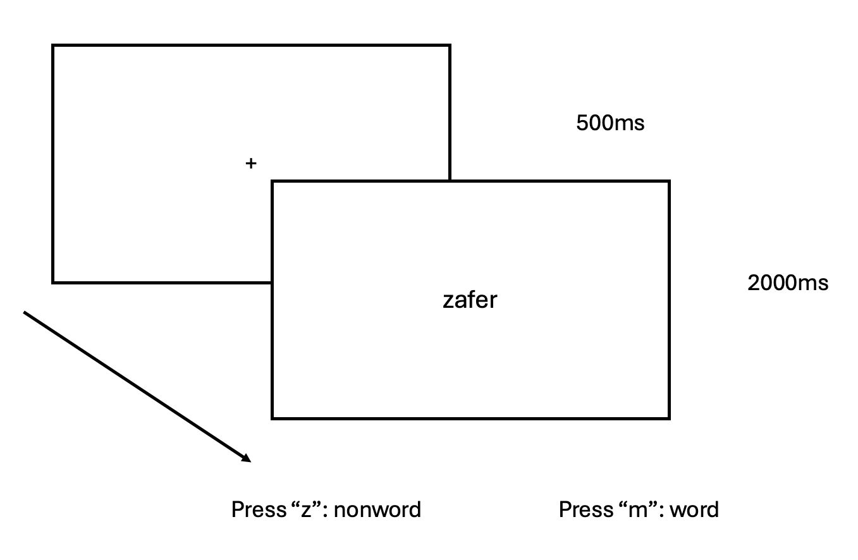
Experiment 1 Vowel harmony for words
𐰽𐰑𐰯𐰖𐰴𐰽𐰯𐰽𐰑𐰴𐰖𐰣𐰯𐰽𐰑𐰯𐰴𐰯𐰖𐰍𐰣𐰺𐰤𐰀𐰀𐰆𐰣𐰋𐰀𐰾𐰓𐰯𐰚𐰾𐰘𐰏𐰦𐰯𐰠𐰚𐰏𐰾𐰚𐰾𐰯𐰯𐰴𐰯𐰀𐰠𐱁𐰴𐰀𐰠𐰇𐰀𐰯𐰯𐰚𐰴𐰆𐰞𐰀𐱁𐰾𐰇𐰠𐰯𐰀𐰚𐰯𐰆𐰴𐰍𐰀𐰞𐱁𐰾𐰀𐰢𐰯𐰚𐰡𐰯𐰚𐰏𐰚𐰢𐰓𐰯𐰚𐰚𐰏𐰯𐰓𐰚𐰓𐰚𐰼𐰘𐰏𐰤𐰀𐰠𐰚𐰤𐰀𐰼𐰚𐰲𐰋𐰢𐰍𐰃𐰀𐰺𐰆𐰉𐰲𐰴𐱃𐰉𐰆𐰃𐰺𐰏𐰀𐰘𐰚𐰍𐰃𐱃𐰆𐰆𐰀𐰯𐰘𐰚𐰠𐰤𐰚𐰼𐰏𐰴𐰃𐰞𐰖𐰴𐰆𐰀𐰯𐰖𐰆𐰞𐰴𐰭𐰺𐰴𐰃𐰴𐰞3𐰆𐰆𐰼𐰀𐰴𐰘𐰠𐰚𐰢𐰯𐰤𐰏𐰼𐰴𐰃𐰖𐰴𐰆𐰆𐰀𐰴𐰘𐰠𐰯𐰚𐰤𐰴𐰃𐰺𐱃𐰆𐰆𐰀𐰘𐰠𐰯
Lexical decision task.
Implemented in PsychoPy (Peirce et al., 2019), and conducted online using the Pavlovia server.
The analyses were conducted using Bayesian linear mixed effects models.

Slide 14
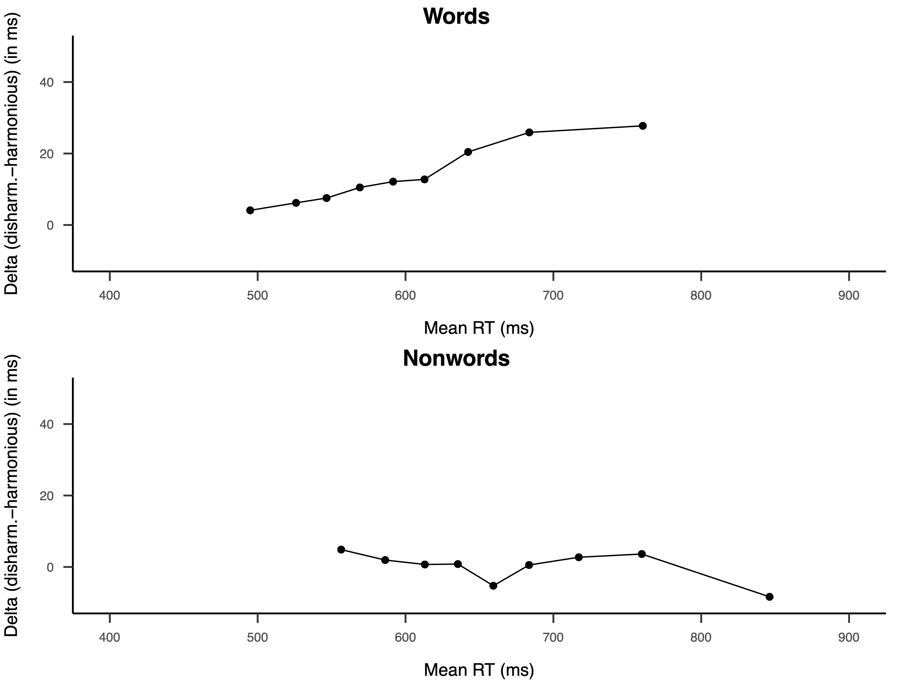
Experiment 1
𐰽𐰑𐰓𐰯𐰖𐰴𐰽𐰯𐰽𐰑𐰴𐰖𐰣𐰯𐰽𐰑𐰯𐰴𐰯𐰖𐰍𐰣𐰺𐰤𐰀𐰀𐰆𐰣𐰋𐰀𐰾𐰯𐰚𐰾𐰘𐰏𐰦𐰯𐰠𐰚𐰏𐰾𐰚𐰾𐰯𐰯𐰴𐰯𐰀𐰠𐱁𐰴𐰀𐰠𐰇𐰀𐰯𐰯𐰚𐰴𐰆𐰞𐰀𐱁𐰾𐰇𐰠𐰯𐰀𐰚𐰯𐰆𐰴𐰍𐰀𐰞𐱁𐰾𐰀𐰢𐰯𐰚𐰡𐰯𐰚𐰏𐰚𐰢𐰓𐰯𐰚𐰚𐰏𐰯𐰓𐰚𐰓𐰚𐰼𐰘𐰏𐰤𐰀𐰠𐰚𐰤𐰀𐰼𐰚𐰲𐰋𐰢𐰍𐰃𐰀𐰺𐰆𐰉𐰲𐰴𐱃𐰉𐰆𐰃𐰺𐰏𐰀𐰘𐰚𐰍𐰃𐱃𐰆𐰆𐰀𐰯𐰘𐰚𐰠𐰤𐰚𐰼𐰏𐰴𐰃𐰞𐰖𐰴𐰆𐰀𐰯𐰖𐰆𐰞𐰴𐰭𐰺𐰴𐰃𐰴𐰞3𐰆𐰆𐰼𐰀𐰴𐰘𐰠𐰚𐰢𐰯𐰤𐰏𐰼𐰴𐰃𐰖𐰴𐰆𐰆𐰀𐰴𐰘𐰠𐰯𐰚𐰤𐰴𐰃𐰺𐱃𐰆𐰆𐰀𐰘𐰠𐰯
Means
Delta plots
 |  |  | RT | Accuracy
Word
 | Harmonious | Harmonious | 604 | 0.97
 | Disharmonious | Disharmonious | 623 | 0.97
Pseudoword
 | Harmonious | Harmonious | 685 | 0.95
 | Disharmonious | Disharmonious | 686 | 0.94
As expected, harmonious words produced faster responses. However, there was no effect for pseudowords.
Notes:
Preliminary conclusion, yes VH plays a role in visual word recognition. For words the effect was clear. For pseudowords, we didn’t get any effect this null effect differs from the experiment in Finnish that I mentioned earlier. We design a second experiment 2 to solve this discrepancy.

Slide 15
Experiment 2 Solving the apparent discrepancy for pseudowords
𐰽𐰑𐰯𐰖𐰴𐰽𐰯𐰽𐰑𐰴𐰖𐰣𐰯𐰽𐰑𐰯𐰴𐰯𐰖𐰍𐰣𐰺𐰤𐰀𐰀𐰆𐰣𐰋𐰀𐰾𐰓𐰯𐰚𐰾𐰘𐰏𐰦𐰯𐰠𐰚𐰏𐰾𐰚𐰾𐰯𐰯𐰴𐰯𐰀𐰠𐱁𐰴𐰀𐰠𐰇𐰀𐰯𐰯𐰚𐰴𐰆𐰞𐰀𐱁𐰾𐰇𐰠𐰯𐰀𐰚𐰯𐰆𐰴𐰍𐰀𐰞𐱁𐰾𐰀𐰢𐰯𐰚𐰡𐰯𐰚𐰏𐰚𐰢𐰓𐰯𐰚𐰚𐰏𐰯𐰓𐰚𐰓𐰚𐰼𐰘𐰏𐰤𐰀𐰠𐰚𐰤𐰀𐰼𐰚𐰲𐰋𐰢𐰍𐰃𐰀𐰺𐰆𐰉𐰲𐰴𐱃𐰉𐰆𐰃𐰺𐰏𐰀𐰘𐰚𐰍𐰃𐱃𐰆𐰆𐰀𐰯𐰘𐰚𐰠𐰤𐰚𐰼𐰏𐰴𐰃𐰞𐰖𐰴𐰆𐰀𐰯𐰖𐰆𐰞𐰴𐰭𐰺𐰴𐰃𐰴𐰞3𐰆𐰆𐰼𐰀𐰴𐰘𐰠𐰚𐰢𐰯𐰤𐰏𐰼𐰴𐰃𐰖𐰴𐰆𐰆𐰀𐰴𐰘𐰠𐰯𐰚𐰤𐰴𐰃𐰺𐱃𐰆𐰆𐰀𐰘𐰠𐰯
In the Finnish experiment of Perea et al. (2022), words were always harmonious. Thus, any item that was not harmonious was a nonword, which could have led to faster RTs for disharmonious pseudowords
Vowel harmony is less crucial for Turkish (around 25% of words are disharmonious) than Finnish readers, so it is a less salient marker for “nonword" responses.
To tell apart these two explanations, we designed Experiment 2
Notes:
There can be two potential reasons for this apparent discrepancy.

Slide 16
Experiment 2 Vowel harmony for pseudowords
𐰽𐰑𐰯𐰖𐰴𐰽𐰯𐰽𐰑𐰴𐰖𐰣𐰯𐰽𐰑𐰯𐰴𐰯𐰖𐰍𐰣𐰺𐰤𐰀𐰀𐰆𐰣𐰋𐰀𐰾𐰓𐰯𐰚𐰾𐰘𐰏𐰦𐰯𐰠𐰚𐰏𐰾𐰚𐰾𐰯𐰯𐰴𐰯𐰀𐰠𐱁𐰴𐰀𐰠𐰇𐰀𐰯𐰯𐰚𐰴𐰆𐰞𐰀𐱁𐰾𐰇𐰠𐰯𐰀𐰚𐰯𐰆𐰴𐰍𐰀𐰞𐱁𐰾𐰀𐰢𐰯𐰚𐰡𐰯𐰚𐰏𐰚𐰢𐰓𐰯𐰚𐰚𐰏𐰯𐰓𐰚𐰓𐰚𐰼𐰘𐰏𐰤𐰀𐰠𐰚𐰤𐰀𐰼𐰚𐰲𐰋𐰢𐰍𐰃𐰀𐰺𐰆𐰉𐰲𐰴𐱃𐰉𐰆𐰃𐰺𐰏𐰀𐰘𐰚𐰍𐰃𐱃𐰆𐰆𐰀𐰯𐰘𐰚𐰠𐰤𐰚𐰼𐰏𐰴𐰃𐰞𐰖𐰴𐰆𐰀𐰯𐰖𐰆𐰞𐰴𐰭𐰺𐰴𐰃𐰴𐰞3𐰆𐰆𐰼𐰀𐰴𐰘𐰠𐰚𐰢𐰯𐰤𐰏𐰼𐰴𐰃𐰖𐰴𐰆𐰆𐰀𐰴𐰘𐰠𐰯𐰚𐰤𐰴𐰃𐰺𐱃𐰆𐰆𐰀𐰘𐰠𐰯
A new sample of thirty-six Turkish participants participated (M = 26.94 y.o.).
The same pseudowords are used as in Experiment 1.
We replaced the 71 disharmonious nouns with similar-frequency harmonious nouns from the same corpus.
All procedures and data analysis are the same as in Experiment 1.
The experiment was pre-registered in OSF.
Notes:
There can be two potential reasons for this apparent discrepancy.

Slide 17
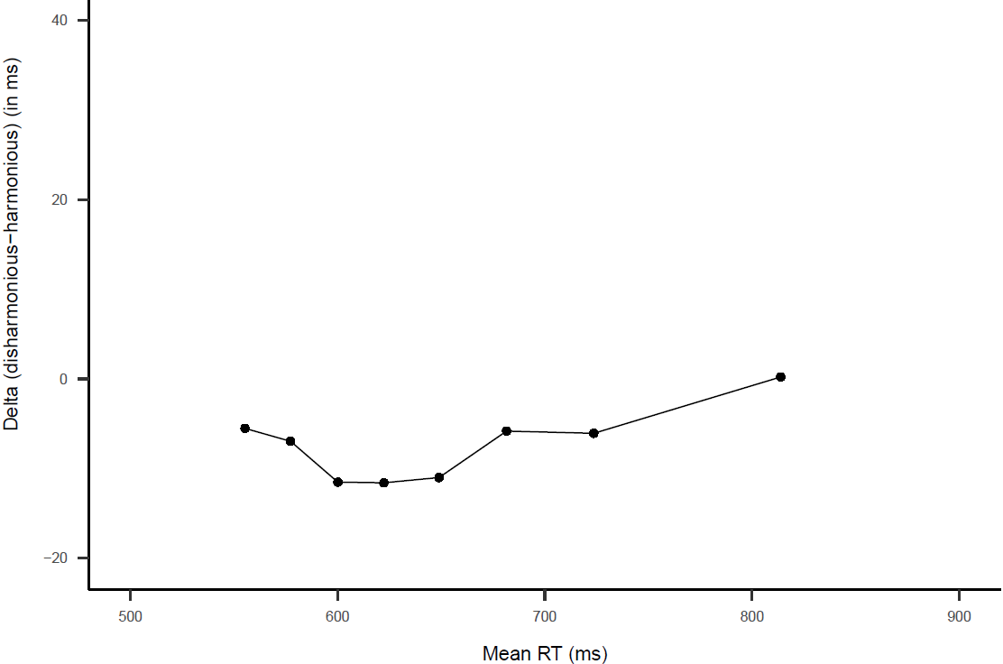
Experiment 2
Delta plot
Means
Nonwords
 |  | RT | Accuracy
Pseudoword
 | Harmonious | 658 | 0.955
 | Disharmonious | 652 | 0.957
We found evidence for a small but reliable effect of vowel harmony (b = 5.72, 95%CrI [0.25, 14.14]): RTs were faster for disharmonious than harmonious pseudowords.
Notes:
We found evidence for this effect however the effect size was much smaller than Finnish

Slide 18
Conclusions
𐰽𐰑𐰯𐰖𐰴𐰽𐰯𐰽𐰑𐰴𐰖𐰣𐰯𐰽𐰑𐰯𐰴𐰯𐰖𐰍𐰣𐰺𐰤𐰀𐰀𐰆𐰣𐰋𐰀𐰾𐰓𐰯𐰚𐰾𐰘𐰏𐰦𐰯𐰠𐰚𐰏𐰾𐰚𐰾𐰯𐰯𐰴𐰯𐰀𐰠𐱁𐰴𐰀𐰠𐰇𐰀𐰯𐰯𐰚𐰴𐰆𐰞𐰀𐱁𐰾𐰇𐰠𐰯𐰀𐰚𐰯𐰆𐰴𐰍𐰀𐰞𐱁𐰾𐰀𐰢𐰯𐰚𐰡𐰯𐰚𐰏𐰚𐰢𐰓𐰯𐰚𐰚𐰏𐰯𐰓𐰚𐰓𐰚𐰼𐰘𐰏𐰤𐰀𐰠𐰚𐰤𐰀𐰼𐰚𐰲𐰋𐰢𐰍𐰃𐰀𐰺𐰆𐰉𐰲𐰴𐱃𐰉𐰆𐰃𐰺𐰏𐰀𐰘𐰚𐰍𐰃𐱃𐰆𐰆𐰀𐰯𐰘𐰚𐰠𐰤𐰚𐰼𐰏𐰴𐰃𐰞𐰖𐰴𐰆𐰀𐰯𐰖𐰆𐰞𐰴𐰭𐰺𐰴𐰃𐰴𐰞3𐰆𐰆𐰼𐰀𐰴𐰘𐰠𐰚𐰢𐰯𐰤𐰏𐰼𐰴𐰃𐰖𐰴𐰆𐰆𐰀𐰴𐰘𐰠𐰯𐰚𐰤𐰴𐰃𐰺𐱃𐰆𐰆𐰀𐰘𐰠𐰯
1) In Turkish, vowel harmony helps during visual word recognition
2) This finding favors the idea that vowel harmony may help attain stable phonological codes (global coherence hypothesis) that, in turn, provide evidence that the item is a “word”.
3) Unlike Finnish, vowel harmony does not play a key role in “no” responses in lexical decision in Turkish, very likely because vowel disharmony is not a reliable marker of nonword-likeness.
Next step: Examining the effects of vowel harmony during silent reading, in both developmental and adult readers.
Notes:
The design is matter. But its not a critical criterion.

Slide 19
! 𐱅𐰀𐱁𐰚𐰚𐰇𐰼𐰠𐰀𐰼
𐰽𐰑𐰯𐰖𐰴𐰽𐰯𐰽𐰑𐰴𐰖𐰣𐰯𐰽𐰑𐰯𐰴𐰯𐰖𐰍𐰣𐰺𐰤𐰀𐰀𐰆𐰣𐰋𐰀𐰾𐰓𐰯𐰚𐰾𐰘𐰏𐰦𐰯𐰠𐰚𐰏𐰾𐰚𐰾𐰯𐰯𐰴𐰯𐰀𐰠𐱁𐰴𐰀𐰠𐰇𐰀𐰯𐰯𐰚𐰴𐰆𐰞𐰀𐱁𐰾𐰇𐰠𐰯𐰀𐰚𐰯𐰆𐰴𐰍𐰀𐰞𐱁𐰾𐰀𐰢𐰯𐰚𐰡𐰯𐰚𐰏𐰚𐰢𐰓𐰯𐰚𐰚𐰏𐰯𐰓𐰚𐰓𐰚𐰼𐰘𐰏𐰤𐰀𐰠𐰚𐰤𐰀𐰼𐰚𐰲𐰋𐰢𐰍𐰃𐰀𐰺𐰆𐰉𐰲𐰴𐱃𐰉𐰆𐰃𐰺𐰏𐰀𐰘𐰚𐰍𐰃𐱃𐰆𐰆𐰀𐰯𐰘𐰚𐰠𐰤𐰚𐰼𐰏𐰴𐰃𐰞𐰖𐰴𐰆𐰀𐰯𐰖𐰆𐰞𐰴𐰭𐰺𐰴𐰃𐰴𐰞3𐰆𐰆𐰼𐰀𐰴𐰘𐰠𐰚𐰢𐰯𐰤𐰏𐰼𐰴𐰃𐰖𐰴𐰆𐰆𐰀𐰴𐰘𐰠𐰯𐰚𐰤𐰴𐰃𐰺𐱃𐰆𐰆𐰀𐰘𐰠𐰯

