Slide 1
Recurrent Neural Network
Neural Network Characterized by Direction of the Flow of Information Between Its Layers

Slide 2
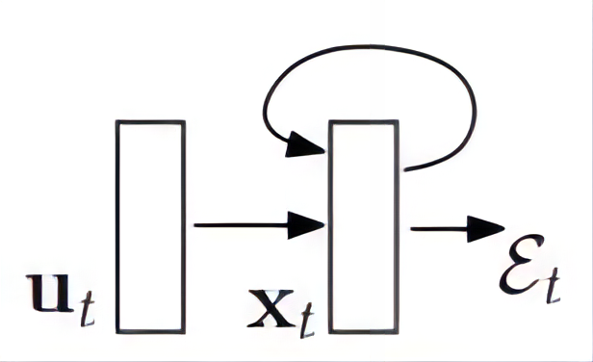
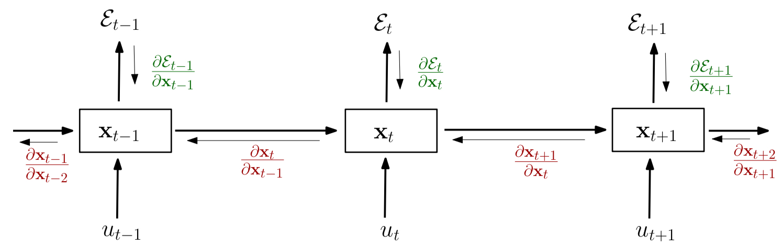
Recurrent Neural Network

Slide 3
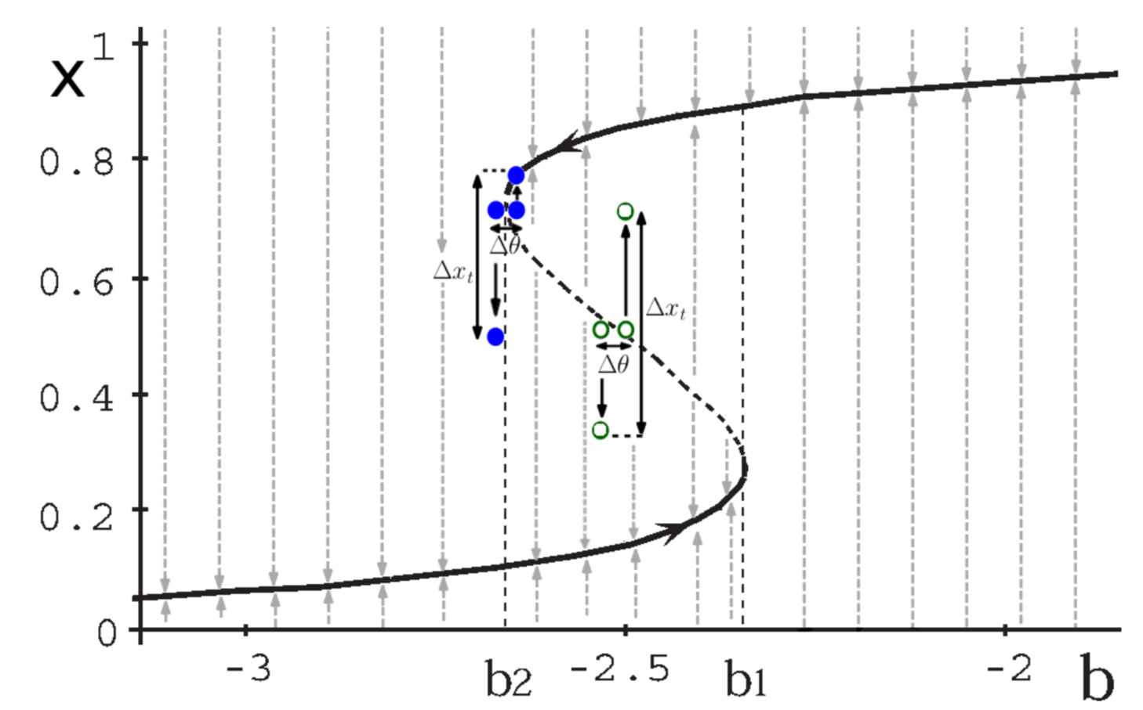
Gradient Explosion & Vanishing Gradient

Slide 4
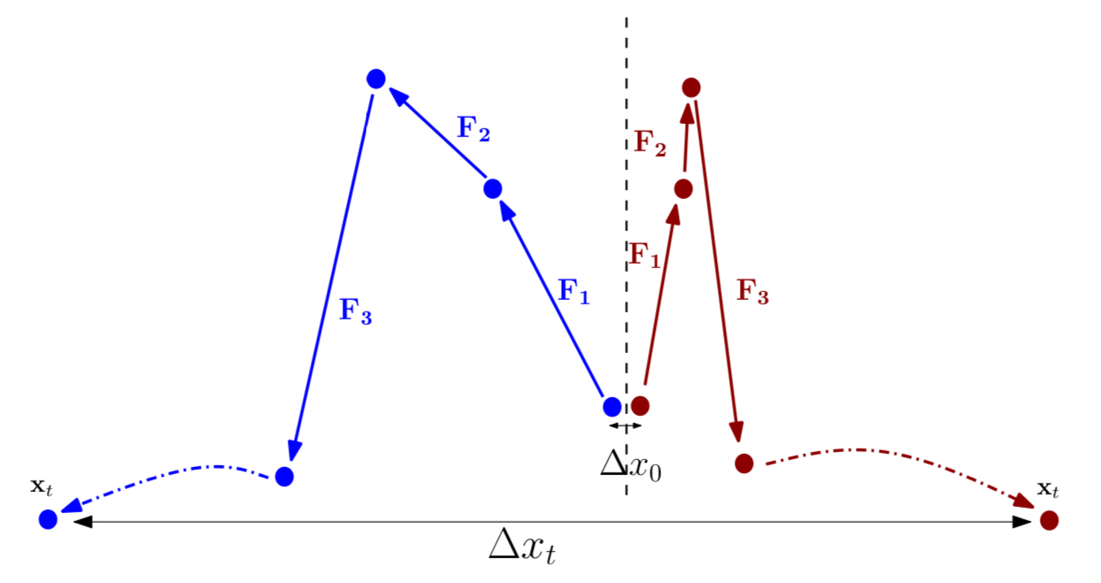
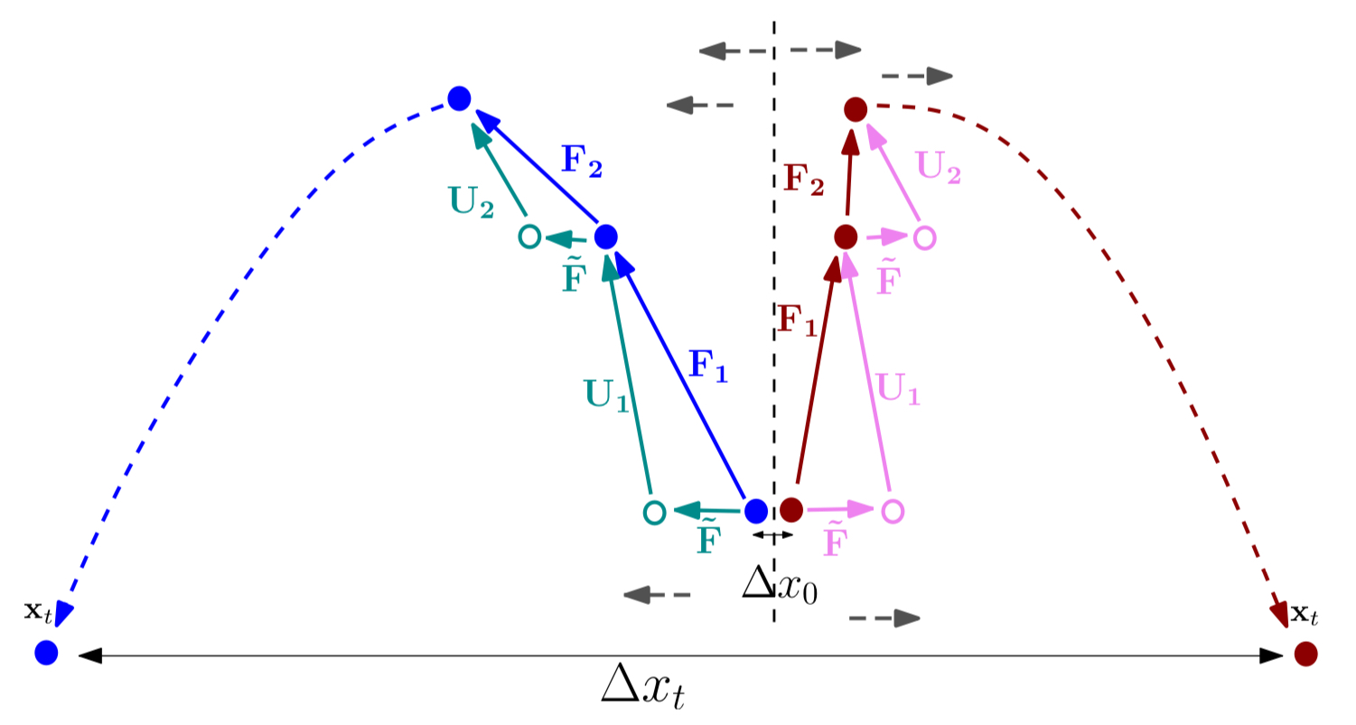
Gradient Explosion & Vanishing Gradient

Slide 5
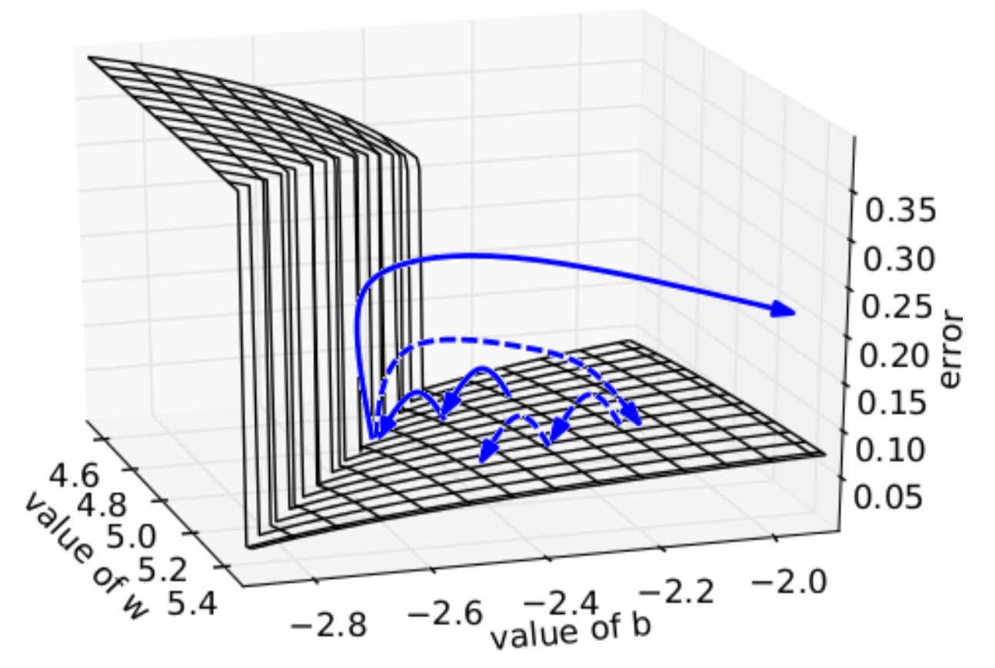
Geometric interpretation

Slide 6
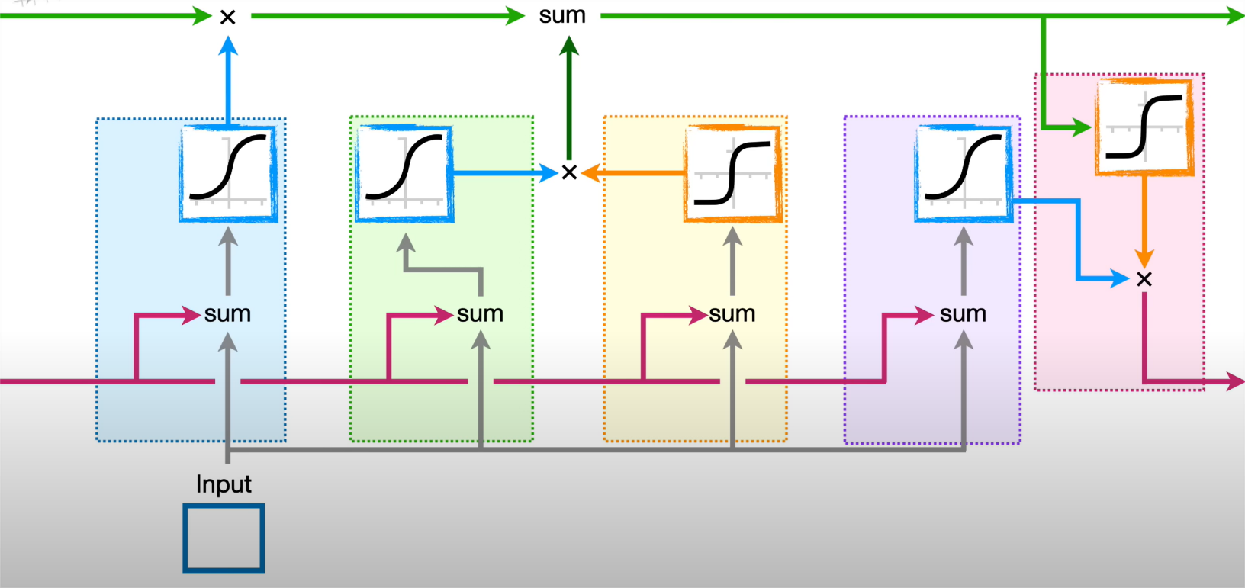
Long-Short Term Memory

Slide 7
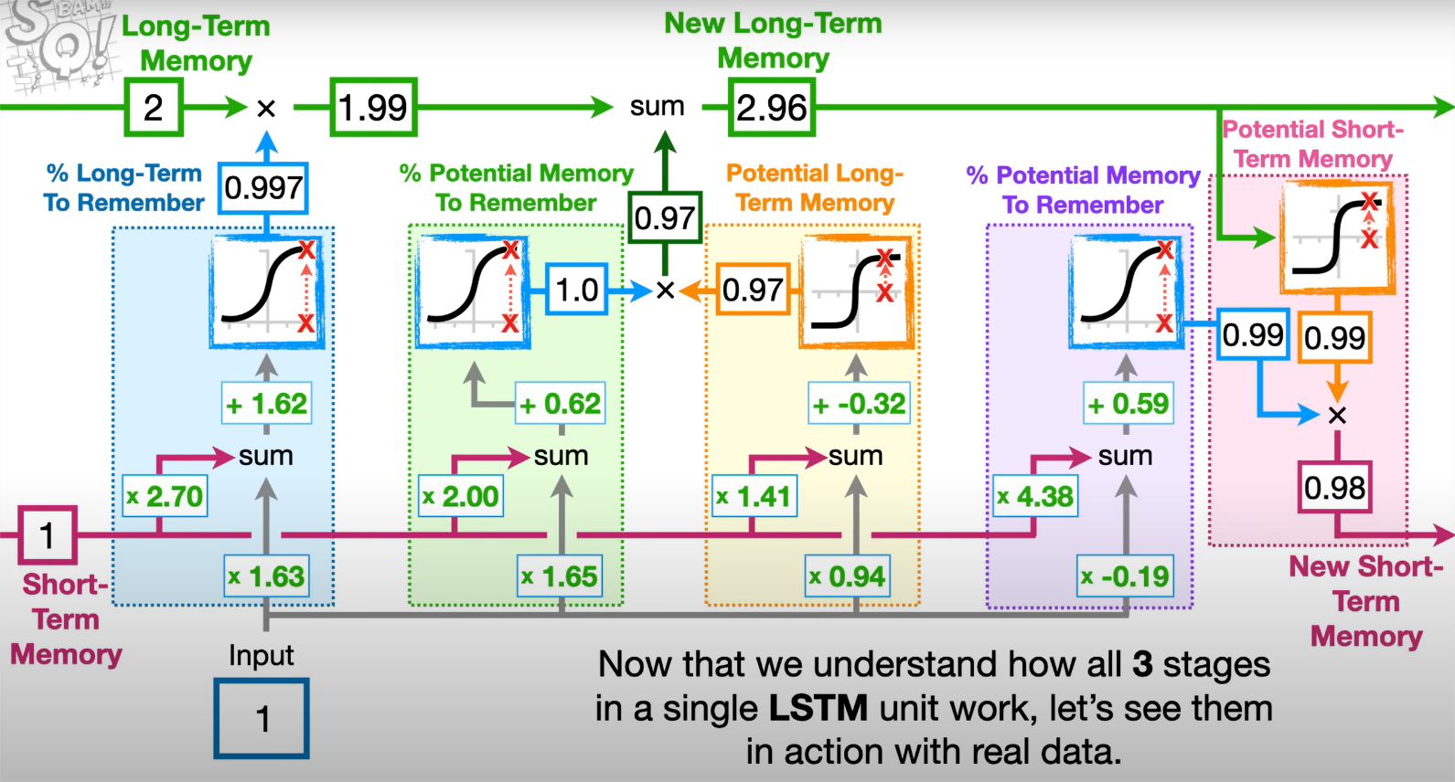
Long-Short Term Memory

Slide 8
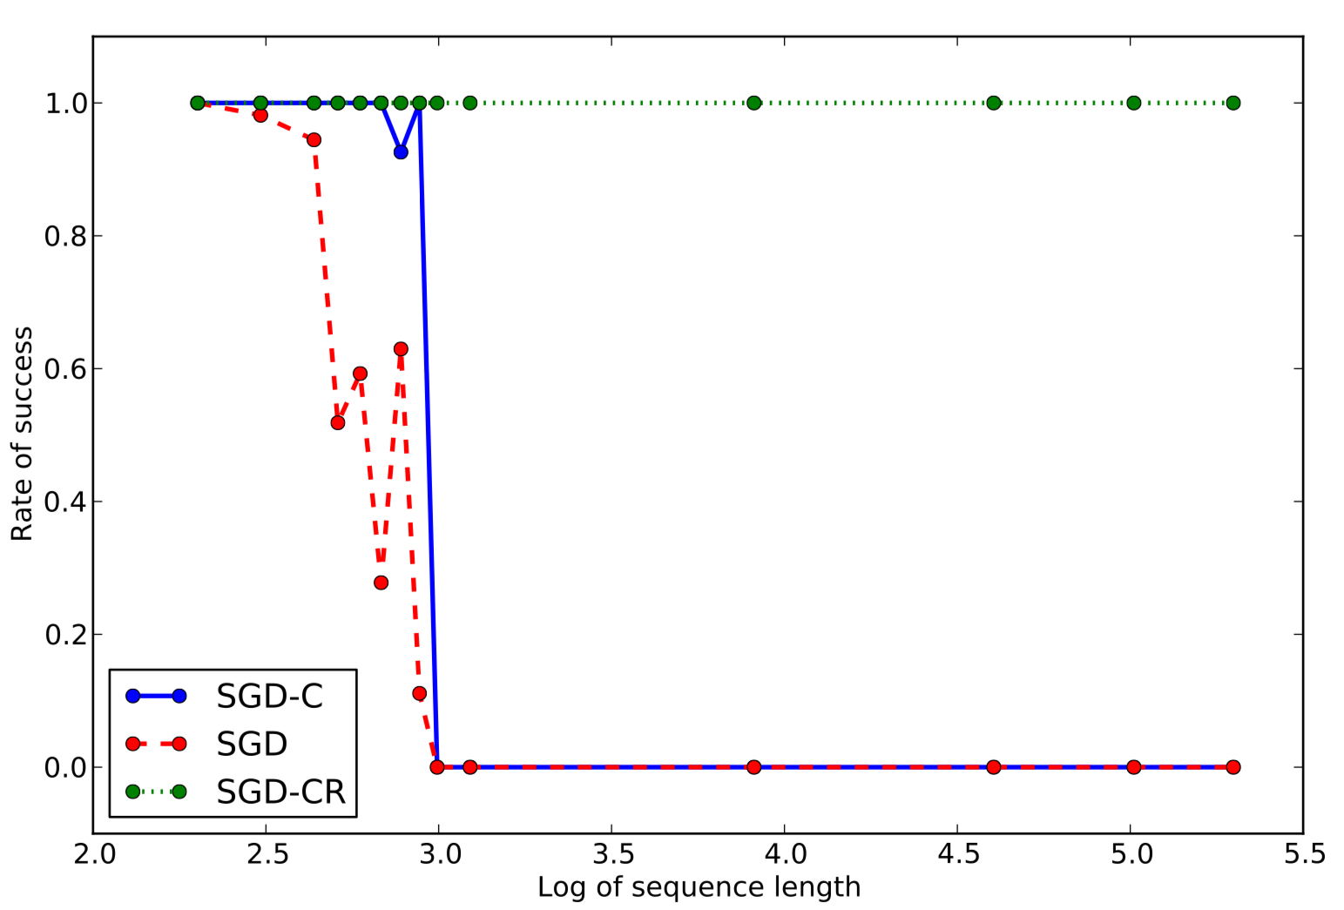
Time Series Problem

Slide 9
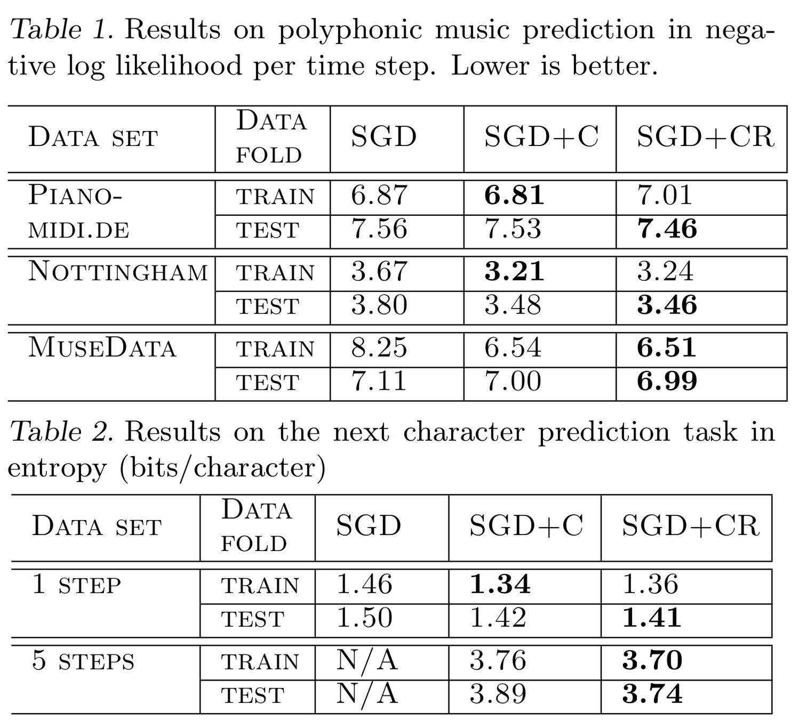
Pathological Tasks

