Slide 1

Steam Macro Analysis
Understanding the Steam Game Market from a
Macroeconomic Perspective
By: ZY Liu
2024/6/15

Slide 2
Project purpose
This project aims to enhance data analysis and data science skills while deepening the understanding of gaming market.

Slide 3

Main question
What are the mainstream game genres?
Which games are popular?
What are the game pricing trends?
How is player retention and market performance on Steam?

Slide 4
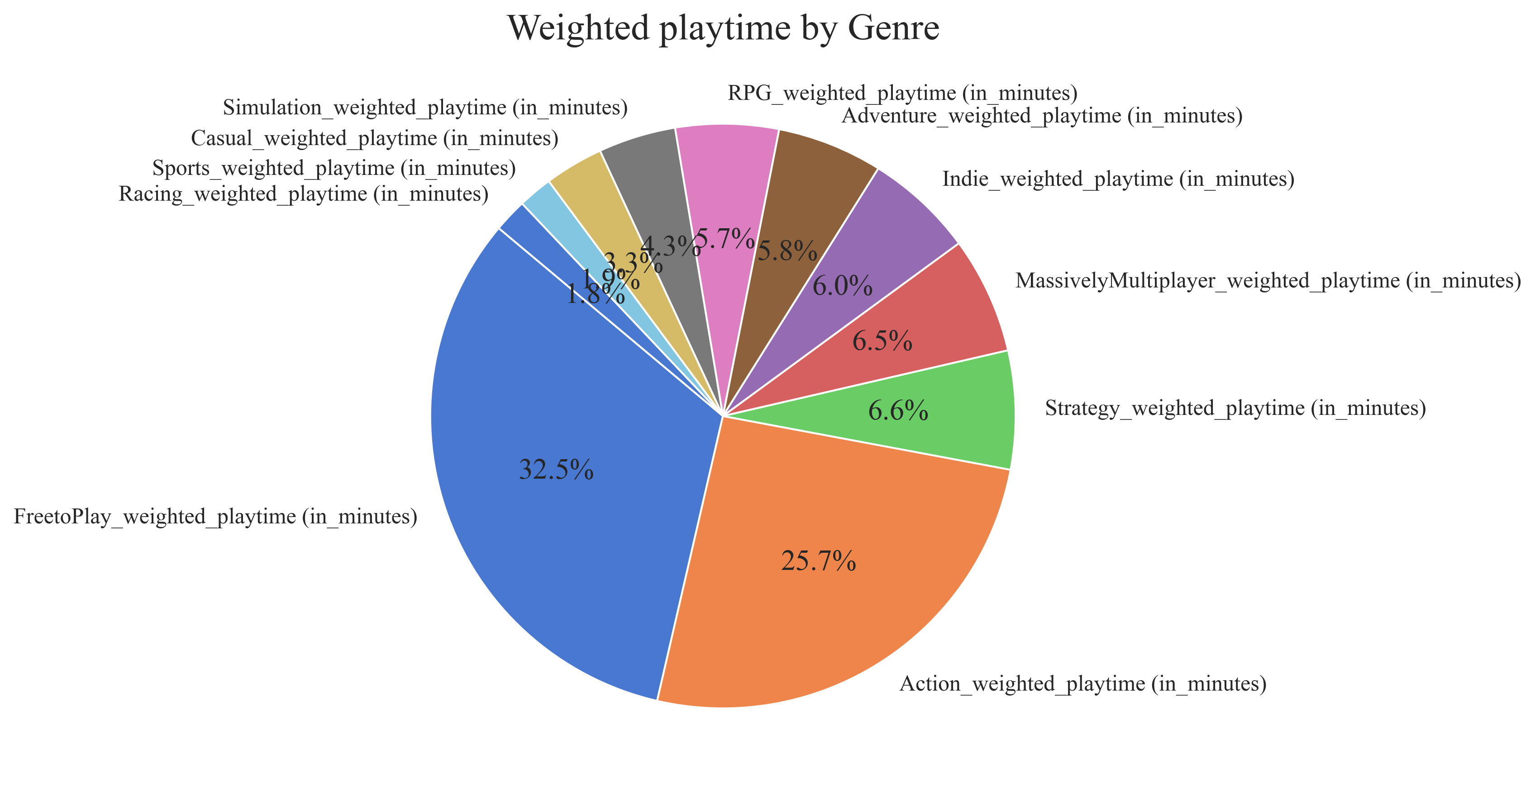
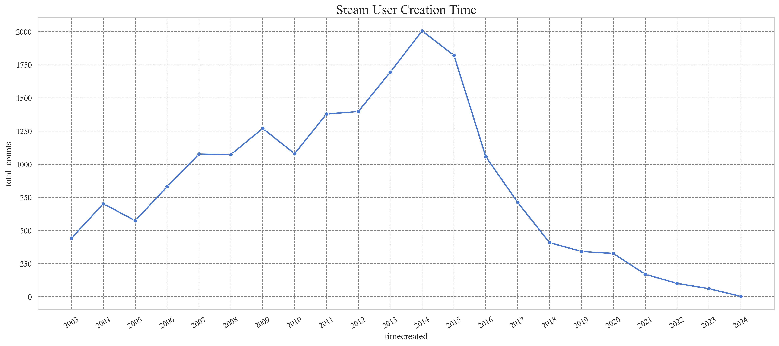
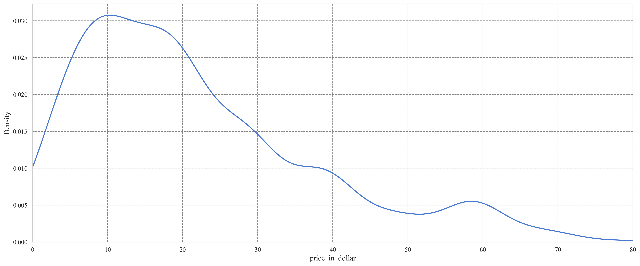
Executive summary
Mainstream game genres
Game price distribution
Growth of Steam users
Action games are the most popular on the Steam market.
Games tend to cluster into several price ranges to some extent, with $10-15 being the most common pricing range.
2014 and 2015 were the fastest-growing periods for Steam users, and the growth rate gradually slowed down afterwards.

Slide 5
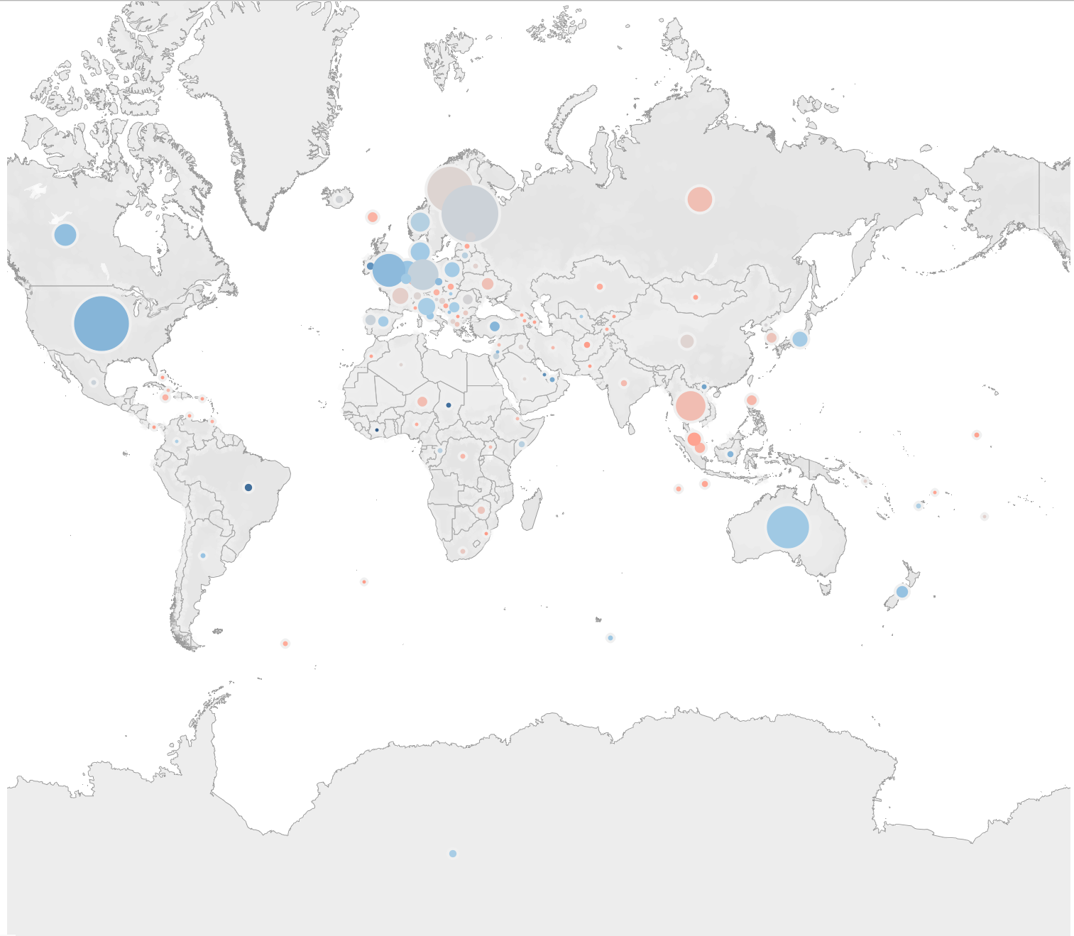
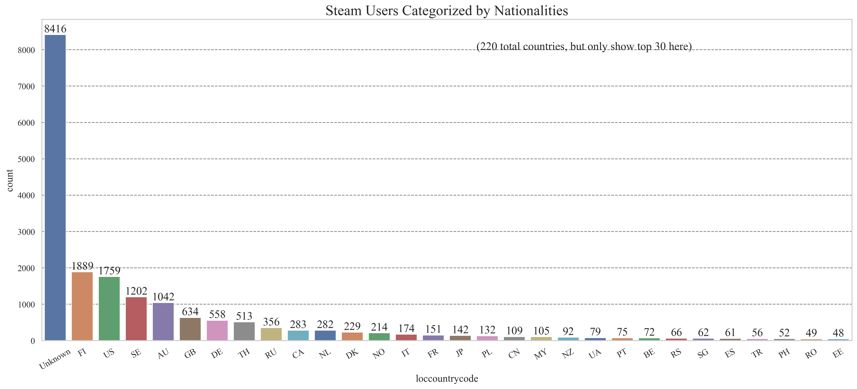
Key findings:
Only 25% users are willing to show their personal profile。

Slide 6
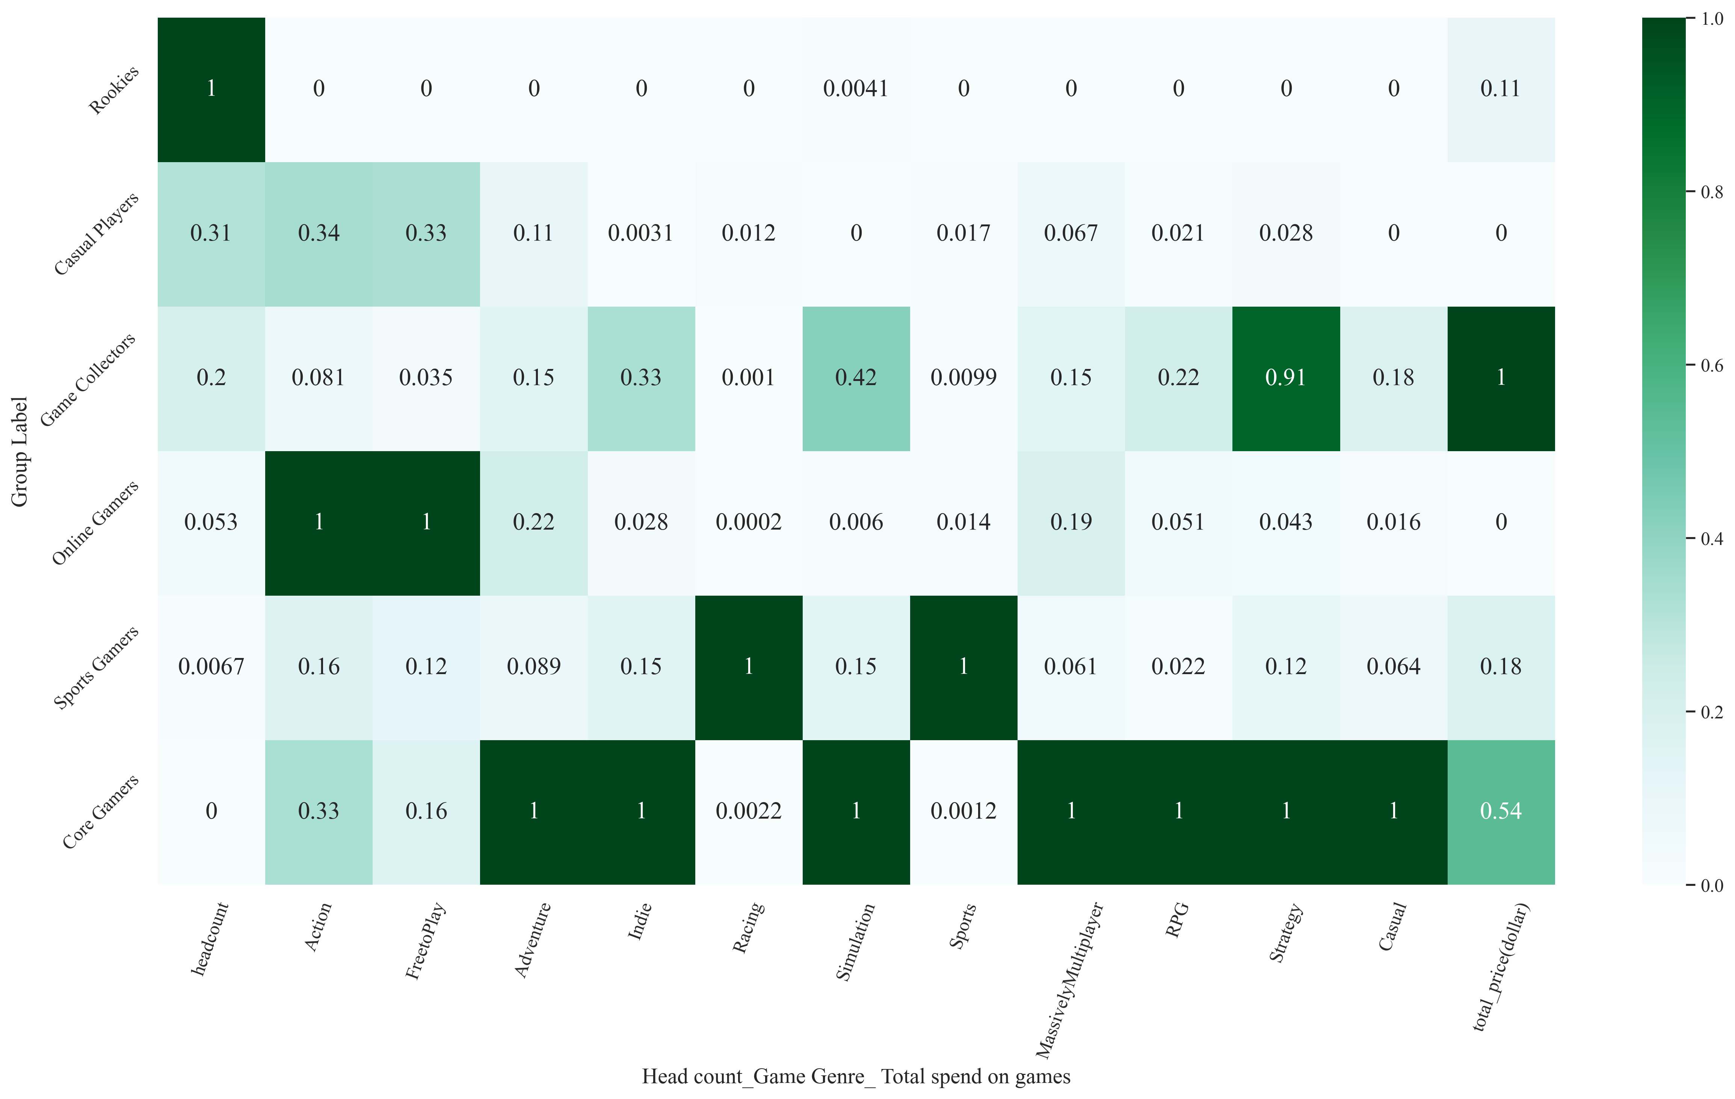
Key findings:
Among the players, 15.4% have strong purchasing potential, while most are casual players or free-to-play gamers.

Slide 7
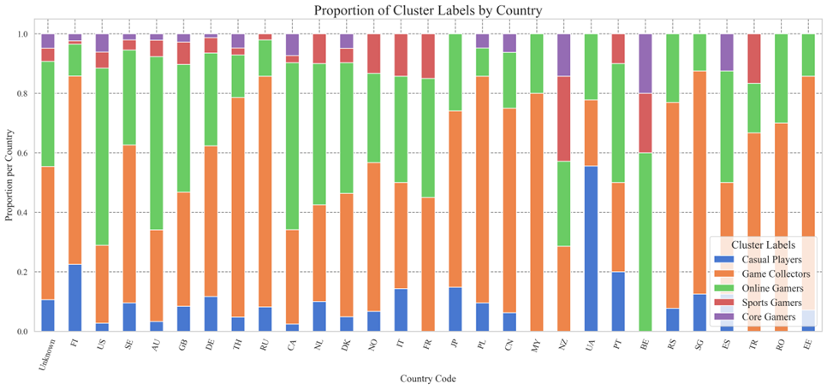
Key findings:
The preference for sports games in Europe is much higher than in Asia.

Slide 8
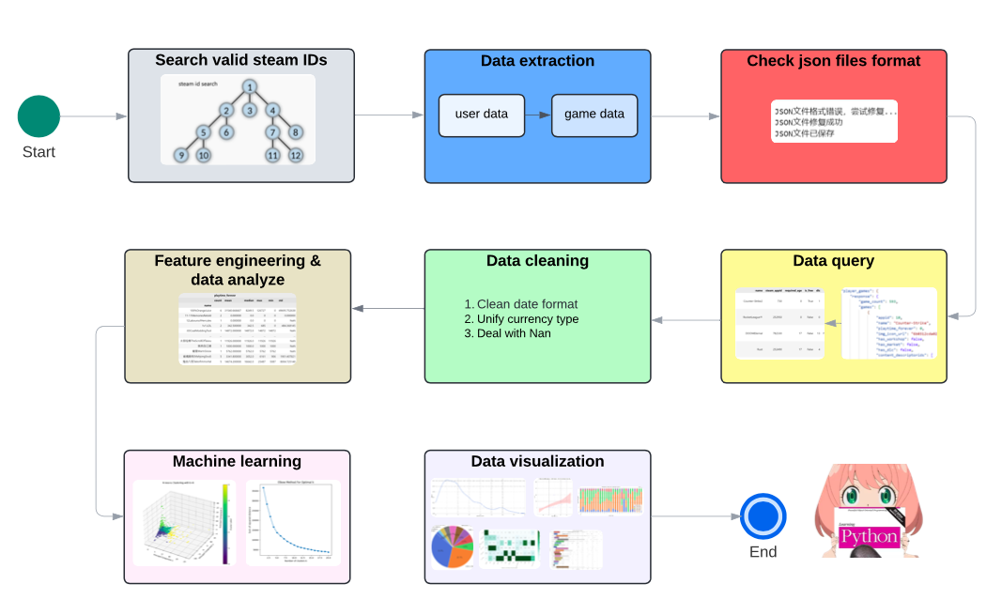
Workflow

Slide 9
Potential Issues
Issue 1
Issue 2
Issue 3
Search valid steam ID
Breadth-First Search (BFS) on Steam accounts may cause coverage and result biases, favoring homogeneous user groups and overlooking diverse data.
Machine learning
Using PCA and K-means can lead to information loss, model bias, and reduced interpretability.
Data maintenance
The data currently captured from Steam is time-sensitive. Thus we need to maintain data regularly.

Slide 10
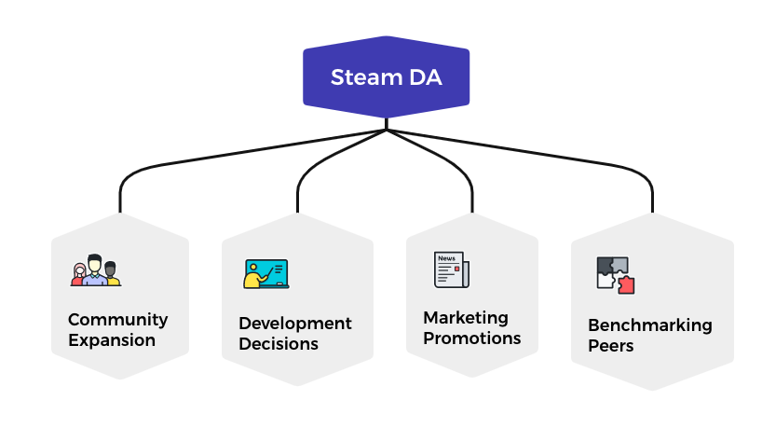
Business opportunities

Slide 11

Thank you!

