Slide 1
Artificial Intelligence
Assignment 2 – Final delivery
Group 07
Carolina Rosemback Guilhermino, up201800171
José Eduardo Henriques, up201806372
Miguel Carreira Neves, up201608657

Slide 2
Project Specification
Natural Language Processing (NLP Problems): Detecting Offense
In an NLP Problem, the textual data should be processed and transformed into appropriate datasets. Then, an initial exploratory data analysis should be carried out, along with different pre-processing and feature engineering techniques. The employed machine learning algorithms should be tested and compared (performance during learning, confusion matrix, precision, recall, accuracy, F1 measure) and the time spent to train/test the models.
This project aims to identify how offensive a given text is, by attributing a score from (higher score => more offensive).
The test file contains 9000 labels and ratings from a balanced set of age groups from 18-70. The annotators also represented a variety of genders, political stances and income levels.

Slide 3
Related Work
Splitting into train, dev and test sets: https://cs230.stanford.edu/blog/split/
N-Grams: https://www.lexalytics.com/lexablog/context-analysis-nlp
SMOTE: https://machinelearningmastery.com/smote-oversampling-for-imbalanced-classification/
Dealing with unbalanced datasets: https://machinelearningmastery.com/data-sampling-methods-for-imbalanced-classification/
“Method for Detecting and Rating Humor Based on Multi-Task Adversarial Training”: https://arxiv.org/pdf/2104.10336v1.pdf
Learning curve: https://scikit-learn.org/stable/auto_examples/neural_networks/plot_mlp_training_curves.html
Moodle contents from the UC

Slide 4
Tools and Algorithms Implemented
Machine learning algorithms:
SVM
Neural Networks (MLP)
Logistic Regression
Random Forest
Decision Tree

Slide 5
Data Preprocessing
Porter Stemmer
Bag of Words
N-grams (bi-grams and tri-grams)
TF-IDF

Slide 6
Techniques Used
Divided Data into train, test and dev sets in order to avoid overfitting to the test set.
Removed Stop words from phrases.
Due to our dataset being highly imbalanced (from 9000 rows, ~6400 were scored 0):
→ Rounded our labels (they were floats) and transformed labels 2-5 in 2, in order to simplify classification. The amount of examples of the higher scores was below 200.
→ Used SMOTE along with Random Under Sampler to balance our data to 3.000 examples of each

Slide 7
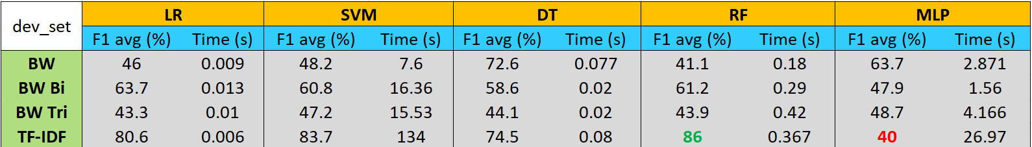
F1 average score and fit elapsed time
Results for each (pre-processor, classifier) pair prediction applied to the dev_set.

Slide 8
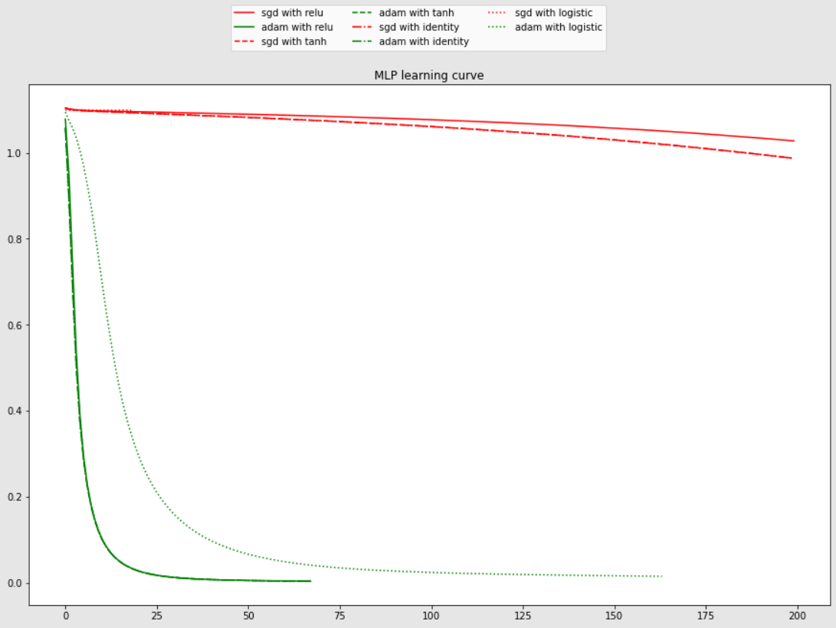
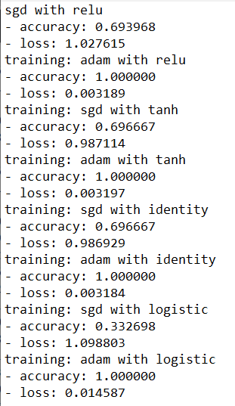
MLP Learning curve

