Slide 1

IART Assignment 1 Checkpoint
Group 07
Carolina Rosemback Guilhermino
José Eduardo Henriques
Miguel Carreira Neves

Slide 2
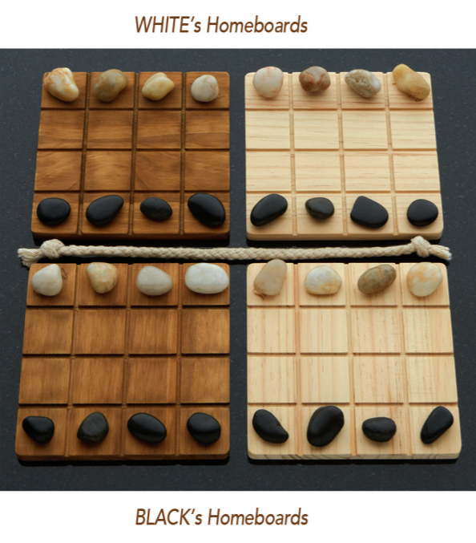
Project Specification
Two-Player Adversarial Board Game: Shobu
Turn based game, where each turn is comprised of two moves: first one Passive move and then one Aggressive move.
The passive move must be played on one of the player’s two homeboards. The player chooses one of their colour pieces and moves it into any direction inside the board, up two spaces, without pushing or jumping over any piece.
The aggressive move must be made in the same direction and number of spaces as the passive move, on one of the opposite colour boards as the one chosen in the passive move. Additionally, the aggressive move can push, at most, one piece, of the opponent colour. If a piece is pushed off the board, that piece is removed from the game.
The game’s objective is to remove all opponent pieces from one board. First one to do so wins the game.
Fig. 1 – Shobu Initial Boards

Slide 3
References
https://www.smirkandlaughter.com/shobu

Slide 4
Search Problem Formulation
State Representation:
4-Dimensional matrix M[ H[ B[4,4], B[4,4] ], H[ B[4,4], B[4,4] ] ]. State M is a matrix consisting of two H matrices. H represents a player’s homeboard, consisting of two B matrices. B represents a board, consisting of a 4x4 matrix. A board is filled with ‘B’, ‘W’ or ‘ ‘ chars, representing a black piece, a white piece and an empty space, respectively.
Initial State:
Each board’s top row is filled with white pieces, bottom row is filled with black pieces and the rest with empty spaces (as shown in Fig. 1)
Objective State:
Any state containing a board with only black pieces (and empty spaces), assuming the black player’s perspective.
Operators:
updateBoard(passive_piece, aggressive_piece, movement, players_piece, opponents_piece)
// updates necessary boards, applying the given movement to the selected passive_piece and aggressive_piece
// passive_piece, aggressive piece: length 4 arrays with coordinates to the selected pieces
// movement: length 2 arrays representing the movement offset

Slide 5
Search Problem Formulation
Operator Preconditions:
passar legalPassiveMoves e legalAgressiveMoves (temos que meter tudo? É que n vamos ter espaço para tudo)
Operator Effects:
M[passive_piece[0]] [passive_piece[1]] [passive_piece[2]] [passive_piece[3]] = ‘ ‘
M[passive_piece[0]] [passive_piece[1]] [passive_piece[2] + movement[0]] [passive_piece[3] + movement[1]] = playes_piece
ForEach(cell along the movement from the aggressive_piece): cell = ‘ ‘
M[aggressive_piece[0]] [aggressive_piece[1]] [aggressive_piece[2] + movement[0]] [aggressive_piece[3] + movement[1]] = playes_piece
If(found an opponents_piece along the movement from the aggressive_piece):
M[aggressive_piece[0]] [aggressive_piece[1]] [aggressive_piece[2] + movement[0] + v_next] [aggressive_piece[3] + movement[1] + h_next] = opponents_piece
Operator Costs:
1
If(movement[0] != 0) :
v_next = movement[0]/abs(movement[0])
Else: v_next = 0
If(movement[1] != 0) :
h_next = movement[1]/abs(movement[1])
Else: h_next = 0

Slide 6
Implemented Work
Python

