Slide 1
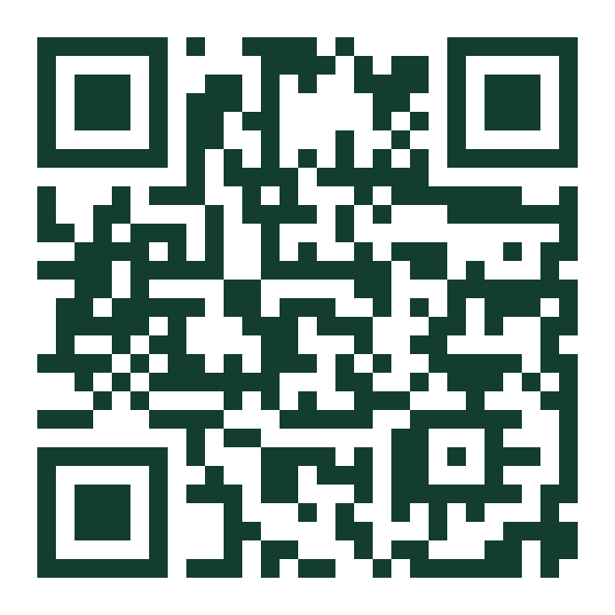
Track 3: Start Something
Groundworking
Example with fictional answers
Mobile bike repair, Gateshead
Needs work
An honest check on whether a business idea will last, and the cheapest way to test it, for people in the North East with a tight budget and little spare time.
Overall. A rough view, not a prediction.
Financial stability
Needs work
Long-term sustainability
Promising
Free verdict. Full plan £4.99.
Room in the market
Needs work
Skills and ability
Strong
Try it now
groundworking.web.app
Notes:
About 15 seconds. "We're Groundworking, Track 3. Lots of people in the North East have a business idea but no way to know if it would last before they spend money. We built an honest check." Replace "Groundworking" with the team name if it differs. The card is the real product output for a fictional example.

Slide 2



Most new businesses don't last five years
Who has it
Under 2 in 5
Students, career changers and people in insecure work in the North East with an idea, a small budget and few spare hours.
The pain
UK businesses started in 2019 were still trading five years later.
They only learn whether the idea holds up after the money is spent. Free AI chat tends to encourage, not test.
Why now
Around 1,700 businesses started in the North East CA area in a single quarter (Q1 2024), and closures have outnumbered starts since 2022.
Source: ONS, Business demography UK 2024
Why now source: North East CA evidence hub, experimental ONS data
Notes:
About 30 seconds. Lead with the stat, then the person: someone with an idea and £300, who finds out it does not work only after spending it. The "why now" line is the regional pressure: more closures than starts. Figures: ONS Business demography UK 2024 puts five-year survival for 2019 starts at about 38%; NE CA evidence hub (experimental ONS data) for the Q1 2024 starts and the trend since 2022.

Slide 3




What we built: an honest check, then a plan
In
Groundworking
Out
Your idea, budget, weekly hours and skills, then a few follow-up questions Claude writes from your answers. "Not sure" is always allowed.
Claude rates four things in words: financial stability, long-term sustainability, room in the market, skills and ability. The overall can be no better than the weakest area.
Free: the verdict and your top 2 risks. £4.99: what to improve, a roadmap of cheap tests, and an improved business plan.
Why it beats the alternatives
vs Free AI chat Structured, tests rather than encourages, never invents grants or figures.
vs Advisers and courses Minutes, not weeks, and £4.99 rather than a fee.
vs Templates Tailored to your budget, your hours and your place.
Notes:
About 40 seconds, then switch to the live demo: type an idea, answer round 1, one follow-up round, show the verdict, unlock with the test-mode payment. Name where it fails: it cannot know local rents or regulations, so it says so and points to professional advice. If the API fails, the app falls back to the cached example plan.

Slide 4
Who pays, and does it make money?
At 100 paying customers a month
£4.99
~4.4p
Revenue (100 × £4.99) | £499
Card fees (1.5% + 20p each) | −£28
AI for 100 payers | −£8
AI for ~3,230 free checks | −£142
Hosting and domain | −£20
Profit | £301
one-off, paid by the founder for the full plan
AI cost per free check (call 2 adds ~4p, payers only)
7
~£301
Assumptions: 3% of people who get a free verdict pay (rule-of-thumb, to be tested); AI cost on Claude Sonnet 5.5 list prices, to be replaced by our measured token log; no wages, the team is unpaid at this stage.
paying customers a month to break even
profit a month at 100 paying customers
Notes:
About 25 seconds. Price £4.99 one-off. AI cost estimated from Anthropic list prices for Claude Sonnet 5.5 ($2 / $10 per million tokens) on an assumed 10k in, 4k out per person: about 4.4p. The paid plan is a second AI call, run only after payment, so free users never cost it. Stripe standard UK card rate 1.5% + 20p. Break-even: £20 fixed costs divided by about £3.21 contribution per payer (after card fee, AI, and the free checks each payer carries at 3% conversion) = 7 a month. This assumes CLAUDE_MODEL=claude-sonnet-5-5 in .env; the engine defaults to Opus 5.5, which roughly doubles AI cost. Replace the 4.4p with the real token log before pitching if Khaliq has it.

Slide 5



Our first 100 customers
Who first
Targets
Students and recent graduates in Newcastle with a side-business idea. They are reachable, short of money and time, and we are among them.
Month 1: 1,000 free checks, 30 paid
Month 2: 2,400 more checks, 70 paid
Total: 100 paying customers at 3%
The offer
A free, honest verdict in minutes. The full plan for £4.99, less than a takeaway.
Route in
Biggest risk
University enterprise and careers teams, student societies, then local business networks and community groups.
People may not pay when free AI chat exists. Test: show the £4.99 unlock to our first 200 users before charging, and count the taps. Under 3% means we rethink the offer.
Notes:
About 25 seconds. Targets are our plan, not results. The 3% conversion is a rule of thumb we will test with the fake-door unlock count described in the risk box. Team: confirm the first segment (idea.md open question) before pitching; edit if you choose a different one.

Slide 6
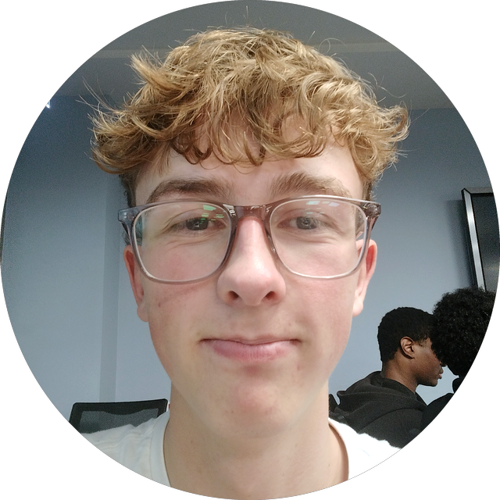
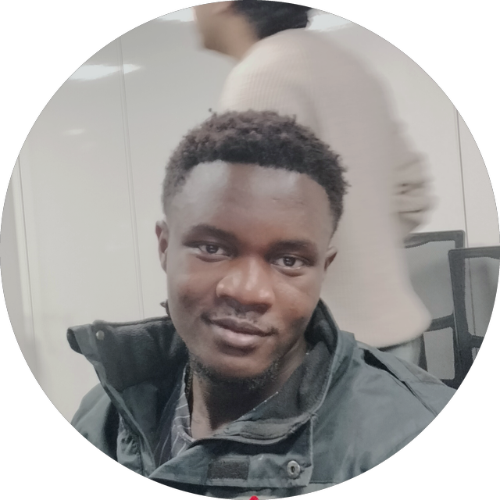
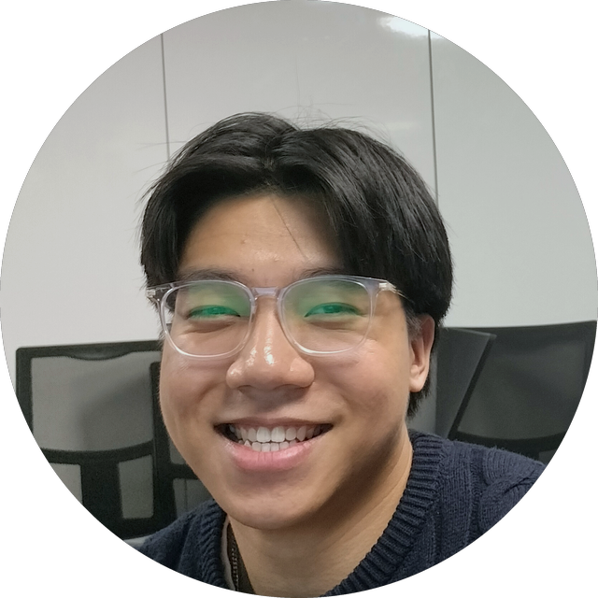
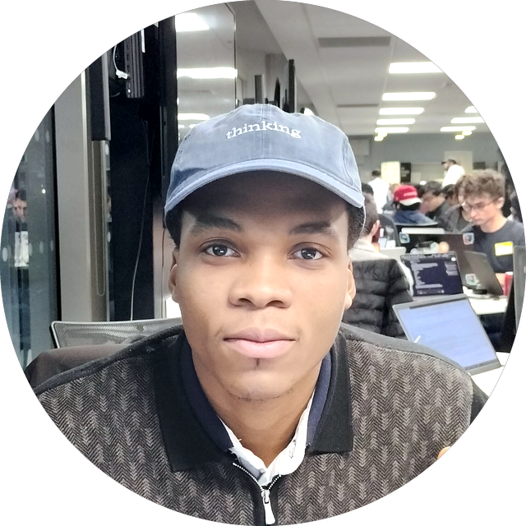
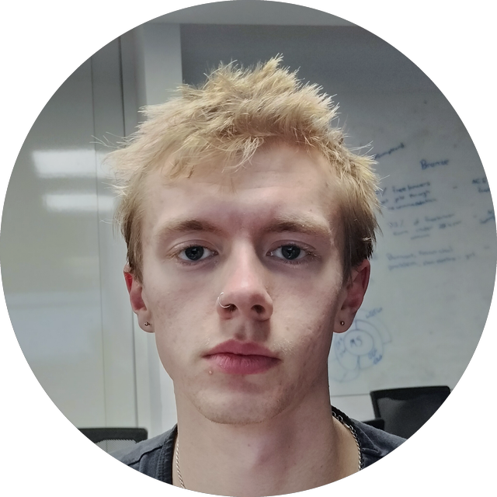
The team
Zac
Eric
Michael
Khaliq
George
Project lead and intake
Research
UI design
AI and API
Backend flow
Runs the build and owns the question flow
Checks every figure and local fact we show
Owns the look, the verdict and the plan screens
Prompts, honest scoring and cost tracking
Server, payment test mode and the fallback
Why this team: each part of the product has one owner, so five people built in parallel with Claude Code in under four hours. Zac is a Northumbria Networks and Cyber Security student, so payments and user data are treated with care from day one.
Notes:
About 15 seconds, then close: "Groundworking tells you the truth before you spend. Thank you." Each member should edit their own one-line description before submission; only Zac's background is stated here because it is the only one we have confirmed.

