Slide 1
Computer Architecture and Operating Systems Lecture 13: Advanced instruction-level parallelism
Andrei Tatarnikov
atatarnikov@hse.ru
@andrewt0301

Slide 2
Instruction-Level Parallelism (ILP)
Pipelining: executing multiple instructions in parallel
To increase ILP
Deeper pipeline
Less work per stage ⇒ shorter clock cycle
Multiple issue
Replicate pipeline stages ⇒ multiple pipelines
Start multiple instructions per clock cycle
CPI < 1, so use Instructions Per Cycle (IPC)
E.g., 4GHz 4-way multiple-issue
16 BIPS, peak CPI = 0.25, peak IPC = 4
But dependencies reduce this in practice

Slide 3
Multiple Issue
Static multiple issue
Compiler groups instructions to be issued together
Packages them into “issue slots”
Compiler detects and avoids hazards
Dynamic multiple issue
CPU examines instruction stream and chooses instructions to issue each cycle
Compiler can help by reordering instructions
CPU resolves hazards using advanced techniques at runtime

Slide 4
Speculation
“Guess” what to do with an instruction
Start operation as soon as possible
Check whether guess was right
If so, complete the operation
If not, roll-back and do the right thing
Common to static and dynamic multiple issue
Examples
Speculate on branch outcome
Roll back if path taken is different
Speculate on load
Roll back if location is updated

Slide 5
Compiler/Hardware Speculation
Compiler can reorder instructions
e.g., move load before branch
Can include “fix-up” instructions to recover from incorrect guess
Hardware can look ahead for instructions to execute
Buffer results until it determines they are actually needed
Flush buffers on incorrect speculation

Slide 6
Static Multiple Issue
Compiler groups instructions into “issue packets”
Group of instructions that can be issued on a single cycle
Determined by pipeline resources required
Think of an issue packet as a very long instruction
Specifies multiple concurrent operations
⇒ Very Long Instruction Word (VLIW)

Slide 7
Scheduling Static Multiple Issue
Compiler must remove some/all hazards
Reorder instructions into issue packets
No dependencies with a packet
Possibly some dependencies between packets
Varies between ISAs; compiler must know!
Pad with nop if necessary

Slide 8
RISC-V with Static Dual Issue
Two-issue packets
One ALU/branch instruction
One load/store instruction
64-bit aligned
ALU/branch, then load/store
Pad an unused instruction with nop
Address | Instruction type | Pipeline Stages
n | ALU/branch | IF | ID | EX | MEM | WB
n + 4 | Load/store | IF | ID | EX | MEM | WB
n + 8 | ALU/branch |  | IF | ID | EX | MEM | WB
n + 12 | Load/store |  | IF | ID | EX | MEM | WB
n + 16 | ALU/branch |  |  | IF | ID | EX | MEM | WB
n + 20 | Load/store |  |  | IF | ID | EX | MEM | WB

Slide 9
Dynamic Multiple Issue
“Superscalar” processors
CPU decides whether to issue 0, 1, 2, … each cycle
Avoiding structural and data hazards
Avoids the need for compiler scheduling
Though it may still help
Code semantics ensured by the CPU

Slide 10
Dynamic Pipeline Scheduling
Allow the CPU to execute instructions out of order to avoid stalls
But commit result to registers in order
Example
ld x31,20(x21) add x1,x31,x2 sub x23,x23,x3 andi x5,x23,20
Can start sub while add is waiting for ld

Slide 11
Why Do Dynamic Scheduling?
Why not just let the compiler schedule code?
Not all stalls are predicable
e.g., cache misses
Can’t always schedule around branches
Branch outcome is dynamically determined
Different implementations of an ISA have different latencies and hazards

Slide 12
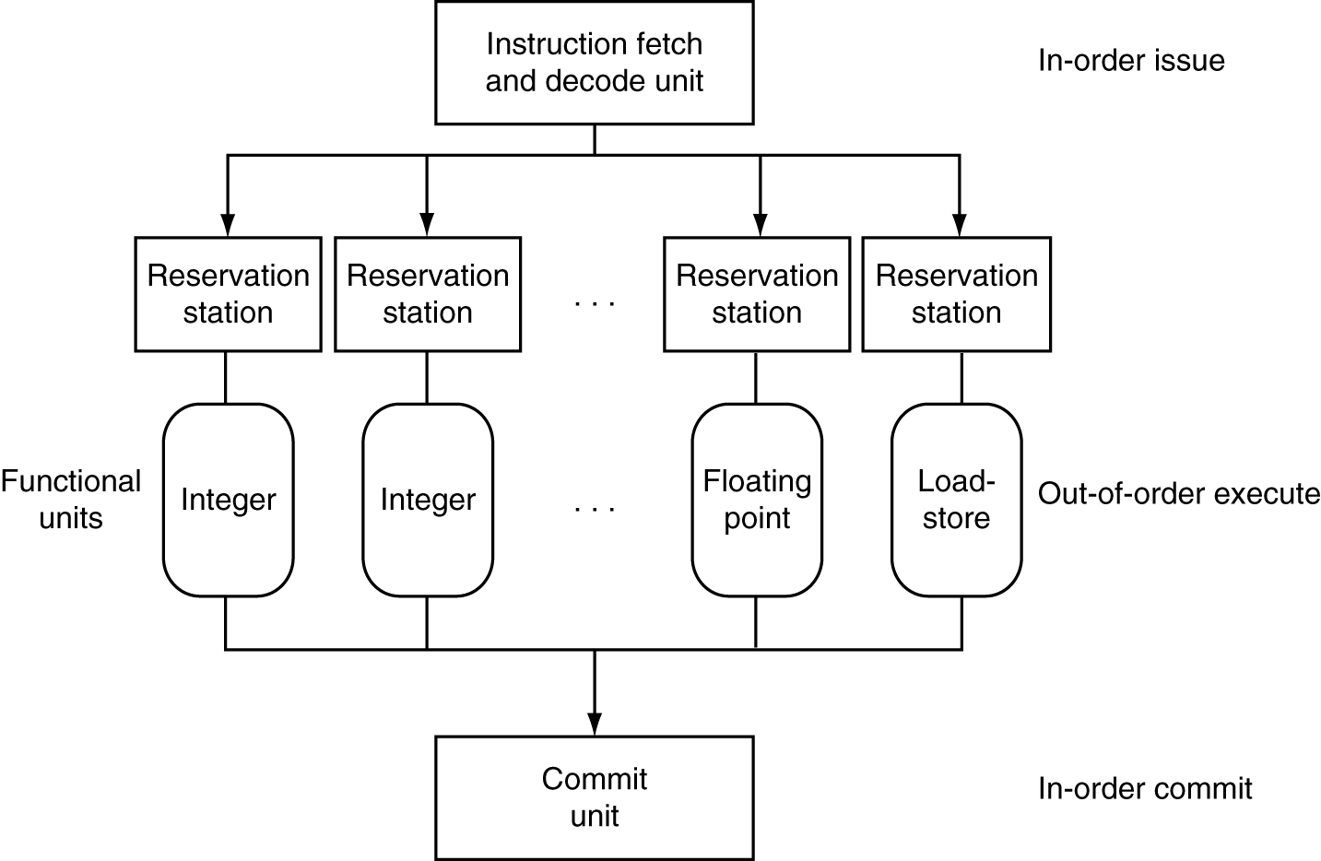
Dynamically Scheduled CPU
Preserves dependencies
Hold pending operands
Results also sent to any waiting reservation stations
Reorders buffer for register writes
Can supply operands for issued instructions

Slide 13
Does Multiple Issue Work?
Yes, but not as much as we’d like
Programs have real dependencies that limit ILP
Some dependencies are hard to eliminate
e.g., pointer aliasing
Some parallelism is hard to expose
Limited window size during instruction issue
Memory delays and limited bandwidth
Hard to keep pipelines full
Speculation can help if done well

Slide 14
More Types of Parallels
Single instruction, single data (SISD) stream: A single processor executes a single instruction stream to operate on data stored in a single memory. Uniprocessors fall into this category.
Single instruction, multiple data (SIMD) stream: A single machine instruction controls the simultaneous execution of a number of processing elements on a lockstep basis. Each has an associated data memory, so that instructions are executed on different sets of data by different processors. Vector and array processors fall into this category.
Multiple instruction, single data (MISD) stream: A sequence of data is transmitted to a set of processors, each of which executes a different instruction sequence. Not commercially implemented.
Multiple instruction, multiple data (MIMD) stream: A set of processors simultaneously execute different instruction sequences on different data sets. SMPs, clusters, and NUMA systems fit into this category.

Slide 15
Instruction and Data Streams
An alternate classification
SPMD: Single Program Multiple Data
A parallel program on a MIMD computer
Conditional code for different processors
 |  | Data Streams
 |  | Single | Multiple
Instruction Streams | Single | SISD: Intel Pentium 4 | SIMD: SSE instructions of x86
 | Multiple | MISD: No examples today | MIMD: Intel Xeon e5345

Slide 16
Conclusion
ISA influences design of datapath and control
Datapath and control influence design of ISA
Pipelining improves instruction throughput using parallelism
More instructions completed per second
Latency for each instruction not reduced
Hazards: structural, data, control
Multiple issue and dynamic scheduling (ILP)
Dependencies limit achievable parallelism
Complexity leads to the power wall

Slide 17
Any Questions?
.text
__start: addi t1, zero, 0x18
addi t2, zero, 0x21
cycle: beq t1, t2, done
slt t0, t1, t2
bne t0, zero, if_less
nop
sub t1, t1, t2
j cycle
nop
if_less: sub t2, t2, t1
j cycle
done: add t3, t1, zero

