Slide 1
ICT MODULE 2
PRODUCTIVITY TOOLS

Slide 2
INTRODUCTION
Productivity Tools Productivity software is a type of application programs that help users produce outputs such as documents, databases, graphs, worksheets and presentations. Many productivity applications are intended for business use. There are some that are used in schools and universities for research and assignments.

Slide 3
Office Suite
A software suite, also called an application suite or productivity suite, is two or more software applications bundled and sold together. For example, in the corporate office environment, Microsoft Office is a standard suite of office automation software applications that includes Microsoft Word, Outlook, Excel, Access, OneNote and PowerPoint.
Benefits of Software Suites The biggest benefit of using a software suite of applications is the compatibility and integration between them. The software applications in a suite are designed to work with one another, making it easier for users to move work product between them. Another benefit of software suites is reduced cost. The software suite bundle of applications is generally priced far less than it would cost to buy each separately.

Slide 4
Popular Software Suites
Some of the more widely known and used business and design software suites include:
Microsoft Office 365 – WORD, EXCEL, ACCES
Adobe Creative Suite or Cloud – PHOTOSHOP, INDESIGN, DREAMWEAVER
Apache OpenOffice – WRITER, CALC, IMPRESS
iWork – PAGES, KEYNOTE, NUMBERS
Google Docs – DOCS, SHEETS, SLIDES

Slide 5
Word Processors
A word processor is a software application that involves composition, modification, and printing of documents

Slide 6
Word Processing Compared to Using a Typewriter
Although the typewriter is the fastest way of having a printed document, there are several disadvantages incorporated into it:
You will not be able to make changes without either retyping the entire document, use liquid eraser to cover up the mistake, or simply overtype the characters inside.
There are cases when the ribbon from the typewriter needs to be replaced. This turned out to be messy and may result to having untidy documents.
Mechanical typewriters only have a single font for formatting.
Typewriters do not have spell checkers.
Some keys get stuck when they are often pressed too hard.
No reproduction available for the same document; what you need to do is go to a photocopier to have a new copy of the document.

Slide 7
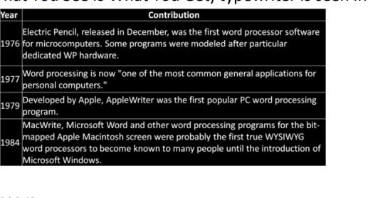
Notes:
The first major advance from manual writing as far as the individual was concerned was the typewriter. Henry Mill, an English engineer of the early eighteenth century, is credited with its invention. He was an English inventor who patented the first typewriter in 1714. The fact that almost nothing is known about his early version today is evidence of its lack of success. The evolution of typewriters up to a WYSIWYG

Slide 8
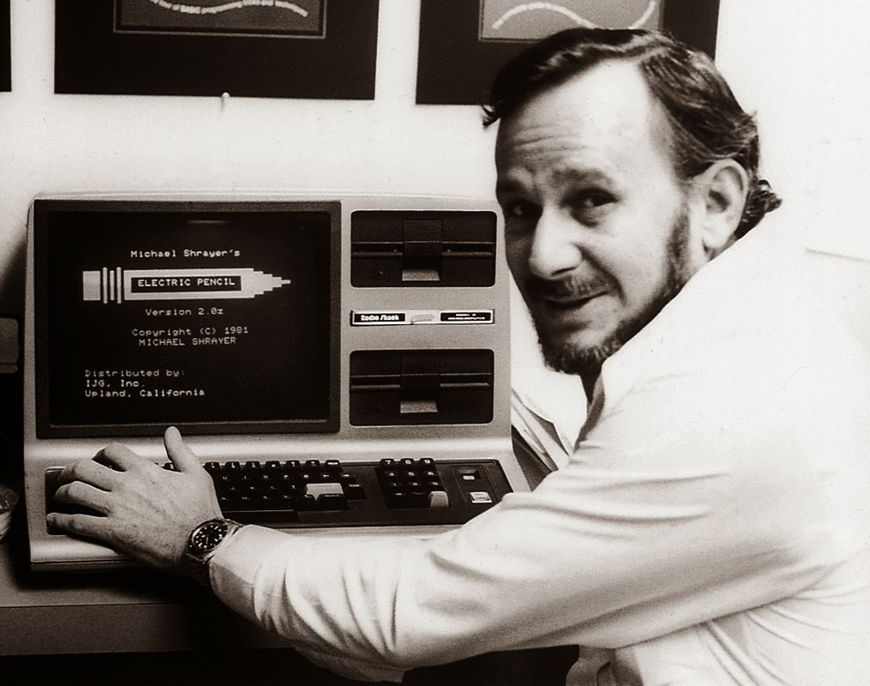
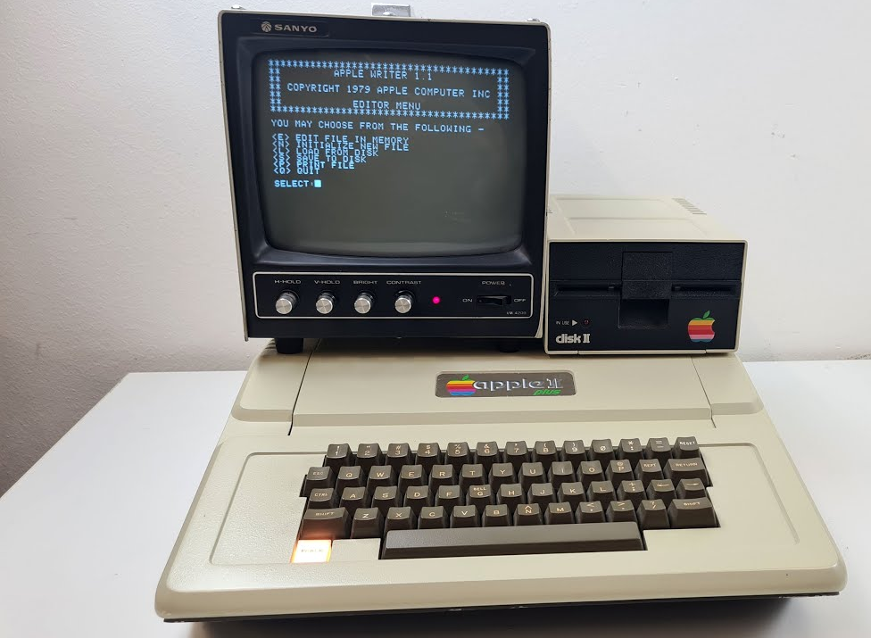
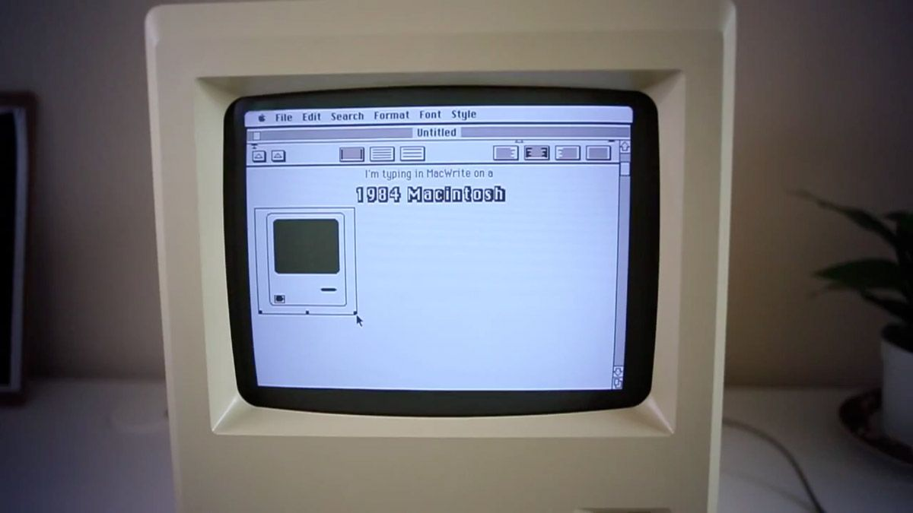

Slide 9
Features of Standard Word Processors
Open Microsoft words

Slide 10
Essential Word Processing Features
TEXT INPUT
TEXT MANIPULATION
TEXT FORMATTING
TEXT OUTPUT
STYLES
MACROS AND MERGING

Slide 11
Creating Documents with Available Templates
NEWS LETTERS
ADVERTISEMENTS
CERTIFICATES
RESUME
LETTERS

Slide 12
Modifying an Image
Crop
Resize
Rotate/flip
Text wrapping

Slide 13
SPREADSHEETS
A spreadsheet is an application designed for managing and organizing the data in tabular format.

Slide 14
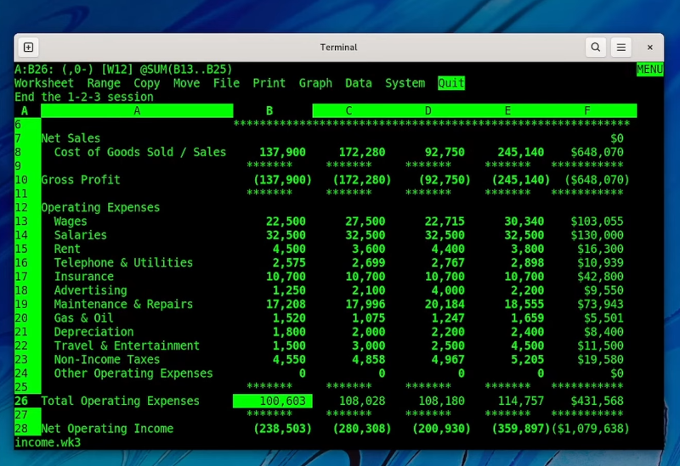

Slide 15
Features of Spreadsheets
Visual Design - Spreadsheets allow you to lay figures out on a grid, calculating and manipulating them visually. Often, this may result in you being able to process the information more quickly.
Automatic Calculations - Spreadsheet software gives you the ability to enter mathematical formulas ranging from simple arithmetic to complex statistics.
Dynamic Updates - In addition to the standard method of entering data in a spreadsheet --typing numbers in cells --you can also create a cell with a value generated dynamically based on other cells. Any time you base the value of one cell on the value of other cells, the value of one cell updates automatically when the other is changed
Data Analysis - Most spreadsheet software can automatically create graphs and charts from your data, giving you different ways of comparing and analyzing information.

Slide 16
How spreadsheets work
SUM()
VLOOKUP()
MAX()andMIN()
ROUND()
NOW()
SQRT()

Slide 17
Charts and Graphs
When a spreadsheet contains a set of data organized within worksheets, you can represent this data in a form of a chart. This will allow users to view data in a manner easy to understand. Spreadsheet programs offer automated tools for transforming data sets into graphs and charts.

Slide 18
Different Types of Graph
Pie chart A pie chart is a circular type of chart wherein data are represented by slices.It isgenerally used to show percentage or proportional data and usually the percentage represented by each category is provided next to the corresponding slice of pie.
Bar chart A bar graph is a type of representation where each data is represented by either a horizontal or vertical bar.
Line graph A line graph is a type of graph where the corresponding data is represented by dots that are interconnected by a line.
Scatter chart Scatter charts are almost similar with line graphs except that the dots are not connected with each other.This type of chart is best used to show the correlation of variables.

Slide 19
Presentation program
Presentation software (sometimes called "presentation graphics") is a category of application program used to create sequences of words and pictures that tell a story or help support a speech or public presentation of information. Presentation software can be divided into business presentation software and more general multimedia authoring tools

Slide 20
Features of Presentation Program
The following are the standard features of a presentation program:
Slides
Layout
Templates
Animation effects
Slide master
Transitions
Slide notes

Slide 21
Hyperlinks in Presentation Software
Show to students

Slide 22
IMAGING AND DESIGN
LAYOUT AND GRAPHICS
LAYOUT - The process of planning and arranging in detail something such as a page or book to be reproduced.
GRAPHICS - may refer to any computer device or program that makes a computer capable of displaying and manipulating pictures.

Slide 23
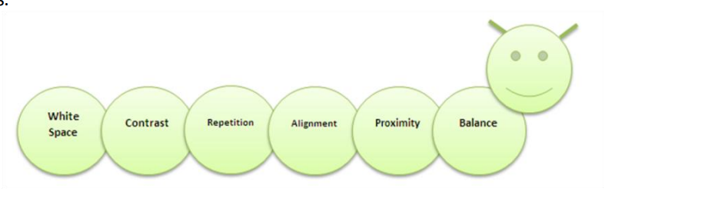
BASIC PRINCIPLES OF GRAPHICS AND LAYOUT

Slide 24
BALANCE - It is the equal distribution of visual weight.
Symmetrical - an arrangement of elements so that they are evenly distributed to the left and to the right, or top and bottom of center.
Asymmetrical - an arrangement of unlike objects of equal weight on each side of the page.

Slide 25
TIPS ON CREATING BALANCE
Colors have weight (Red = Heavy, Baby Blue = Light)
Text/type must be legible. Use simple font. Also consider the size (Larger = Heavier)
Lines: Thin vs. thick

Slide 26
PROXIMITY Related items be grouped together, be move physically close to each other so that they appear as one cohesive group rather than a bunch of unrelated bits.
ALIGNMENT When items are aligned, the result is a stronger cohesive unit. The basic purpose of alignment is to unify and organize the page
REPETITION It can be anything that a reader will visually recognize as being a “theme.” Repetition can be thought of as consistency. It is a conscious effort to unify all parts of a design.
CONTRAST Contrast is the most effective way to add visual interest to your page. A reader should always be able to glance at a document and instantly understand what's going on. Add contrast through your type face choices, line thicknesses, colors, shapes, sizes, space, etc.
Notes:
Proximity- grouped related info, hindi kalat kalat at organized tignan, alignment- organized text connected to the image, repetition- bold letters for theme, titles
Contrast – add contrast defends on the image, it will be interesting to viewer not boring, avoid plain image

Slide 27
WHITE SPACE
It breaks up the elements on the page.
It provides visual breathing room for the eye.
Add white space to make a page less cramped, confusing, or overwhelming.
It doesn’t actually have to be white.
White space is also referred to as “negative space”

Slide 28
VISUAL MESSAGE
Visual message design involves the appropriate considerations of visual perceptions when designing an instructional program.
The purpose of visual message design is to gain attention, create meaning, and facilitate retention.

Slide 29
PRINCIPLES OF VISUAL MESSAGE DESIGN USING INFOGRAPHICS
Be Unique
Keep It Simple
Be Creative And Bold
Less Is More
Sharing
Notes:
Unique- to capture interest of audience simple- to avoidcolorful backgrounds and easy to understand, bold- straightforward, give the main messages
Less is more- many text can bore audience sharing – effective way to share with friends using links

Slide 30
ONLINE FILE FORMATS FOR IMAGES AND TEXT
JPEG
GIF
PNG
BMP
TIF
EPS
Notes:
Png – compress and lossless bmp – uncompress and lossless tif – photographer, high q image eps- high q image printing, billboard

Slide 31
IMAGE MANIPULATION
Principles and basic techniques of image manipulation
Proportion
Texture
ColorBlending
Emphasis on Detail
Combining Multiple Images
Shadows

Slide 32
PROPORTION
Proportion is probably one of the most important things a designer must possess if he wants to do image manipulations. This will make the image more realistic if the original design is extremely farfetched. Remember that images that are supposed to be far away have to be smaller than the ones that are closer

Slide 33
TEXTURE
Texture is the surface quality of the image. It adds to the depth of the image and blend all the images together evenly. Blending is a huge part of image manipulation, so textures are something a designer have to carefully select

Slide 34
COLOR BLENDING
Not every image you use is going to match your background, your texture, or even other images. That is where color blending comes in. Colors like pink, white, yellow, and orange blend together easily. That is what a designer should look for at first; colors that already blend.

Slide 35
EMPHASIS ON DETAIL
When creating a piece of art, set one area as the main focus. You want to draw viewer’s eyes instantly to that spot. Work on focusing attention on the most vibrant, colorful, or sharp area in the design. The artwork shows that the fire is the first thing that catches your eye. The fire is the most vibrant and brightest part of the image, so it instantly stands out.

Slide 36
COMBINING MULTIPLE IMAGES
Images are like missing puzzle pieces; without them you can never fully complete the puzzle. In your design you can use a multitude of images, but they all have to flow properly, and be used to your advantage

Slide 37
SHADOWS
Shadows also makes the image more realistic, because it emphasizes the object effectively. It is realistic in the way that every item has a shadow if it needs one and every item is proportional to everything else.

