Slide 1

LU decomposition
Created by Zhailybaev Raiym

Slide 2

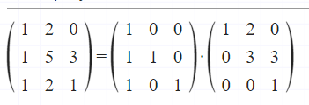
Our goal:
Decompose a matrix to Lower and Upper-triangular matrixes

Slide 3
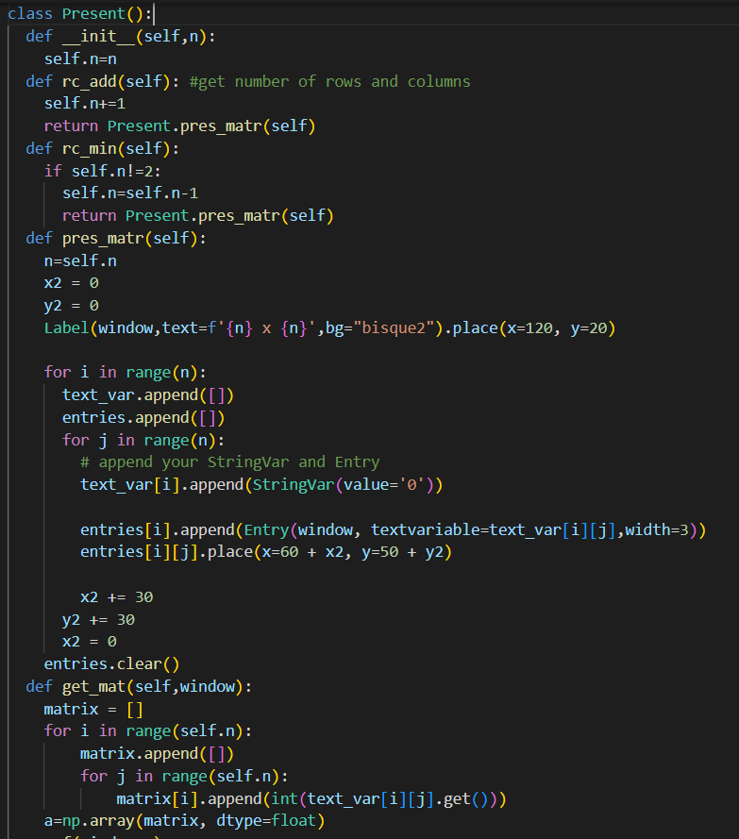
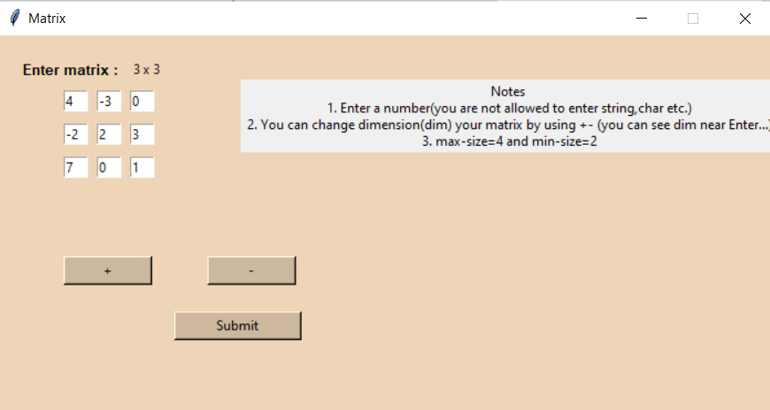

Slide 4
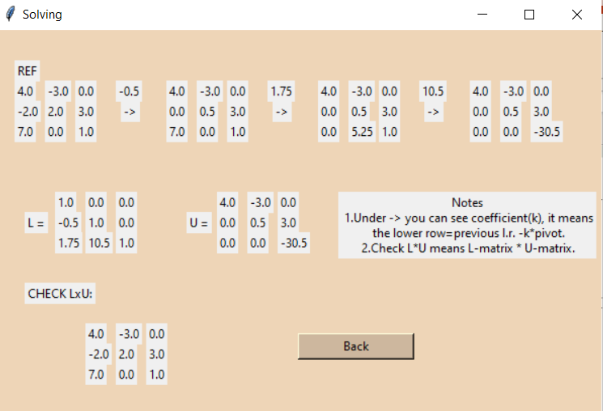
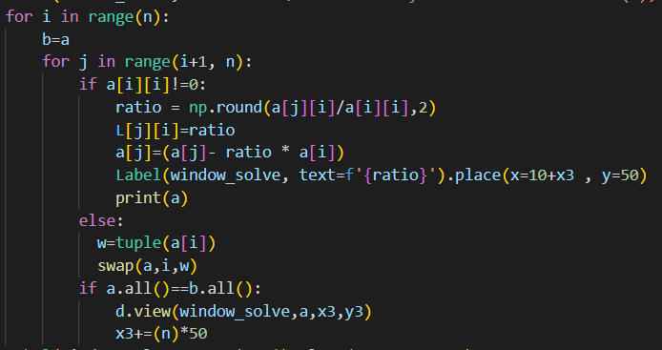

Slide 5
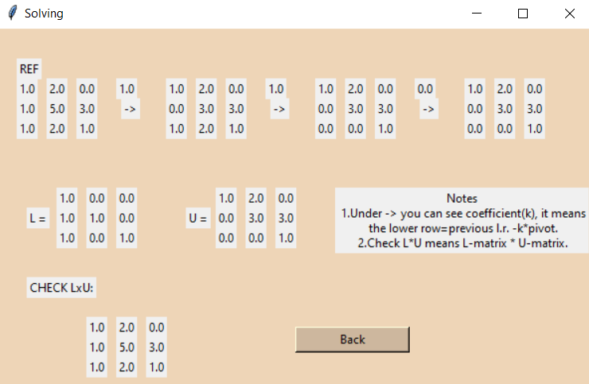

Slide 6


Slide 7
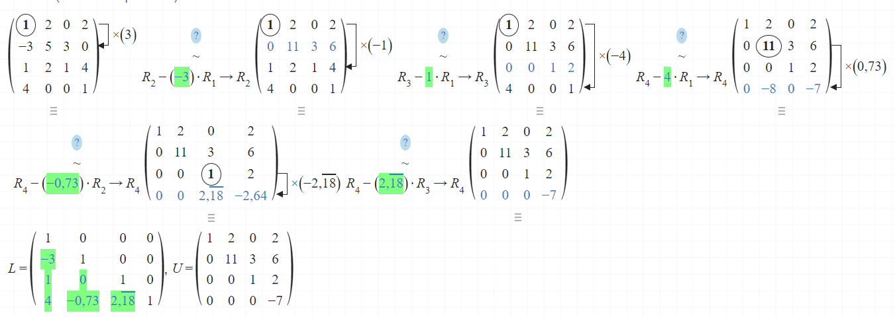


Slide 8
Thank you for your attention!

