Slide 1
FLO
E-Commerce
Data Analysis
KAZAKHSTAN
flo.com.kz
Web Scraping · Data Cleaning · EDA · Machine Learning
Prepared by:
Yernar Tashkenbay · Zhayik Musakhan
Yerkebulan Bekbatyr · Dinmukhambet Akhmet
2026

Slide 2
01 Introduction & Motivation
Why FLO Kazakhstan?
Market Research
Strategic Planning
Entrepreneurial Insight
Understand how established retailers categorize products & manage large-scale inventories at scale.
Identify essential features — pricing structures, brand hierarchies — to build a competitive platform.
Technical foundation for launching an independent online shop, using data to inform product & pricing decisions.
Goal: Extract actionable business intelligence from FLO's catalog to understand market structure & inform future e-commerce strategy.

Slide 3
02 Data Source Description
Source: flo.com.kz
10 Scraped Attributes
FLO is a leading footwear & sportswear retailer across Kazakhstan and Central Asia, listing thousands of products from international and local brands.
Field | Description
Name | Product title
Brand | Manufacturer label
Price | Current sale price (KZT)
Old_price | Original price (KZT)
Discount | % discount applied
Category | Product category
Model | Model identifier
Gender | Men / Women / Unisex / Kids
Color | Product color
Material | Primary external material
Pages 2 – 2,000 scraped across all categories

Slide 4
03 Scraping Methodology
Phase 1 — Listing Pages
Phase 2 — Detail Pages
Iterated pages 2–2000 using: flo.com.kz/ru/all-categories?page={n} Extracted per product card: Name · Brand · Price · Old Price · Discount · Product URL
Visited each product URL to extract: Gender · Color · Material · Model · Category Used requests.Session() for connection reuse.
All records exported to
flo_products.csv (UTF-8-sig)
→
⚡ ThreadPoolExecutor (max_workers=10)
7–8×
faster
Parallelized detail page requests — 10 pages fetched simultaneously per batch

Slide 5
04 Data Cleaning & Transformation
01
Duplicate Removal
02
Text Normalization
Kept first occurrence of repeated product records from paginated listings.
Stripped special chars from Name; removed 'Комп.' abbreviation from Material.
03
Type Conversion
04
Missing Values
Price, Old_price & Discount converted from raw strings to numeric (removed KZT, %, spaces).
Column-specific strategies: Mode, bfill, ffill, 'Unisex', 'Unknown', 0 fill.
05
Outlier Handling
06
Feature Engineering
IQR detection → Winsorization (retained valid extremes: 490 KZT accessories to 99,990 KZT sneakers).
Added: Savings, Brand_Price_Diff, Price_bucket (4 tiers), Is_Premium_Brand flag.

Slide 6
05 Analysis — Statistics & Correlation
1.49
0.89
−0.26
0.53
Price Skewness
Price ↔ Old Price
Price ↔ Discount
Premium Brand ↔ Price
Right-skewed — most products are budget/mid-range
Strong positive correlation
Cheaper items get bigger discounts
Brand status drives price significantly
Correlation Highlights

Slide 7
06 Segment-Level Analysis
Avg Price by Gender (KZT)
Avg Discount % by Price Tier
Top Brands by Avg Price (KZT)

Slide 8
07 Statistical Hypothesis Testing
Method: Independent two-sample Welch's T-test (unequal variances) · Significance threshold: p < 0.05
H1: Premium brands are significantly more expensive than non-premium brands.
✓ ACCEPTED
Premium avg: ~30,600 KZT | Regular avg: ~14,133 KZT
Being a premium brand guarantees a 2× price premium.
p-value ≈ 0
H2: Budget products receive higher percentage discounts than Premium products.
✓ ACCEPTED
Budget avg discount: ~24.9% | Premium avg discount: ~11.8%
FLO uses discounts to drive mass-market volume, not premium sales.
p-value < 0.05
H3: Men's products are priced higher than Women's products.
✓ ACCEPTED
Men avg: ~19,911 KZT | Women avg: ~16,446 KZT
Gender pricing gap (~3,465 KZT) is statistically robust.
p = 1.61 × 10⁻²⁷

Slide 9
08 Key Findings & Insights
1
Mass-market discount focus
2
Brand is the #1 price driver
Large discounts on Budget products; minimal discounts protect premium brand equity & margin.
Nike, Adidas & Puma average 2× higher prices than non-premium brands (confirmed by T-test).
3
Catalog skewed toward accessible
4
Men's products priced higher
Majority of products fall in Budget & Mid-range tiers despite presence of luxury items.
~3,465 KZT gender price gap — statistically significant (p = 1.61×10⁻²⁷).
5
Standardized promotional tiers
6
Metadata gaps = opportunity
Discount peaks at 0%, 20%, 40%, 50% — applied in predefined tiers, not product-by-product.
Missing color & material data in FLO — richer product metadata is a competitive differentiator.

Slide 10
09 Challenges Faced
Challenge 1: Nested Page Architecture
⚡ Solution: ThreadPoolExecutor
Key attributes (Gender, Color, Material) required visiting each product's detail page → second for loop → extremely slow scraping.
Solved using concurrent.futures.ThreadPoolExecutor (10 workers) → 7–8× speed improvement.
Challenge 2: Inconsistent & Missing Data
Price fields had non-breaking spaces, mixed decimal separators, and appended currency labels. Several product pages had absent attributes. Required field-specific cleaning logic — not a one-size-fits-all approach.
Challenge 3: Outlier Interpretation
IQR flagged extremes — but these were real products (490 KZT accessories to 99,990 KZT sneakers, 88% discounts). Decision: retain + apply Winsorization (capping) rather than removal.

Slide 11
10 Bonus 1: Discount Classification Model
Feature Importance
70.7%
Accuracy
Random Forest
100 Trees
80/20 Split
Classification Results
Target:
Is_Discounted
(binary)
Not Discounted
F1: 0.63
Precision: 0.65
Recall: 0.61
Discounted
F1: 0.76
Precision: 0.74
Recall: 0.77
Is_Premium_Brand scored lowest (0.017) — premium status alone does not predict discounting.

Slide 12
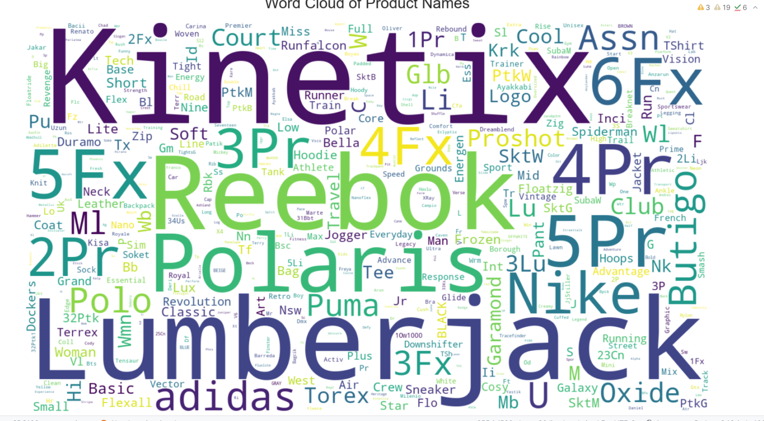
11 Bonus 2: Word Cloud Analysis
Word Cloud of Product Names — 500 most frequent terms, viridis colormap
[Word Cloud Image]
Insert screenshot from notebook output
01
Brand Dominance
Kinetix, Polaris & Lumberjack dominate by volume. Nike, Adidas, Reebok & Puma are present but smaller.
02
Versioned Product Lines
5Fx, 4Fx, 3Pr, 2Pr patterns reveal iterative naming — catalog growth without full redesigns.
ML Value: Brand_Price_Diff — the #1 feature in our Random Forest model (importance: 0.423)

Slide 13
12 Individual Contributions
YB
Yerkebulan Bekbatyr
ZM
Zhayik Musakhan
Web Scraping & Data Cleaning
Exploratory Data Analysis
Developed the web scraping infrastructure and implemented data cleaning protocols to ensure dataset integrity.
Conducted EDA to identify statistical trends, distributions, and pricing correlations across the dataset.
DA
Dinmukhambet Akhmet
YT
Yernar Tashkenbay
Data Visualization
Project Lead & Reporting
Designed and produced high-fidelity data visualizations to represent market findings and category comparisons.
Acted as project lead, responsible for technical reporting, final presentation structure, and synthesizing insights.

Slide 14
FLO
Thank You!
KAZAKHSTAN
Questions & Discussion
→ Web Scraping (2,000 pages + ThreadPoolExecutor)
→ Data Cleaning & Feature Engineering
→ EDA, Correlation & Hypothesis Testing
→ Bonus: ML Model (70.7%) + Word Cloud

