Slide 1
Planner
Presented by Beketova Zhanymgul, ID 26108
Link - https://goo-gl.su/KK6T9

Slide 2
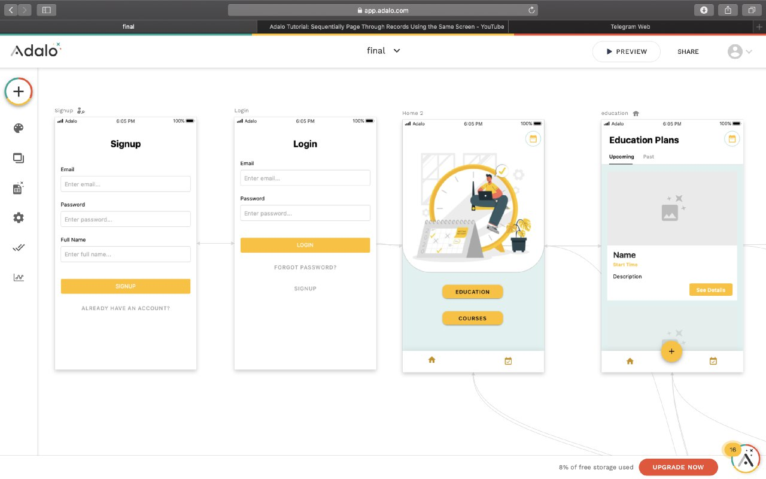

Planner
Application for scheduling tasks in education sphere
Easy and straightforward to use

Slide 3
01
GOAL 1
Help to streamline education tasks
GOAL
02
GOAL 2
Help not to forget deadlines
03
GOAL 3
Help focus on the importance of the task

Slide 4
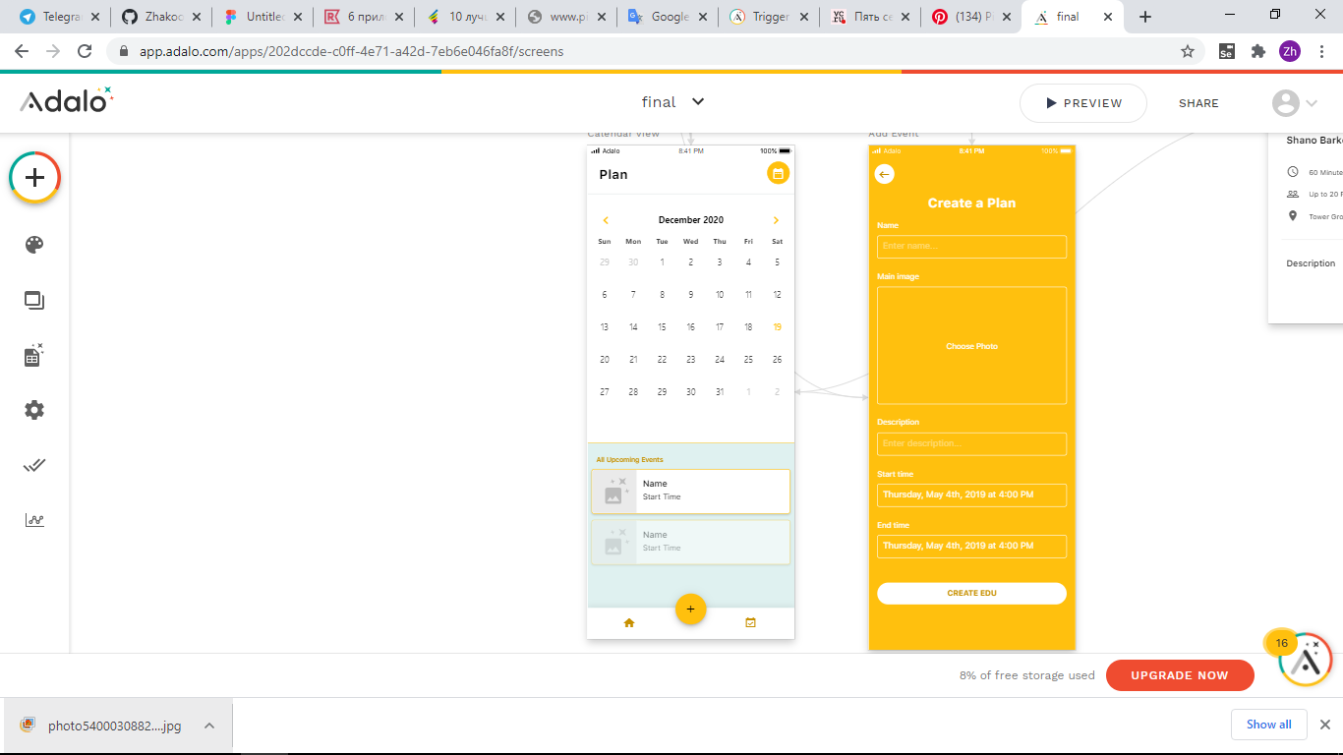
Features
- authorization
- division into 2 cases
- adding new tasks
- task notification

Slide 5
Pros
+ task notification
+ time management
+ includes only the field of education, which helps not to confuse with different cases
+ easy to use, no complicated functionality
Cons
- no task execution statistics
- no task archive

Slide 6
Analog versions
Trello
Trello is a good planner app that allows students to organize all the projects they are working on through boards. Whether you’re managing a team of freelancers, writing an epic screenplay, or just making a list of stuff, Trello makes sure you’re organized and on top of it all.
- More suitable for organization, complex functionality for the student. No calendar support - Trello doesn't natively offer support for calendar integration, while other options do.
Wunderlist
Wunderlist is the easiest way to manage and share your daily to-do lists. This app is designed to help the student with planning and organizing.
- Editing tasks is a bit of a nuisance because you have to double click on a task to access its data. Even editing a task name is a bit of a faff. Also, dragging tasks is not hassle-free.

Slide 7
Thank you for attention!

