Slide 1
Undo Mechanism in Stack
BY:Zhala Soran Mohammed

Slide 2
Operations on Stacks
Push: Add an element to the top.
Pop: Remove the top element.
Top/Peek: Get the top element without removing it.
isEmpty: Check if the stack is empty.
isFull: Check if the stack is full (for a fixed-size stack).

Slide 3
Operations on Stacks
The program is a solution that hold a stack to implement an undo mechanism. The stack is used to store actions, such as typing, deleting, or inserting elements, allowing users to revert to previous states by popping the most recent action from the stack. The program introduce push, pop, peek, and isEmpty, and isFull operations to manage the undo mechanism. To make it more clear, the program deal with how word documents work as an example on stack operation. When writing a report, or essay, how does stack deals with it. The other slides deals with the operations in detail addition to code implementations and the output as well.

Slide 4
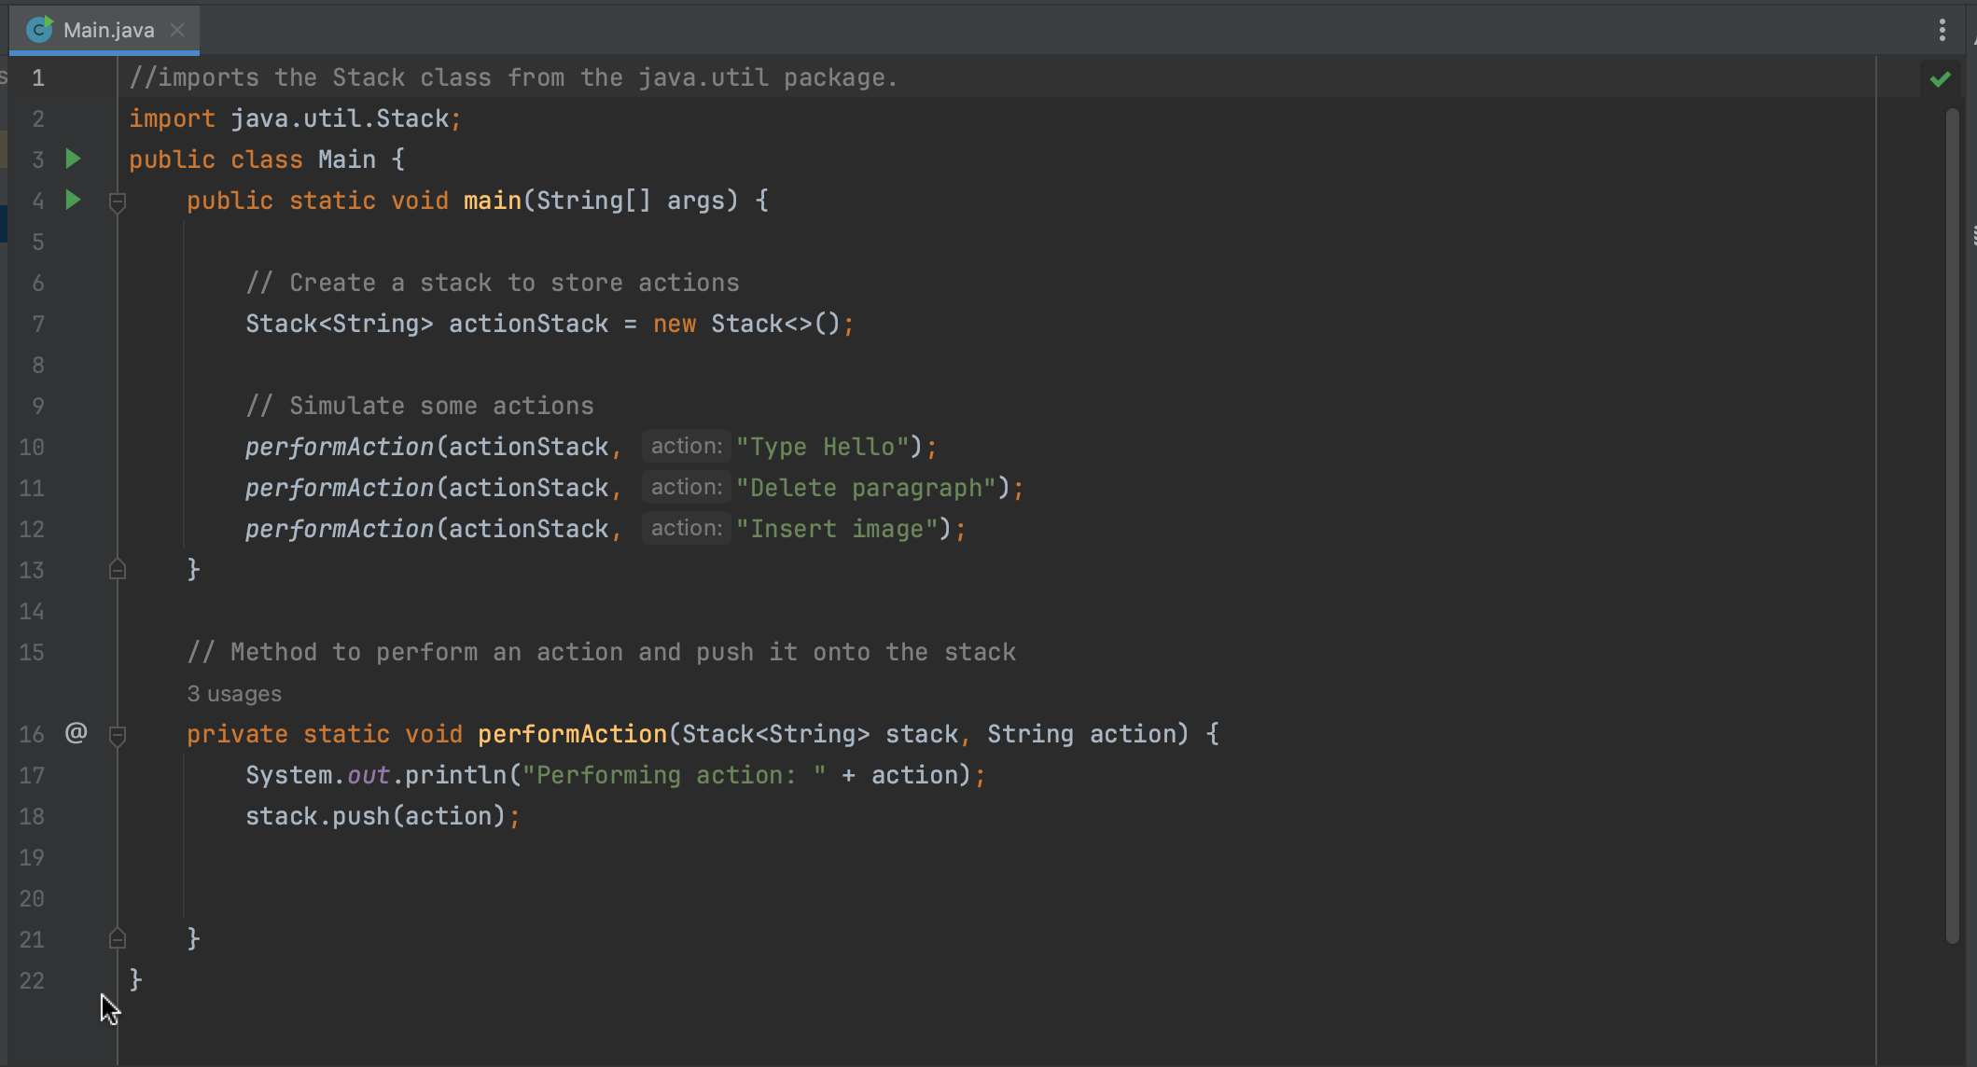
PUSH

Slide 5
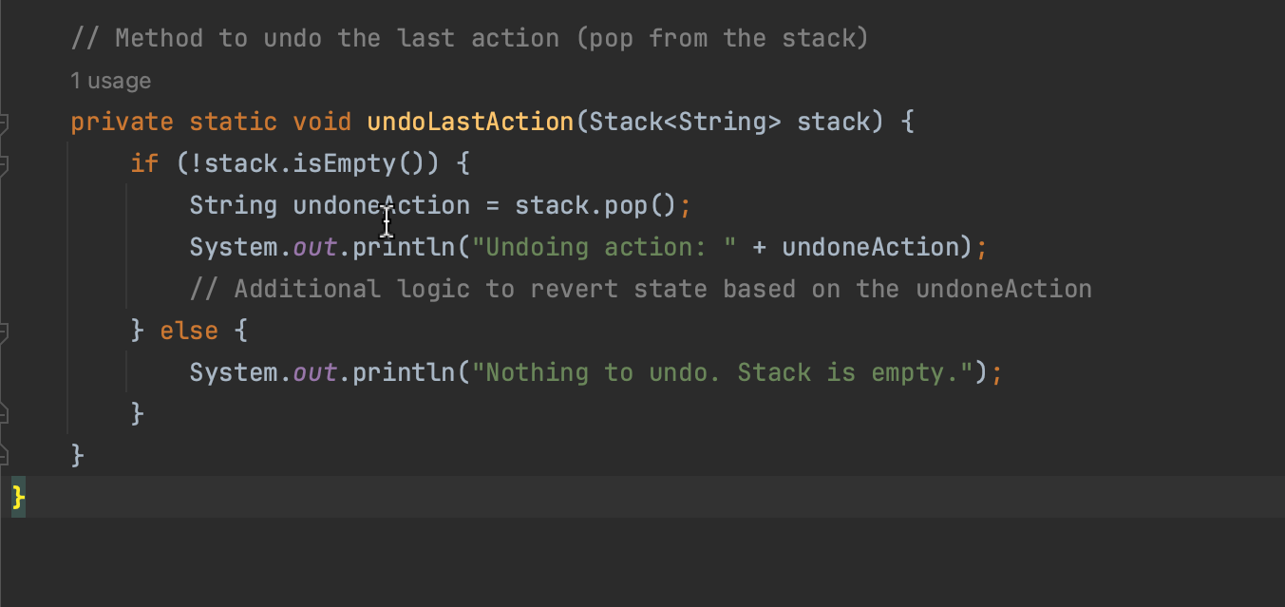
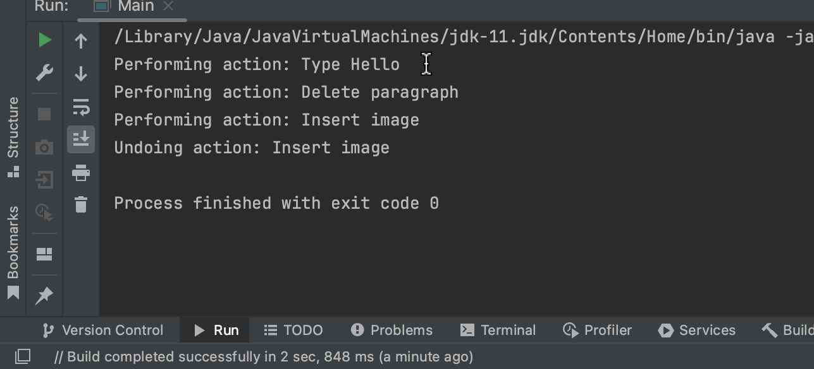
Pop
User trying to undo the last action that was done. This performance is done through “pop” operation, and removes the most recent action from the stack.

Slide 6
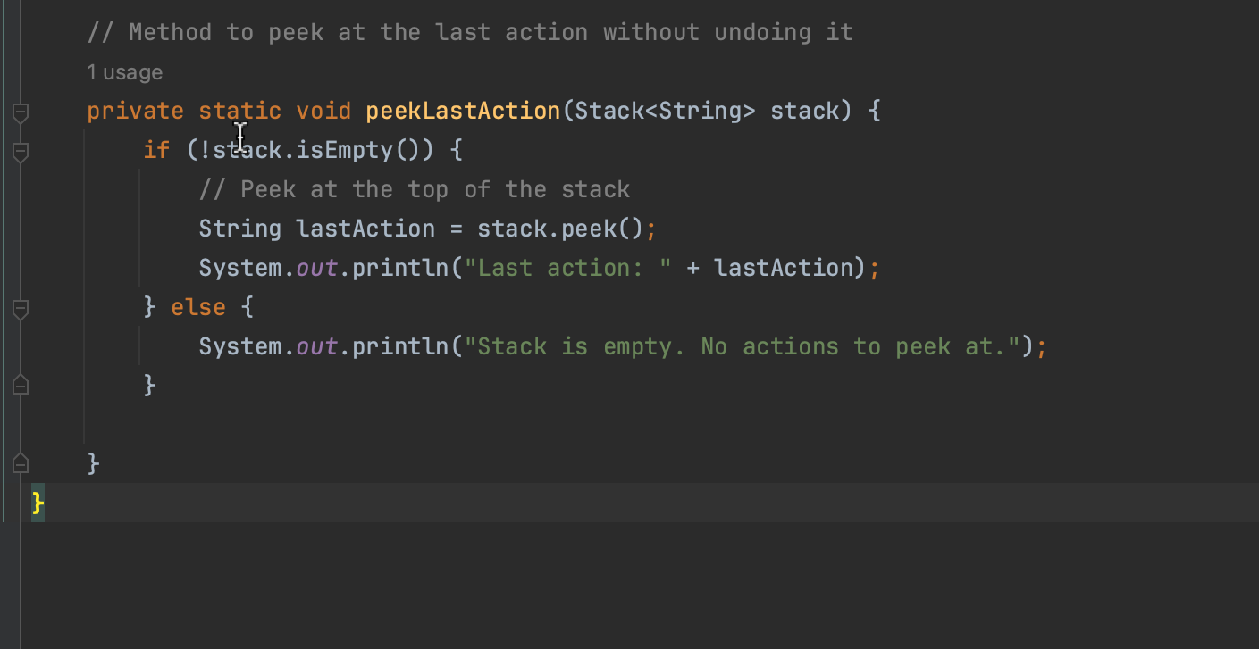
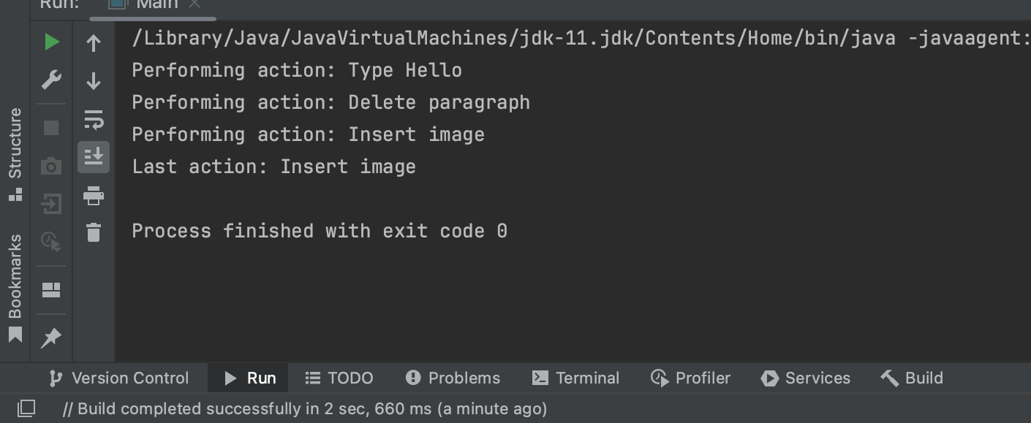
Top/Peek
If the stack is not empty, a method will be used called stack.peek().
Retrieve the top and most recent action from the stack without removing.

Slide 7
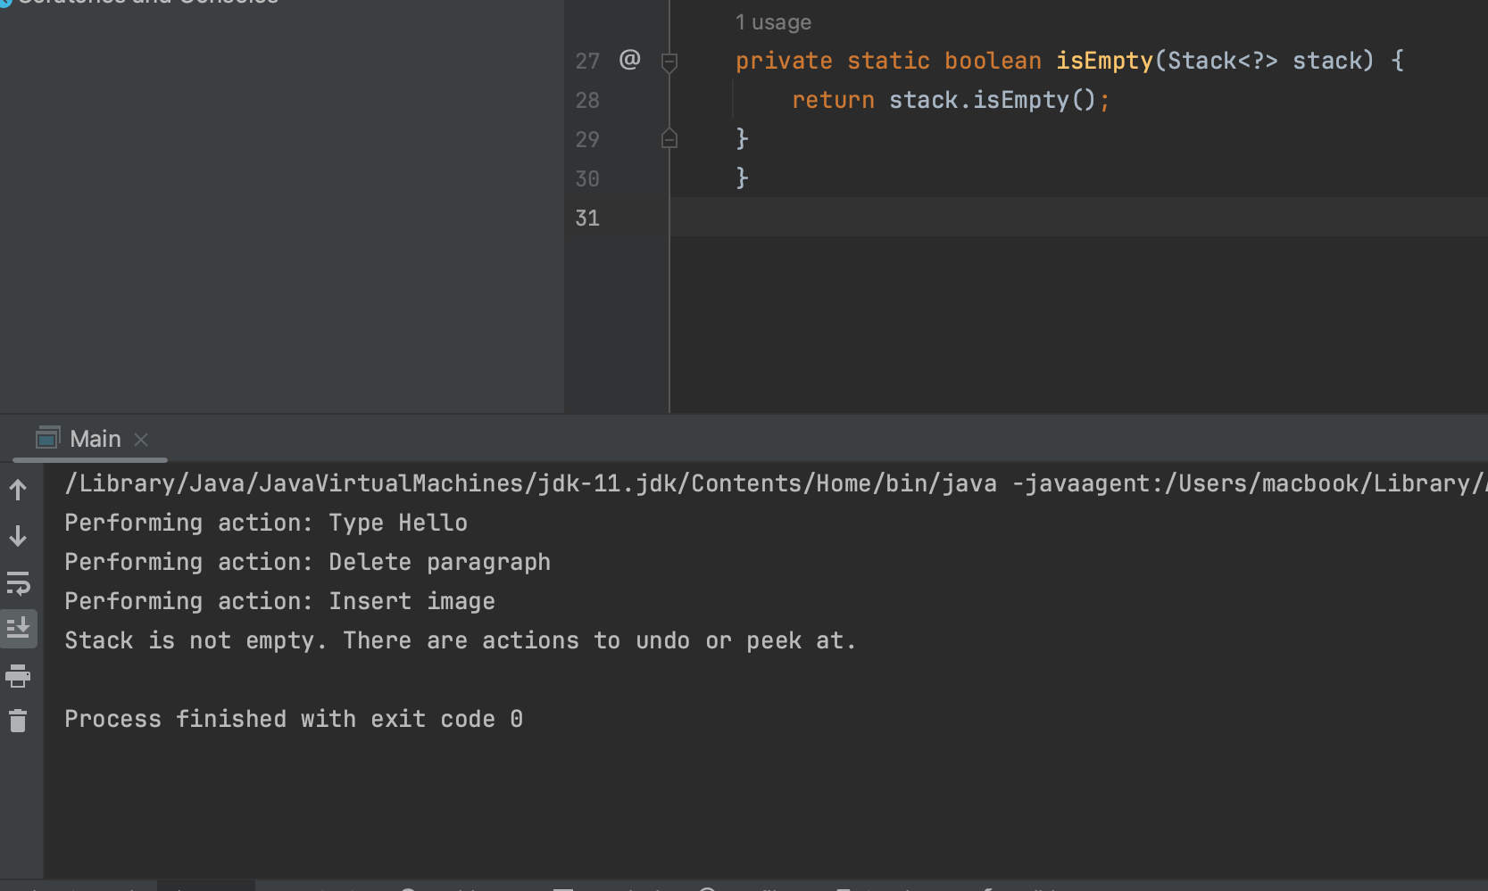
IsEmpty
If the stack Is empty this means that there are no actions left to undo. On the other hand it prevent error from occurring.

Slide 8
IsFull
This operation deals with whether or not the stack is full or not. In case of undo Mechanism there is no fixed size and there’s no need to check if its full or not.
For Instance;/ While using a word document in term of undo Mechanism there’s no need to check If the stack is full or not. The reason is that there’s no fixed size and uses dynamic data structure which allows them to grow or shrink as its needed

