Slide 1

BlockChain
AND Smartcontract
区块链与智能合约

Slide 2
CONTENTS
01
BlockChain
02
Smart Contract
03
Development
04
Future

Slide 3
Part 01
BlockChain
Introduction
The development of BlockChain
BlockChain technology and Contract theory

Slide 4
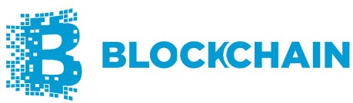
Introduction
The core driving force of the third revolution of the Internet and the next generation of disruptive technology.
BlockChain technology provides a new way to record and communicate value which can make value transmission more transparent fair and secure and realize the transformation from data interconnection to value interconnection to order interconnection.
It will probably revolutionize the way in which the value of human society as a whole is transmitted.

Slide 5

The history of BlockChain
1991(Stuart Haber and Scott Stornetta)
the first data block application based on cryptography to implement a distributed file system with document timestamps
1992
(Bayer, Haber, and Stornetta)
incorporated the Merkle tree into the design
(Stuart Haber and Scott Stornetta)
2008(Satoshi Nakamoto)
published A white paper titled “Bitcoin: A Peer to Peer Electronic Cash System”
2009.1.3 Genesis block, appeared in Finland
2009.1.9 The birth of an instantiated digital currency blockchain

Slide 6
Block Chain technology
·distributed data storage
·point-to-point transmission
·consensus mechanism
·encryption algorithm
·other technologies
BlockChain properties
·decentralization
·de-trust
·information transparency
·identity anonymity
·traceability
·collective maintenance
enform

Slide 7
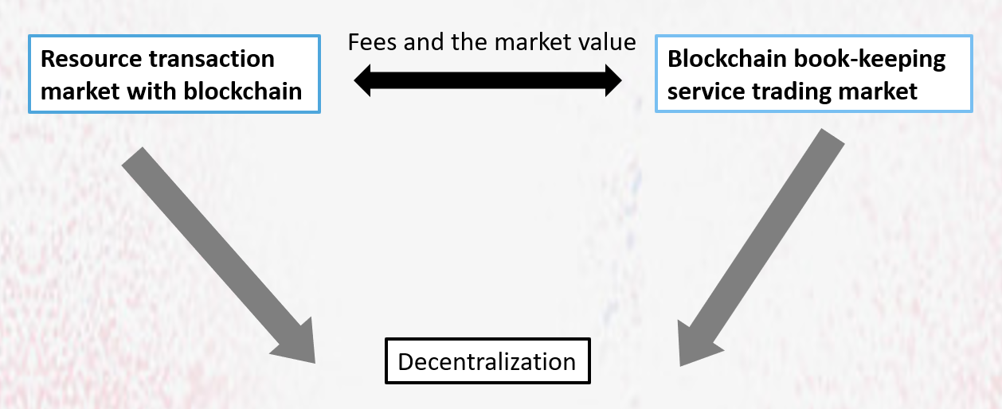
Contract theory
To design the optimal contract under the condition of information asymmetry and finally achieve the global optimal.

Slide 8
Consensus Mechanism
Solves problem：
Mutual trust among nodes under the idea of decentralization restricts the cost input and income distribution among nodes
-> reduce transaction costs in a competitive environment
In conclusion, the decentralized, point-to-point blockchain market can operate normally without the existence of centralized companies.

Slide 9
Part 02
Smart Contract
Comparison of contract methods
Applications

Slide 10
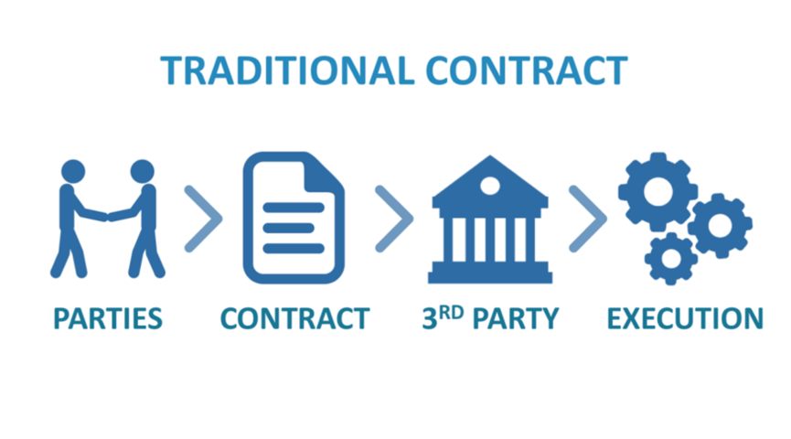
Comparison of contract methods
Traditional contract
Time-consuming — checking the contract, validation, and approval, enabling next steps, etc.
Resource consuming — execution of a traditional contract may require human intervention
Costly — it may involve a third party; this is even true during a dispute.

Slide 11
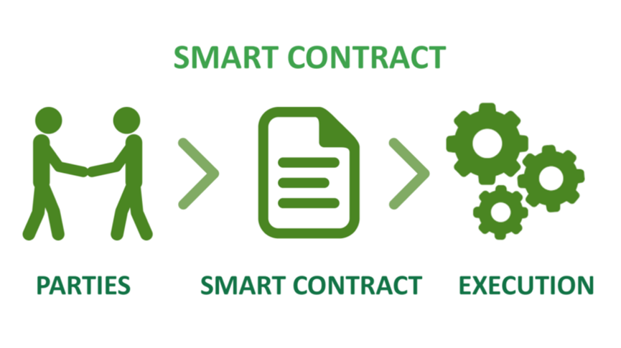
Smart contract
Smart contracts are translations of an agreement, including terms and conditions into a computational code (script).
Blockchain developers write the script, which is void of ambiguity and does not lead to misinterpretation.

Slide 12
Advantages of smart contract
Decentralization :
No need to rely on third party central organization and completed by computer programs.
Accuracy :
Controlled by computer programs without human‘s participation, eliminating the possibility of mistakes.
Tamper-refused :
After the smart contract is deployed, all contents cannot be modified, and neither party can interfere with the contract.
Efficiency :
Reduce the intermediate links, respond to requests at any time.
Low-cost :
Once the contract is broken, the code will be enforced, reducing the cost of adjudication, execution and supervision of the contract.

Slide 13

Application
Ensuring the authenticity of a copyrighted product
Money or currency transfer without an intermediary.
Protect intellectual property.
Protection from theft and counterfeit Internet of things
Internet of things
Authenticate certificates
Insurance ……

Slide 14
Blockchain technology is a distributed database that records all transactions that have ever occurred in the network. Different distributed applications beyond cryptocurrencies can be deployed on top of blockchain.
One of these applications is smart contracts, which are executable codes that facilitate, execute and enforce an agreement between untrusted parties.

Slide 15
Part 03
Development
Ethereum
HyperChain(趣链科技)

Slide 16
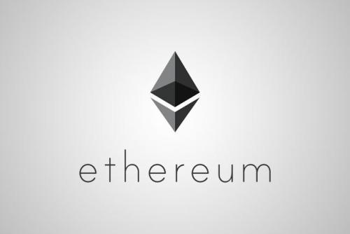
Ethereum
——Blockchain with expressive programming language
Ethereum has a native cryptocurrency called Ether (ETH). ETH is digital money(be similar to bitcoin).
Ethereum is programmable, which means that developers can use it to build new kinds of applications. And these applications gain the benefits of cryptocurrency and blockchain technology

Slide 17
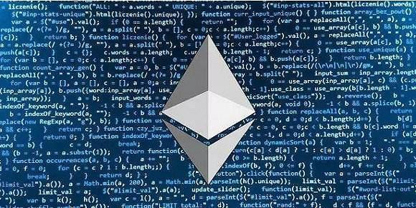
Applications on Ethereum:
1.Cryptocurrency wallets that let you make cheap, instant payments with ETH or other assets
2. Financial applications that let you borrow, lend, or invest your digital assets
3. Decentralized markets, that let you trade digital assets, or even trade “predictions” about events in the real world
4. Games where you own in-game assets, and can even make real money

Slide 18
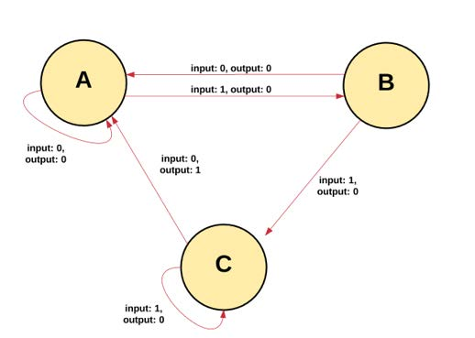
The Ethereum blockchain paradigm
The Ethereum blockchain is essentially a transaction-based state machine.—(read a series of inputs and, based on those inputs, will transition to a new state.)

Slide 19
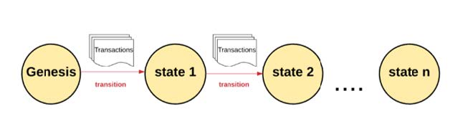
We begin with a “genesis state.” When transactions are executed, this genesis state transitions into some final state.
At any point in time, this final state represents the current state of Ethereum.

Slide 20
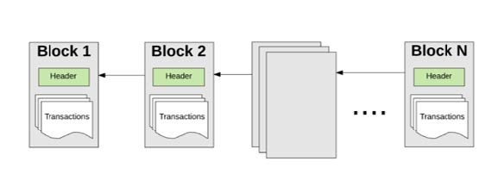
The state of Ethereum has millions of transactions. These transactions are grouped into “blocks.”
A block contains a series of transactions, and each block is chained together with its previous block.

Slide 21
Transaction validity
To cause a transition from one state to the next, a transaction must be valid.
Mining is one innovation that makes decentralized record-keeping possible. The process of validating each block by having a miner provide a mathematical proof is known as a “proof of work.”
For each block of transactions, miners use computers to repeatedly and very quickly guess answers to a puzzle until one of them wins.(through a hash function)
Every time a miner proves a block, new Ether tokens are generated and awarded.

Slide 22
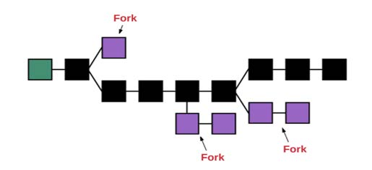
No “Forks”
How to guarantees that everyone sticks to one chain of blocks?
How can we be sure that there doesn’t exist a subset of miners who will decide to create their own chain of blocks?
——If the chains were to diverge, you might own 10 coins on one chain, 20 on another, and 40 on another. In this scenario, there would be no way to determine which chain was the most “valid.”

Slide 23
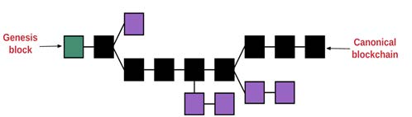
To determine which path is most valid and prevent multiple chains, Ethereum uses a mechanism called the “GHOST protocol.”
“GHOST” = “Greedy Heaviest Observed Subtree”
In simple terms, the GHOST protocol says we must pick the path that has had the most computation done upon it.
One way to determine that path is to use the block number of the most recent block (the “leaf block”), which represents the total number of blocks in the current path (not counting the genesis block). Using this reasoning allows us to agree on the canonical version of the current state.

Slide 24
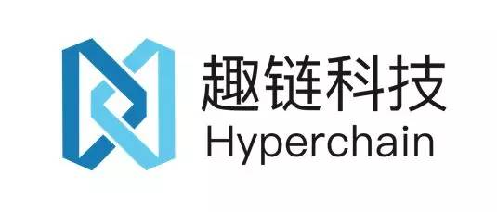
HyperChain(趣链科技)
HyperChain(趣链科技) was was founded in 2016, focusing on blockchain technology products and application solutions. The main products are: the domestic independent controllable block chain underlying platform, data sharing and security computing platform BitXMesh, block chain open service platform FiLoop, supply chain finance platform FiloLink, storage service platform FiloInk, smart contract security research and
development platform MeshSec.
And it's worth mentioning that the founders of this startup company is a 'ZJU group', many of the founders and core members are graduated from Zhejiang University.

Slide 25
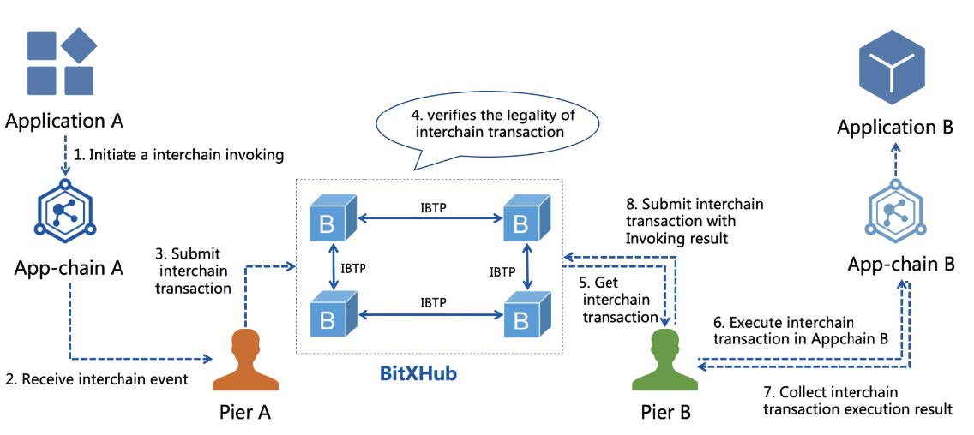
The technical team of HyperChain also share their research and develoment on the open-source community, such as BitXHub, which is is committed to building a scalable, robust, and pluggable inter-blockchain reference implementation, that can provide reliable technical support for the formation of a blockchain internet and intercommunication of value islands.

Slide 26
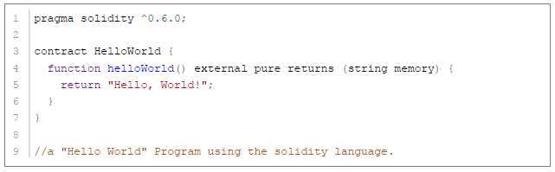
Solidity, the Contract-Oriented Programming Language
Solidity is a statically-typed curly-braces programming language designed for developing smart contracts that run on the Ethereum Virtual Machine. Smart contracts are programs that are executed inside a peer-to-peer network where nobody has special authority over the execution, and thus they allow to implement tokens of value, ownership, voting and other kinds of logics.

Slide 27
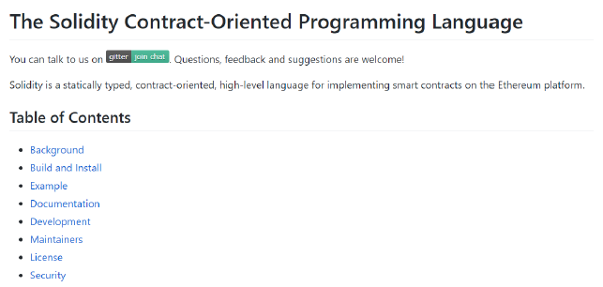
Solidity, the Contract-Oriented Programming Language
When deploying contracts, you should use the latest released version of Solidity. This is because breaking changes as well as new features and bug fixes are introduced regularly. We currently use a 0.x version number to indicate this fast pace of change.

Slide 28
Part 04
Future

Slide 29

Nowadays constraints
The current limitations of block chain technology are mainly in the distributed system to make all nodes unified, and the constraints can be summed up as the followings:
1. Performance limitations
2. Limitation of scalability
3. Usability limitations
4. Limitation of compatibility
5. Storage limitations
6. Rigorous mathematical proof
7. Formal verification
8. Synchronization restrictions
9. Governance constraints
10. Limitations on software upgrades

Slide 30
Future improvements
The technologies should be improved in the future development of block chain are:
1. Performance and scalability
2. Security of blockchain
3. Privacy protection
4. Authenticity of data
5. Password security
6. Identity authentication and authority management
7. Governance and supervision
8. Prevent centralization

Slide 31
Block chain 1.0 is represented by Bitcoin.
Block chain 2.0 is represented by Ethereum.
Block chain 3.0 can be a programmable organization and a programmable society in the future with the help of smart contracts.

Slide 32
Future fields
1.Block chain operating system
2.Block chain middleware
3.Block chain network direction
4.Enterprise-level block chain
5.Block chain storage,
6.Anti-quantum algorithm,
7.Scene applicability innovation

Slide 33
Thanks For Listening!
Team members: 季奕君 康大凯 康锦辉
聂俊哲 求昊泽 王晨露 袁浩然
张 琦 张溢弛 朱王逸

