Slide 1
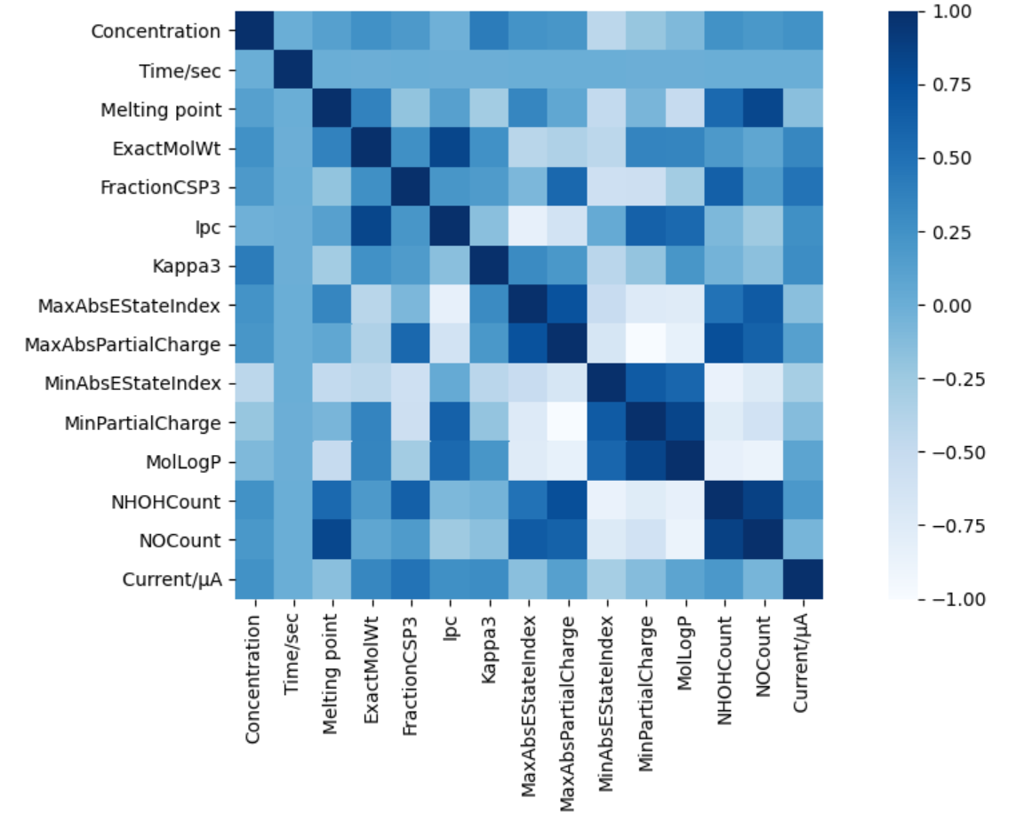
特征工程

Slide 2
Features | Description
c, Concentration | The concentration of Ethyl Red (C₁₇H₁₉N₃O₂). t
M, ExactMolwt | The exact molecular weight of the molecule.
F_{c}, FractionCSP3 | The fraction of C atoms that are SP3 hybridized.
I_{p}, Ipc | This returns the information content of the coefficients of the characteristic polynomial of the adjacency matrix of a hydrogen-suppressed graph of a molecule.
K_{p}, Kappa3 | The third kappa shape index.
T_{a,} MaxAbsEstateIndex | The tuple of maximum absolute electrotopological state indices for the molecule.
P_{c}, MaxAbsPartialCharge | Maximum absolute partial charge.
T_{b}, MinAbsEstateIndex | The tuple of minimum absolute electrotopological state indices for the molecule.
P_{c}, MinPartialCharge | Minimum partial charge.
L_{p}, MolLogP | Wildman-Crippen LogP (octanol/water) value.
N_{a}, NHOHCount | Number of NHs or OHs.
N_{b}, NOCount | Number of Nitrogens and Oxygens.

Slide 3
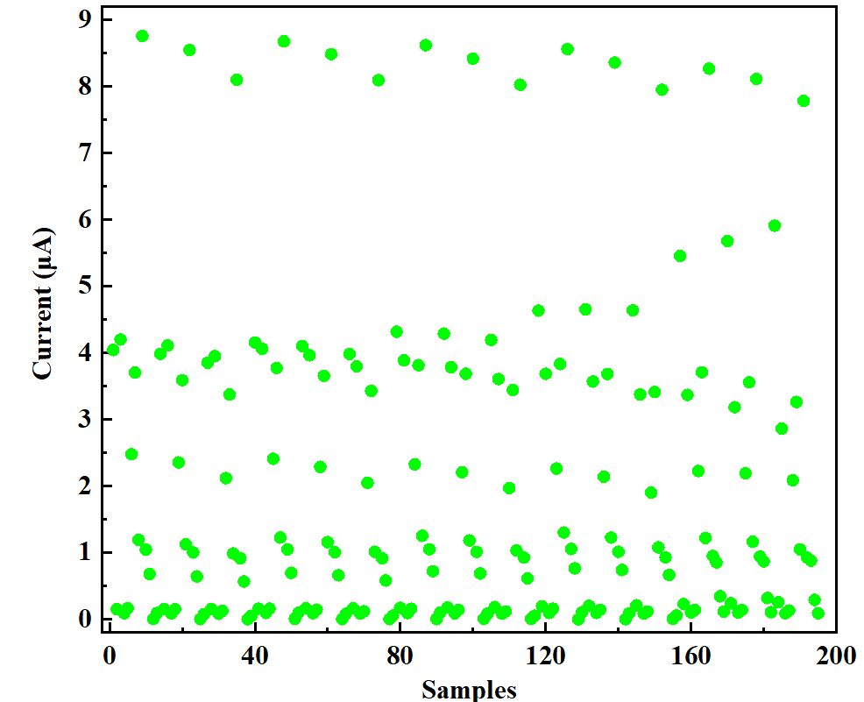
阈值设定
阈值设定时，光电流小于1.5μA的为低电流（0），大于1.5μA的为高电流（1）

Slide 4
140个样本作为训练集，55个样本作为测试集，均已做了归一化处理，使用4种算法进行分类
随机森林分类： 测试集最高准确度100%
ExtraTrees分类：测试集最高准确度100%
SVM poly分类：测试集最高准确度82%
GaussianProcess分类：测试集最高准确度73%

Slide 5
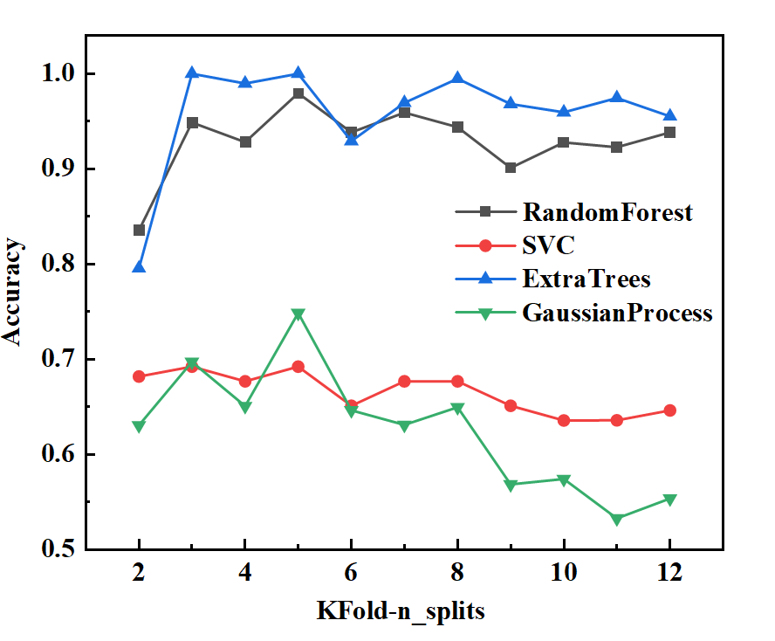

Slide 6
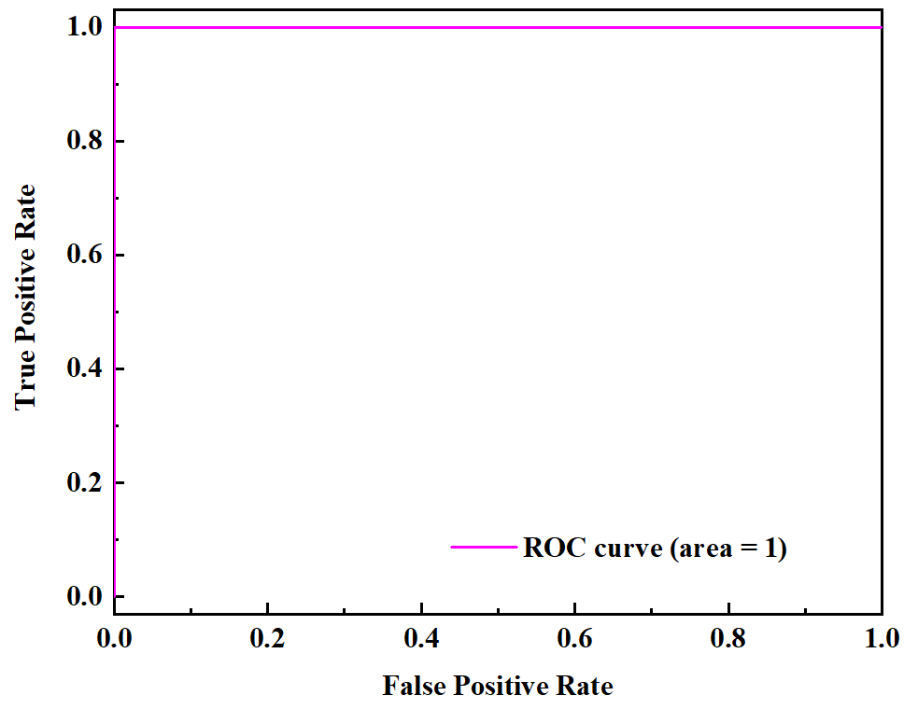
随机森林分类

Slide 7
ExtraTrees分类

Slide 8
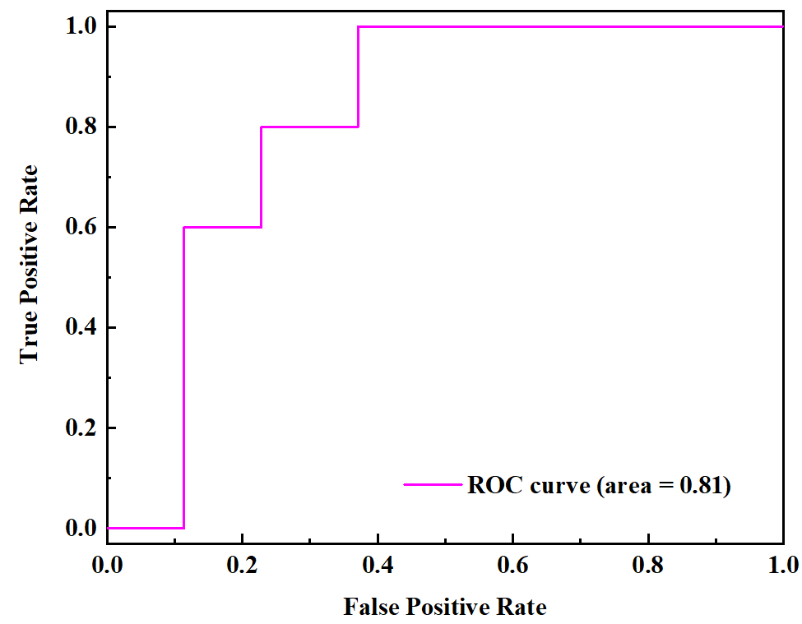
SVM分类

Slide 9
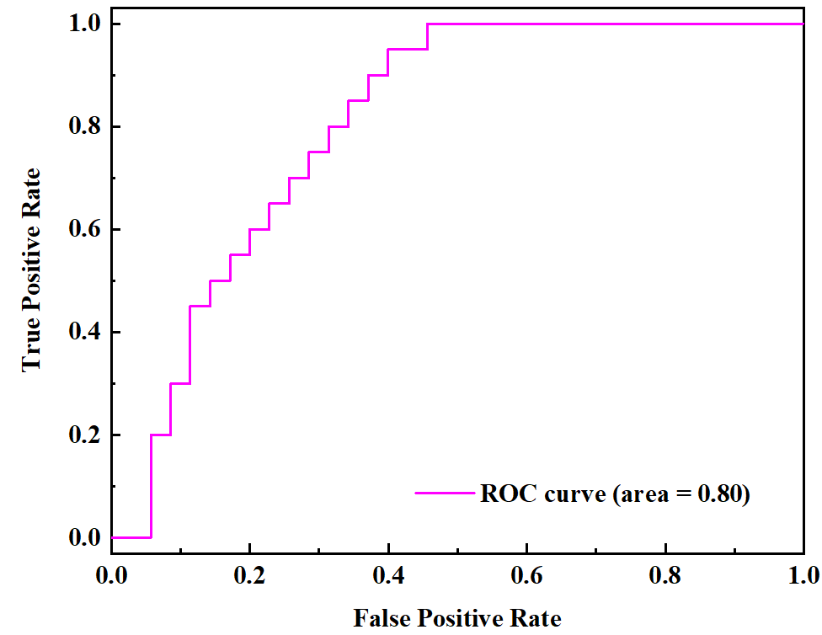
GaussianProcess分类

Slide 10
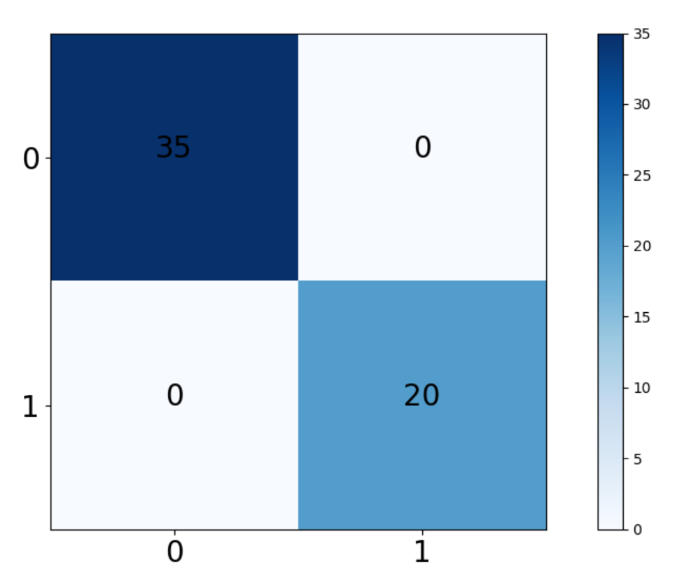
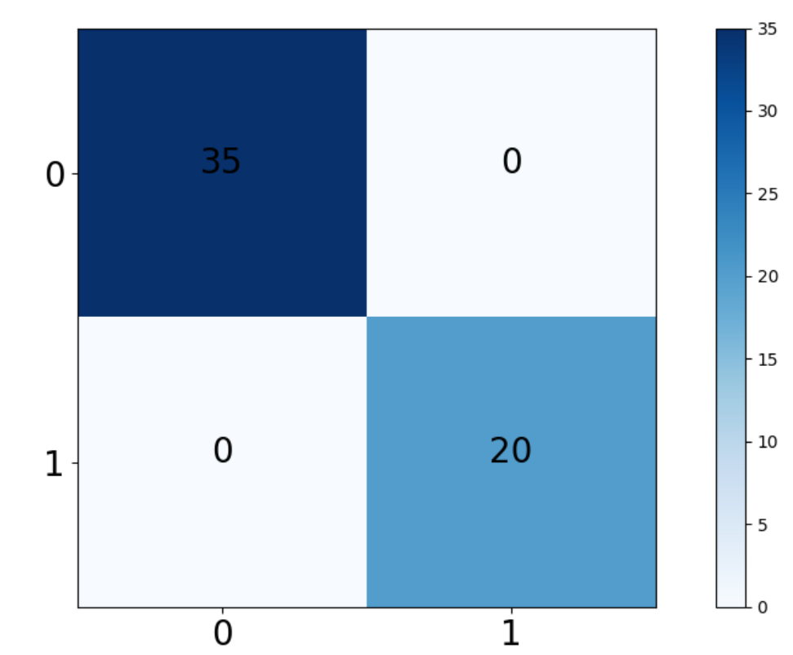
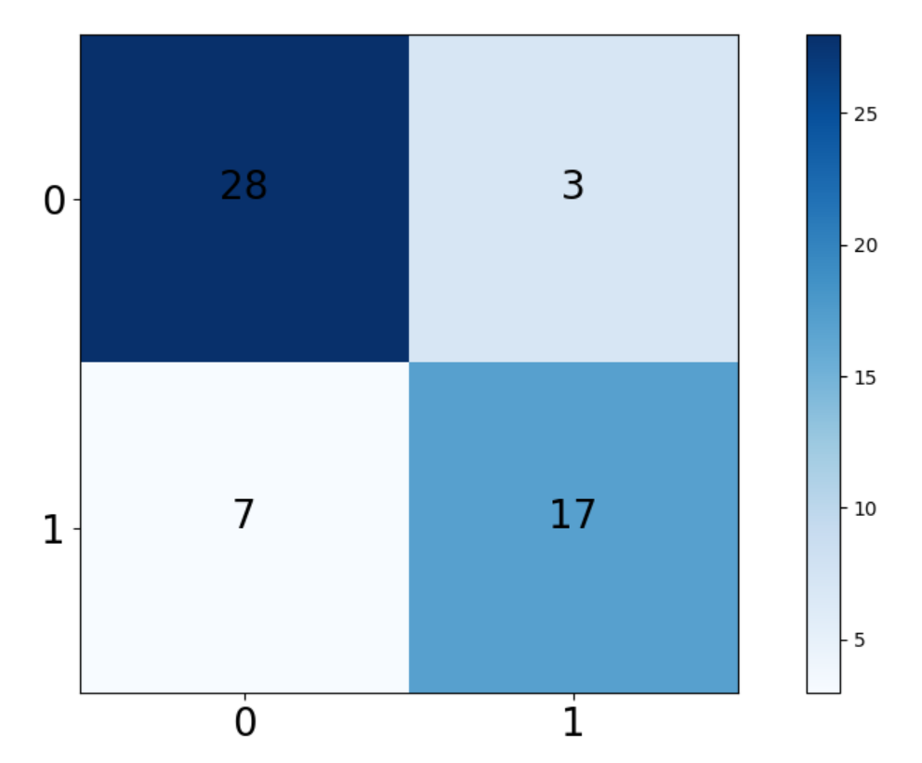
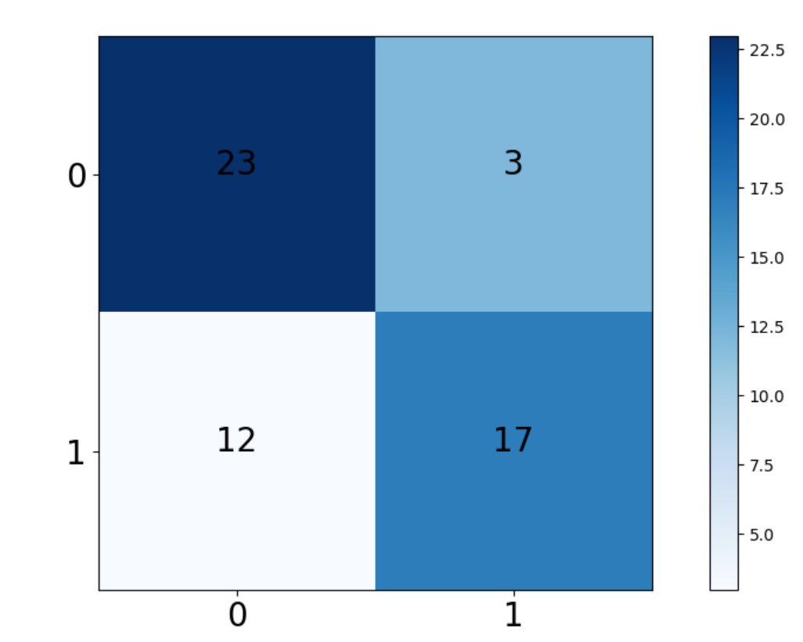
随机森林分类
ExtraTrees分类
SVM poly分类
GaussianProcess分类

Slide 11
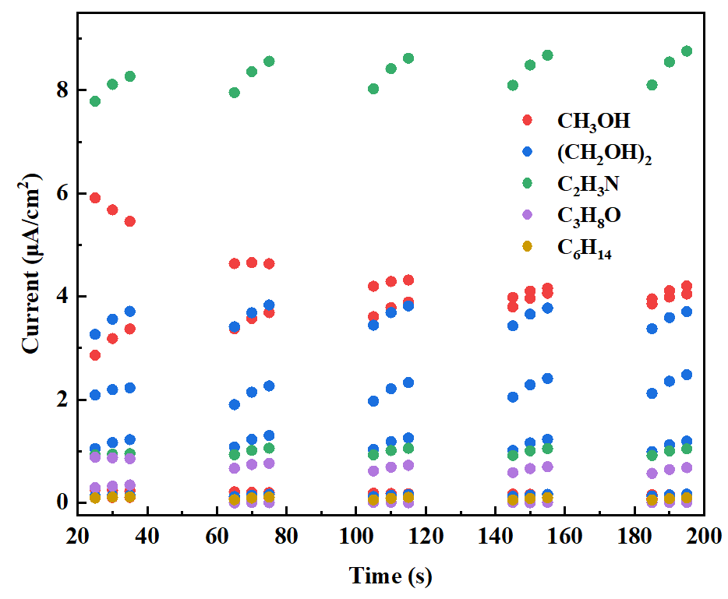

Slide 12
