Slide 1
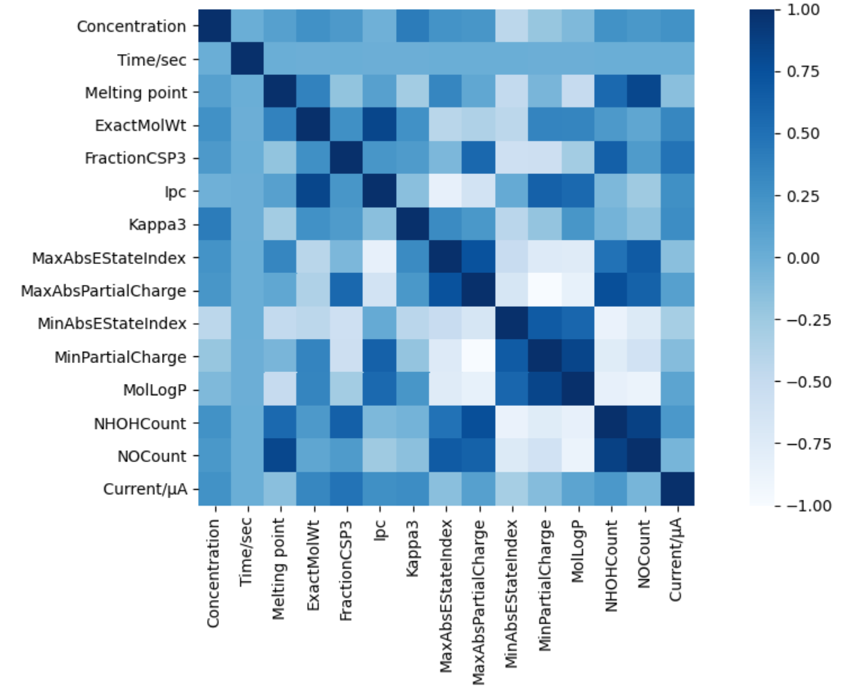
特征工程
C
T
M_{p}
M
F_{c}
I_{p}
K_{p}
T_{a}
P_{a}
T_{b}
P_{b}
L_{P}
N_{a}
N_{b}
I
C T M_{p} M F_{c} I_{p} K_{p} T_{a} P_{a} T_{b} P_{b} L_{P} N_{a} N_{b} I

Slide 2
Features | Description
C | The concentration of Ethyl Red (C₁₇H₁₉N₃O₂).
M | The exact molecular weight of the molecule.
F_{c} | The fraction of C atoms that are SP3 hybridized.
I_{p} | This returns the information content of the coefficients of the characteristic polynomial of the adjacency matrix of a hydrogen-suppressed graph of a molecule.
K_{p} | The third kappa shape index.
T_{a} | The tuple of maximum absolute electrotopological state indices for the molecule.
P_{a} | Maximum absolute partial charge.
T_{b} | The tuple of minimum absolute electrotopological state indices for the molecule.
P_{b} | Minimum partial charge.
L_{P} | Wildman-Crippen LogP (octanol/water) value.
N_{a} | Number of NHs or OHs.
N_{b} | Number of Nitrogens and Oxygens.
M_{p} | Melting point.
T | Time (s).

Slide 3
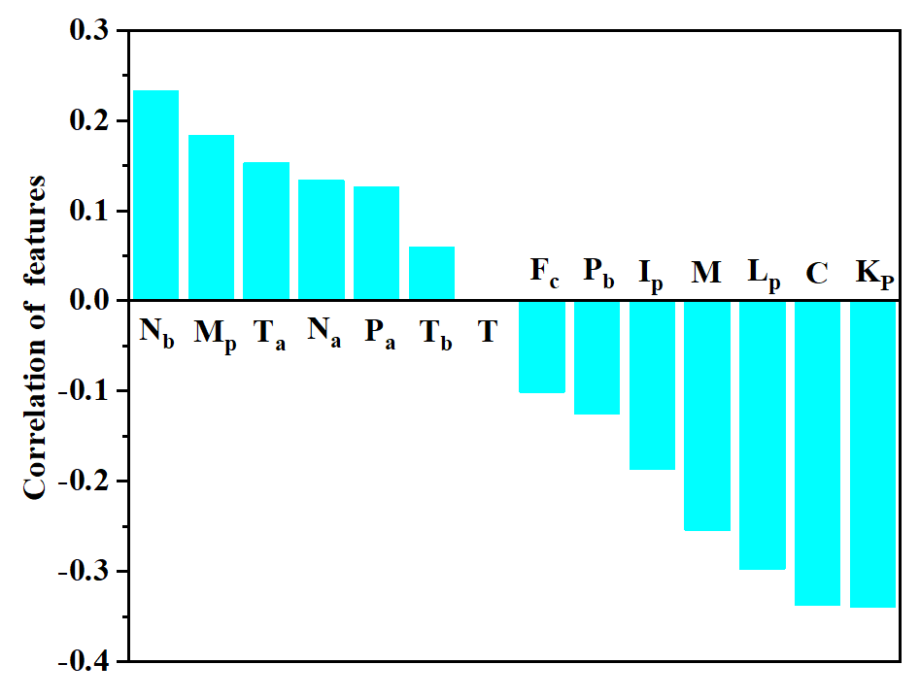

Slide 4
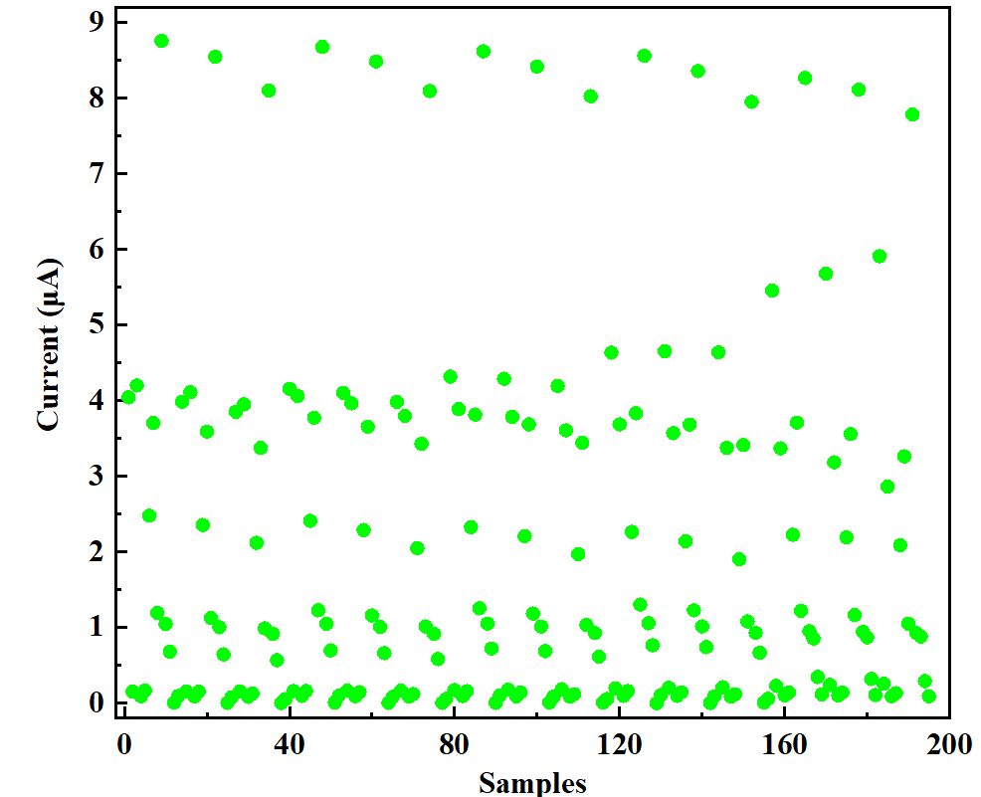
阈值设定
阈值设定时，光电流小于1.5μA的为低电流（0），大于1.5μA的为高电流（1）

Slide 5
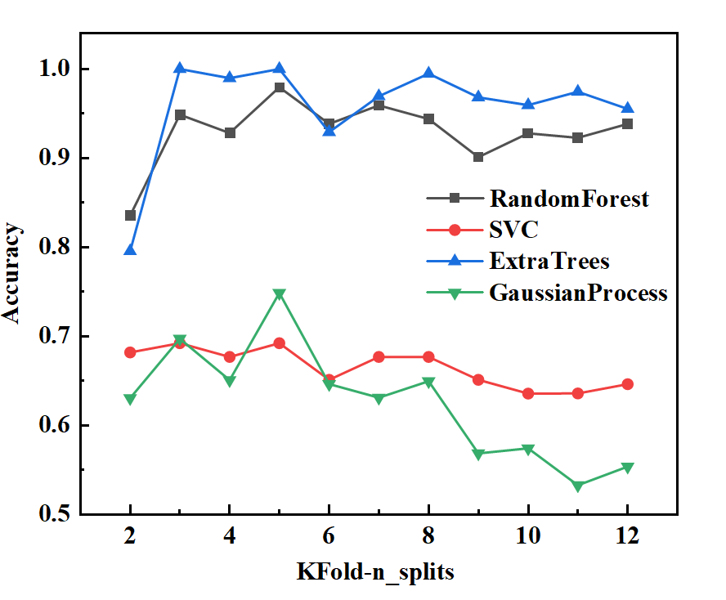
随机森林分类： 测试集平均准确度93%
ExtraTrees分类：测试集平均准确度96%
SVM poly分类：测试集平均准确度66%
GaussianProcess分类：测试集平均准确度62%

Slide 6
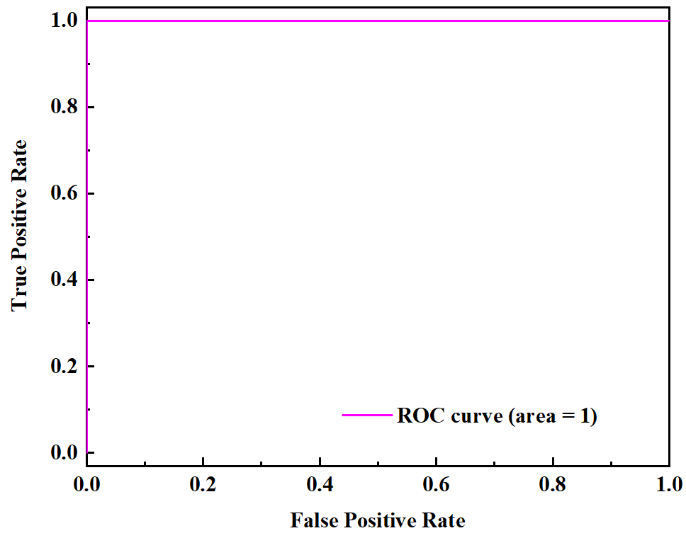
随机森林分类

Slide 7
ExtraTrees分类

Slide 8
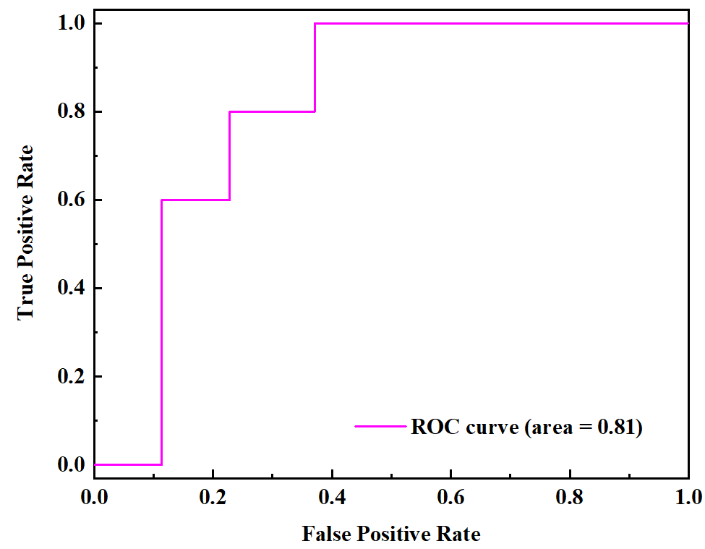
SVM分类

Slide 9
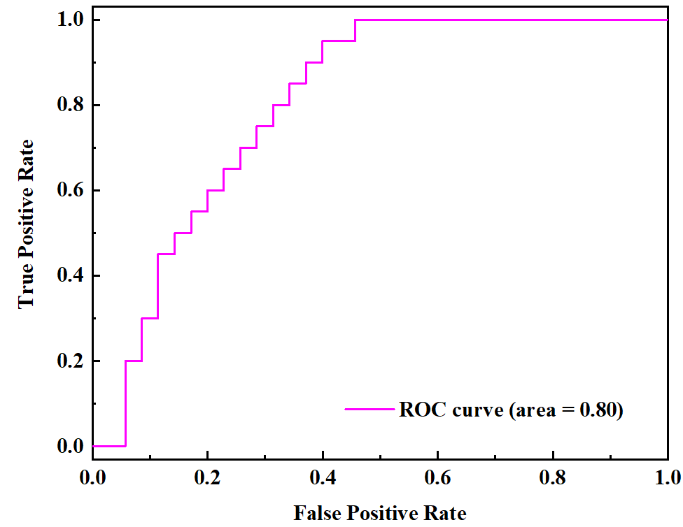
GaussianProcess分类

Slide 10
(a)
(b)
ExtraTrees分类
Random Forest
ExtraTrees
(c)
(d)
SVM
GaussianProcess

Slide 11
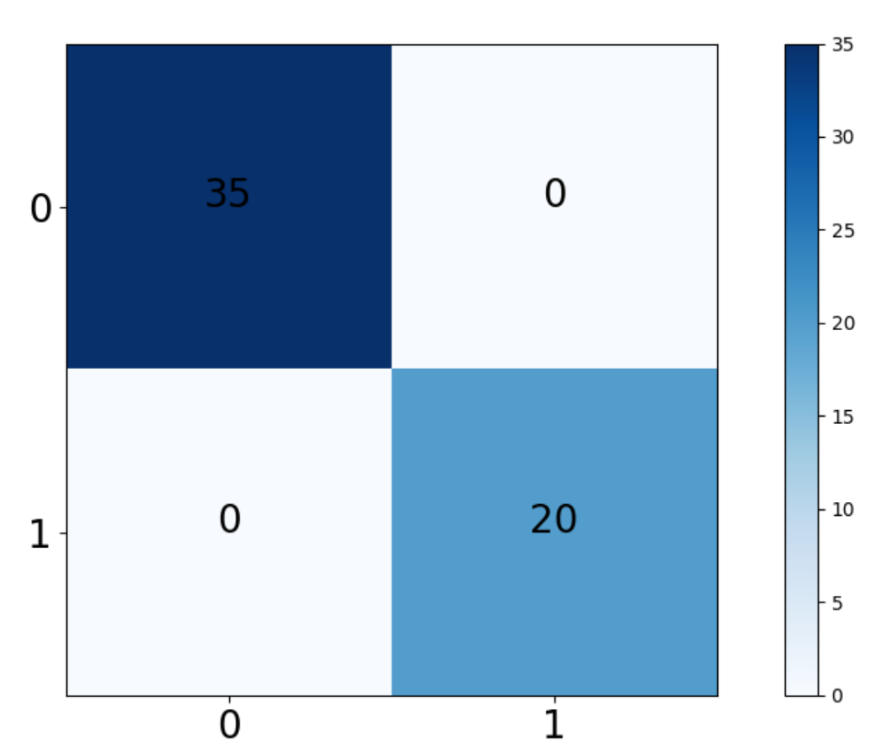
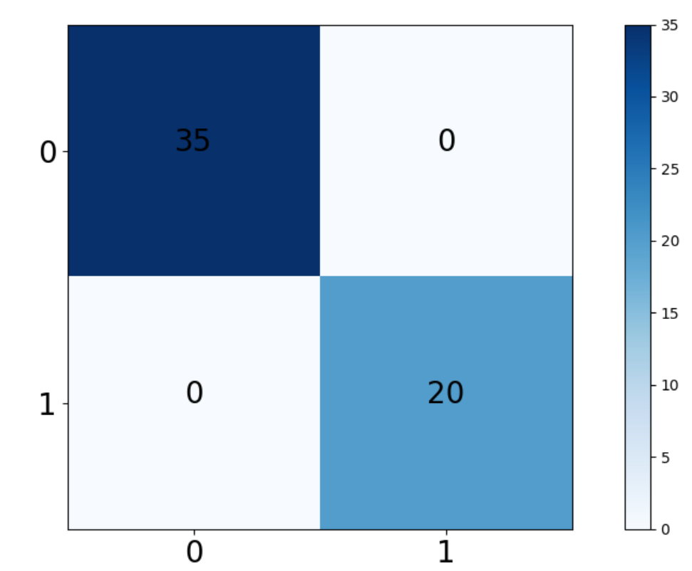
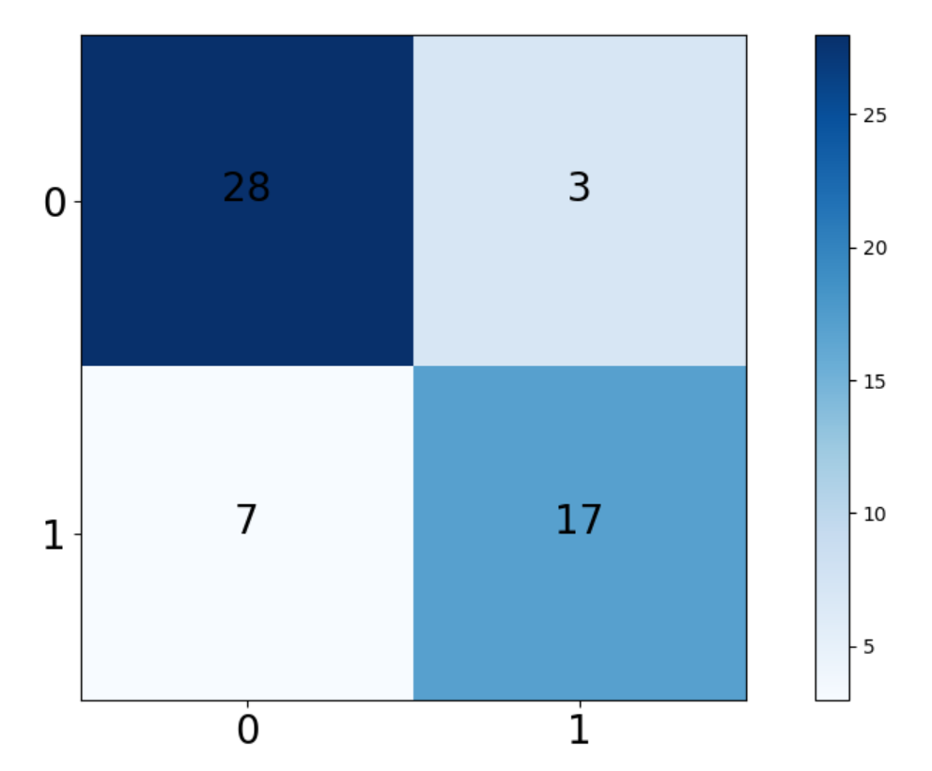
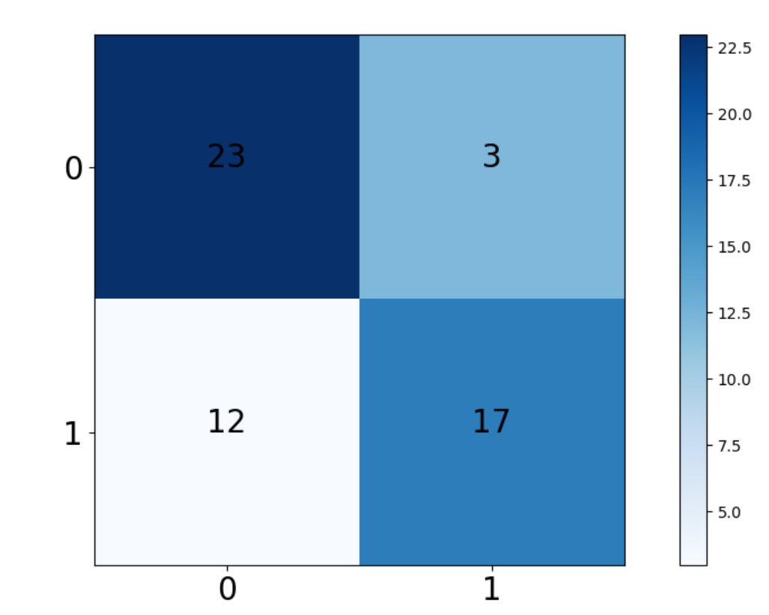
随机森林分类
ExtraTrees分类
SVM poly分类
GaussianProcess分类

Slide 12
(a)
(b)
Random Forest
ExtraTrees
(c)
(d)
SVM
GaussianProcess

Slide 13
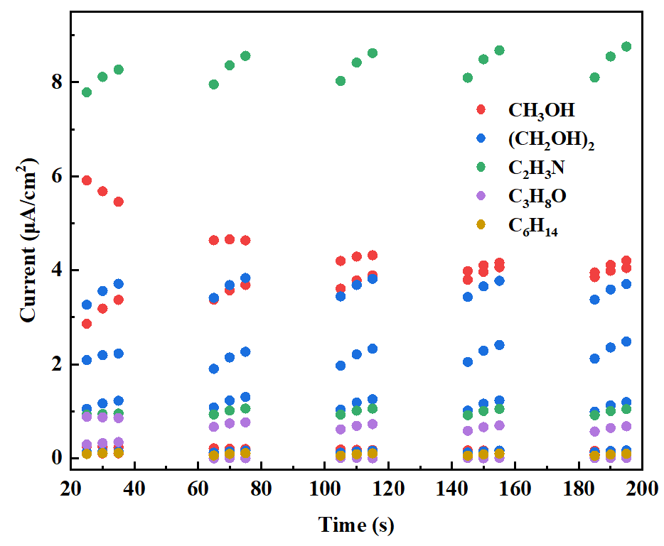

Slide 14
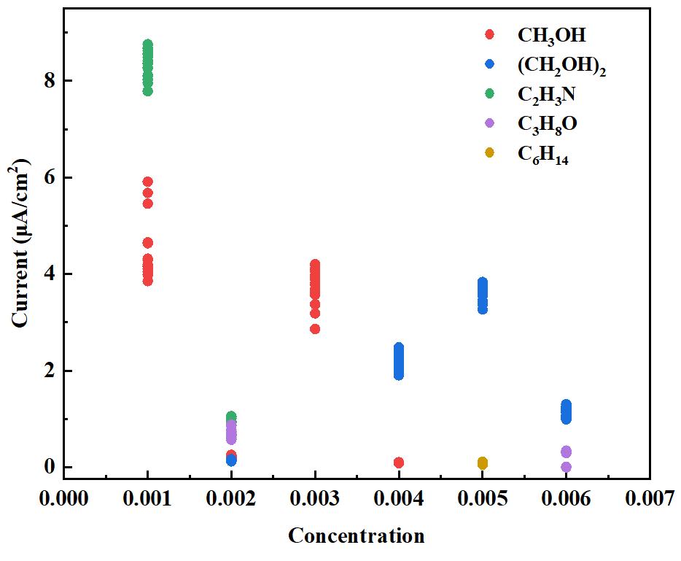

Slide 15
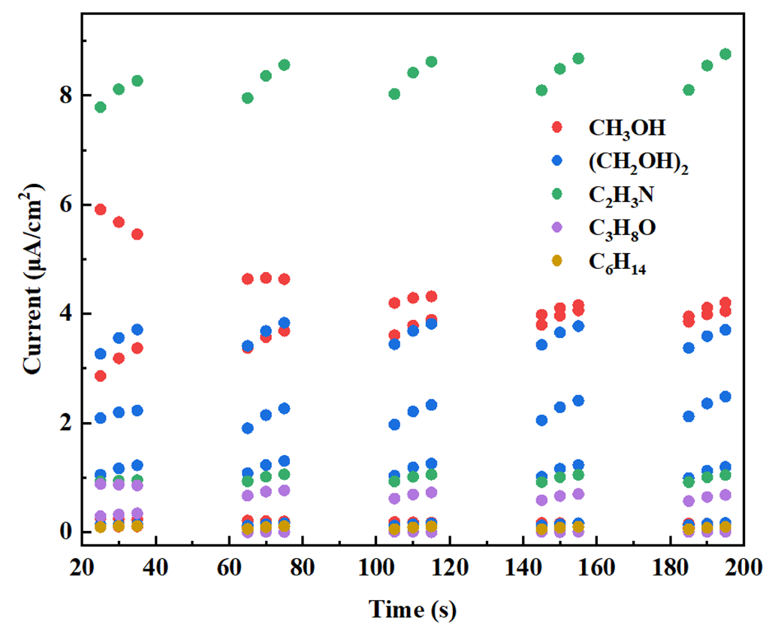
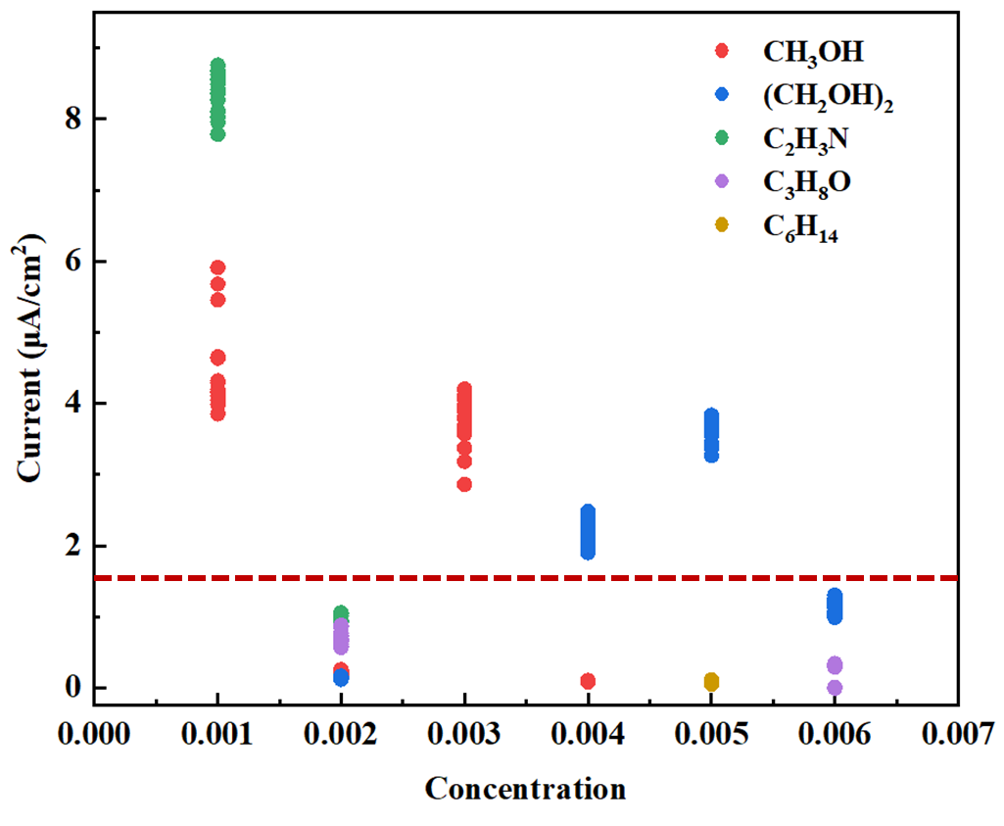
(a)
(b)

Slide 16
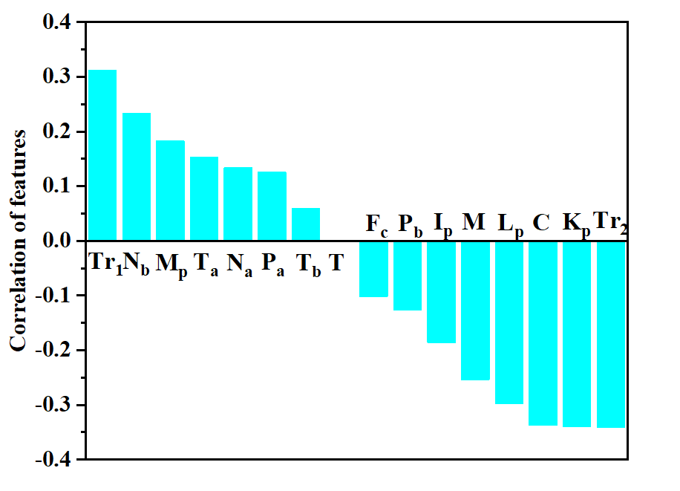
特征组合
Tr₁:T_{b}+N_{a}-I_{p}-C
Tr₂:K_{p}-T_{a}

