Slide 1
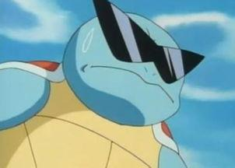
Introduction
9.27 Zhang Shengxuan
Computer science and technology

Slide 2

Basic information
Name:Zhang Shengxuan (Smith) Age:18 year-old
My favorite : computer games , running , volleyball
Hometown : Jinjiang Fujian Province China

Slide 3

What kind of person am I?
Most of the time , I may be a person without any ideas . But sometimes , I can have some great ideas !
In my daily life , I will not mind if anybody who just meet me for the first time to have a conversation with me . In other words , I can be a person who is willing to talk with strangers .
In my study , I’m crazy about math and physics . Admittedly , they can be very difficult , but I’ll feel great if I can work out some questions of math and physics !

Slide 4

That’s all!
Thanks!

